Slide 1
What happens when a State agency wins a farming competition?
SAM RADFORD, Ndeq wellhead protection program coordinator
Carla McCullough, NDEQ 319 Coordinator
Katie Pekarek, Extension Educator UNL School of Natural Resources

Slide 2

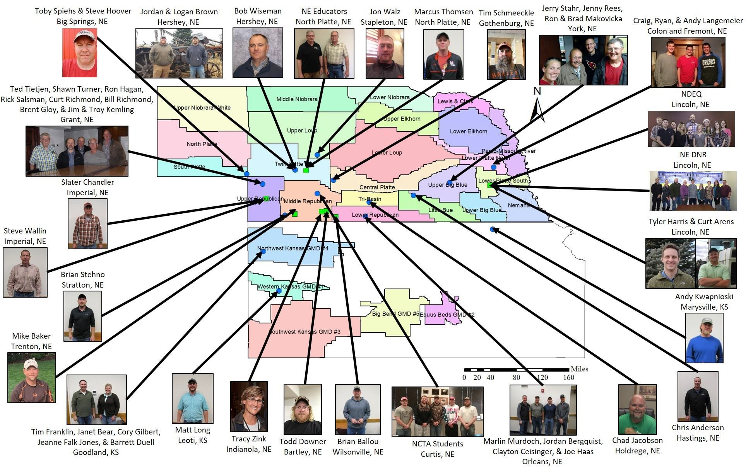
UNL Testing Ag Performance Solutions (TAPS)
Farming competition where participants make management decisions to raise center pivot irrigated corn and Sorghum.
Prizes:
1st most profitable
2nd highest input use efficiency
3rd greatest green yield (% of most profitable)
Source: 2018 UNL Taps Banquet Report
Notes:
TAPS is a competition organized by UNL Extension and NEWBA
This year there was a corn and sorghum competition
Promotes efficiency and profitability while providing interaction among all those involved in the production and/or the business of agriculture production.
A farming competition where 20 teams from NE & KS make management decisions on .4 acre plots extrapolated to mimic a 3,000 acre farm.

Slide 3
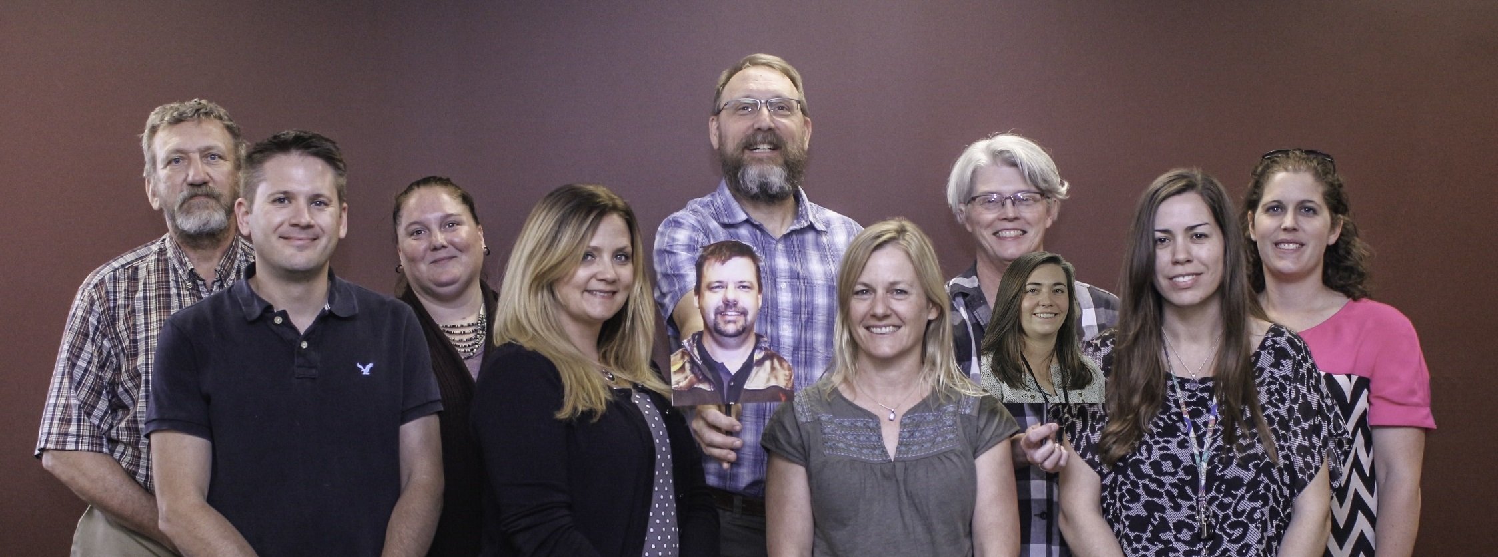
What in the world is NDEQ doing in a farming competition?
LEARNING FROM THE EXPERTS!
Notes:
You all have seen us in many settings talking about reducing nitrate contamination in groundwater.
We work with NRD’s, communities, and other stakeholders to develop plans to reduce nitrate concentrations.
Developing statewide nitrate efforts with the NE Water Balance Alliance, UNL Extension and other stakeholders.
Through the relationships we built, we were invited to participate in the 2018 TAPS Corn Competition.

Slide 4
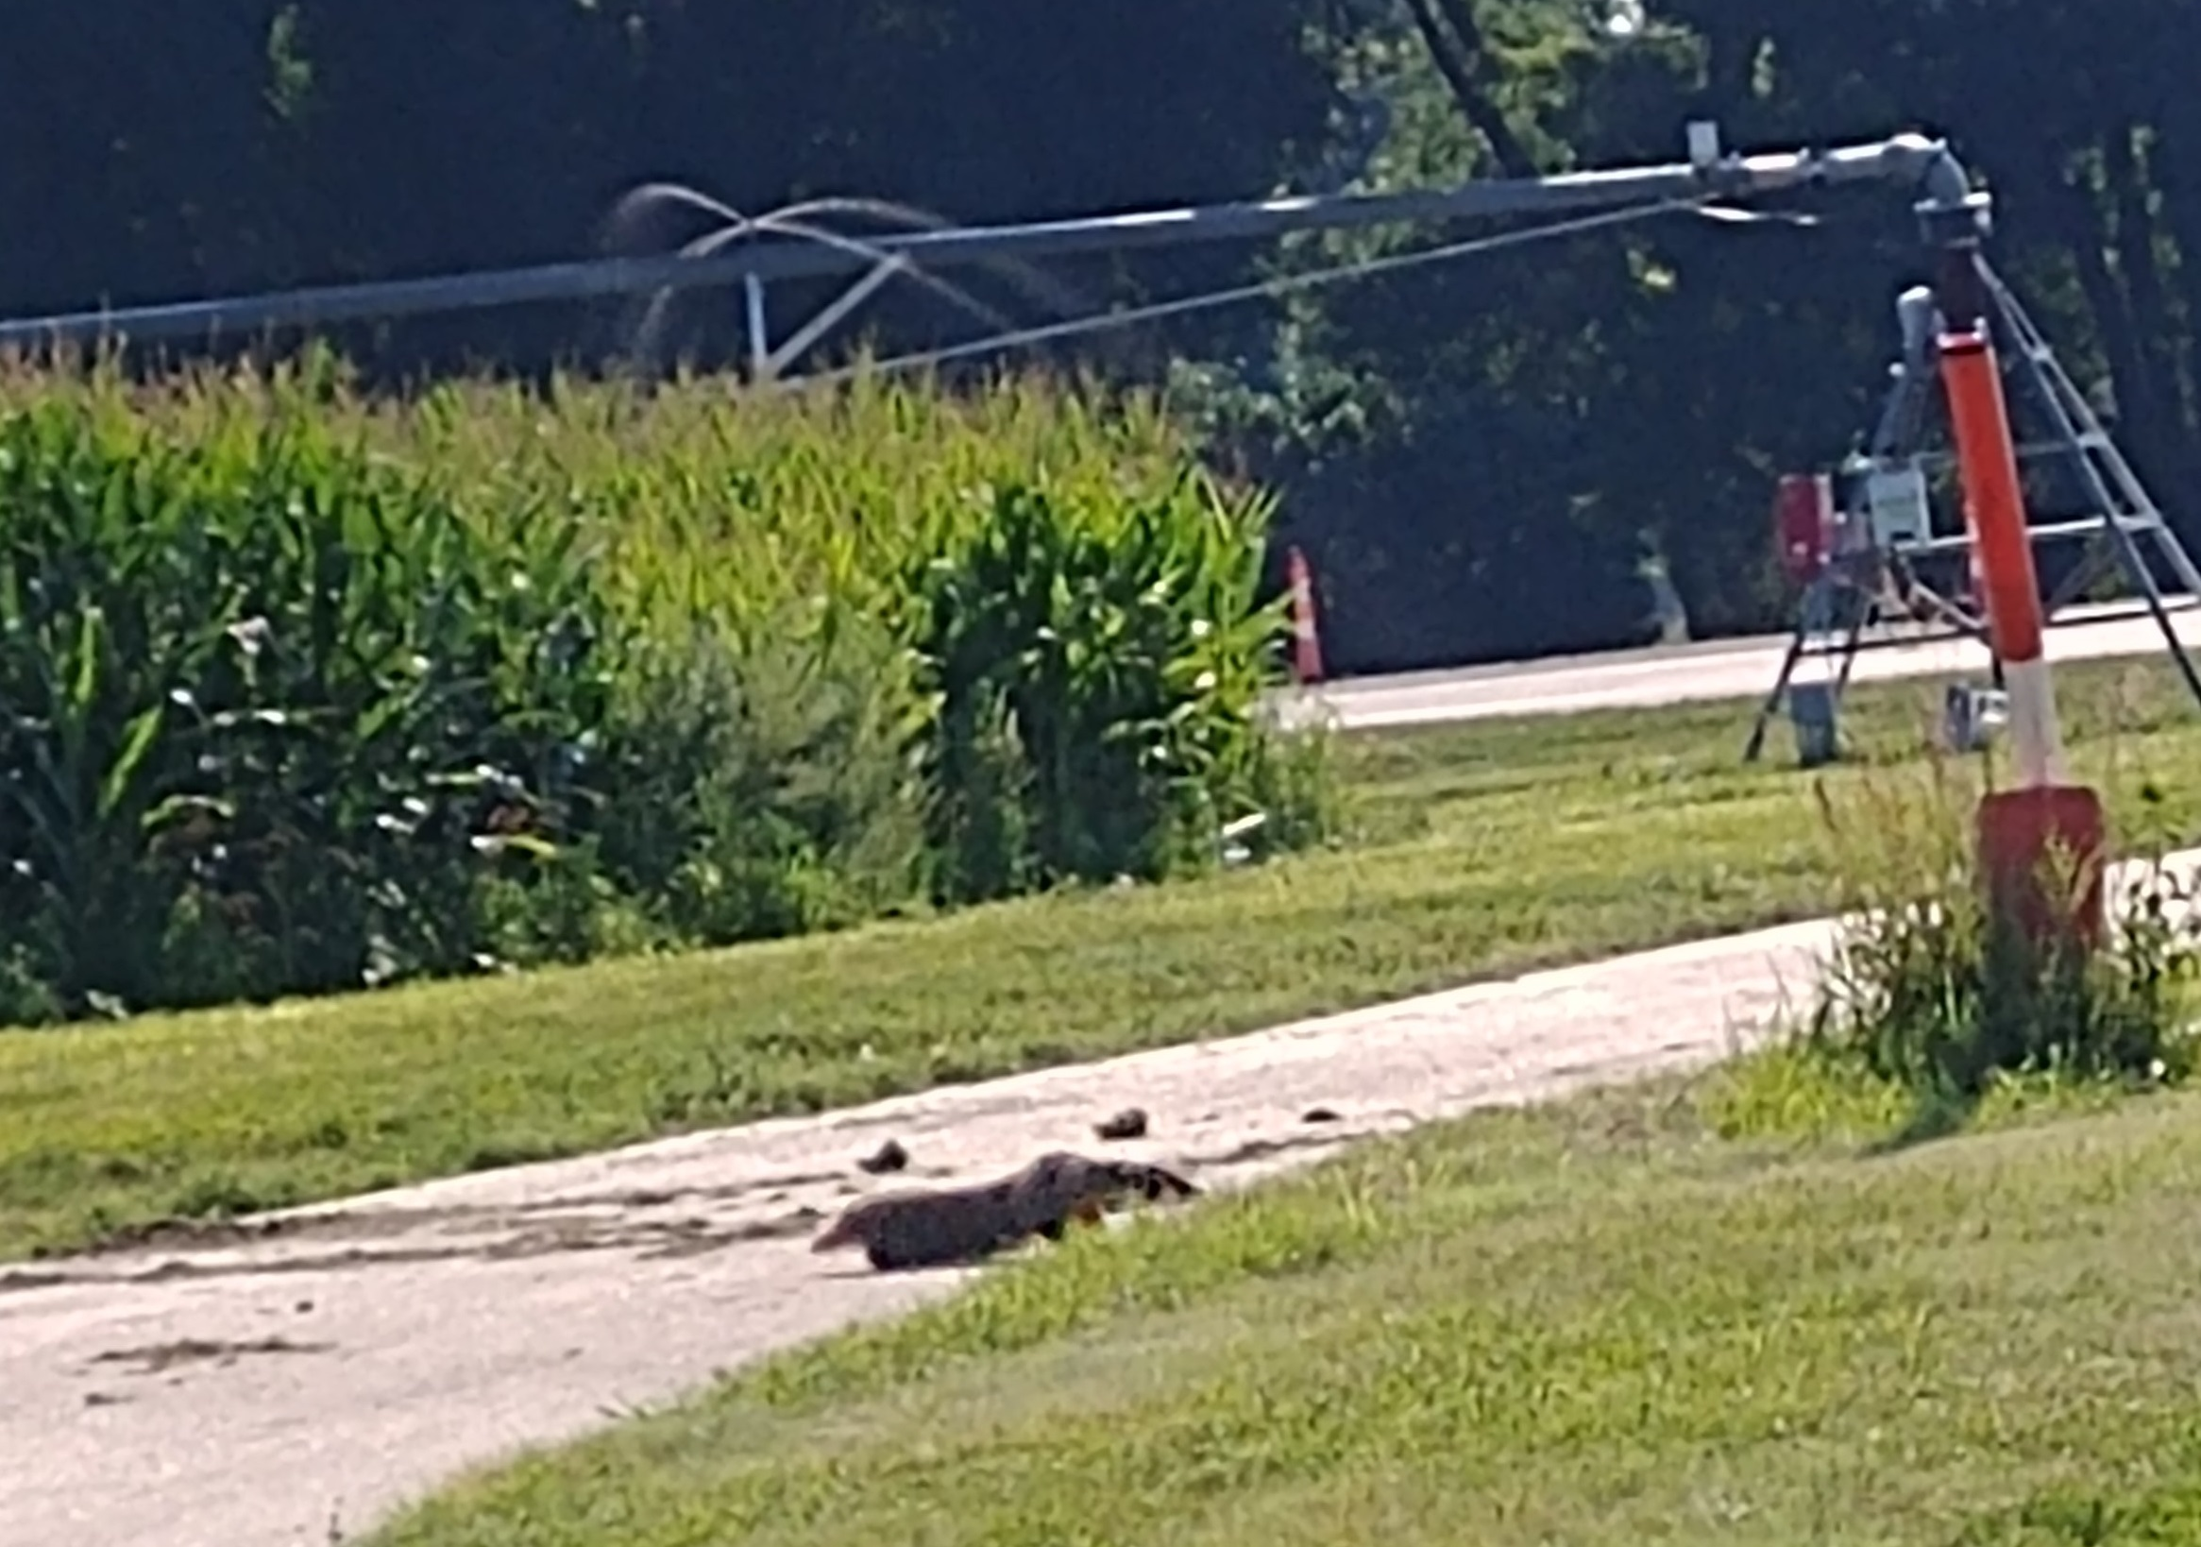
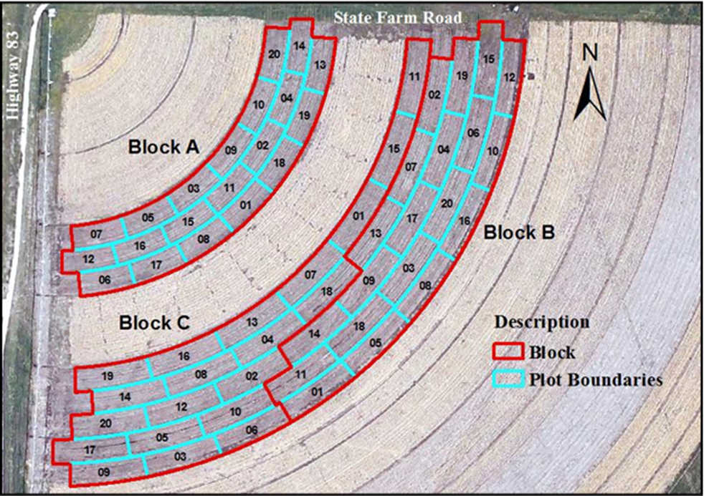
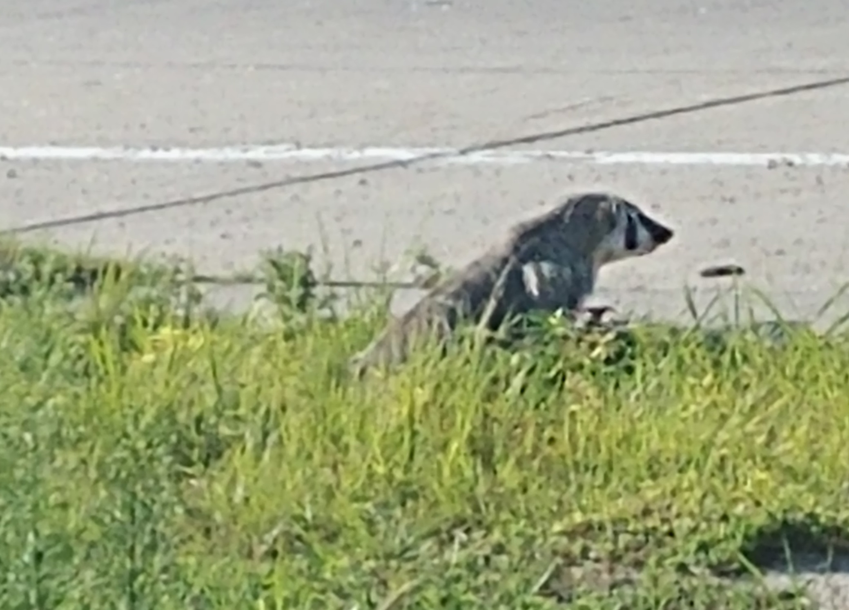
On farm decisions
teams made the following management decisions:
Crop Insurance Selection
Seed hybrid and planting density
Nitrogen Application
Irrigation application
Marketing
Source: 2018 UNL Taps Banquet Report
Notes:
Important to research and learn about every category to ensure a good overall strategy
Utilized available science and people who do this everyday with proven success.
Philosophy: Efficiency and profitability over yield
Started: Message to the public has always been minimizing nitrogen applications.
We needed to walk the walk.
Ended up understanding just how complicated each of their decisions are.
Timing of events is often impacted by outside forces
weather conditions
availability of applications

Slide 5
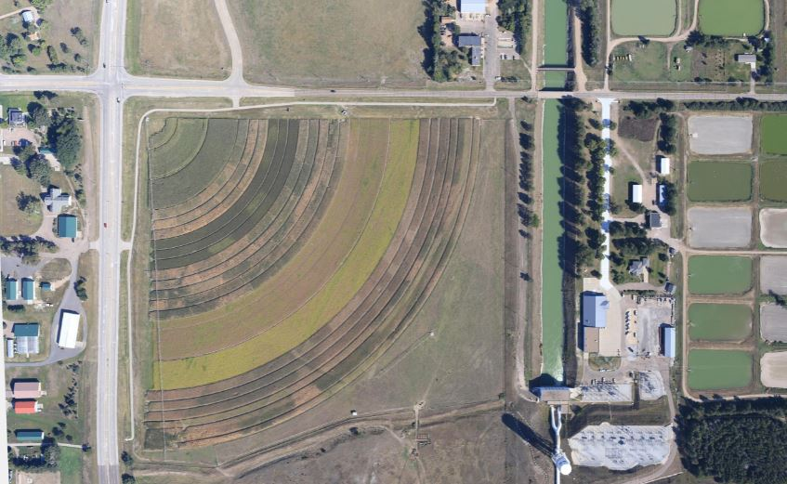
Where we started…
Soil and Yield Information
Soil Texture | Cozad Silt Loam
Soil Organic Matter | 1.4
Soil Test Nitrate – N | 40
Previous Crop | Beans
APH | 225
Source: 2018 UNL Taps Banquet Report
Notes:
Corn after beans: 40lb NO3 credit in the soil (UNL pre-season soil report)
Went into the competition thinking about how we can better talk to farmers about their N use.
Minimal application
Following UNL recommendations
Nitrogen BMP’s
Minimal irrigation

Slide 6
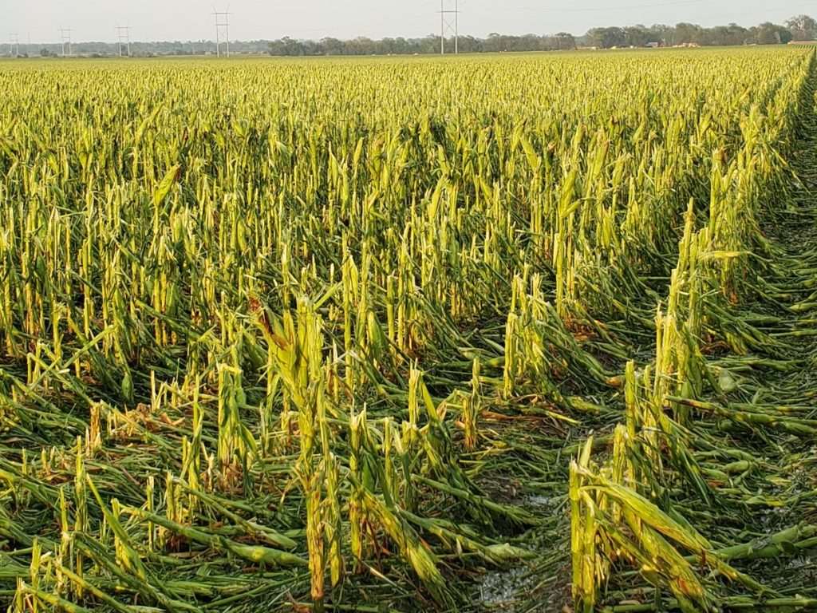
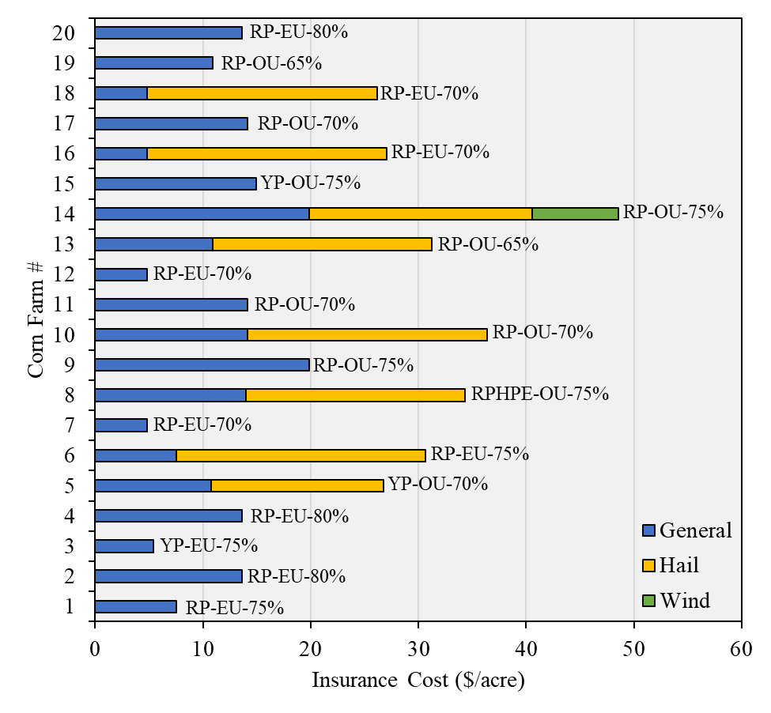
CROP Insurance
Insurance Selection
Coverage | RP - OU
Level | 65%
Hail Protection | 2/10
Hail Coverage Amount | $150
Wind Endorsement | N/A
Photo by Randy via Twitter (@crzy4wx
Source: 2018 UNL Taps Banquet Report
Notes:
Conservative Insurance Selection: The idea of guaranteeing that we would still have a small profit (not lose our a**) in a hard weather year.
Cost for insurance as well as hail and wind coverage ($ per acre) for the 20 teams competing in the corn farm management competition. The insurance package and coverage rate is noted next to each team.
Had some hail damage, but not enough to make a claim
RP stands for revenue protection
YP for yield protection
EU for enterprise units
OU for operational units
RPHPE for revenue protection with harvest price exclusion.

Slide 7
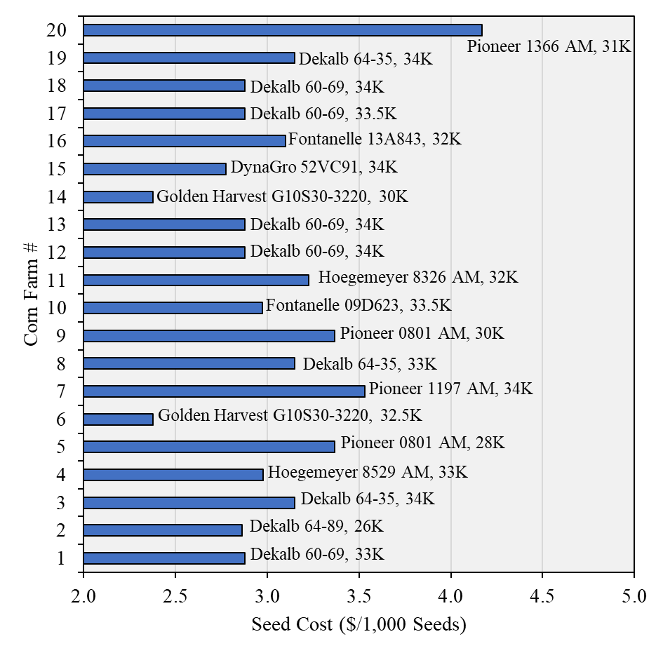

Seed Hybrid and Planting Density
Dekalb DK60-69
Planting Date | May 1st
Seed Selection | 110 day corn, 34K Pop.
Cost | $230.17 per bag ($97.92/acre)
Source: 2018 UNL Taps Banquet Report
Notes:
The most common hybrid (Farms 1, 12, 13, 17, and 18) was Dekalb 60-69 RIB
Most stressful decision by far.
Called all of the seed dealers and discussed our farming strategy
Made the decision based on how they thought their corn would respond
Corn recommended because we planned to fertilize with side dressing and fertigation.
Hybrid responds great to fertigation, especially late in the season.
Studies show it responds well to a shot of nitrogen at brown silk stage. This may be something we want to keep in mind.

Slide 8
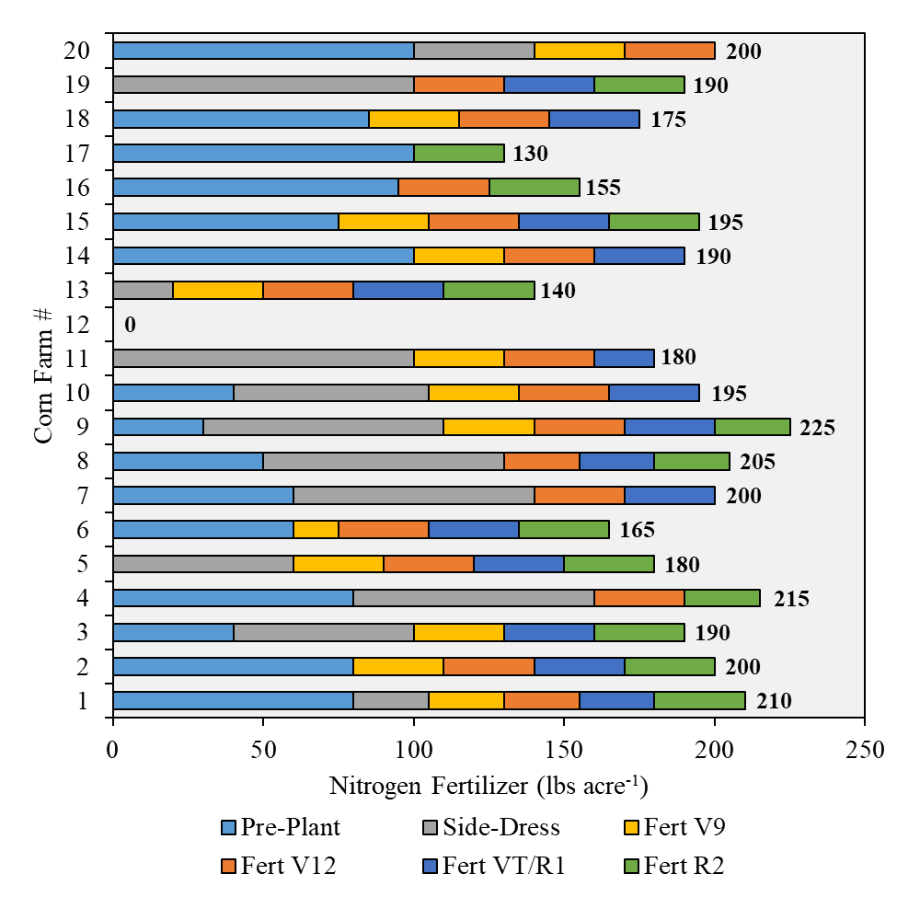
Nitrogen Application
Nitrogen Decisions
Pre-Plant | 0 | 26-Apr-18
Sidedress | 20 | 31-May-18
Fertigation at V9 | 30 | 22-Jun-18
Fertigation at V12 | 30 | 28-Jun-18
Fertigation at VT/R1 | 30 | 12-Jul-18
Fertigation at R2 | 30 | 26-Jul-18
Total N applied was 140# which was less than the UNL recommended 175#
Source: 2018 UNL Taps Banquet Report
Notes:
Corn after beans
40lb N credit in the soil (UNL pre-season soil report) and the 5gal/acre starter fertilizer (10-34-0) to all plots get.
Because of this, we decided to not apply preplant and spoon feed the corn when the corn really needed it.
The competition range of N applied: 130# - 225 # + 5# preplant
UNL N recommendation: 175# (yield goal 235)
Ward Labs recommendation: 200# (yield goal 260)

Slide 9
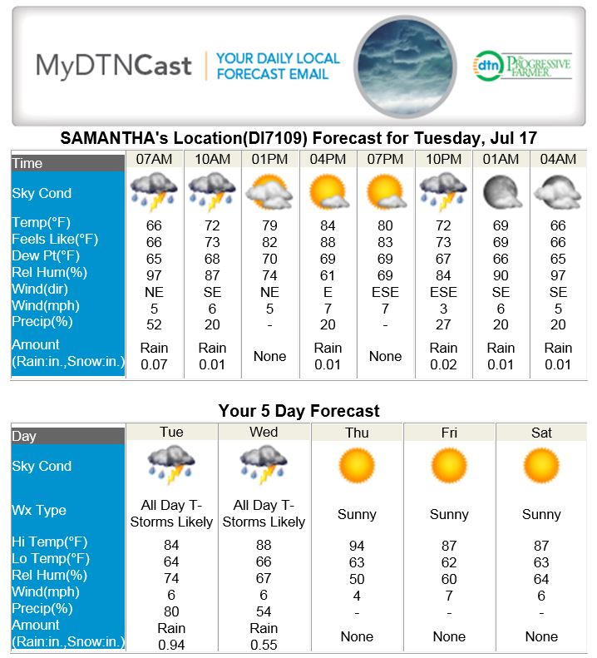
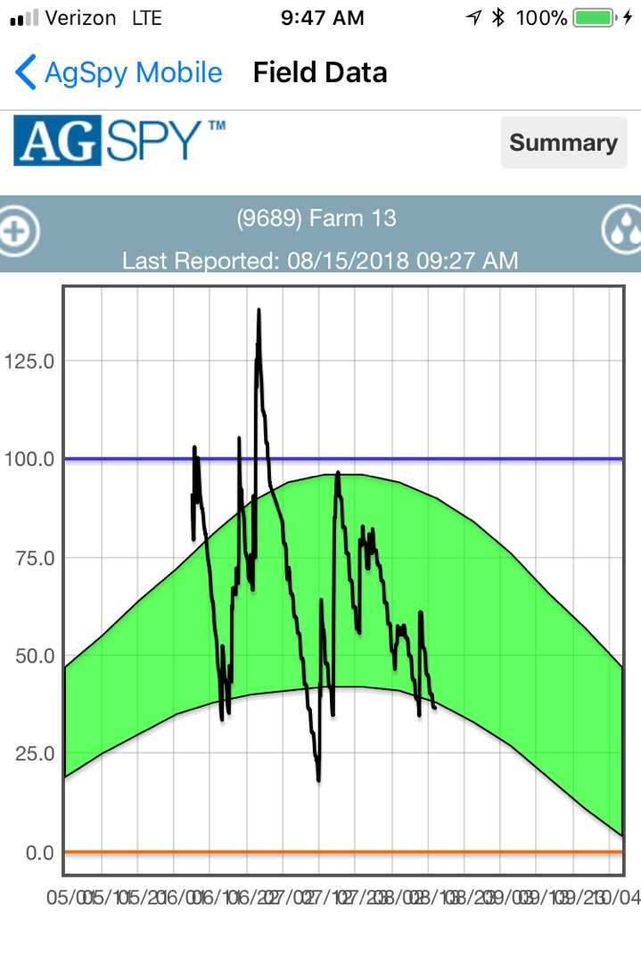
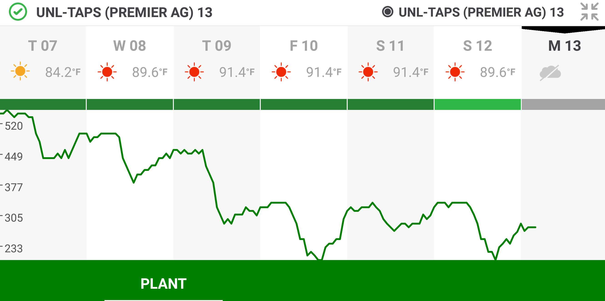
Irrigation Decision Tools
Weather Forecast:
DTN Progressive Farmer
Aqua spy:
Soil Moisture Measurements
Phytech:
Plant stress measurements
We used technology that was easy to learn on the fly….
Notes:
Technology needs to be better at explaining how their tools can be used to make decisions and create solutions
Important to understand the reasoning behind the platforms

Slide 10
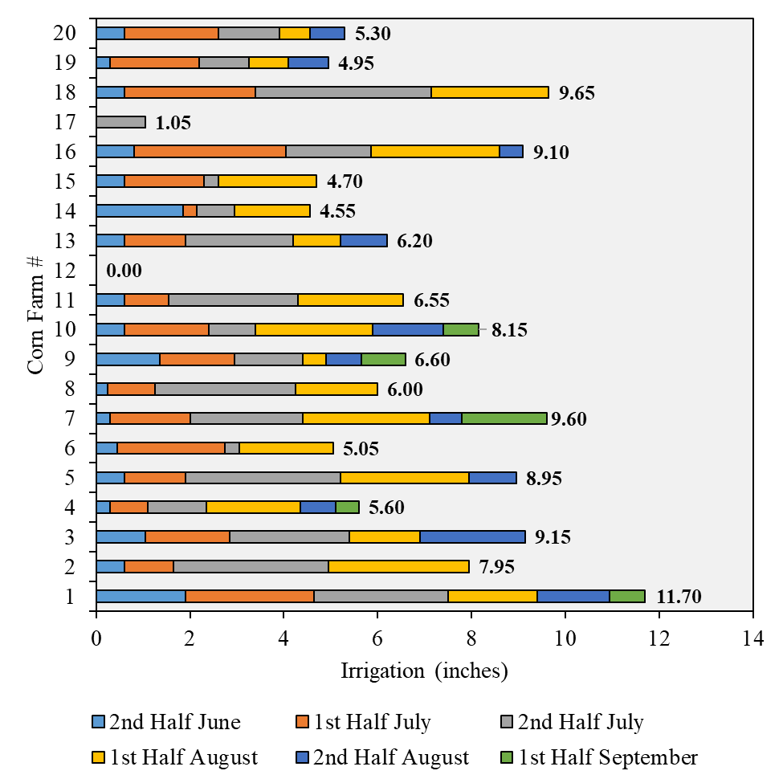
Irrigation
Date | Inches | Type
6/22 | 0.30 | Fertigation
6/28 | 0.30 | Fertigation
7/12 | 0.30 | Fertigation
7/13 | 1.00 | Irrigation
7/16 | 1.00 | Irrigation
7/23 | 1.00 | Irrigation
7/26 | 0.30 | Fertigation
8/9 | 1.00 | Irrigation
8/23 | 1.00 | Irrigation
Source: 2018 UNL Taps Banquet Report
Notes:
2018: the optimal estimated range of seasonal irrigation requirement to achieve maximum yield was between 7.5 and 8.0 inches
(calibrated TAPS ET data)
7 teams exceeded the range
11 teams were below the range
1 team was in range

Slide 11
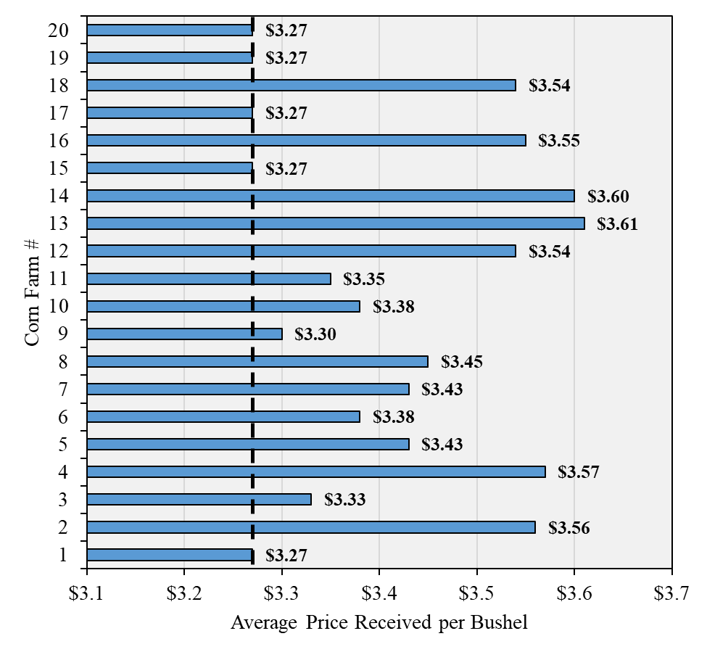
Marketing Decisions
Date | Price | Quantity
March 29 | $3.91 | 202,500
May 3 | $3.96 | 101,250
July 31 | 3.685 | 101,250
August 15 | 3.685 | 33,750
November 1 | 3.26 | 334,350
Source: 2018 UNL Taps Banquet Report
Notes:
Corn prices hit high in Late spring
Base Price was $3.26 Plus $0.01 tariff payment
Farm 13 was able to capture $0.34 a bushel over the base price for its 772,845 bushels of production netting an added value of $262,767.30. ☺
20% of farms did no marketing – just sold at the end.

Slide 12
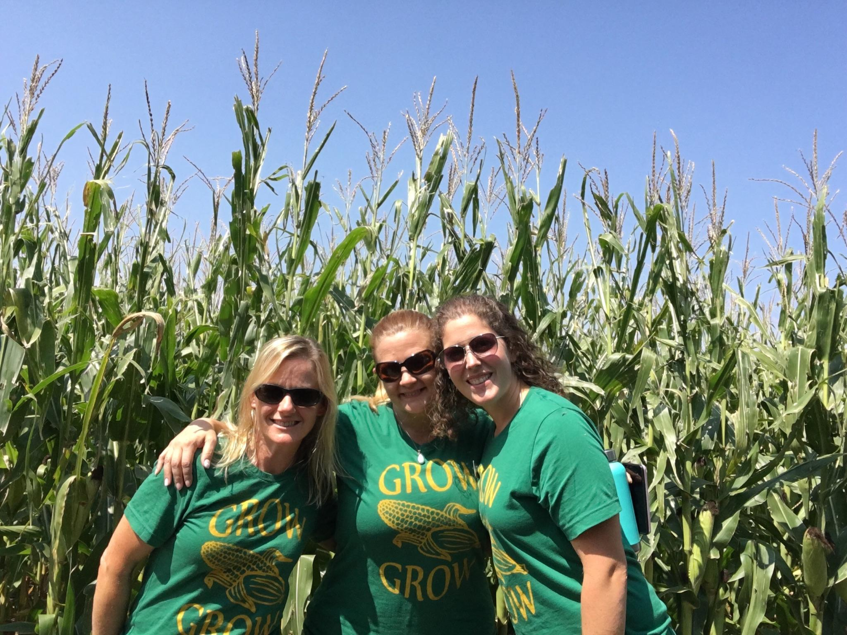
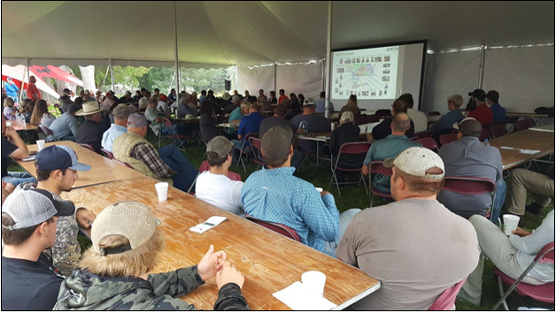
UNL Field day
Source: 2018 UNL Taps Banquet Report
Notes:
Grower Panel
Interesting Points
-different decision making processes
-no one else had sold any grain at this point…. That’s when people started to take note of the NDEQ team!

Slide 13
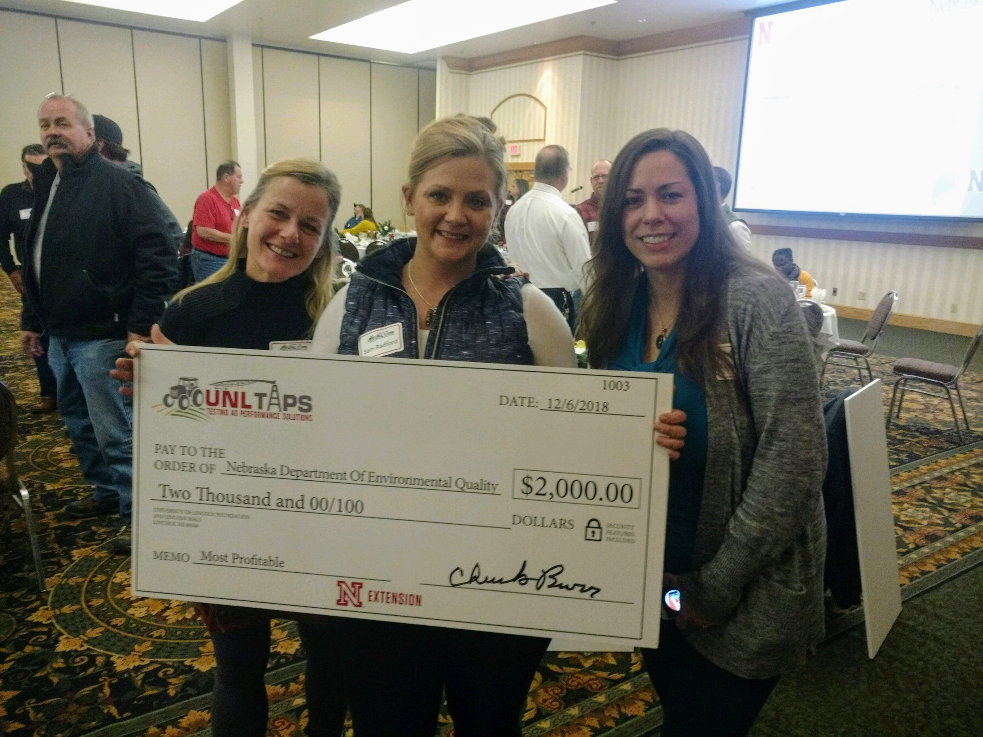
And the winner is...

Slide 14
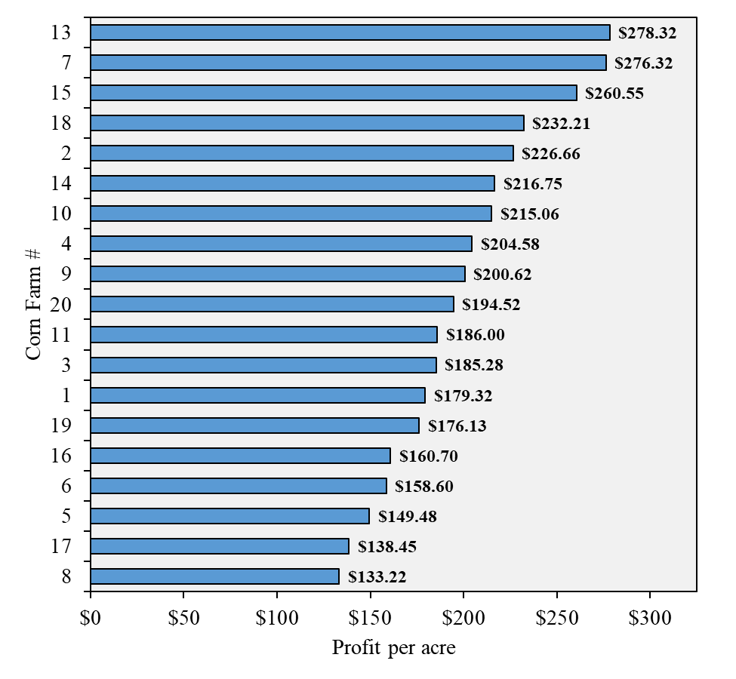
Most Profitable & 2nd in efficiency
Production cost $649.40 (per acre)
Yield = 257.7 bu/acre (137.6 to 288.5)
  Farm #15 won most efficient & 2nd highest yield
  Farm #7 won highest yield and 2nd in profitability & 6th in efficiency

Slide 15
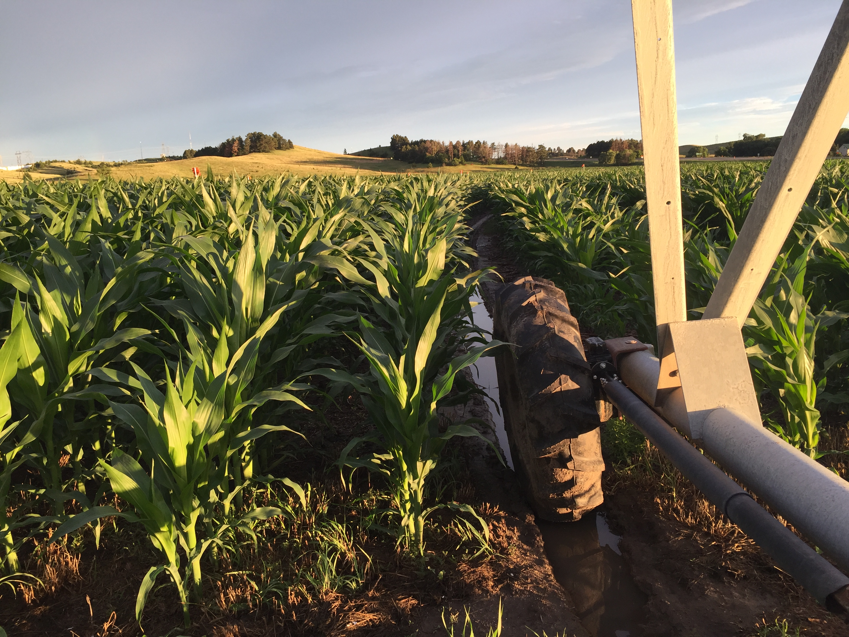
What did we learn?
  Learned from those who do it best
    WE listened and did research
Efficiency alone doesn’t lead to profitability
  Its complicated
  Have to look at the whole picture
  Need to focus on more than just nitrate and water use
  As water professionals we can help create change
    Education for producers and water professionals
    Incentivizing new technology use
    Workshops built into projects
Notes:
Taking time to put ourselves in other’s shoes has provided perspective we wouldn’t have had without this experience
Timing and external factors require the ability to adjust on the fly.
More complicated than simply reducing N applied
Movement towards efficiency and profitability is essential in addition to soil health → N & H2O will naturally fall into line

Slide 16
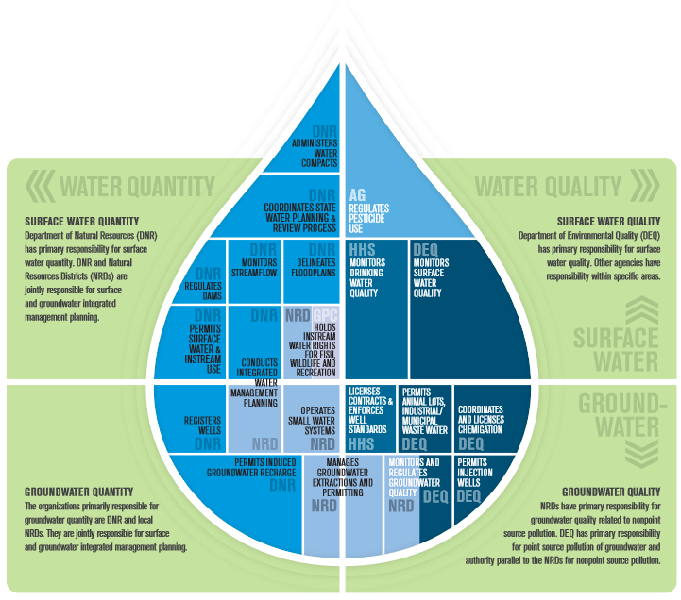
Water Management In Nebraska
Notes:
KP:
Give a brief overview of different agencies in charge of water management
Note the hydrologic connection between surface and groundwater
Note Source water program – 1 line overview referencing Sam
Note 319 program – 1 line overview referencing Carla

Slide 17
Safe Level of Nitrate in Drinking Water
Health Standard for Nitrate in PUBLIC DRINKING WATER SUPPLIES is
10 ppm (mg/L)
No regulation of PRIVATE DRINKING WATER SUPPLIES

Slide 18
Nitrate in the Environment
Increased Plant Uptake
Nitrogen Fertilizer
N stored in Vadose Zone
Discharge to surface water
Discharge to groundwater

Slide 19
Nitrate Changes on the Landscape
More than a 10 fold increase in yearly N fertilizer additions nationwide since 1950, ~600 million tons, total addition
Much of this was lost to the environment through leaching (~50%)
1 pound of N-NO3
= 12,000 gallons of 10 ppm water =
= 0.036 ac-ft of 10 ppm water
= 0.44 ac-in
N fertilizer use rate (g m-2 yr-1)

Slide 20
Increased Risk of Groundwater Contamination

Slide 21
Nitrate in the Environment
Protective Action - Antimicrobial
Excess Nitrate Inputs
Protective Action – Aides Heart Development
Protective Action – Decrease Blood Pressure (Vasodilation)
Environmental NOx Cycling
In Vivo NOx Cycling
Alteration of Nerve Activity
Carcinogenic Activities
Methemaglobinema (Blue Baby Syndrome, not enough Oxygen)
Hormone Disruption

Slide 22
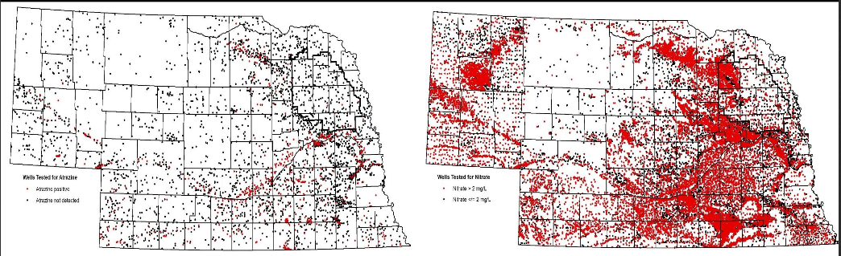
Atrazine and Nitrate in Nebraska
Nitrate Wells Sampled (1977-2014)
18,843 or 25,811(73%) were positive at > 2ppm
Atrazine Wells Sampled (1977-2014)
916 of 4311 (21%) were positive
Atrazine and nitrate are the two most prevalent drinking water contaminants in Nebraska.

Slide 23
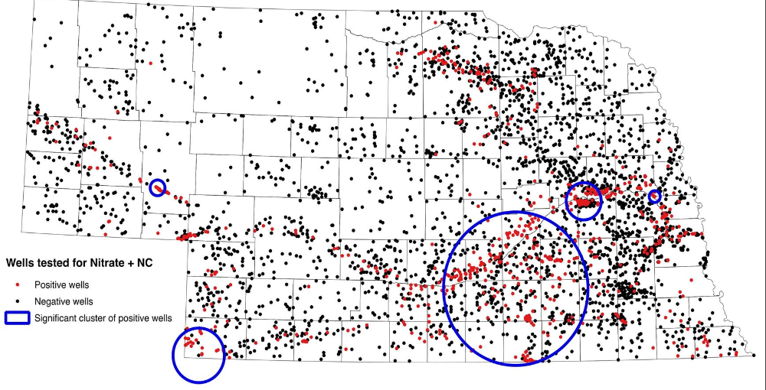

Slide 24
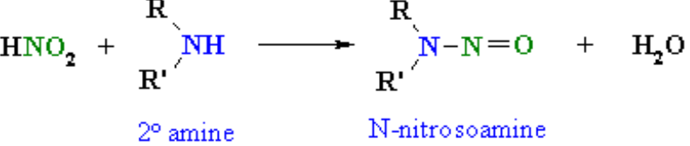
Nitrates, Health, and Nebraska
WHY IS THIS THE QUESTION? WHY ATRAZINE AND NITRATE? WHY NITROSATABLE COMPOUNDS
Atrazine’s chemical structure contains a secondary amine which can nitrosate in the presence of nitrite in an acidic environment such as the human stomach, forming a nitrosamine, N-nitrosoatrazine.
Many nitrosamines are carcinogenic in animal models.
Nitrosamine toxicity is greater when the exposure is chronic vs. acute and exposure to nitrate and atrazine is probably chronic .

Slide 25
Nitrates, Health, and Nebraska
Non-Hodgkins Lymphoma (NHL) Nebraska Study Summary
NHL risk is 2.5 times higher for subjects exposed to nitrate and atrazine in drinking water compared to subjects not exposed.
Risk of developing indolentB-cell Lymphoma is 3.5 times higher for subjects exposed to nitrate and atrazine in drinking water compared to subjects not exposed

Slide 26
Chicken Embryos Exposed to Nitrate and Atrazine
demonstrate that the combination of nitrate and atrazine are toxic to the embryo and further studies are needed in humans to assess the risk of birth defects.

Slide 27
Birth Defects in Nebraska
National birth defects rate: 3.3% of all live births
Nebraska rate 2008-2014: 7.9% of all live births

Slide 28
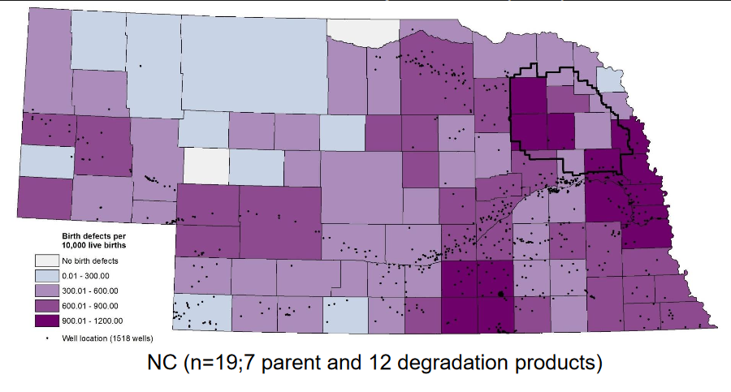
Is Nebraska’s higher birth defect incidence related to Nitrosatable Compounds?
Nebraska county rates for birth defects (2005-2014). Birth defect data obtained from Nebraska Birth Defects Registry, Nebraska Department of Health and Human Services. Well data for nitrate (>0 mg/L) and NC (>0 μg/L) obtained from Quality-Assessed Agrichemical Contaminant Database for Nebraska Ground Water (1977-2014)

Slide 29
Nitrates, Health, and Nebraska
Birth Defects and Nitrosatable Compounds Nebraska Study Summary
There is a positive correlation between the presence of Nitrosatable Compounds in Nebraska
There is a positive correlation between the presence of Atrazine in Nebraska
It is unknown whether this increased incidence of birth defects in Nebraska is associated with wells testing positive for nitrate and nitrosatable compounds

Slide 30
Nitrates, Health, and Nebraska
What’s Next?
  Nebraska Case Study: Is maternal exposure to NO3/ATZ (NC) associated with risk for birth defects in offspring?

Slide 31
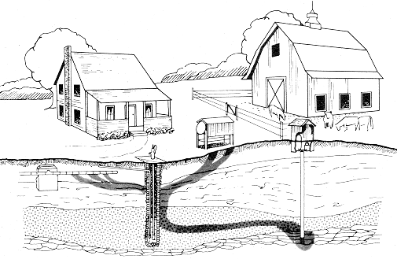
Private Wells
Most well owners drink untreated groundwater
However, wells can contain naturally occurring contaminants or be contaminated by other chemicals or pathogens
Water may taste and look fine but still contain harmful substances!
Notes:
Pekarek
In Nebraska, The Nebraska Department of Environmental Quality (NDEQ) is charged with monitoring, assessing, and to the extent possible, managing the state’s water resources. The purpose of this work is to protect and maintain good quality water and encourage or execute activities to improve poor water quality. Monitoring is done on the over 18,000 miles of flowing rivers and streams, our greater than 280,000 acres of surface water in lakes and reservoirs, and the vast storage of groundwater in Nebraska’s aquifers.
Cost of Testing a Private Drinking Water Supply
There is no single test to determine the safety of drinking water. It would be costly, and in most cases unnecessary, to test a private water well for the nearly 100 contaminants for which public water supplies are required to test. For example, the price for a complete water analysis at the Nebraska Department of Health and Human Services laboratory is currently $3,827.00. Users of private drinking water wells must decide which contaminants to test for and must order tests accordingly. A water-testing laboratory will only test for contaminants specifically requested.
At the very least, have the water tested for bacteria and nitrate. Keep in mind that tests for bacteria and nitrate do not guarantee the water is safe or desirable for domestic use, as other contaminants could be present. Have tests conducted for other substances when specific contaminants are suspected. Some laboratories offer multi-parameter packages that include tests for the most common contaminants of concern. In many situations, these can be good options.

Slide 32

Testing Your Drinking Water
Bacteria
3 times per year and after any major plumbing work
Chemicals and Other Parameters
Generally, twice in first year and every 3-5 years after
Nitrate
Annually

Slide 33
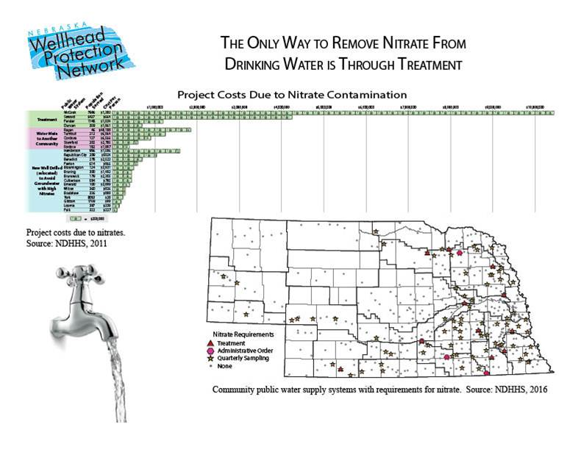
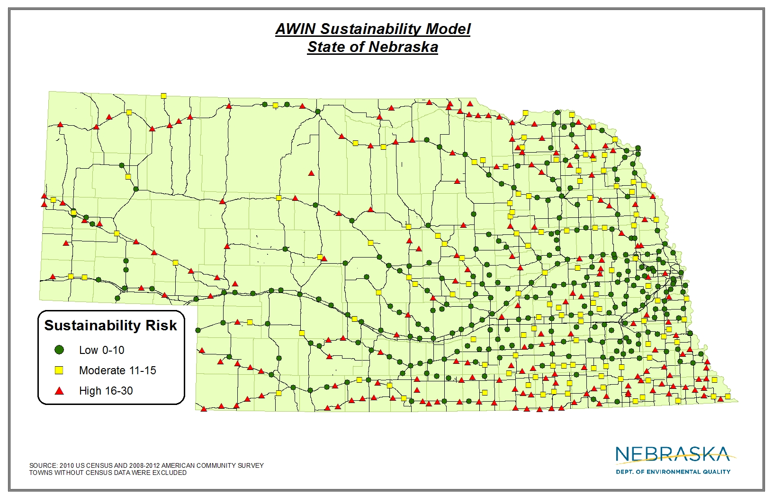
Nitrate – Cost To Communities
Notes:
Carla
Drinking water map of administrative order or AWIN MAP
$$$ Image from Groundwater Foundation

Slide 34
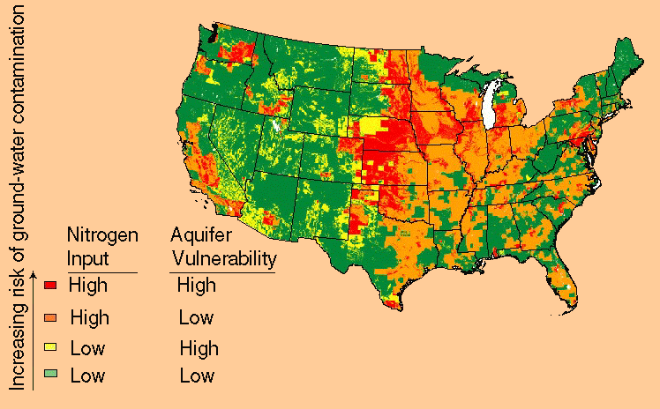
Nitrate in Groundwater – Where is the Problem?
Areas with the highest risk of nitrate contamination of shallow groundwater have:
high nitrogen input
well-drained soils
less extensive woodland relative to cropland.
https://water.usgs.gov/nawqa/nutrients/pubs/wcp_v39_no12
Notes:
Carla
USGS Blue Map from Carla – vulnerability map for groundwater – replace current map

Slide 35
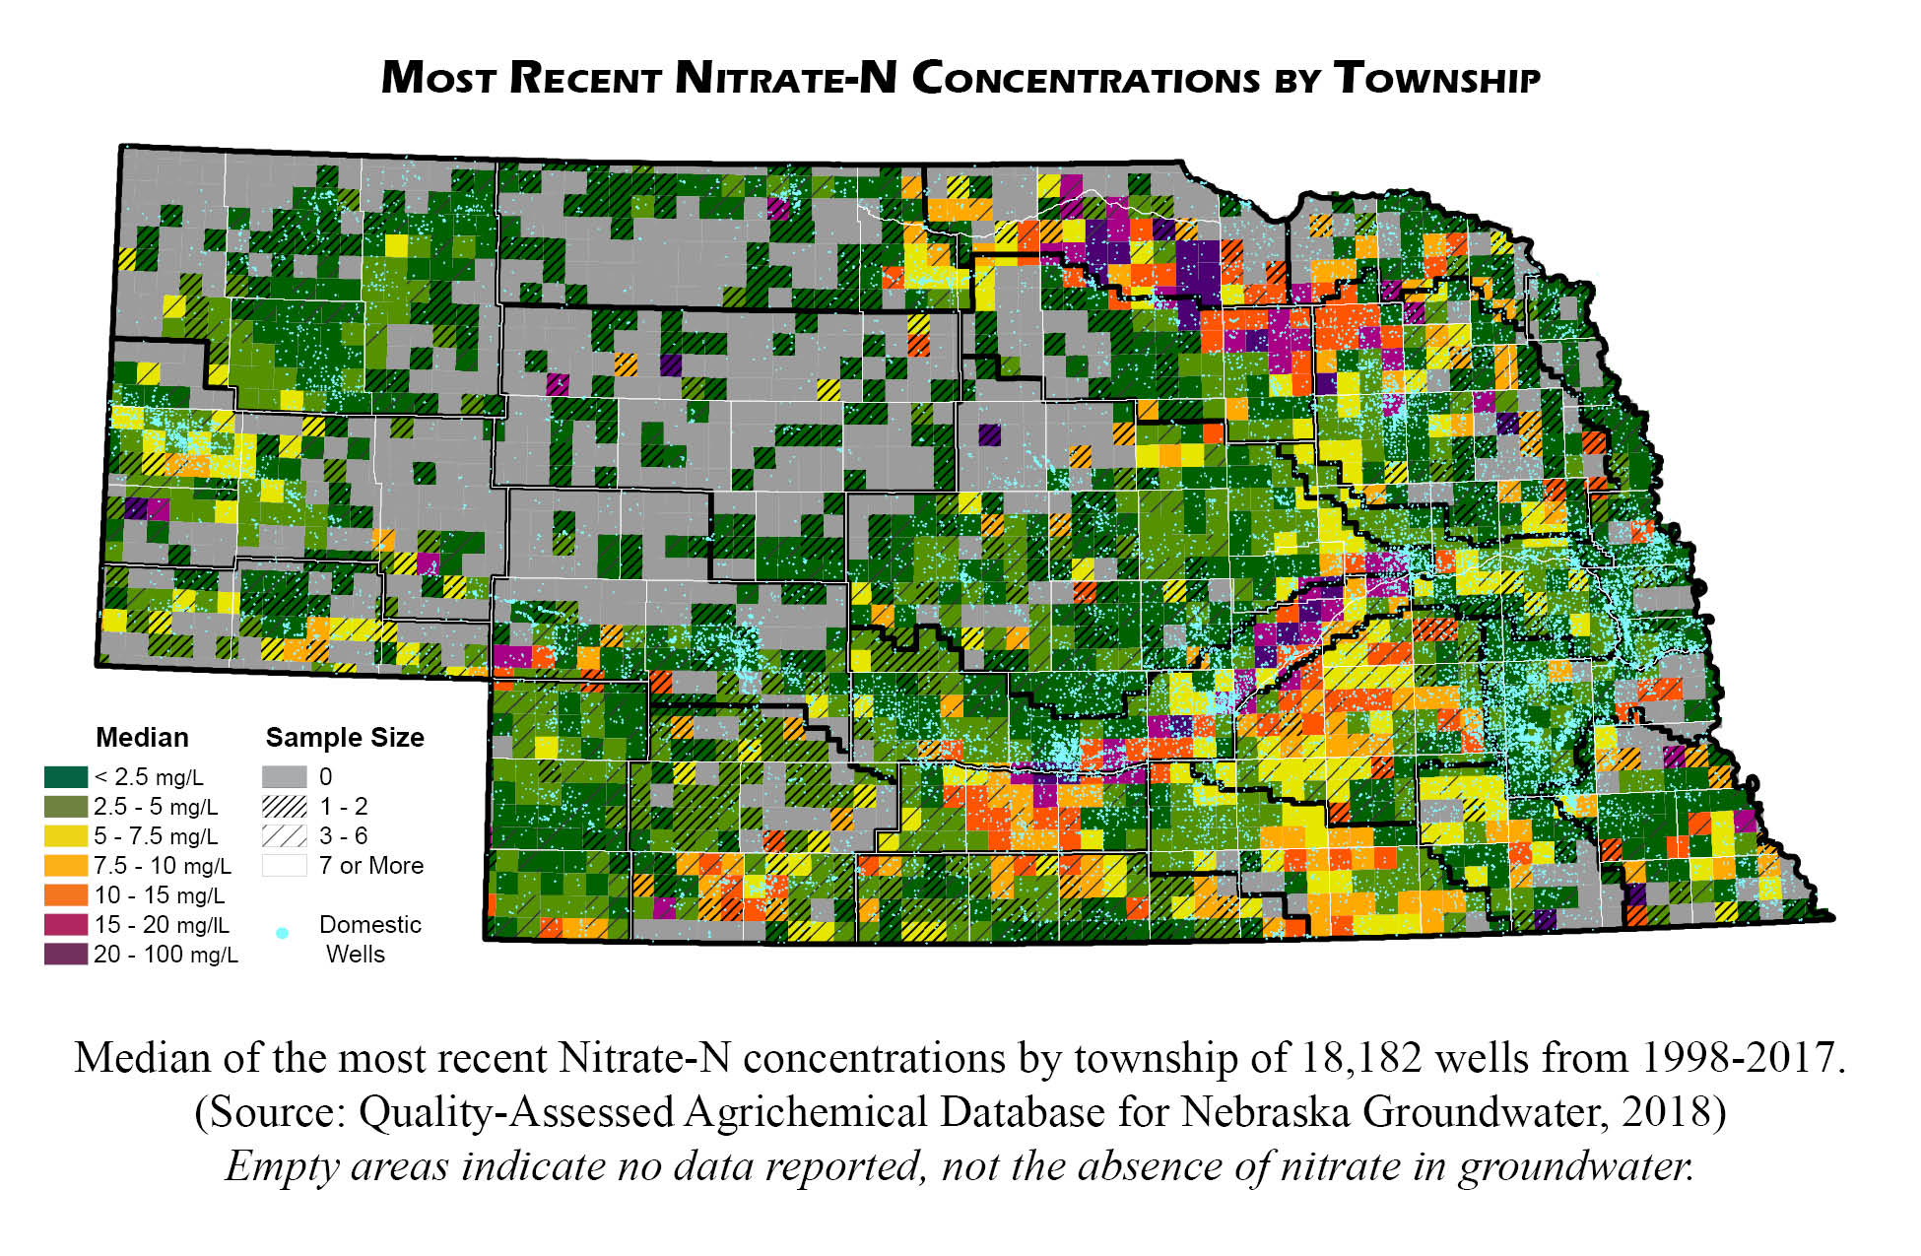
Nitrate in Groundwater – Where is the Problem?
Notes:
Carla
Township Map with domestic wells and major cities overlayed.

Slide 36
Nonpoint Source Pollution in Nebraska
Clean Water Act - Federal Funds
Watershed plans & Projects
Safe Drinking Water act - Federal Funds
Drinking water protection plans
National Water Quality Initiatives
Notes:
Carla’s Project overviews (multiple slides)
Plan Map
NWQI Project
Bazile
York and Project Grow
Drinking Water Protection Management Plans

Slide 38
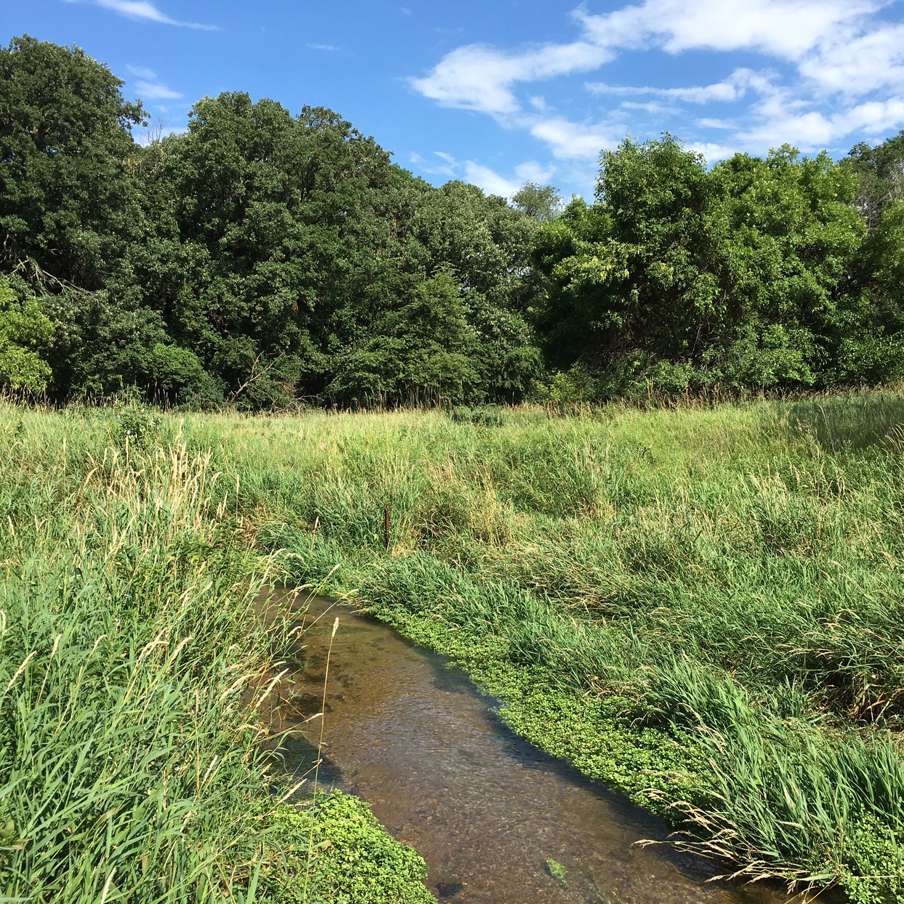
Nonpoint Source Projects
Groundwater/Surface Water
Notes:
Carla’s Project overviews (multiple slides)
Who is interested in working on Nitrates in Nebraska
Logos from Sam

Slide 39
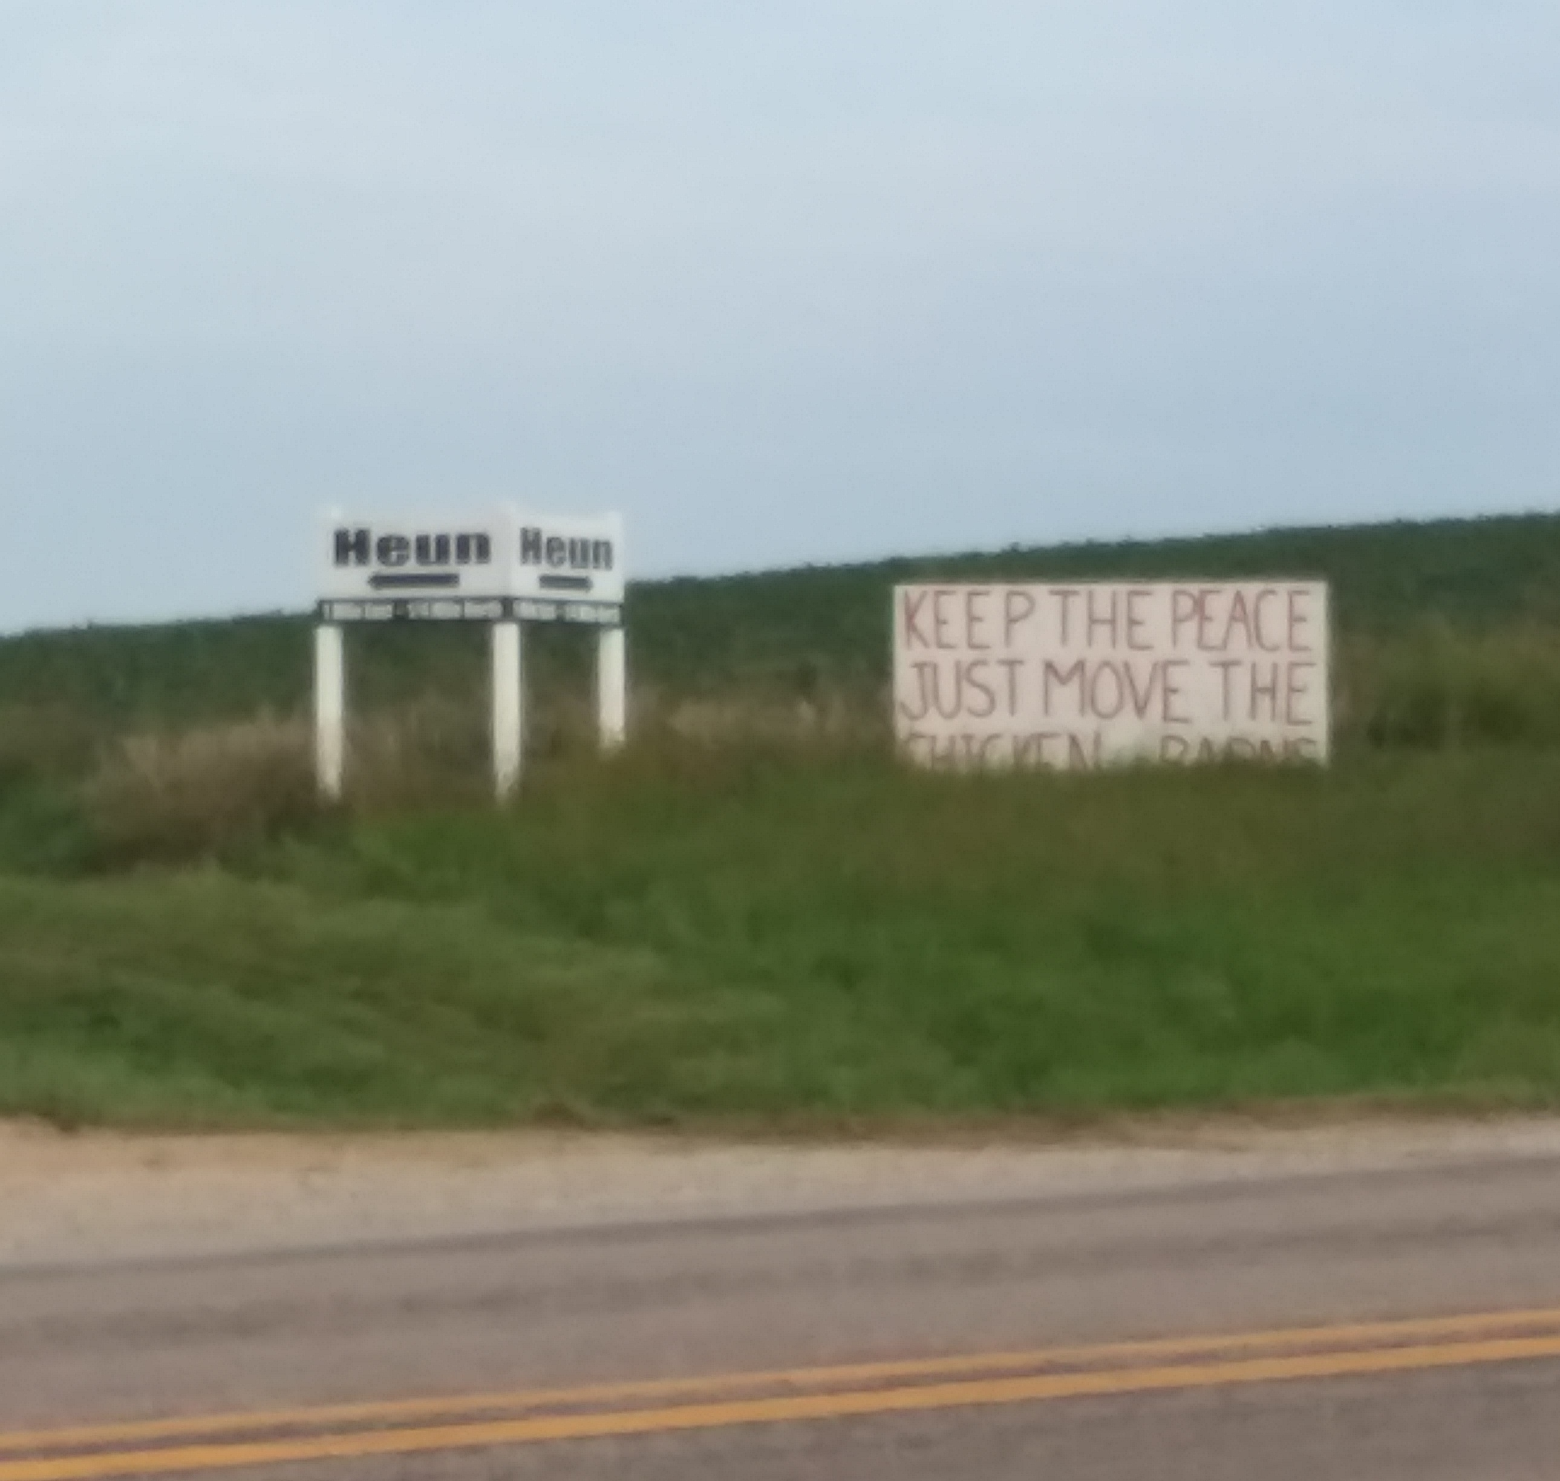
Nonpoint Source Projects
Social issues
Risk communication
Notes:
Carla’s Project overviews (multiple slides)
Who is interested in working on Nitrates in Nebraska
Logos from Sam

Slide 40
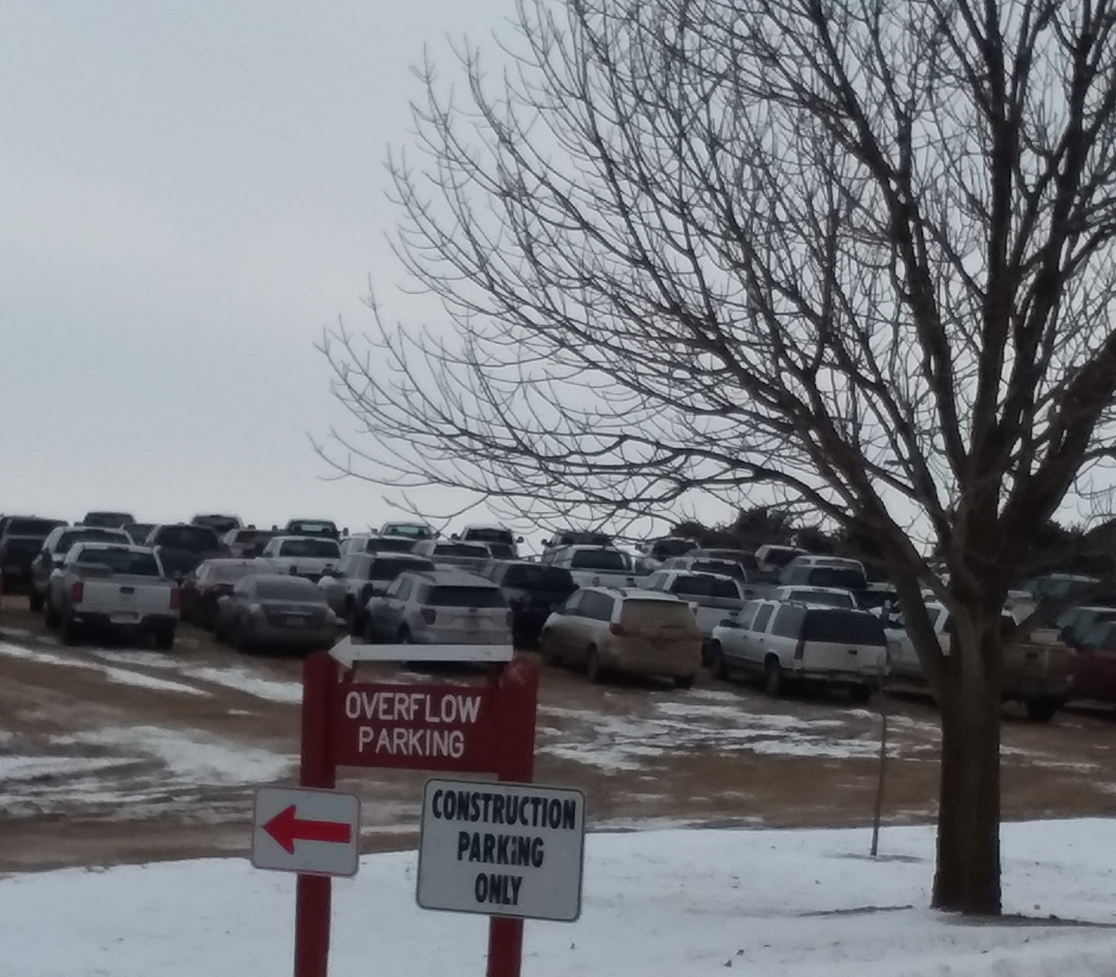
Nonpoint Source Projects
Public meetings
Cost share
Notes:
Carla’s Project overviews (multiple slides)
Who is interested in working on Nitrates in Nebraska
Logos from Sam

Slide 41
Take away
  Learn from the best
Personal Health
  Get Involved
    NRD Board
    Stakeholder Groups

Slide 42
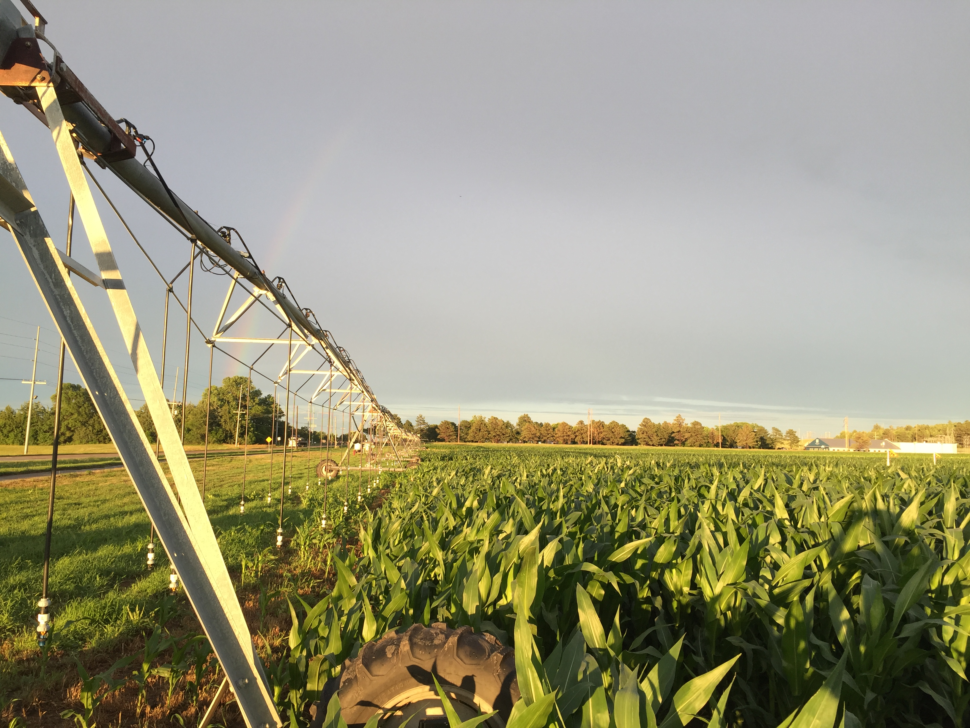
Questions?

