Slide 1
Building Stewardship through Your herd health plan Rob Eirich Nebraska Director of BQA & Extension Educator

Slide 2
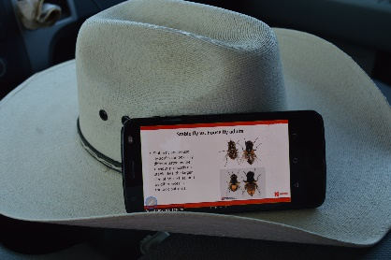
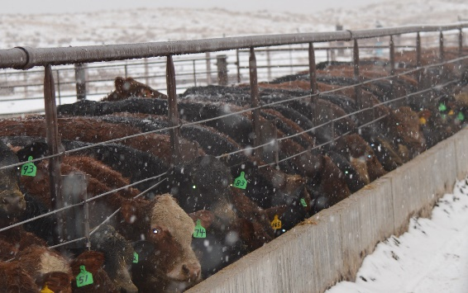
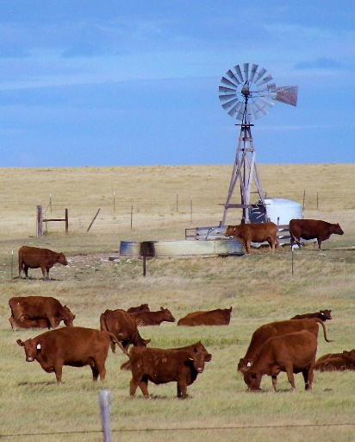
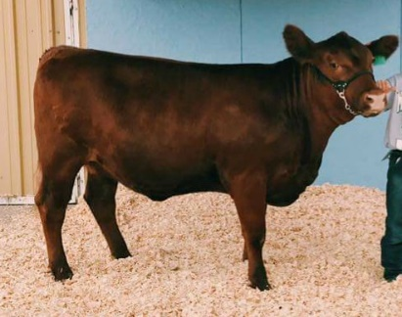
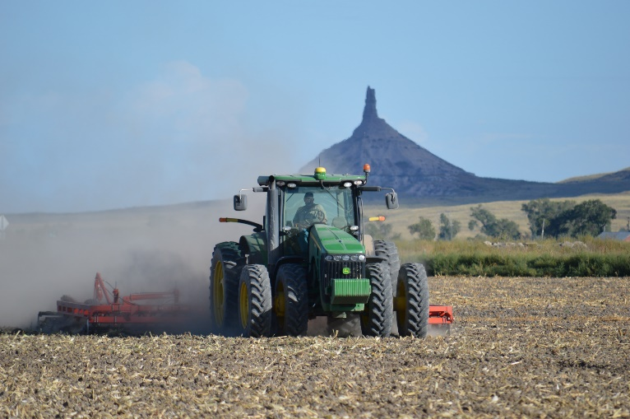
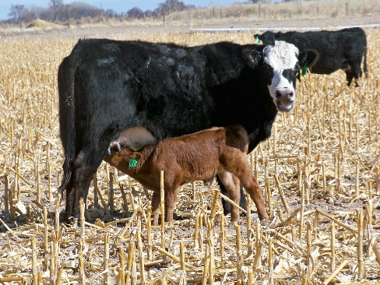
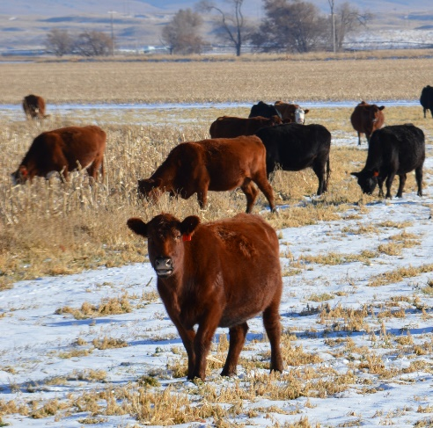
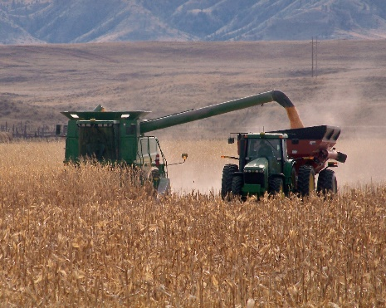
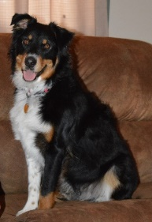

Slide 3
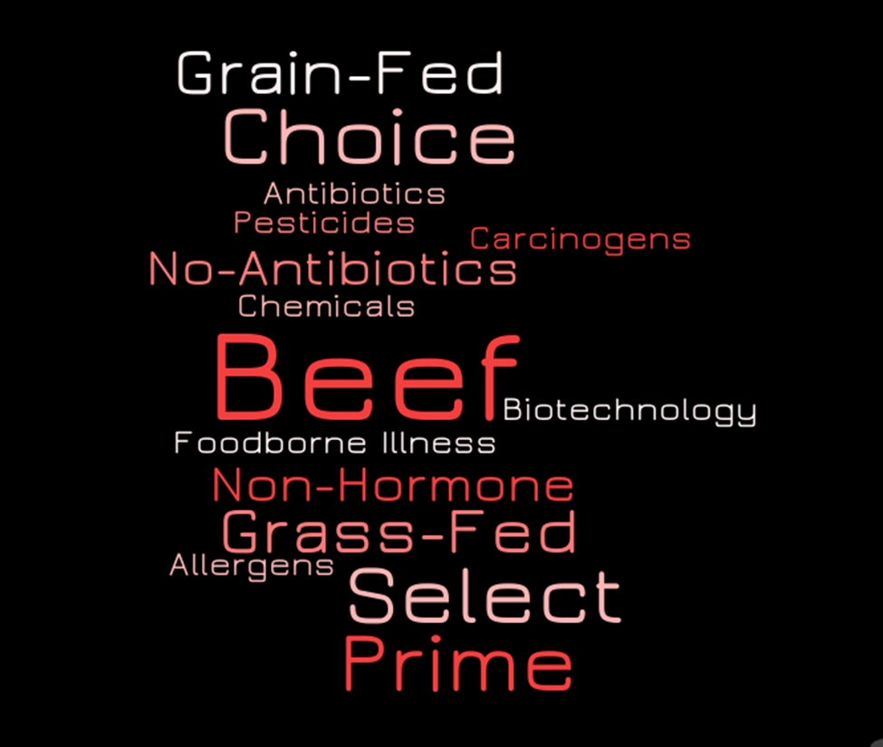

Slide 4
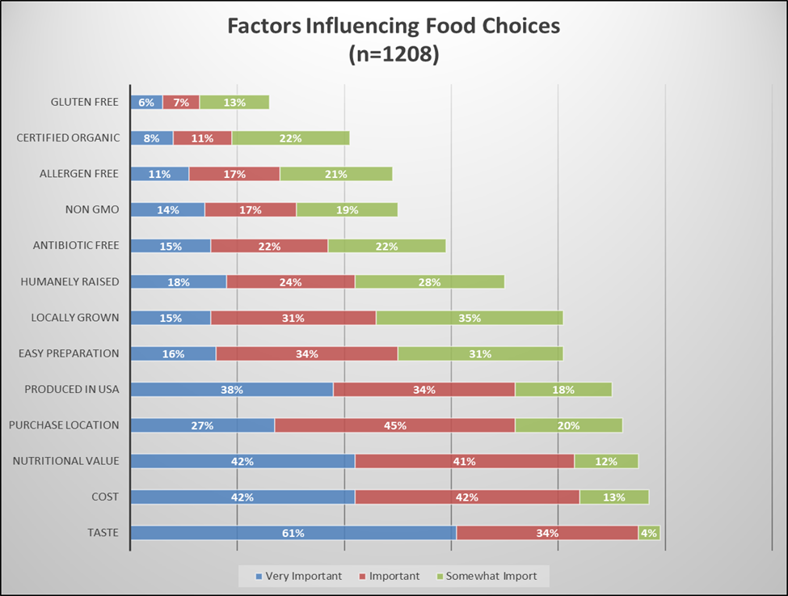
Factors Influencing Food Choices
Top Three
Taste (99%)
Cost (97%)
Nutrition (95%)
Animal Ag Factors
Humanely Raised (70%)
Antibiotic Free (59%)
Certified Organic (41%)
2016 Nebraska Annual Social Indicators Survey, University of Nebraska-Lincoln Bureau of Sociological Research

Slide 5
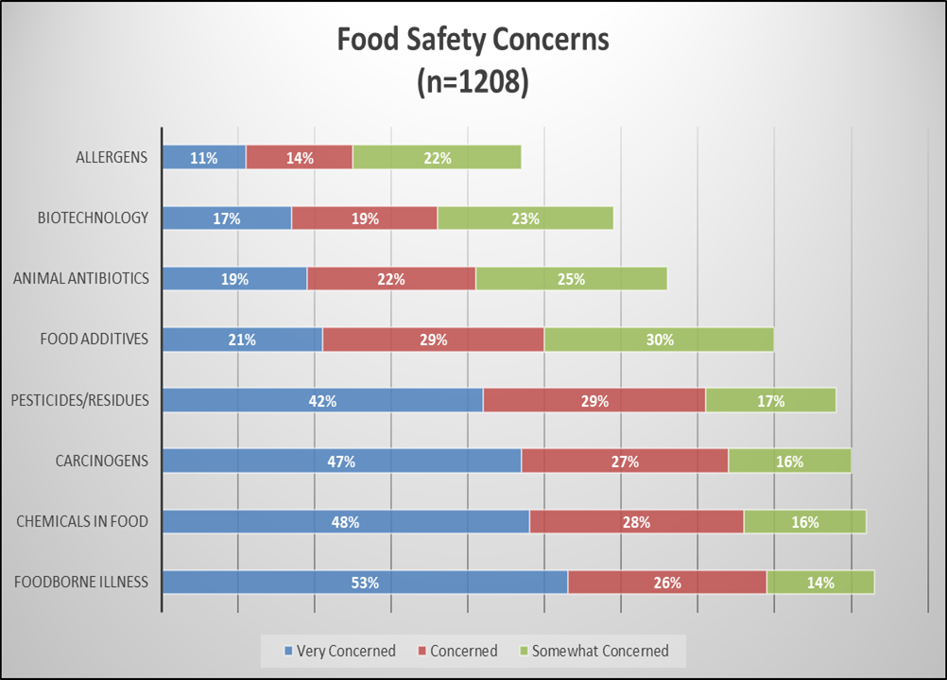
Food Safety Concerns
Foodborne Illness (93%)
Chemicals (92%)
Carcinogens (90%)
Pesticides/Residues (88%)
Additives (80%)
Antibiotics (66%)
Biotechnology (59%)
Allergens (47%)
2016 Nebraska Annual Social Indicators Survey, University of Nebraska-Lincoln Bureau of Sociological Research

Slide 6
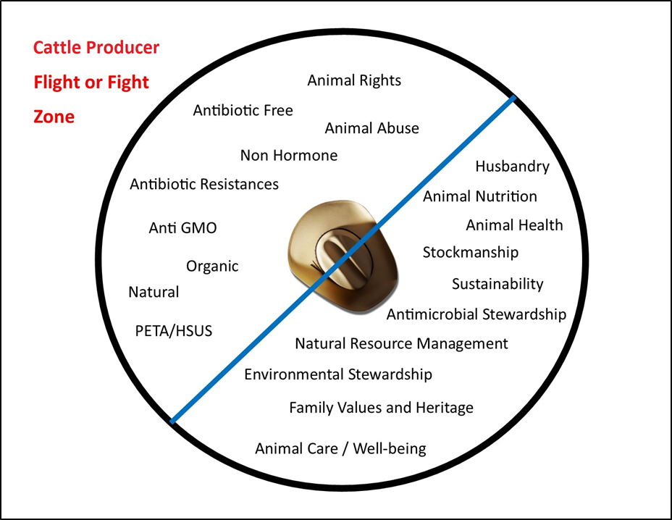
Today’s Cattle Producer
Blind Spot

Slide 7
Stewardship

Slide 8
Herd Health Plan
A planned animal-health and production-management program that uses a combination of regularly scheduled veterinary activities and good herd management designed to optimize animal health and productivity (Blood, 1979)
Principles of these programs may include pregnancy diagnosis, bull breeding soundness evaluations, consulting on vaccination and treatment programs, becoming involved in biosecurity and food safety issues, and it may also involve organizing and reviewing a recordkeeping system (Campbell & Jelenski, 2006)

Slide 9
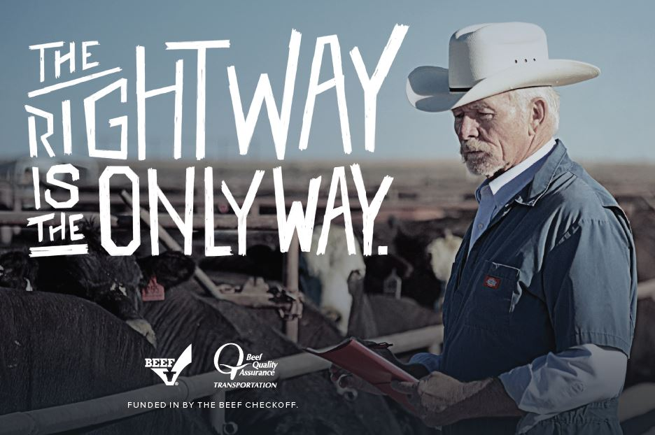
Herd Health Plan
Elements
Identify Herd Production & Health Risks and Pressures
Develop Core Preventative Plan
Know Early Detection Signs
Proper Diagnosis
Develop Treatment Protocol

Slide 10
our Operation, Our Herd
The Operation
Cow/Calf
Stocker
Backgrounder
Feedlot
The Location
Physical Location
Environment & Resources
The Goals
Production
Financial
Resources
The Team
Veterinarians, Nutritionist, Consultants, etc.

Slide 11
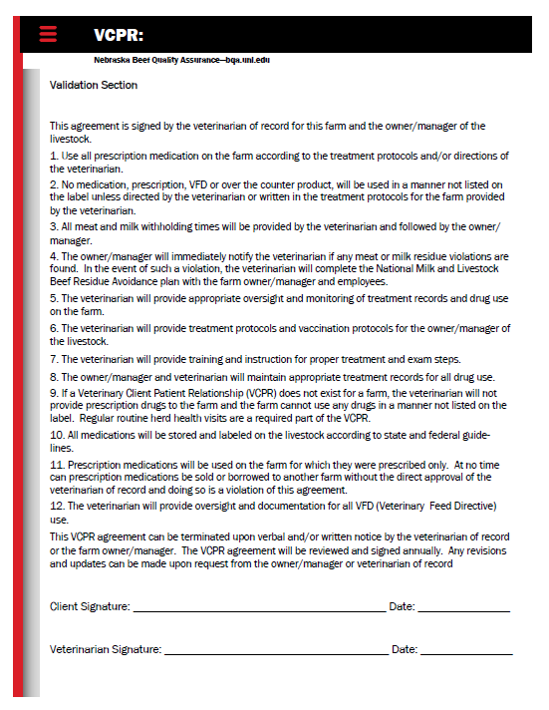
Step 1: The Team
Operation Management
Owners/Managers/Family
Employees/Labor Force
Veterinarian
Veterinarian-Client-Patient Relationship (VCPR)
Nutrition Consulting
Range Specialist
Nutritionist
Others
Extension Educator/Specialist
Genetics Consultant
Banker
Accountant

Slide 12
Step 2: Production Calendar
Develop Monthly Production Calendar
Production Stage & Management
Nutrition
Health
Monthly Plans

Slide 13
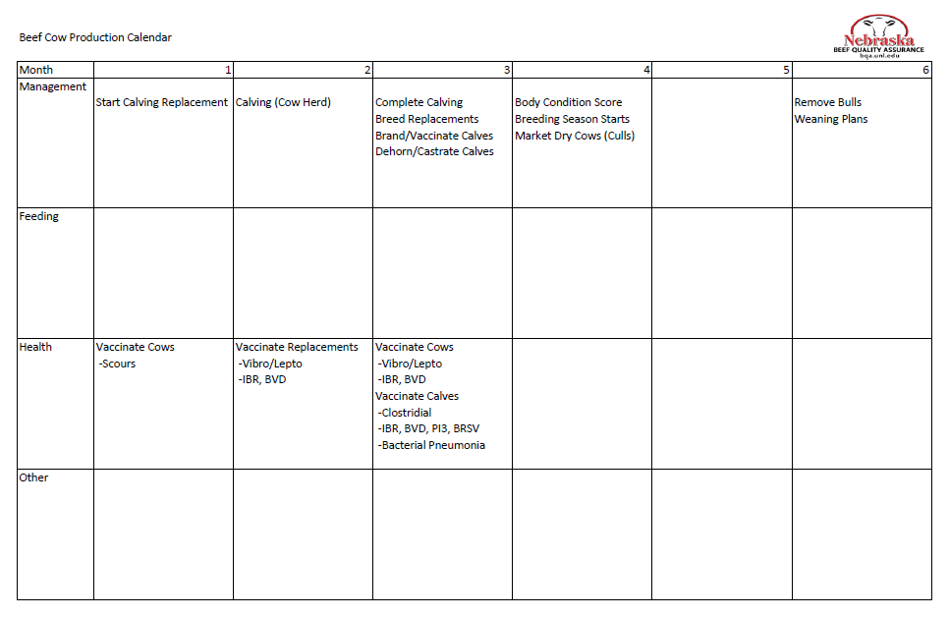

Slide 14
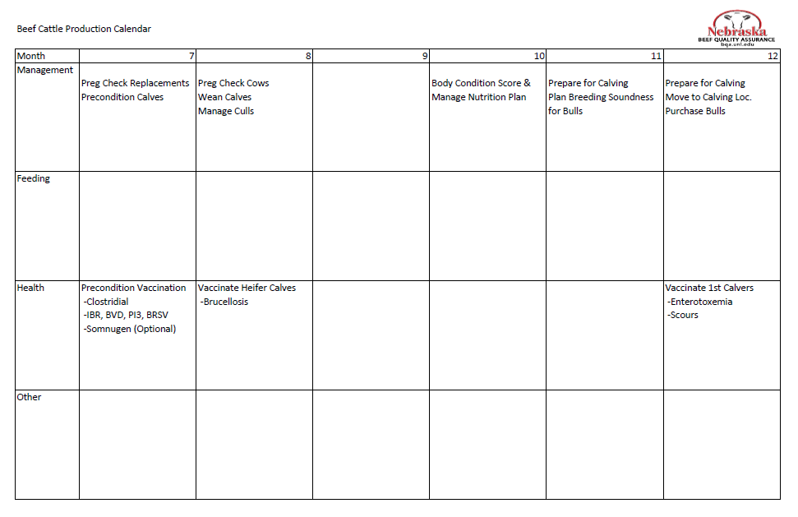

Slide 15
Step 3: Herd Health Plan
What Is The Health Concern?
What Is The Risk Pressure?
Prevention VS Treatment?
What Are The Options?
Management
Prevention
Vaccination
High
Health Concern
Nutrition
Moderate
Antibiotic
Low
Treatment
Med Procedure
Vet Consult

Slide 16
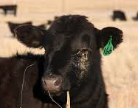
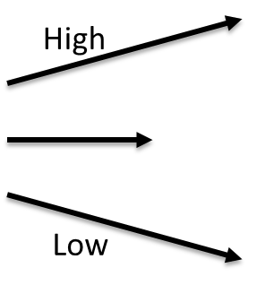
Example: Pink Eye
Fly Control
Ear Tags
Spray
Pink Eye Vaccine
Mineral with IGR
Moderate
Injectable Antibiotic
YES
Treatment
Feed Grade Antibiotic
NO
Patches / Topicals
YES

Slide 17
Step 3A: Herd Health Plan - Prevention
Vaccination Program
Management Practices
Alternatives
Nutrition
Management
Prevention
Vaccination
High
Health Concern
Nutrition
Moderate
Low
Treatment

Slide 18
Step 3A: Herd Health Plan - Prevention
Scours Plan
Sandhills Calving System
Prevention
High
Scour Guard Vaccine
Calf Scours
Cow Supplementation
Moderate
Viral
Bacterial
Parasites
Yeast/Mold
Low
Treatment

Slide 19
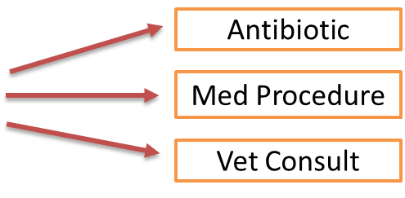
Step 3B: Herd Health Plan - Treatment
Proper Diagnosis & Judicious Use
Available Treatment As Labeled
Follow Up & Retreatment Plan

Slide 20
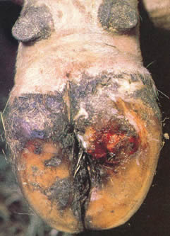
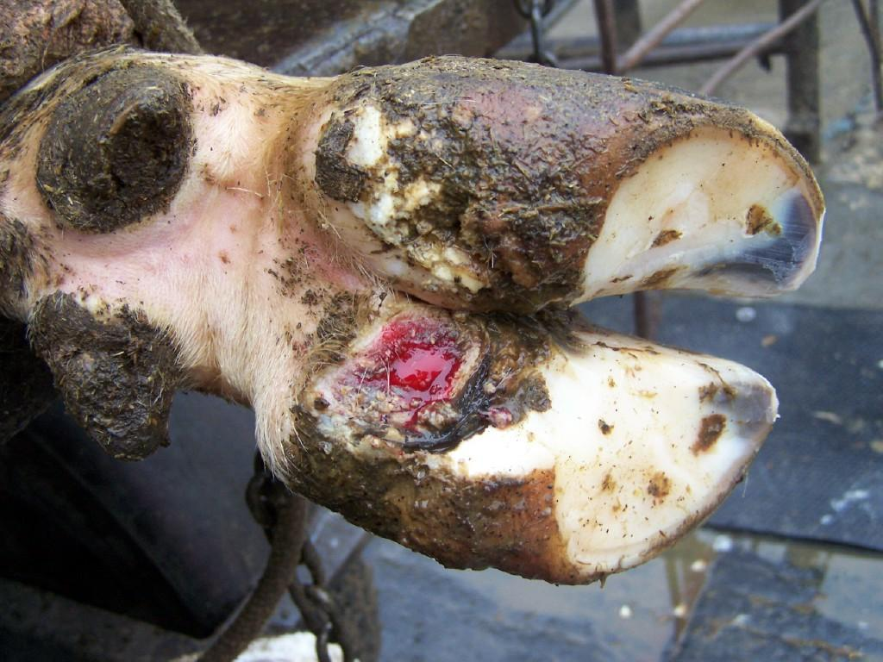
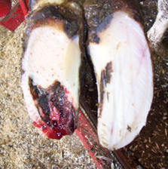
Step 3B: Herd Health Plan - Treatment
Diagnosis & Judicious Use
Foot Rot
Hairy Heel Warts
Toe Abscess

Slide 21
Step 3B: Herd Health Plan - Treatment
Treatments
Foot Rot
Hairy Heel Warts
Toe Abscess
Injectable Antibiotics
Antiseptic Foot Bath Protocol
Trim to Relieve Pressure
Injectable Antibiotic
Block Toe/Hoof

Slide 22
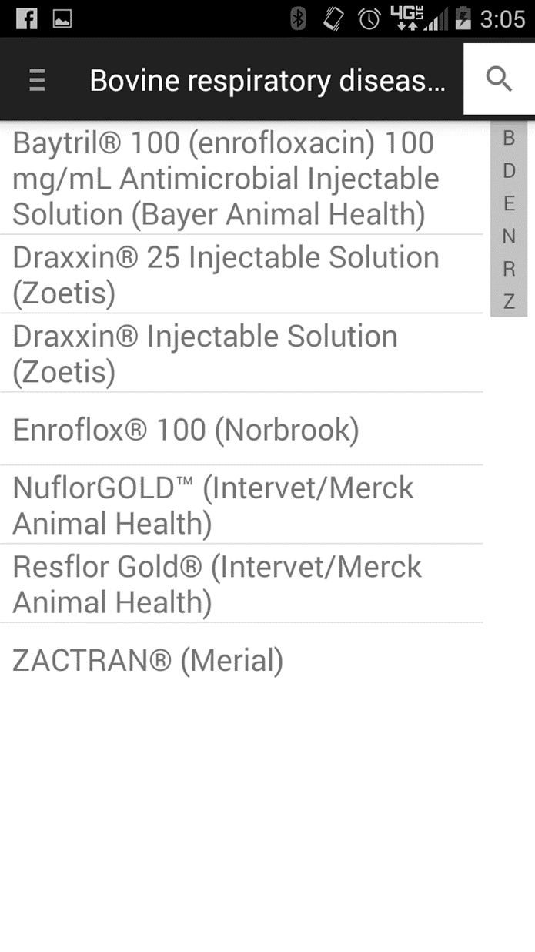
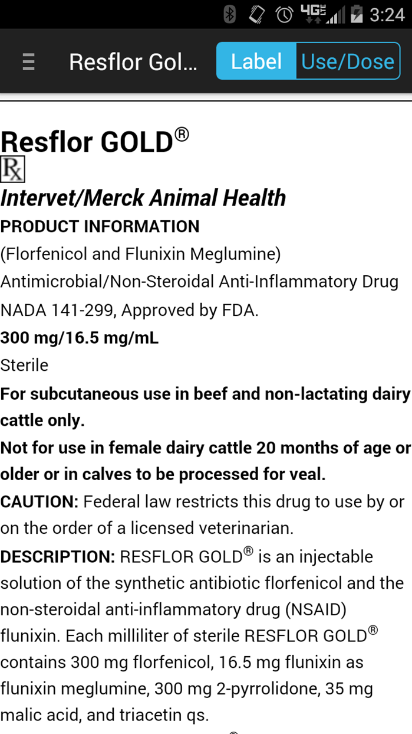
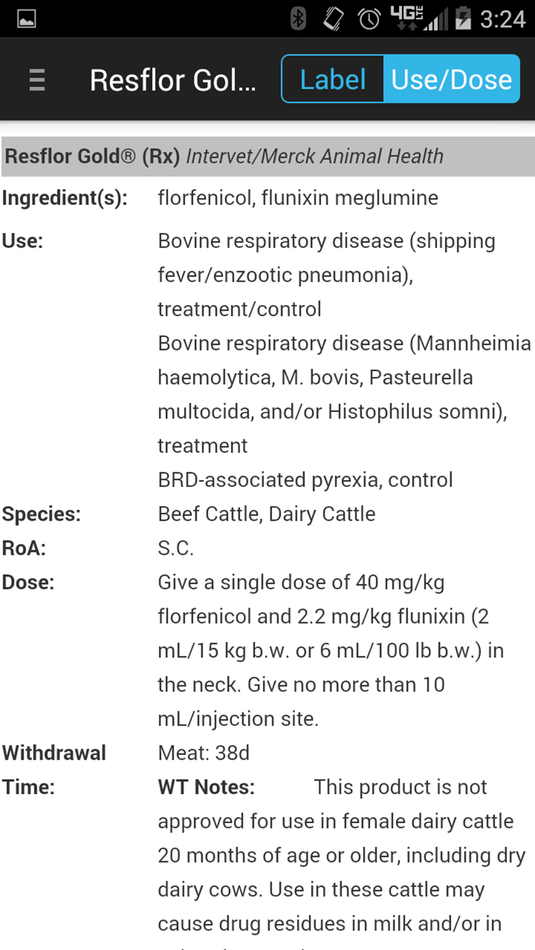
Compendium of Veterinary Products
www.bayerdvm.com/education/compendium-of-vet-products/
Google Play Store or Apple App Store

Slide 23
Step 3C: Herd Health Plan – Follow UP
After Each Treatment
Annually
What Worked?
What Didn’t Work?
Revise Herd Health Plan with Veterinarian

Slide 24
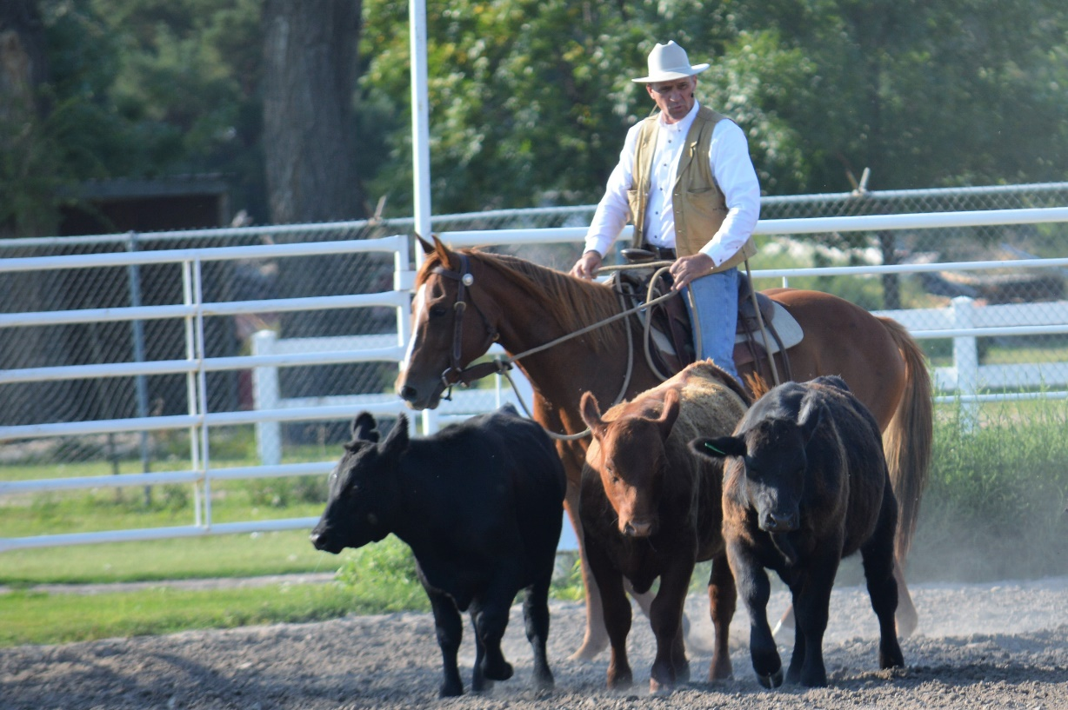
Building Stewardship
Identify Your Team
Develop a Production Calendar
Determine Cattle Health Risk
Build a Herd Health Plan
Prevention
Treatment
Follow-Up
Annual Review/Revise Herd Health Plan

Slide 25
questions
Rob Eirich
Nebraska Director of Beef Quality Assurance
308-632-1230
reirich2@unl.edu

