Slide 1
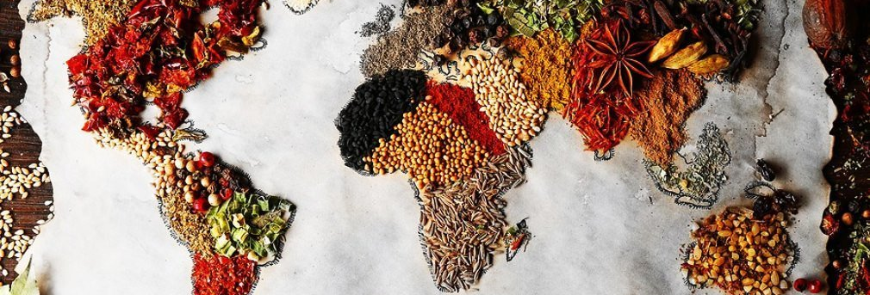
What in the world are people eating?
PAT JONES
FNH EXTENSION EDUCATOR
SANDRA BARRERA
CVI EXTENSION EDUCATOR

Slide 2

GOOD MORNING!

Slide 3





Slide 4

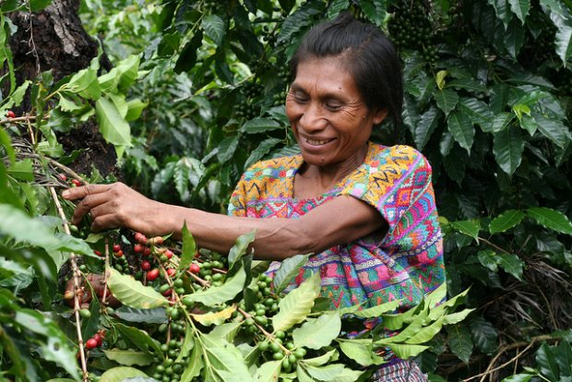
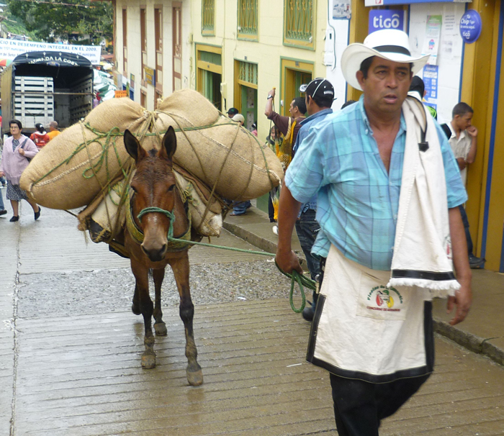
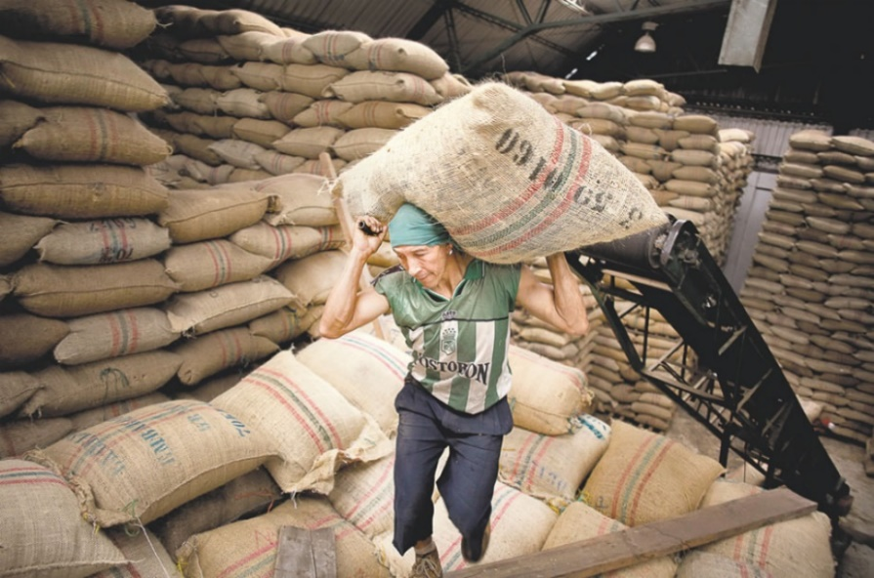

Slide 5


Slide 6
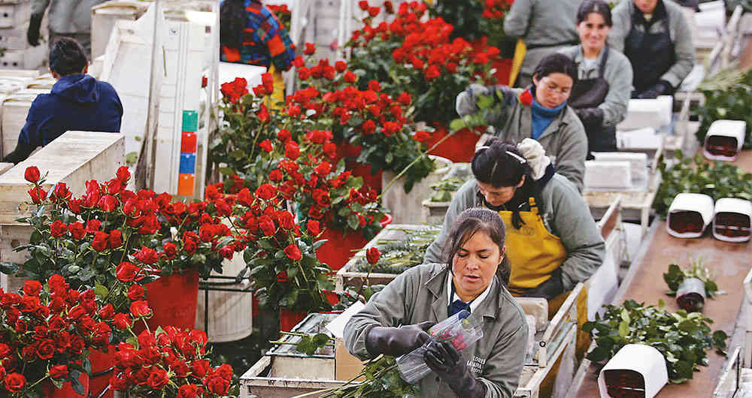
It’s a biggest SALE day of ROSES in my home country to customers in the USA. It’s generated jobs to Colombian women. THANK YOU!
Happy Valentine’s Day!

Slide 7
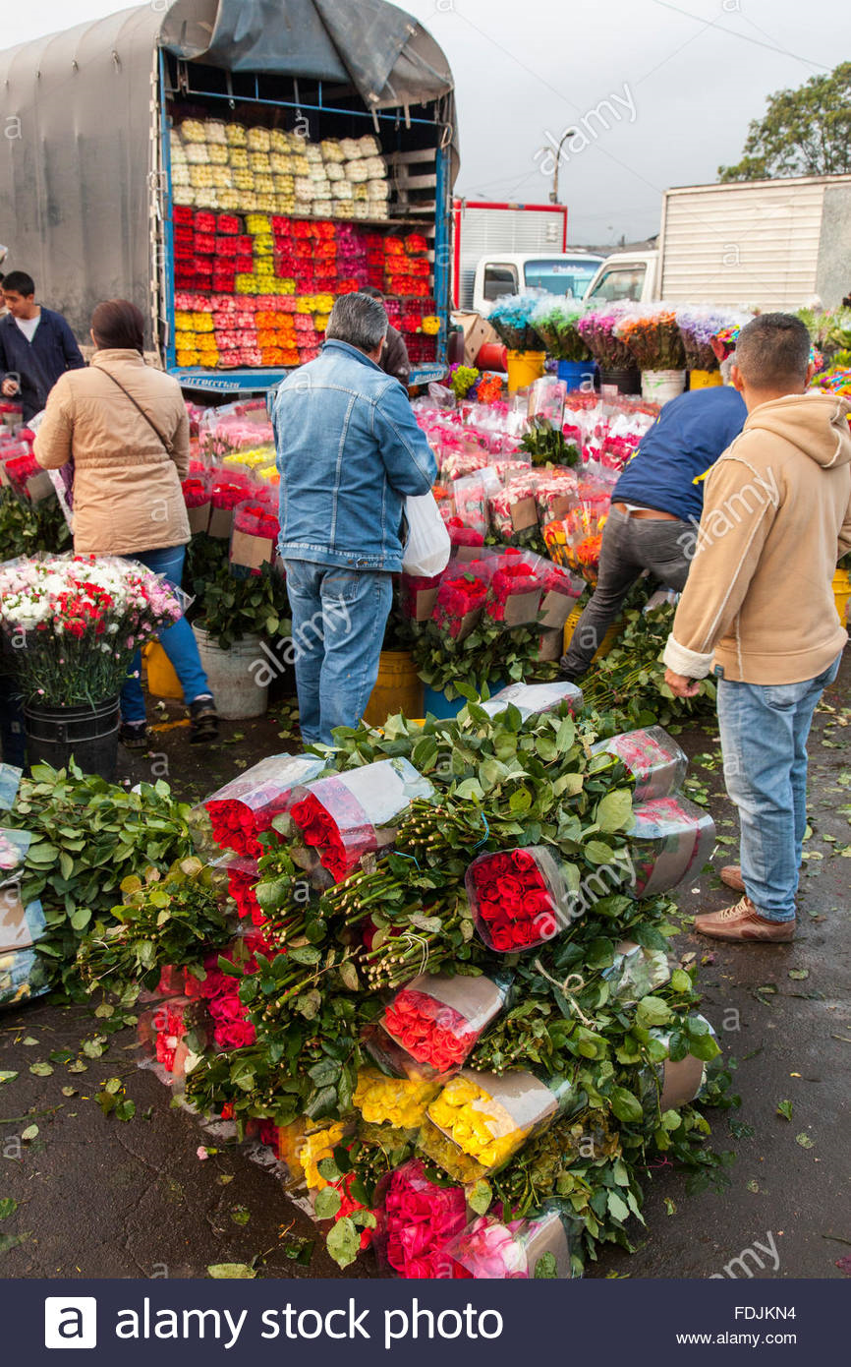
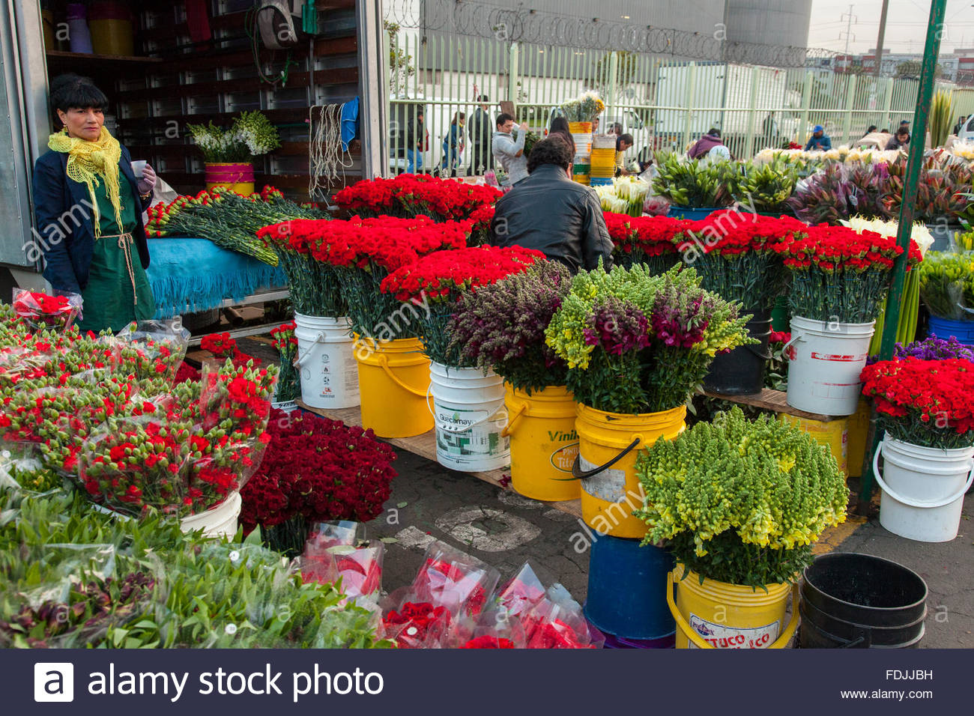
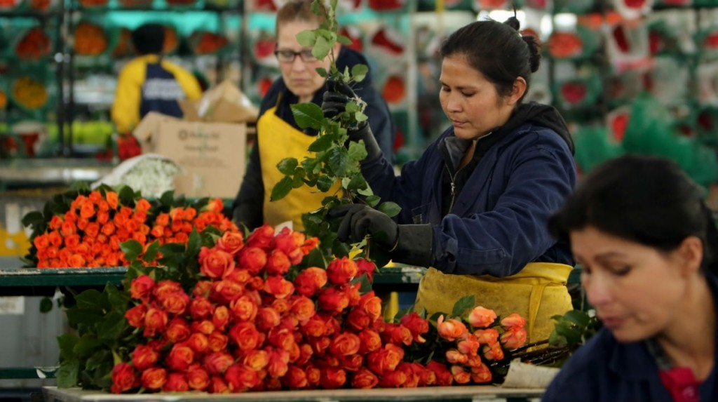

Slide 8
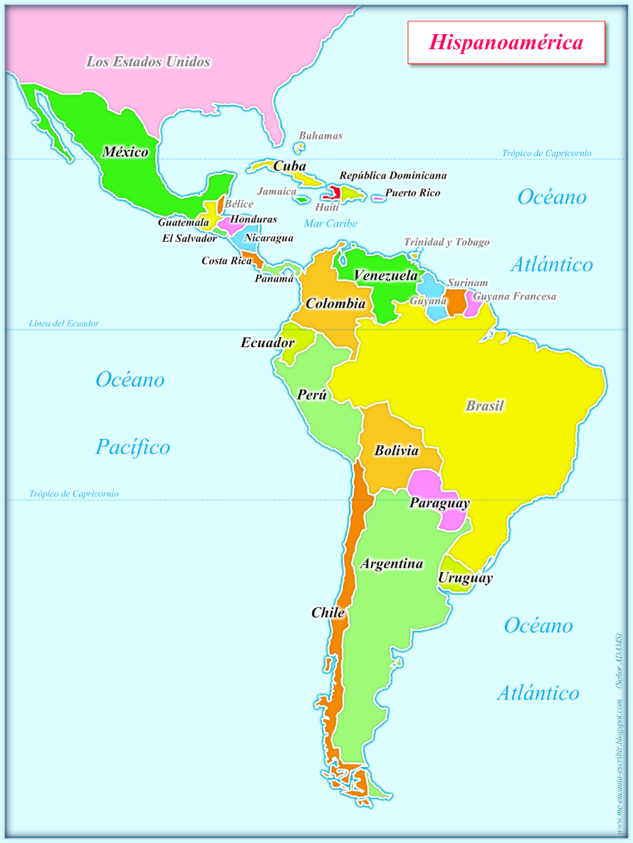
What in the world are people eating?

Slide 9
grains

Slide 10
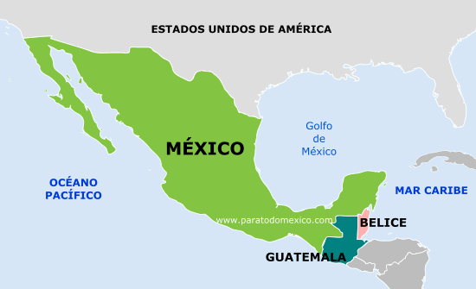
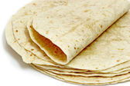
Mexico, Guatemala, Salvador
TORTILLA

Slide 11
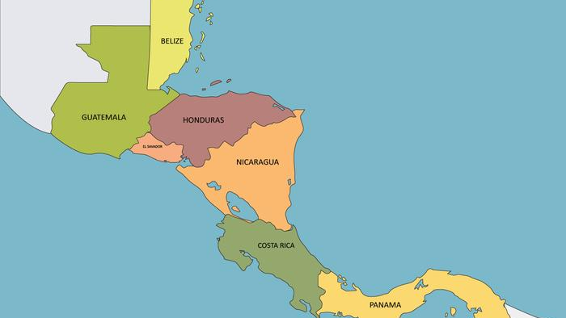
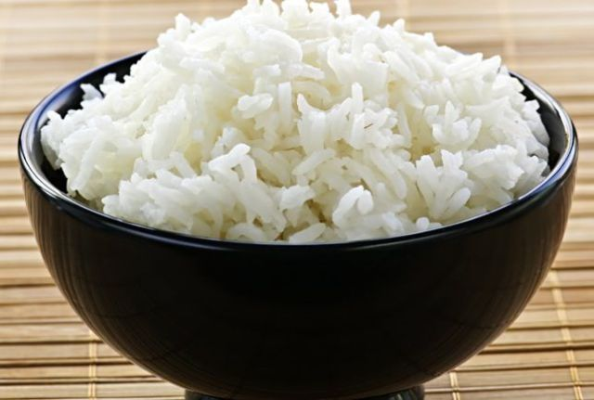
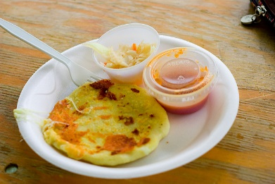
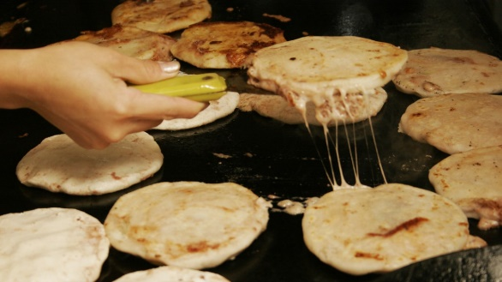
Rice
Pupusas

Slide 12
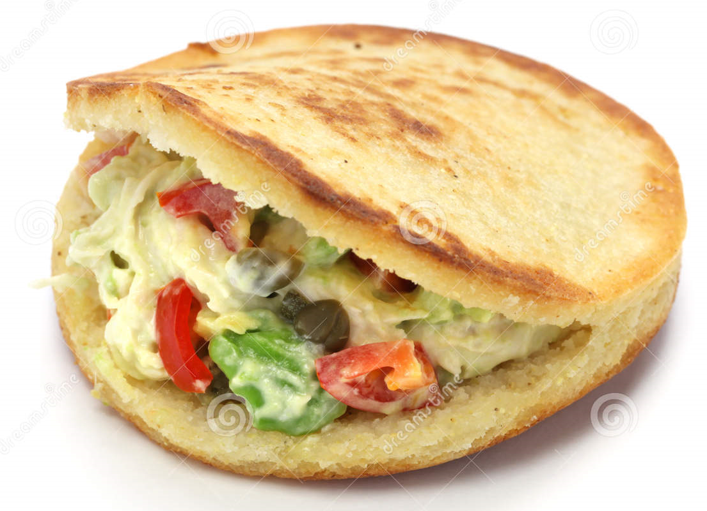
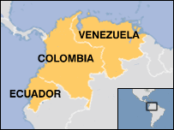
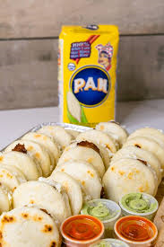
AREPAS
Rice

Slide 13
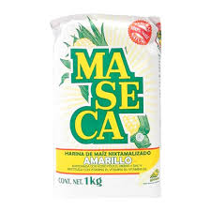
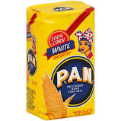
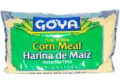

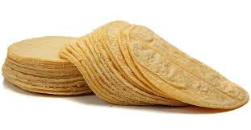
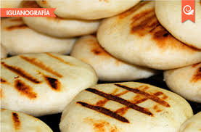
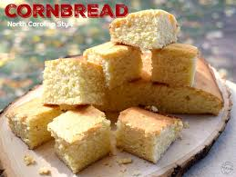
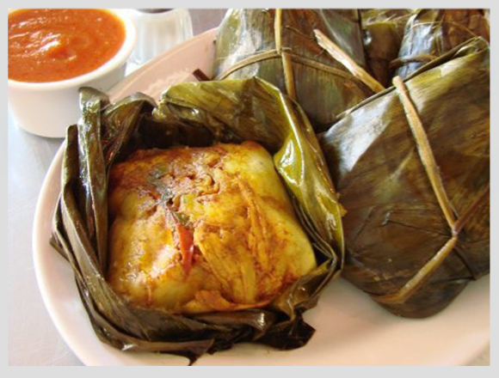
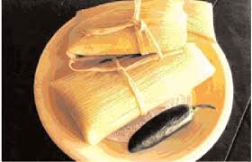
Arepas y Tamales
Tortillas y tamales

Slide 14
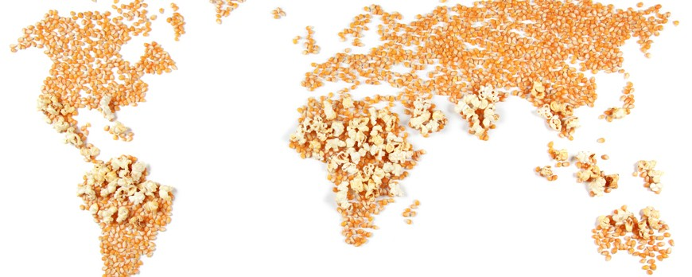

Slide 15


Slide 16



Slide 17
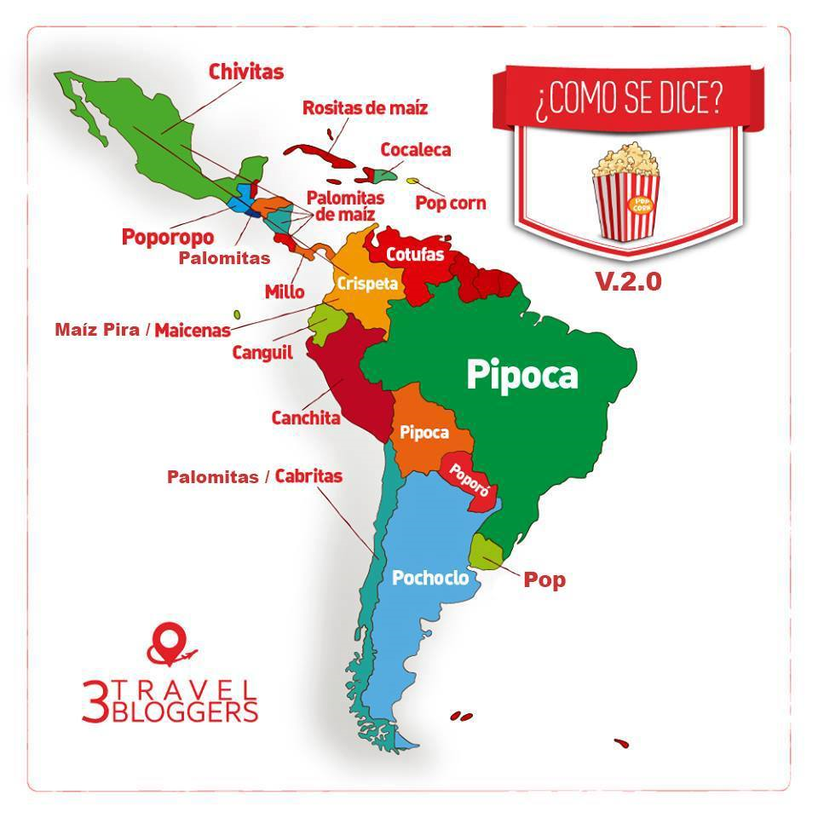
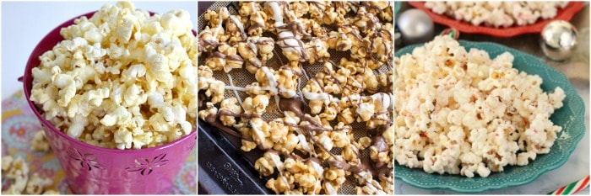
Any where, any name, any flavor..
World love Pop Corn

Slide 18

vegetables

Slide 19
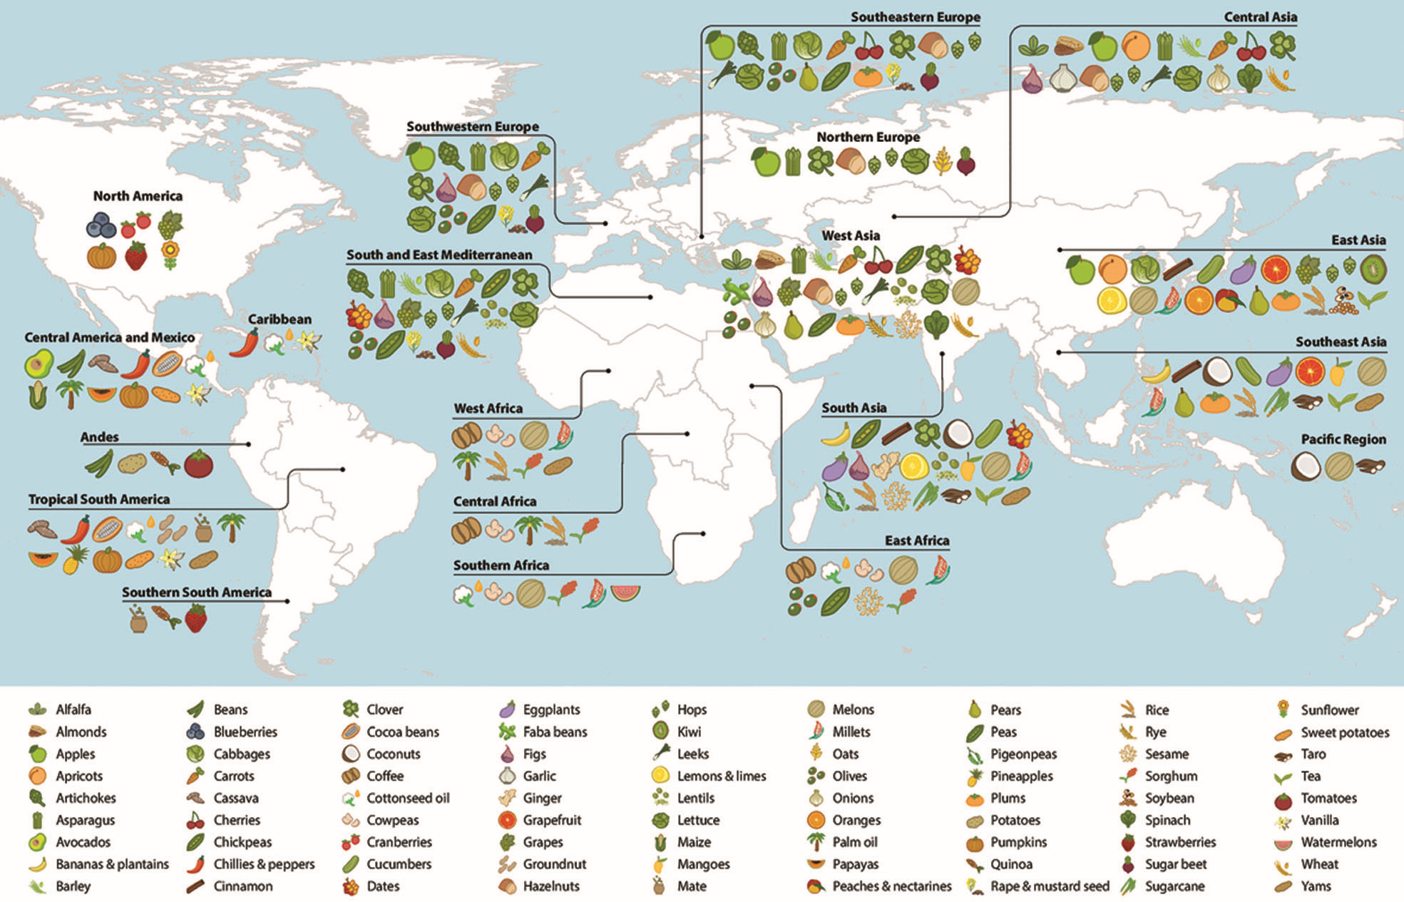
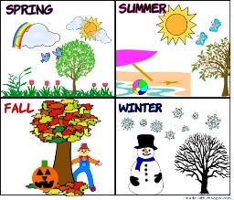
TROPICAL WEATHER

Slide 20
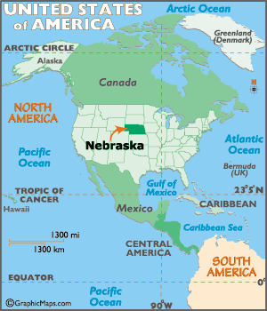
CORN!

Slide 21

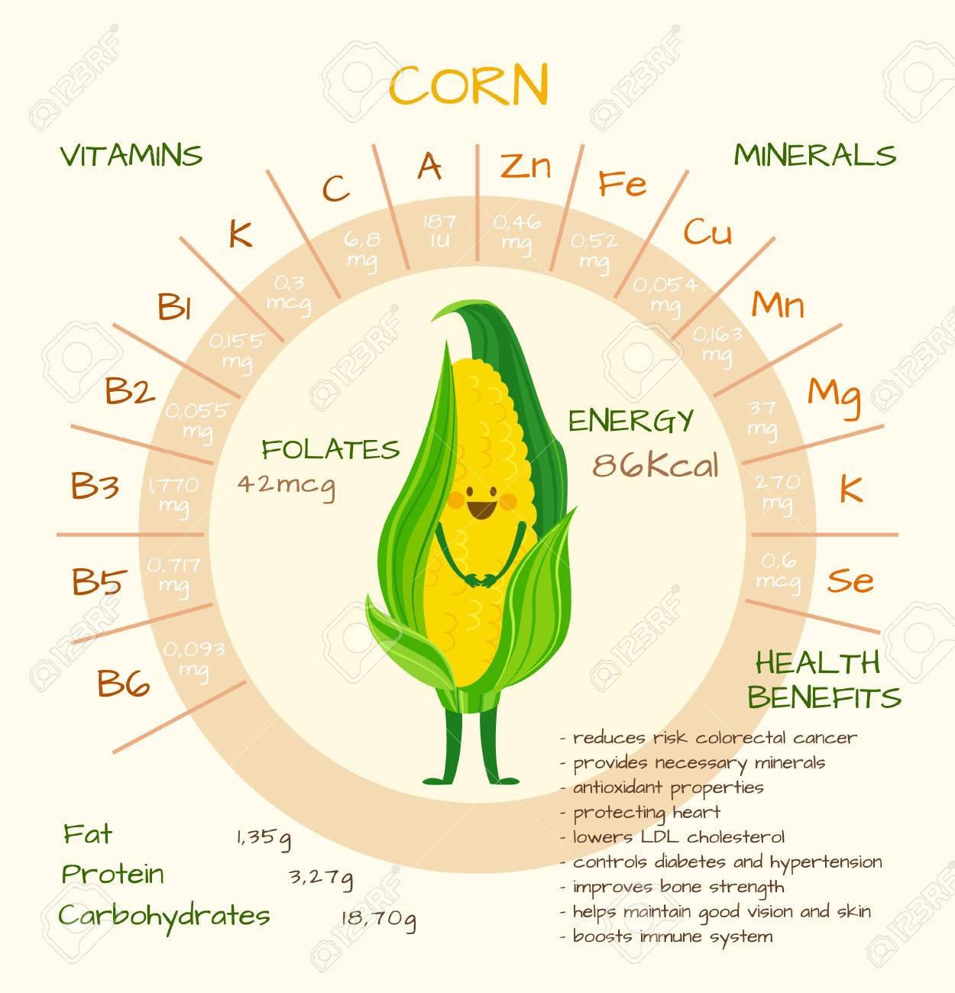

Slide 22
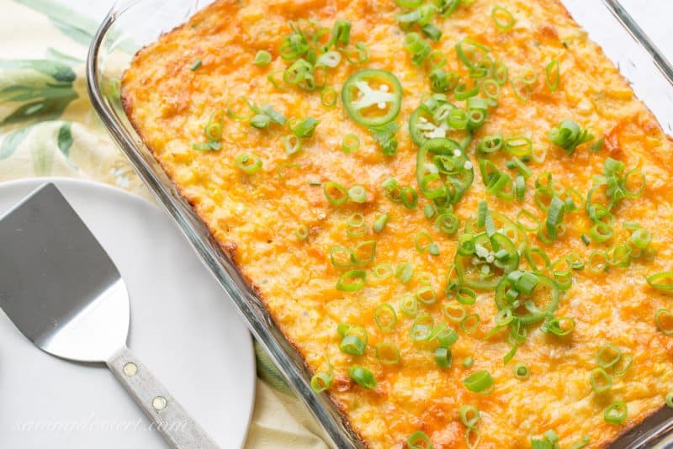
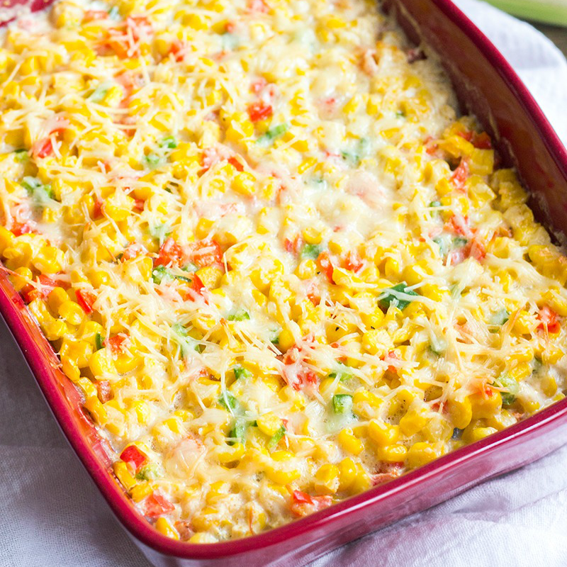

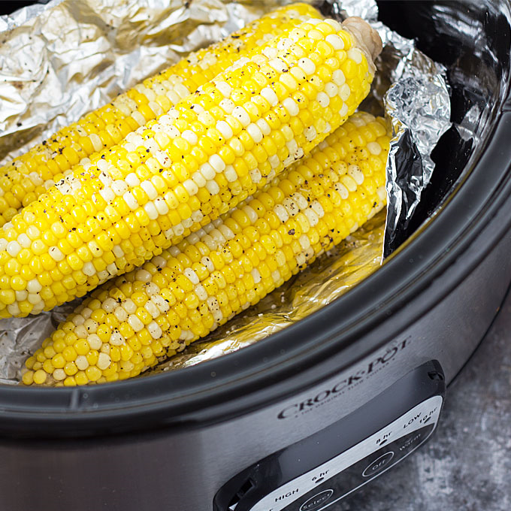
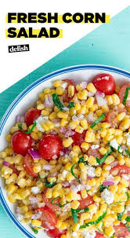
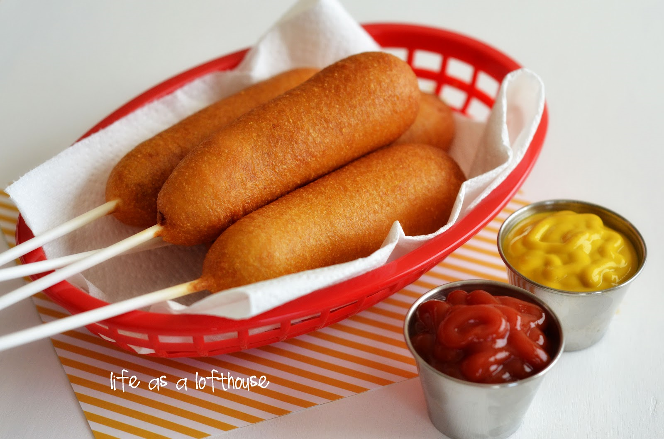
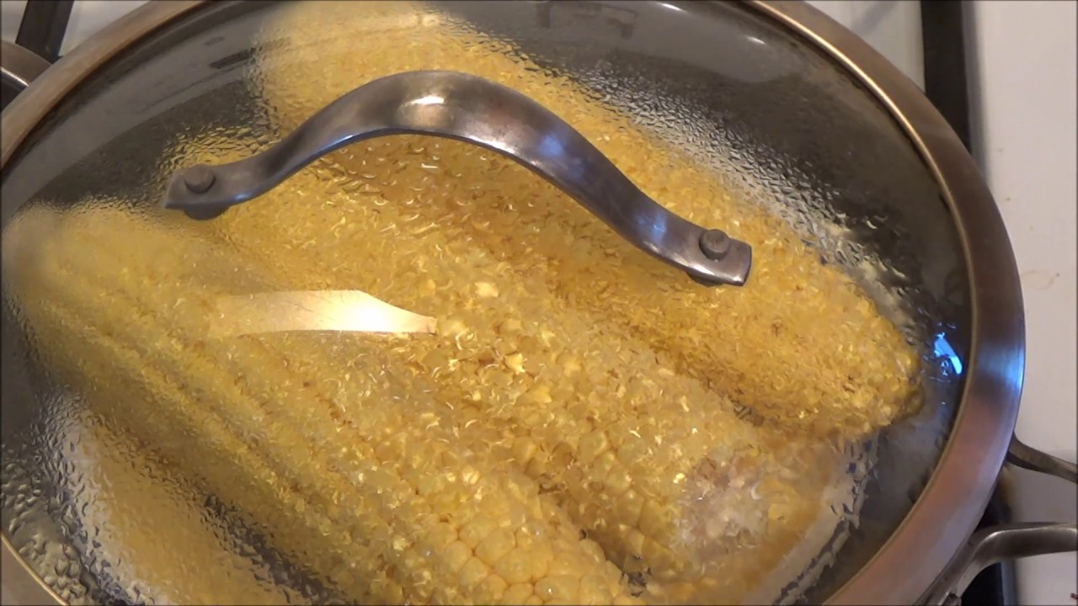
American style…☺
CASSEROLE DISHES

Slide 23
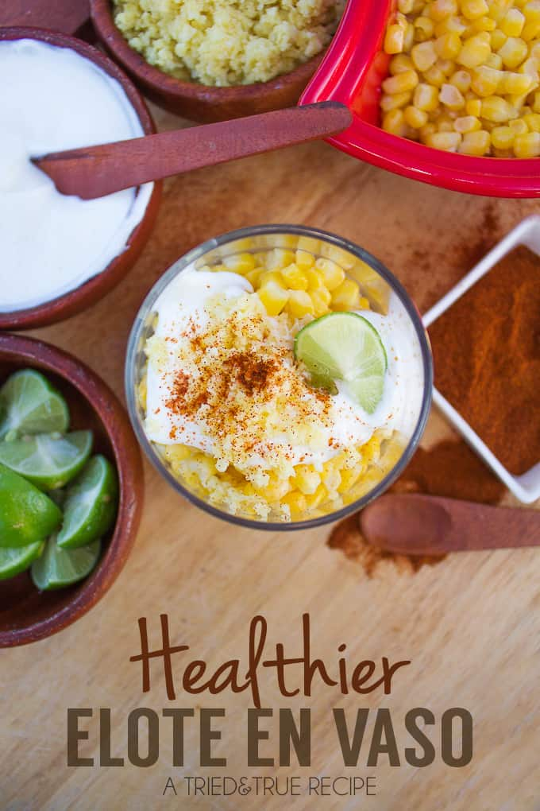
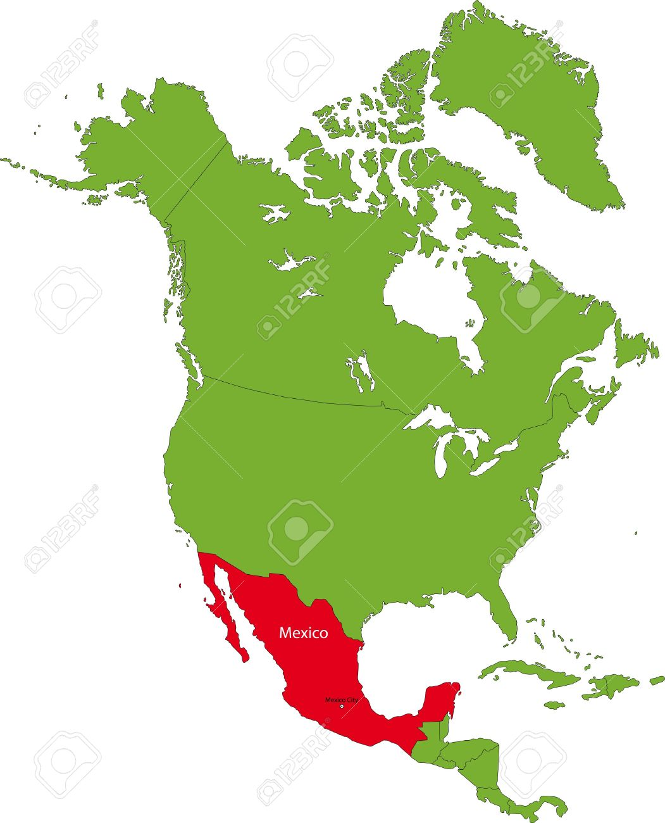
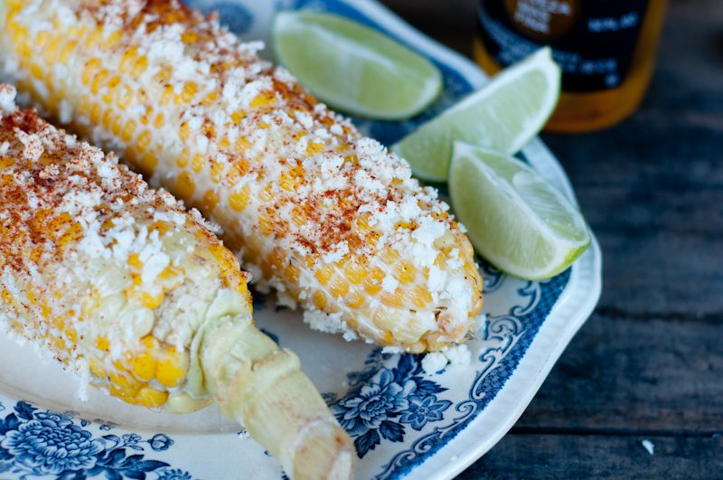
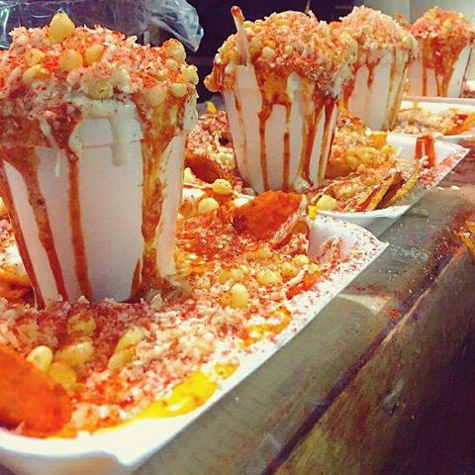
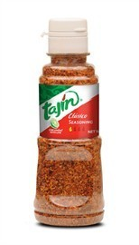
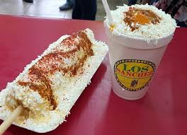
MEXICO
Mayo+ Cheese + TAJIN+ Limon

Slide 24
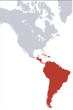
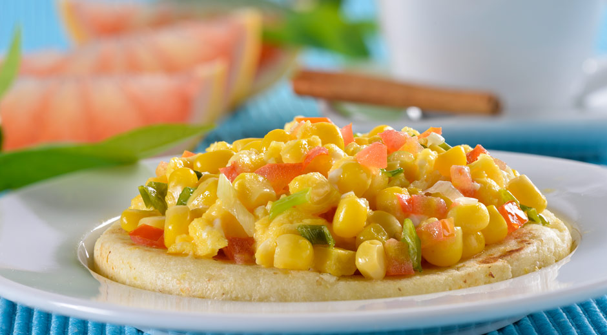
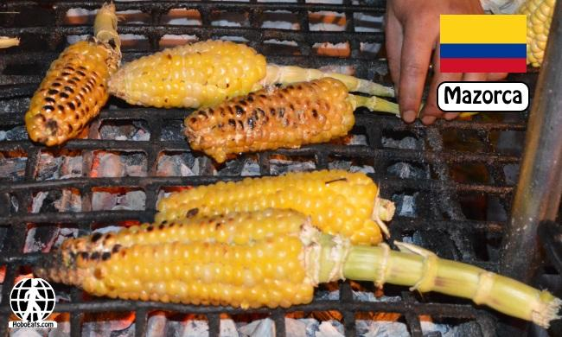
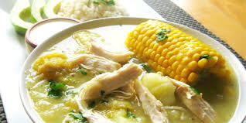
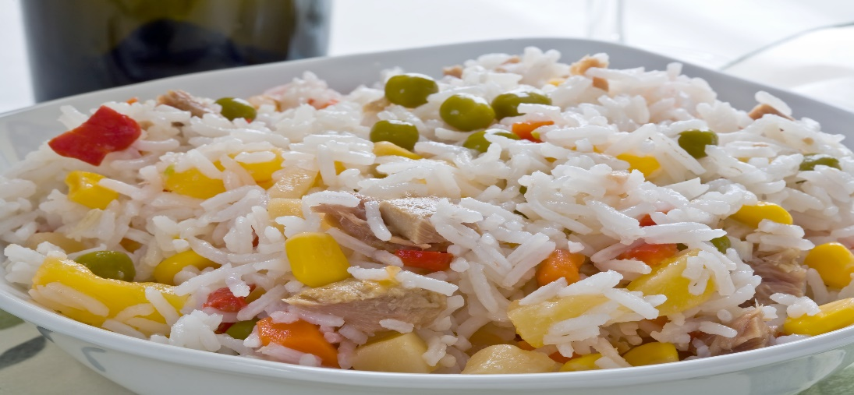
CORN WITH SCRABLE EGGS + AREPA
GRILLED +SALT+BUTTER !
SOUPS
CORN WITH SCRABLE EGGS + AREPA

Slide 25





Slide 26



HOT SALSAS
FRESH
DRY

Slide 27




YUCA-CASSAVA

Slide 28



Slide 29



Puerto Rico
CUBA

Slide 30





Slide 31



PLANTAINS
GREEN PLANTAIN
YELLOW PLANTAIN

Slide 32


SALTHY-HARD
SWEET-SOFT

Slide 33



Slide 34


Slide 35






CHAYOTE

Slide 36










STEAMED
GRILLED

Slide 37



Slide 38

FRUITS

Slide 39


Slide 40







Slide 41


Slide 42



Passion fruit

Slide 43




Slide 44


Slide 45




Slide 46





Slide 47







Slide 48









Slide 49






SALPICON

Slide 50



WOMEN AG AROUND THE WORLD

Slide 51



