Slide 1
Understanding Soil Health and the impacts on Soil Function by Dual Purpose Cover Crops
By Aaron Hird, State Soil Health Specialist, Nebraska USDA/NRCS

Slide 2
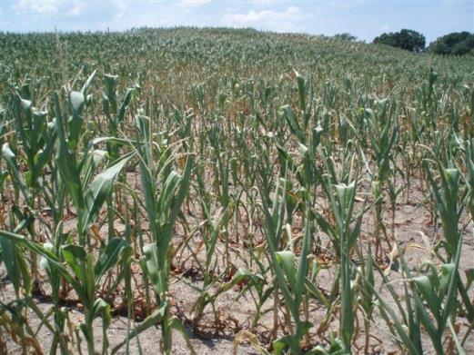
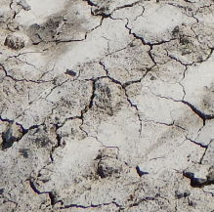
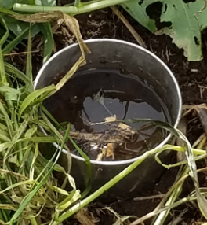
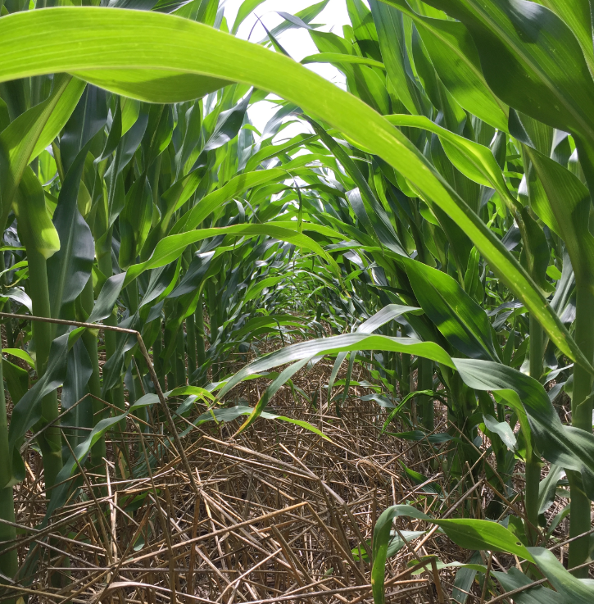
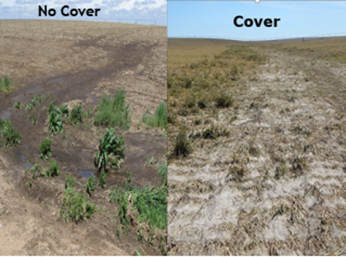
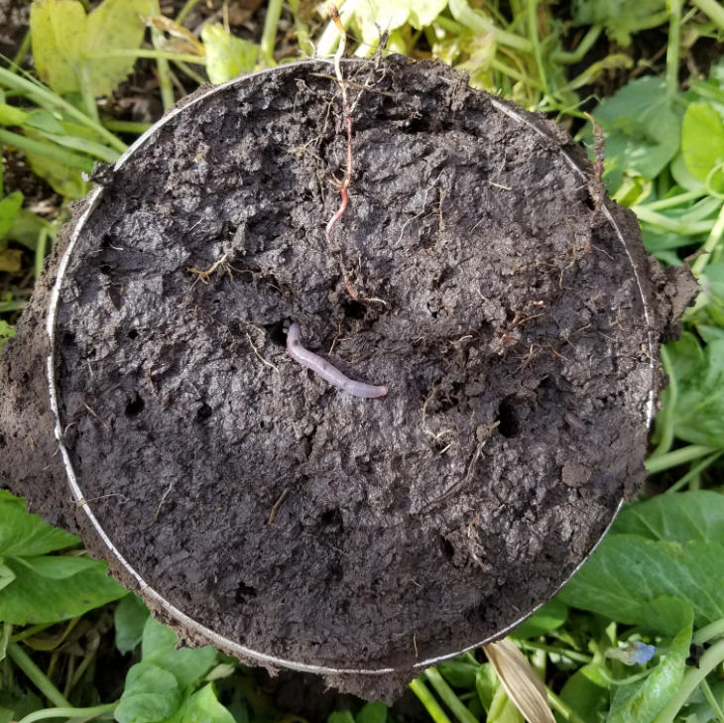
Weather Extremes
What do we have?
What do we need?
Resilient Soil

Slide 3
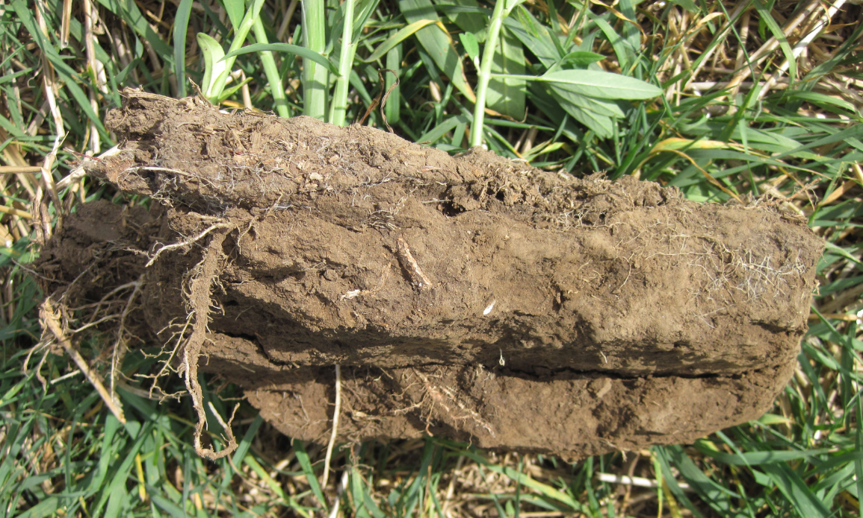
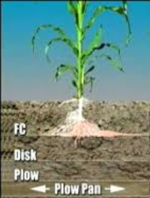
We also have Tillage Induced Restrictive Layers
greatplainsmfg.com

Slide 4
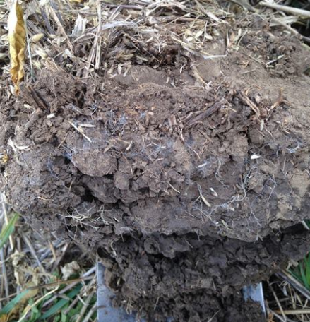
What is Soil Health?
The continued capacity of a soil to function as a vital, living ecosystem that sustains the soil, plants, animals and humans.
Soil function is the result of many physical and biological factors, when combined in different places and at different times yield different results. Collectively I call this Soil Health.
Notes:
This is evident when you look at the types of soil which have developed in two contrasting places like Eastern and Western Ne, or if you compare the productivity of similar soils located only 100 miles apart.

Slide 5
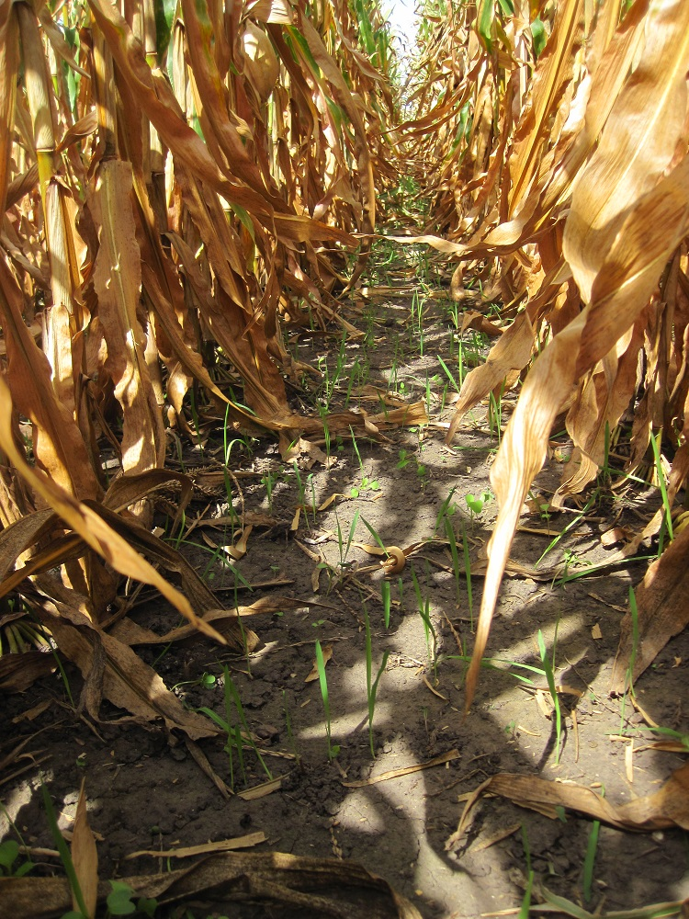
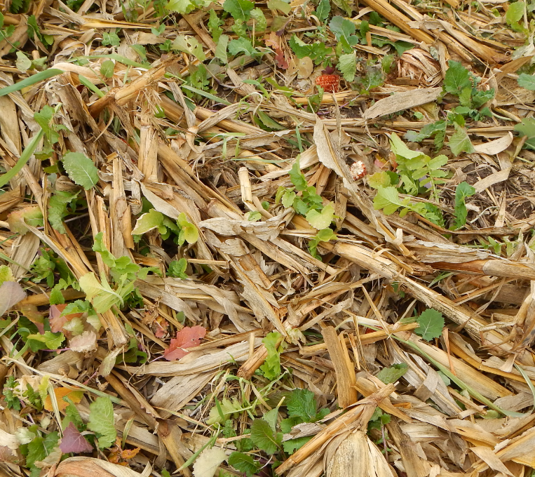
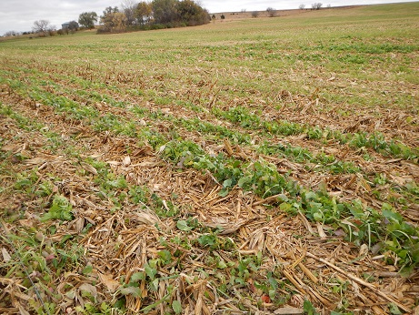
USDA/NRCS - 4 Soil Health Management Principals
1. Keep the soil covered
2. Disturb the soil less or not at all
3. Keep a living root in the soil 10 or more months
4. Allow for lots of plant and root diversity
Notes:
Key Points *:
*Instead of responding to prevent or stop “Bad” things, do something to cause “good” things!
*Learn from the natural system and utilize natural solutions.

Slide 6
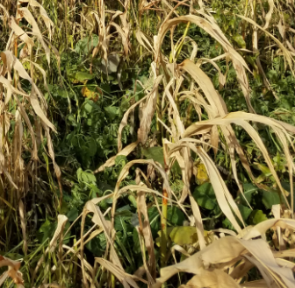
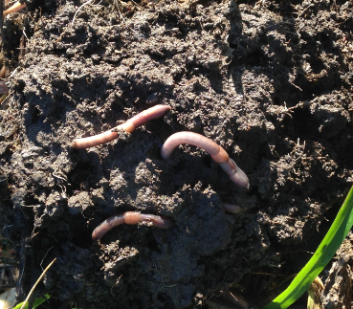
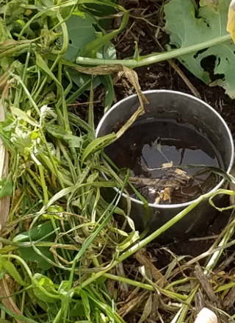
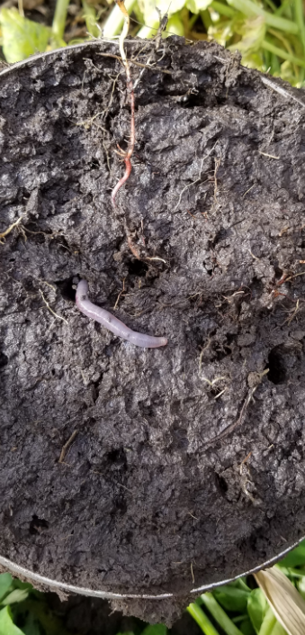
Is the Soil Healthy?
Soil Health is changed through time with Management Practices and Natural Processes.
Every Soil has Unique Physical Properties which set it’s potential. 5 Soil Forming Factors: Time, Aspect, Parent Material, Climate, Biology.
The functions of the soil are influenced by management which impacts Biology.
Supporting the biological activities can reduce or improve the Soils Function up to it’s potential.
Notes:
Just like in your body, by doing the right thing consistently, results accumulate!
These pictures show a soil slice from a continuous silage field. There were compaction layers every 2 inches like an accordion. This field had a 2% slope and had water erosion down every tire track. This is the first year of cover crops. I could see root growth resistance at each compaction layer but penetration did occur.
Next slide is the same field as these pictures.

Slide 7
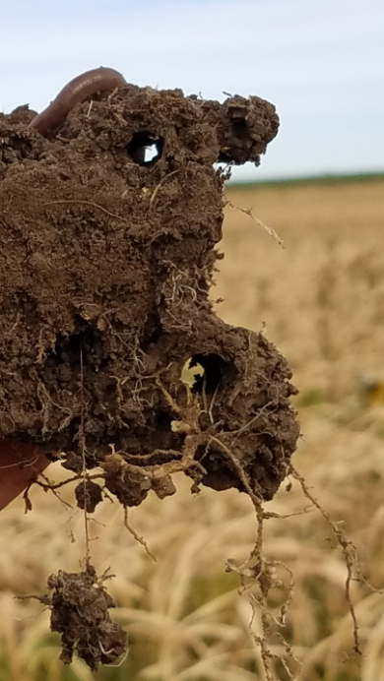
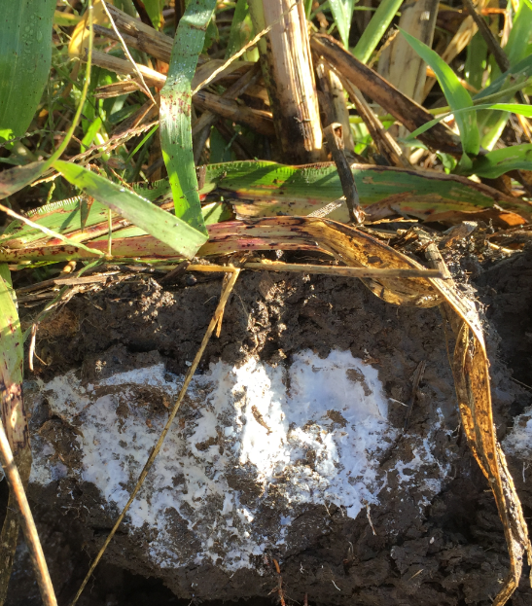
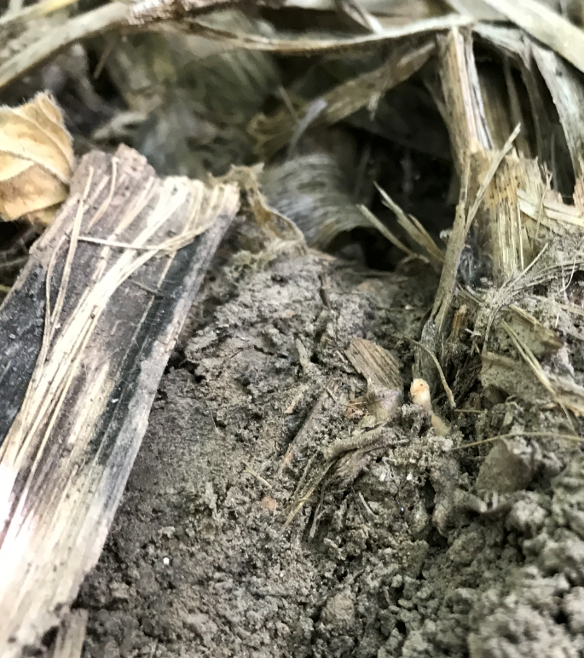
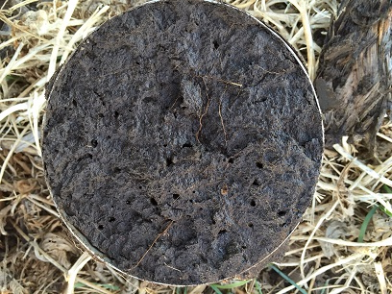
Soil Health based on Soil Properties
“Dynamic Soil Properties” or “Soil Health Indicators”
Soil Organic Matter – Humus, Water Storage/Filtering
Bulk Density – Compaction, Stability
Soil Structure – Horizons, Rooting, Water Infiltration, Aggregate Stability
Soil Fertility – Nutrient Cycling/Storage
Soil Biota – Food Web, Organism Diversity, Smell
Notes:
If you have high blood pressure and your heart is working too hard, you are not considered healthy.

Slide 8
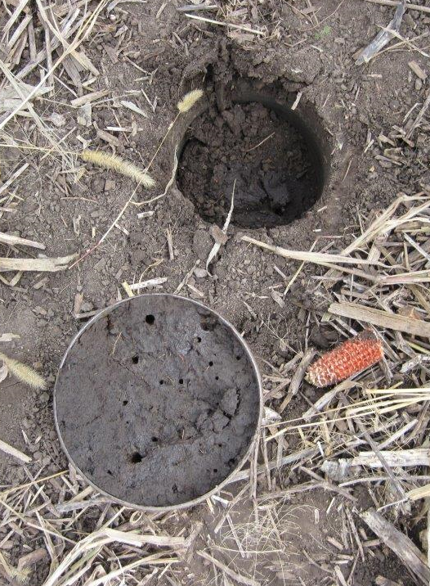
What Soil Functions do you Expect?
Nutrient Cycling
Water Infiltration, Storage & Supply
Physical Stability and Support
Water Filtering and Buffering
Resiliency to reduce Plant Stress & Disease
Biological Habitat
90% of all Soil Function is mediated by
biological activity in the soil.
Notes:
Creative planning and enterprise budgeting should be used to analyze your system for key opportunities in time and place.

Slide 9
Soil Resiliency is achieved by taking “Step #1” to care for the Soil’s Health.
10. Resilient, Functioning Soil

Slide 10
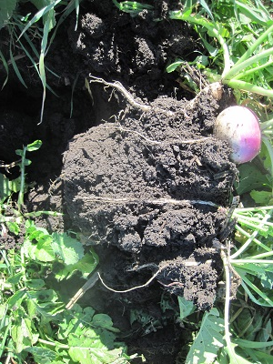
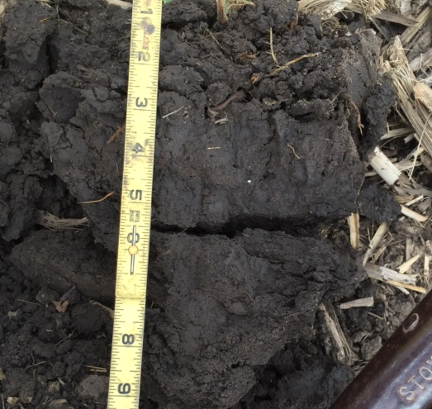
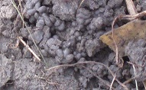
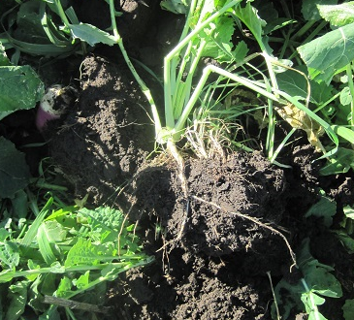
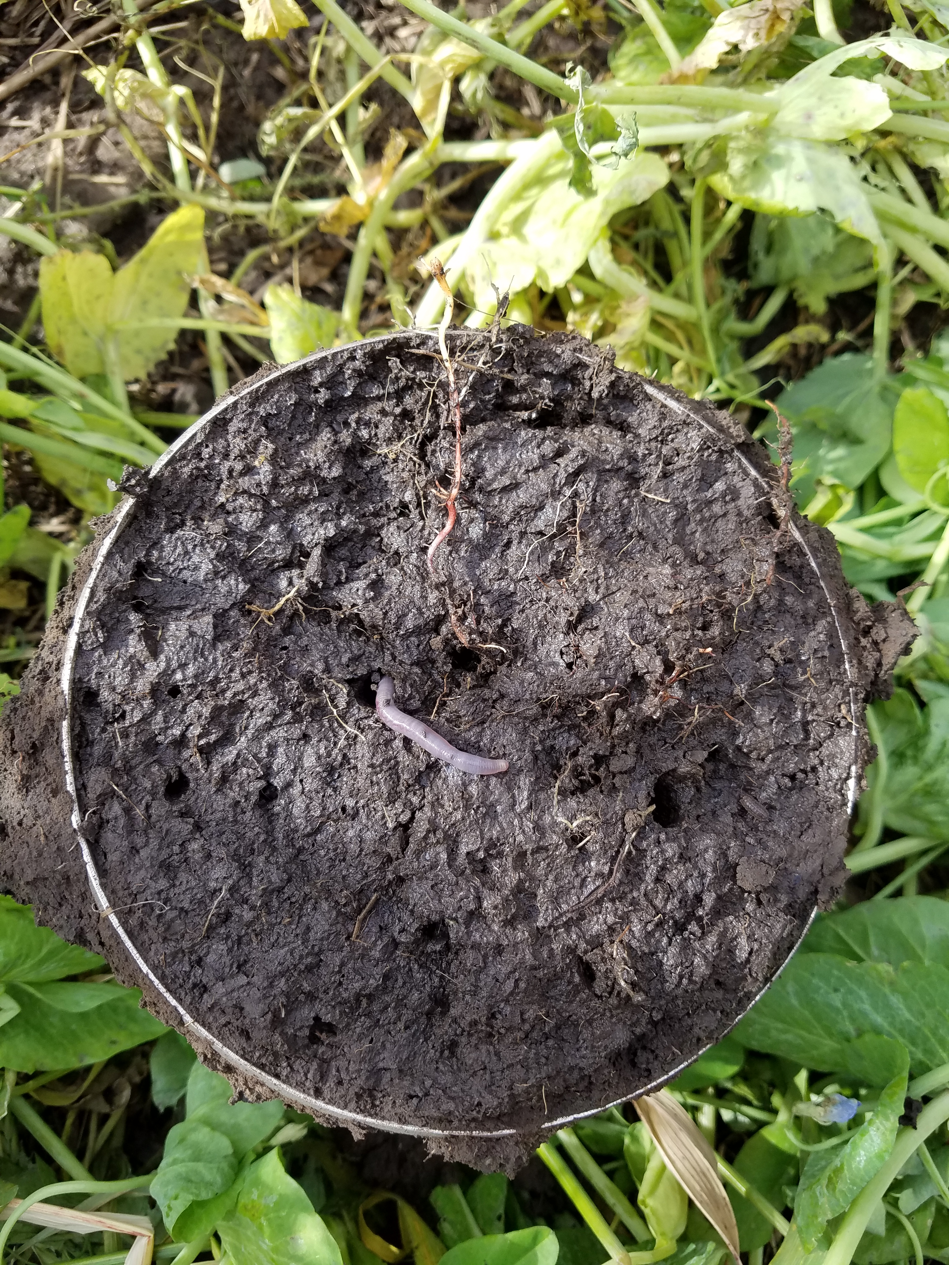
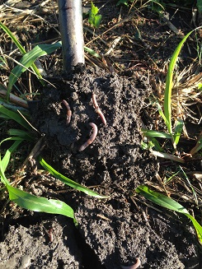
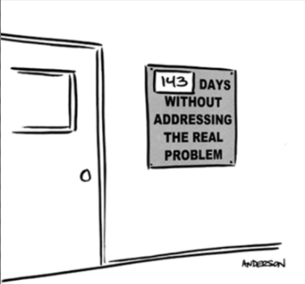
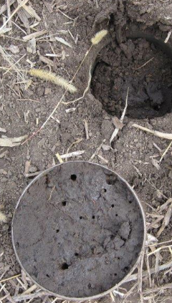
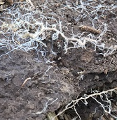
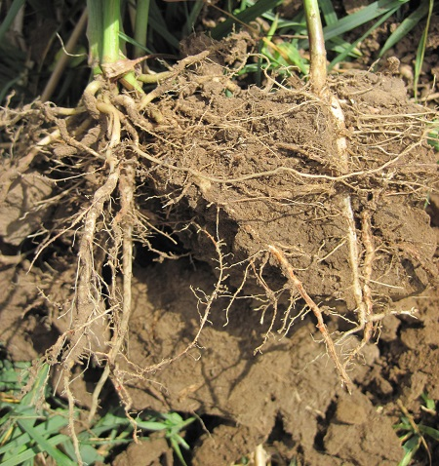
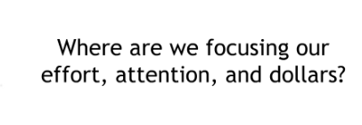
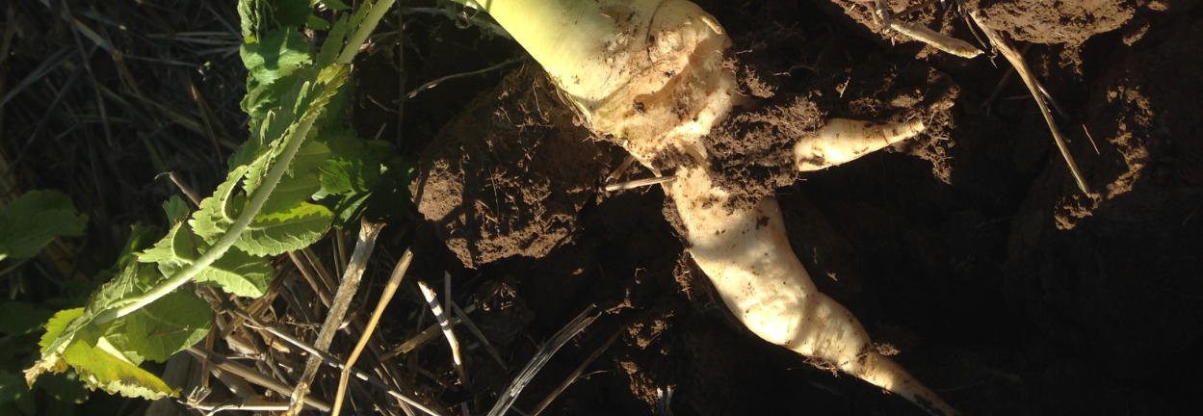
The Work of Cover Crops in the Soil!
Current Problem:
“Start where you are. Use what you have. Do what you can.” A.R. Asche Jr.
After Corn & Bean Harvest!
SOIL HEALTH!

Slide 11
Manage for the Biological Habitat, to form Wet Stable Aggregates, to increase water infiltration, drainage and aeration which builds Resilient Soil Organic Matter.

Slide 13
There is an Accumulation of Benefits! Compounding and Cascading Effects
Soil Health Management Planning involves residue management, No-Till, cover crops and other necessary structural conservation practices (Good Farming Practices)
There are Short Term Benefits of managing for Soil Health improvements. Ways to environmentally and monetarily capitalize in the short term.
Scavenging residual nitrogen, fixing nitrogen, stabilizing the top soil (preventing erosion), stabilizing crop residue, composting crop residue, and providing animal forage.
There are Long Term Benefits of managing for Soil Health improvements. These benefits accumulate over time and provide bigger environmental and monetary results.
Building Soil Organic Matter, Soil Stability, Soil Aggregation, Decreasing Bulk Density, Increasing Water Infiltration Rates, Supporting Soil Biology, and Building/Regenerating Top Soil.
Notes:
There are so many concerns or problems cover crops potentially address. Use the cover crop tool to fix the specific set of issues you have. Find out how it works for you.

Slide 14
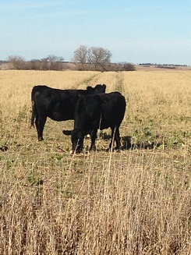
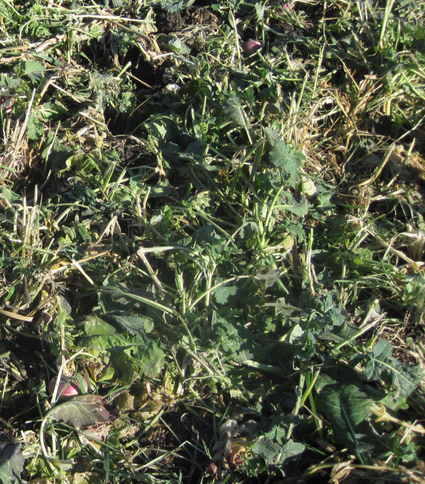
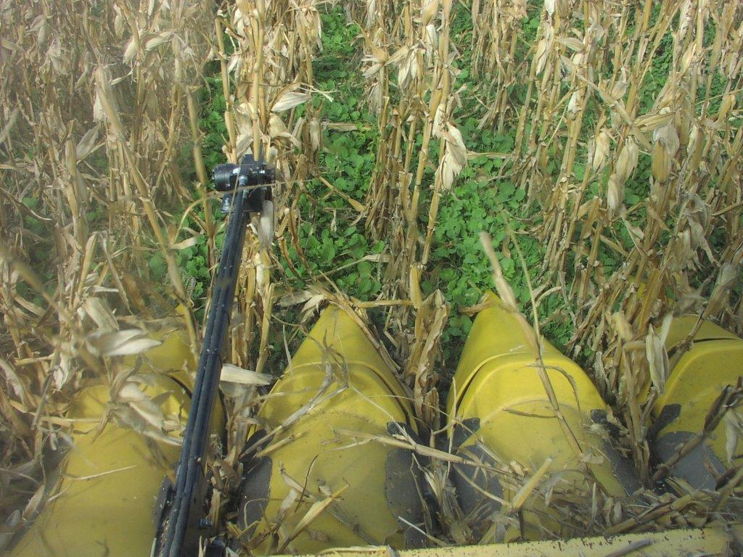
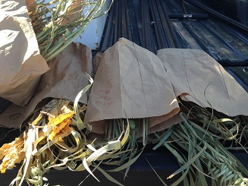
A Dual Purpose Cover Crop; Forage/Cover
Cover Crops require an upfront capital investment of time and money.
Grazing offers the quickest return on the investment, short term.
Cover Crops do pay for themselves over time with their benefits. If We Let Them Work!
Seeding Date; Diversity of the mix; Winter Hardy vs Frost Kill; Residue/Grazing Management.
Grazing cover crops offers a different opportunity to improve soil health!
Over grazing is robbing Peter to pay Paul. Its almost as bad as tillage.
Cover crop below ground and above ground biomass can regrow after grazing.
You must create a grazing plan and establish stocking rates.
Notes:
Cover crop aerial planted in popcorn. Forage Production Sampling to set a stocking rate. Kind and class of animal and timing matter. Grazing management is Key.

Slide 15
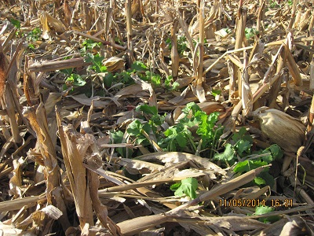
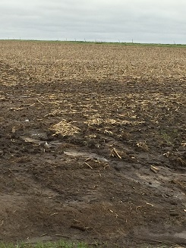
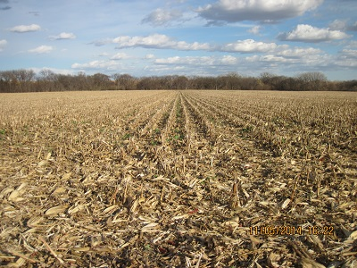
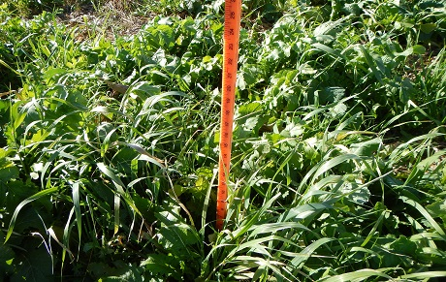
Stocking Rates and Grazing Heights
Supplement for Fall Grazing With Winter Hardy Insurance for Spring Growth
No Cover Crop
~50lbs/ac
Lots of Cover
Crop
16lbs of stalks & shucks/BU Corn avail. @ 50% Use = ~2 AUM/Ac
~1500#/ac
Notes:
220 bu corn = 3520/.50 and 1 cow eats 990 pounds per month. So that’s 1.7 cows per acre per month. Add any green cover crop and it increase utilization of stalks and adds dry matter.

Slide 16
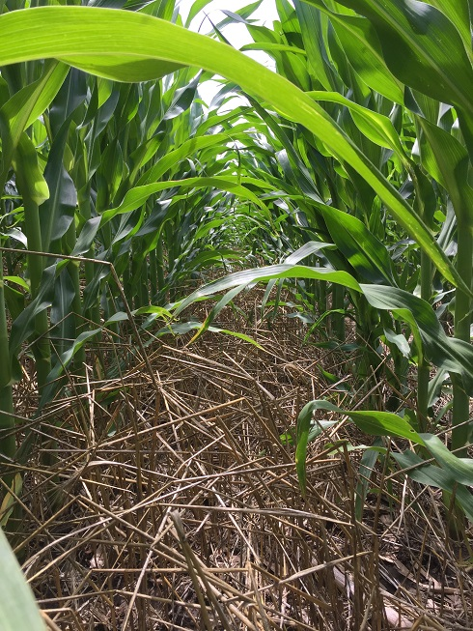
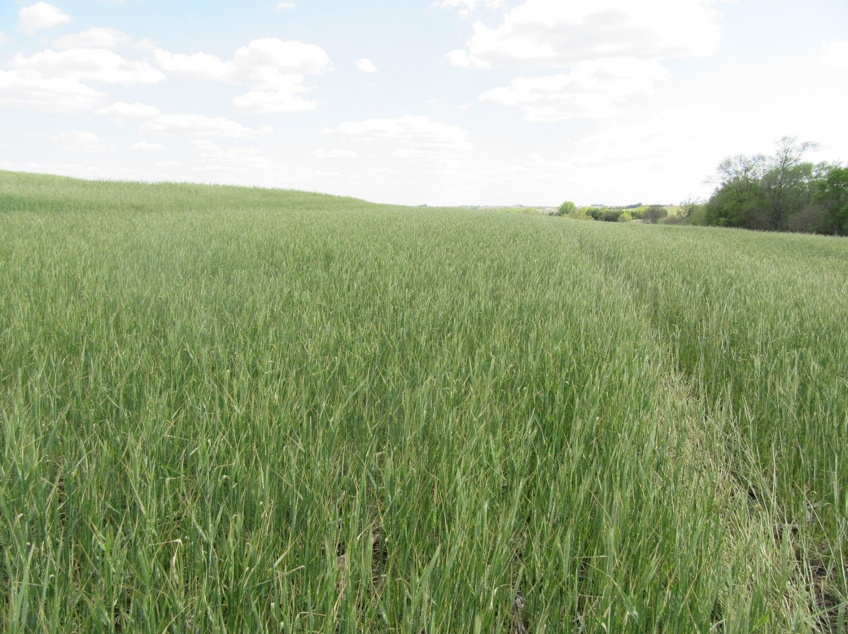
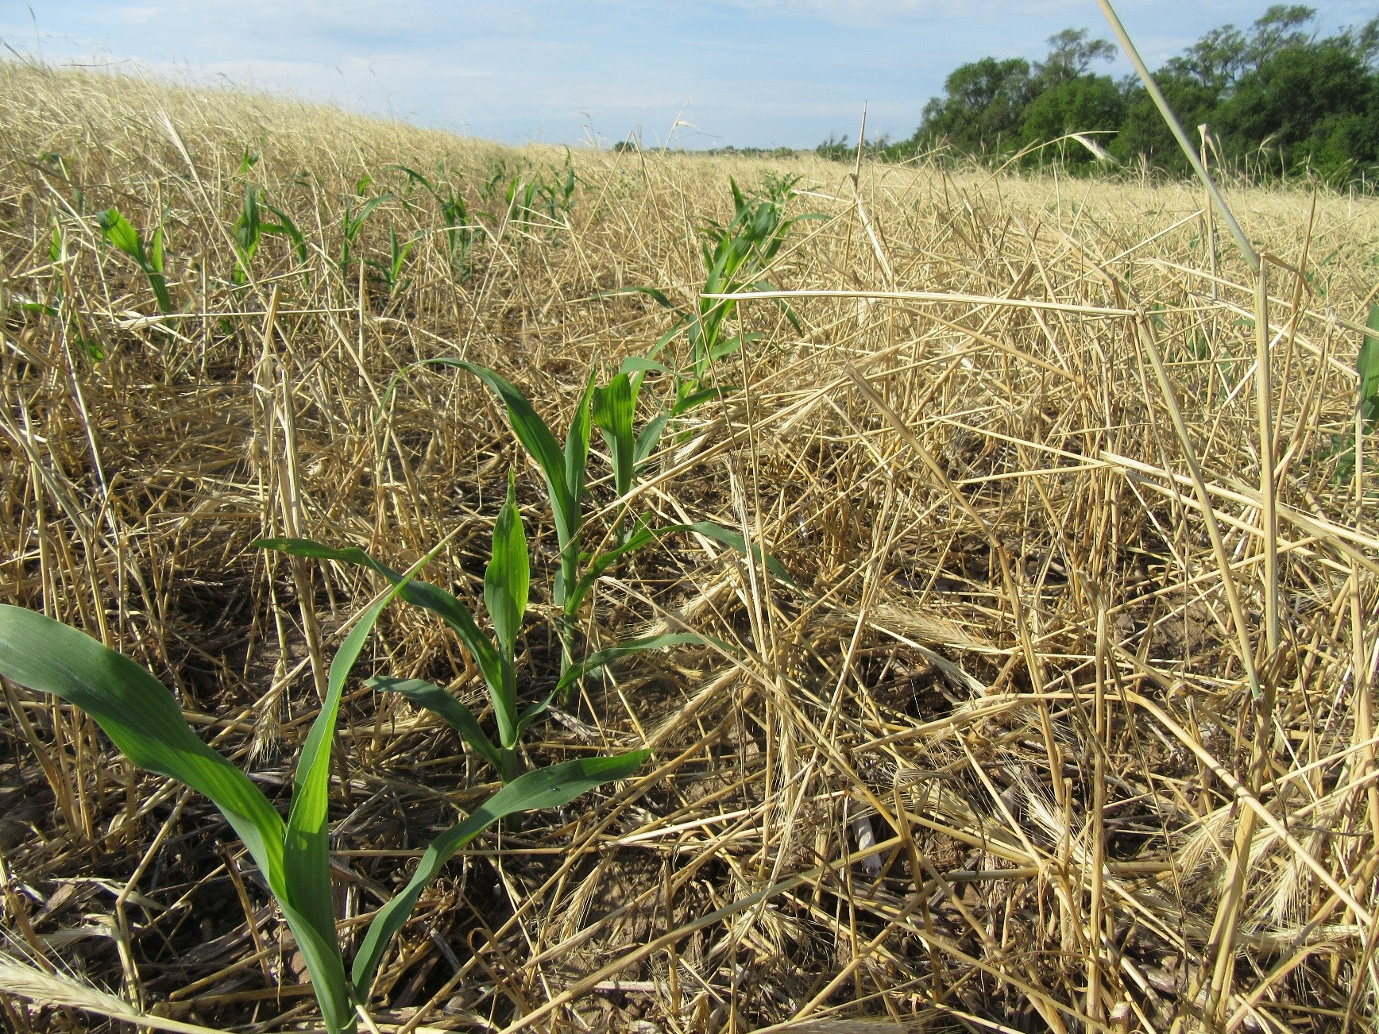
Alleviate Risk during the Learning Curve
The USDA/NRCS is offering incentives for you to use cover crops which reduce the financial risk during your “Start Up” years
EQIP – up to 3 years of 50% cost share to apply cover crops within your crop system
CSP – 5 years of Stewardship Payments providing cost share for applying cover crops in your cropping system.
CTA – Advice and Cover Crop Mix Designs
June 30, 2017
May 1, 2017
June 5, 2017

Slide 17
The Nebraska NRCS Soil Health Initiative
Partnerships remain our central focus.
Geographically distributing key outreach and educational resources
Partner with Key land owners to establish distributed demonstration farm fields
Developing skilled employees with knowledge and tools to provide service locally.
The Goals of the Demonstration Farms
Focus on outreach, education, training and partnership opportunities
Provide a local source of information to answer common questions
Validate Soil Health Management Systems locally via field days & publications.
Facilitate the demonstration of 4 Key Soil Health Principals
5 year EQIP contracts to implement Soil Health comparison cover crop treatments

Slide 18
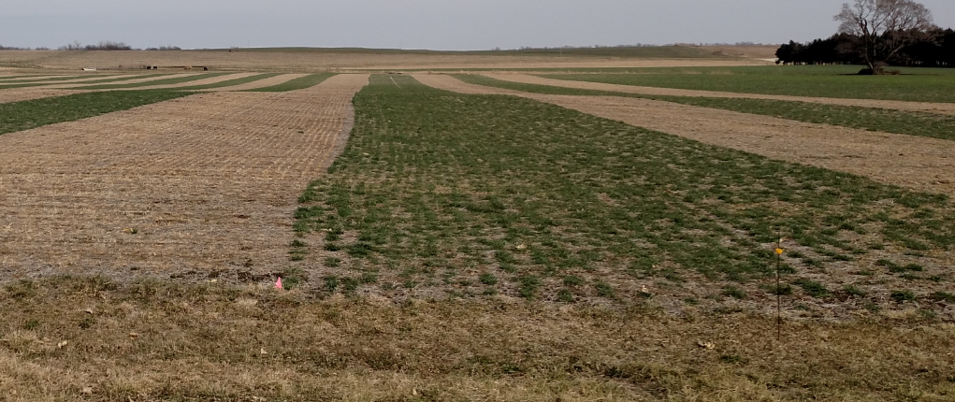
Demonstration Farms
A 5 year, field scale, comparison of two Cover Crop Adaptive Management Activities
A system comparison throughout an expanded crop rotation
Randomized and Replicated Plots
Soil Health Assessments, Soil Lab Reports and Economic evaluations will be measured

Slide 20
In Field Comparisons
Cover Crop Vs No Cover Crop (5)
Monoculture Cover Crop vs Multispecies Cover Crop (1)
Grazed Vs Not Grazed (3)
Drilled Vs Broadcast (2)
Nitrogen Study, When and How Much from the Cover Crop(1)
Cover crop Mix comparisons (4)
Early Termination vs Late Termination (1)
Frost Terminated Crop vs Winter Hardy Cover Crop (1)
Companion Cover Crop vs Dormant Seeded Cover Crop (1)
High Carbon Cover Crop vs Low Carbon Cover Crop (2)
All Farms are collecting Economic Data - 2016-17 Results

Slide 21
17 In Field Projects – 21 comparisons
Cover Crop Vs No Cover Crop (5)
Cover crop Mix comparisons (4)
Grazed Vs Not Grazed (3)
Drilled Vs Broadcast (2)
High Carbon Cover Crop vs Low Carbon Cover Crop (2)
Nitrogen Study, When and How Much from the Cover Crop(1)
Early Termination vs Late Termination (1)
Frost Terminated Cover Crop vs Winter Hardy Cover Crop (1)
Companion Cover Crop vs Dormant Seeded Cover Crop (1)
Monoculture Cover Crop vs Multispecies Cover Crop (1)
All Farms are collecting Economic Data - 2016-18 Results

Slide 22
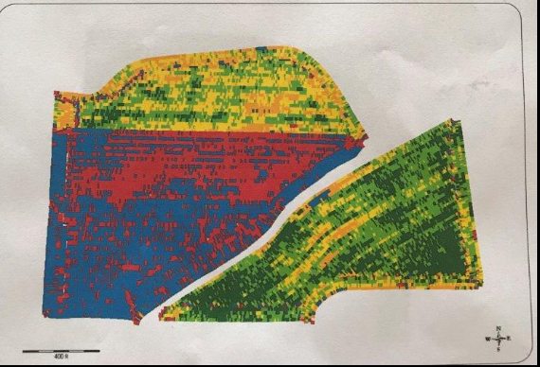
2018 Soybeans Following Winter Killed Cover Crop vs Winter Hardy Cover Crop Nemaha County – Daryl Obermeyer – in Partnership with the University of Nebraska – Lincoln, Field 1A On Farm Research Network
Soil Type: Judson silt loam 0-2% slope; Judson silt loam 2-6% slopes
Planting Date: 5/7/18
Harvest Date: 9/17/18
Cover crop planted after harvest
Row Spacing (in): 15
Hybrid: Pioneer 24T19R
Reps: 4
Previous Crop: Corn
Tillage: No-Till
Herbicides:6 oz/ac Sonic®, 16 oz/ac generic Dual, 16 oz/ac 2,4-D 6#, 8 oz/ac Absorb 100, and 16 oz/ac Buccaneer 5 Extra® on 4/17/18 Post: 16 oz/ac Shafen Star, 8 oz/ac Clethodim 2EC, 32 oz/ac Buccaneer 5 Extra®, 8 oz/ac Absorb 100, and 4 oz/ac N-Tense on 6/16/18
Foliar Insecticides: 3.84 oz/ac Lambda-Cy 1 EC aerial applied on 7/26/18
Foliar Fungicides: 10.5 oz/ac Azoxyprop Xtra aerial applied on 7/26/18
Fertilizer: 1 gal/ac Kugler KS2075 (20% N, 7.5% P, 5% S) aerial applied on 7/26/18
Irrigation: None – Note: Drought conditions prevailed in Aug. & Sept.
1A
1B
1C
2

Slide 23
Soybeans Following Winter Killed Cover Crop vs Winter Hardy Cover Crop Nemaha County – Daryl Obermeyer – in Partnership with the University of Nebraska – Lincoln, On Farm Research Network
Field 1A | ----------------------------2017 Corn------------------------------ |  |  |  |  | --------------------------2018 Soybeans--------------------------
Cover Crop Treatment | Stand Count (plants/ac) | Test Weight | Moisture (%) | Yield† (bu/ac) | Marginal Net Return‡ ($/ac) | Stand Count (plants/ac) | Test Weight | Moisture (%) | Yield† (bu/ac) | Marginal Net Return‡ ($/ac)
Winter Terminated | 30,355 A* | 54 A | 18.0 B | 183 A | 546.97 A | 120,744 A* | 56 B | 11.3 A | 65 A | 452.80 A
Winter Hardy | 30,023 A | 52 B | 19.1 A | 168 B | 498.00 B | 120,246 A | 56 A | 11.2 A | 59 B | 410.75 B
P-Value | 0.802 | 0.021 | 0.003 | 0.0003 | 0.0003 | 0.872 | 0.096 | 0.200 | 0.002 | 0.002
In 2018, soybeans planted after winter terminated cover crops had a higher yield, lower test weight, and higher net return than the winter hardy cover crops. There were visible differences between the winter terminated and winter hardy cover crops, with the winter terminated having a darker green appearance longer.

Slide 24
https://cropwatch.unl.edu/on-farm-research

Slide 25
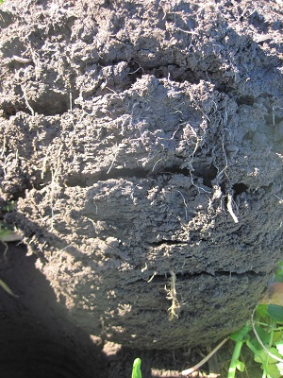
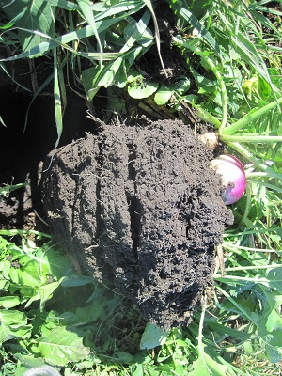
Final Thoughts
The “work” for Soil Health needed in Nebraska is between 4 & 8 inches underground. Dig a hole and check it out.
Will you start growing and building your Soil?

Slide 26
In accordance with Federal civil rights law and U.S. Department of Agriculture (USDA) civil rights regulations and policies, the USDA, its Agencies, offices, and employees, and institutions participating in or administering USDA programs are prohibited from discriminating based on race, color, national origin, religion, sex, gender identity (including gender expression), sexual orientation, disability, age, marital status, family/parental status, income derived from a public assistance program, political beliefs, or reprisal or retaliation for prior civil rights activity, in any program or activity conducted or funded by USDA (not all bases apply to all programs). Remedies and complaint filing deadlines vary by program or incident.
Persons with disabilities who require alternative means of communication for program information (e.g., Braille, large print, audiotape, American Sign Language, etc.) should contact the responsible Agency or USDA’s TARGET Center at (202) 720-2600 (voice and TTY) or contact USDA through the Federal Relay Service at (800) 877-8339. Additionally, program information may be made available in languages other than English.
To file a program discrimination complaint, complete the USDA Program Discrimination Complaint Form, AD-3027, found online at How to File a Program Discrimination Complaint and at any USDA office or write a letter addressed to USDA and provide in the letter all of the information requested in the form. To request a copy of the complaint form, call
(866) 632-9992. Submit your completed form or letter to USDA by:
(1) mail: U.S. Department of Agriculture
Office of the Assistant Secretary for Civil Rights
1400 Independence Avenue, SW
Washington, D.C. 20250-9410;
(2) fax: (202) 690-7442; or
(3) email: program.intake@usda.gov.
USDA is an equal opportunity provider, employer, and lender.

Slide 27
Contact Info
Aaron Hird, State Soil Health Specialist, USDA/NRCS
100 Centennial Mall North, Room 152, Lincoln, NE 68508
1-402-437-4053
Aaron.Hird@ne.usda.gov
www.nrcs.usda.gov/clientgateway Customer Service Client Gateway – Sign Up Today!

