Slide 1


UNDERSTANDING ENTERPRISE Budgets
And Your breakeven
Notes:
Let’s start with a Kahoot: https://create.kahoot.it/k/5c33d183-f9d0-45dc-a106-445b2adbcbab PIN 931073

Slide 2
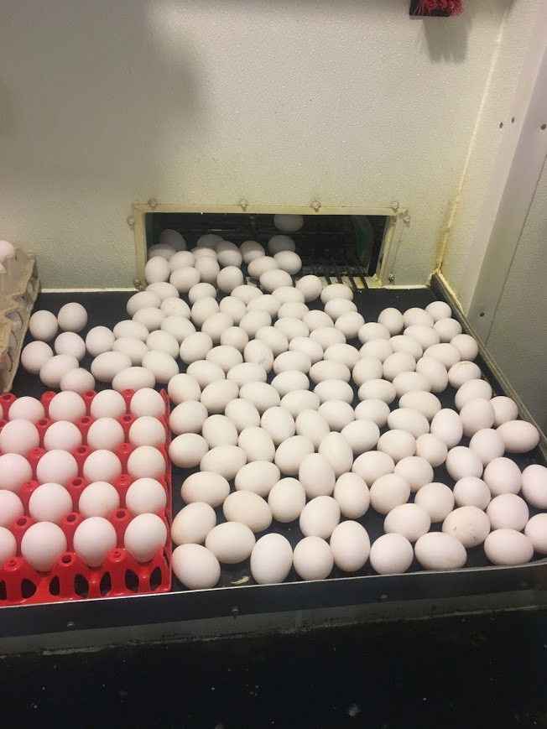

Woohoo, it’s Friday
Oh wait,
I’m a Farmer!
Notes:
Provide Background - Farm Wife / Business Partner # of things in my career - Early on Farm Business Specialist with the NE Farm Business Assoc. Taught agri-business at SCC Lots of small business assistance with planning, loans, marketing BACK at UNL as an Extension Educator and Farm & Ranch Management Specialist

Slide 3

WELCOME!
Session Agenda
Adjustments to Schedule F Accounting while getting to Real Net Farm Income: Joe and Jane Doe example
2. Enterprise Accounting: What’s your breakeven?
3. Exploring UNL Crop Budgets
UNL Livestock Budgets – Cow/Calf Example
5. End with Kahoot.it – Review

Slide 4
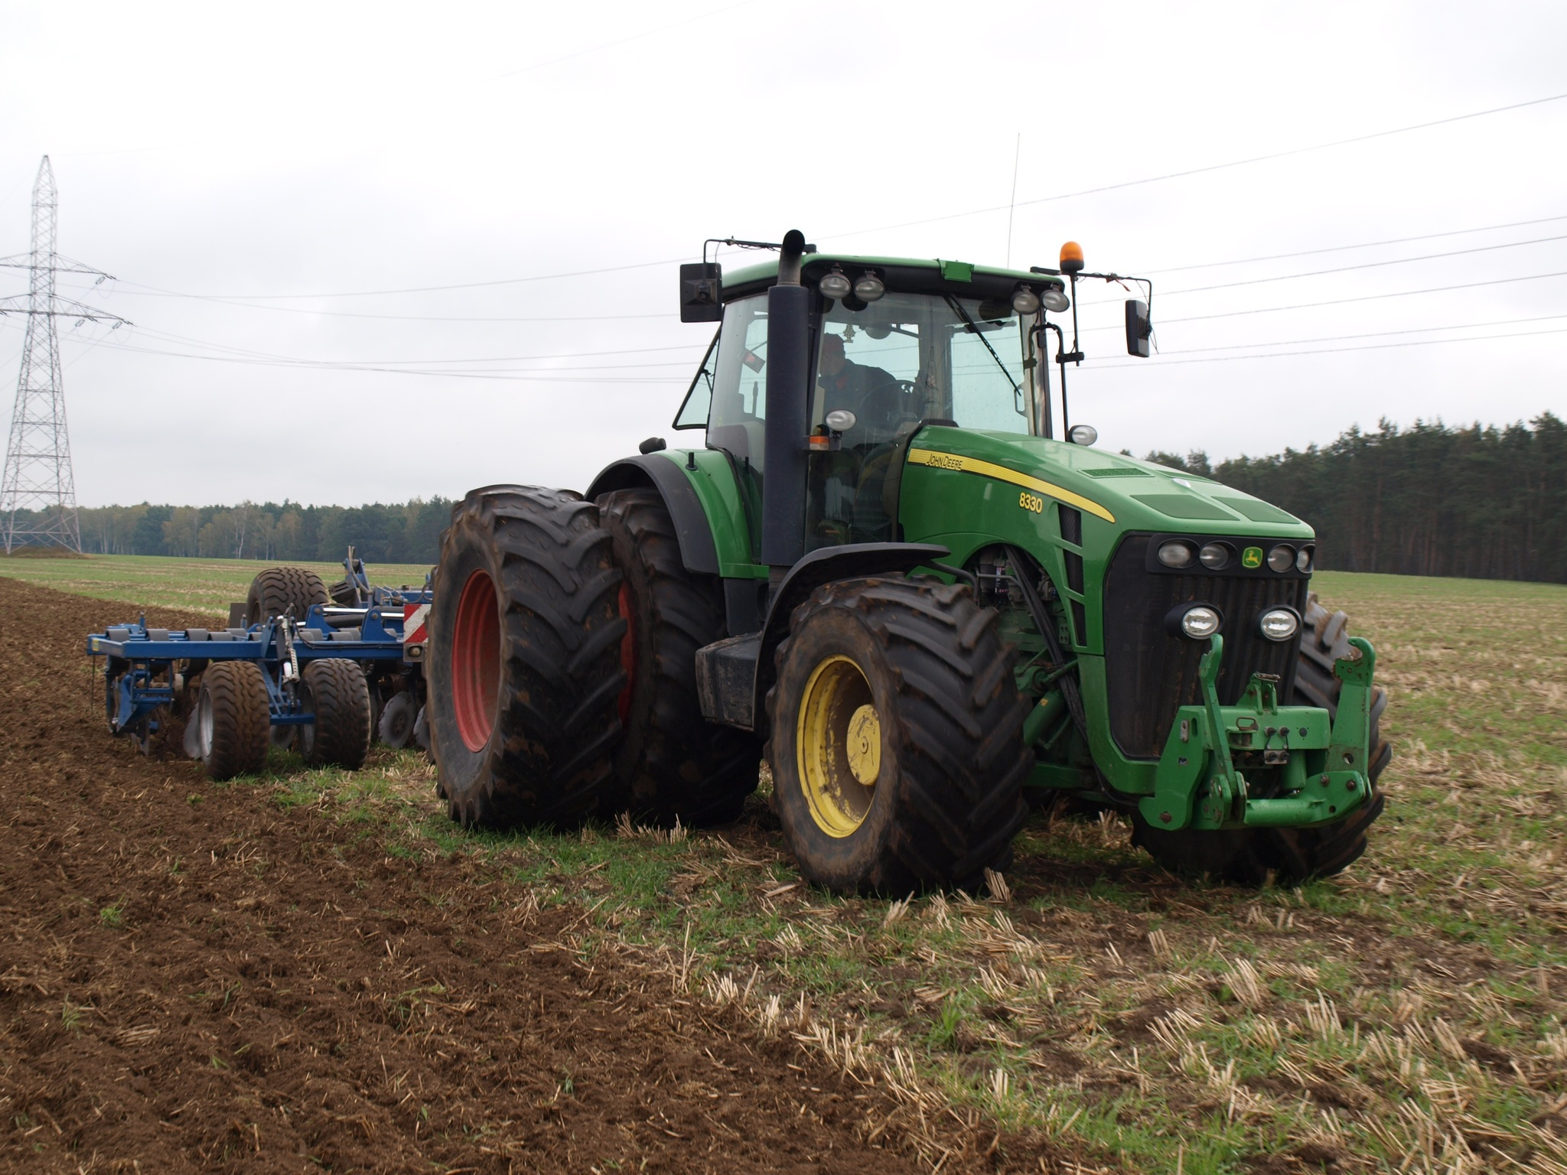
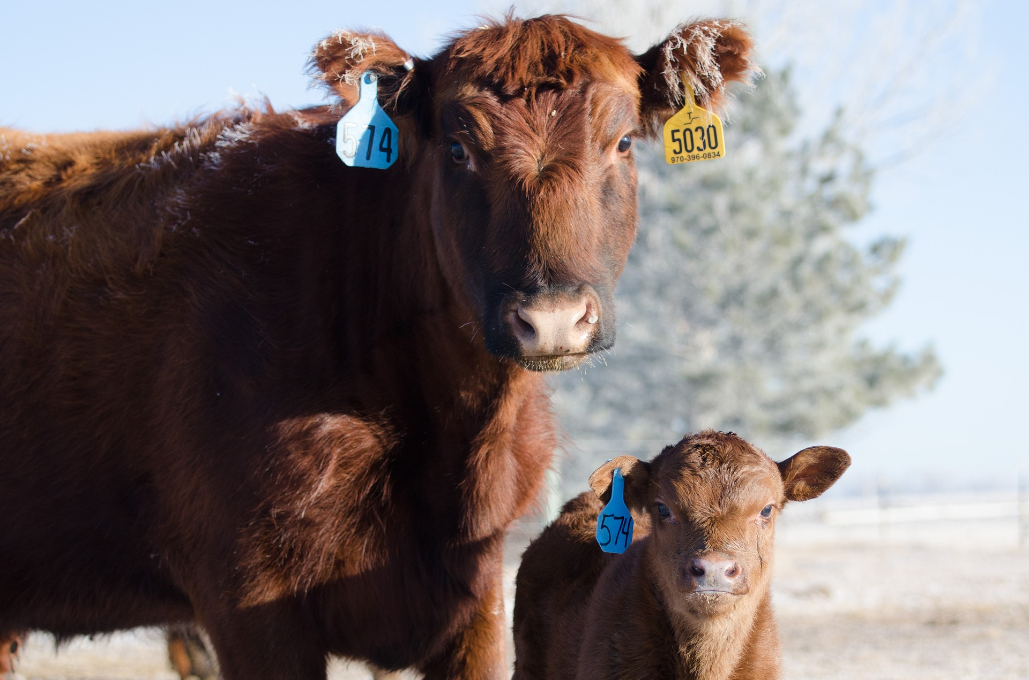
UNL Custom Rates Report ---
https://agecon.unl.edu/custom-rates
UNL CROP BUDGETS ---
https://cropwatch.unl.edu/budgets
UNL LIVESTOCK BUDGETS -
https://agecon.unl.edu/publications/cattle-budgets

Slide 5


VS “Real” Net Farm Income
Schedule F Net Farm Profit - (See Example)
$81,968
What is Different from the Farm Income Statement?
Details on Income and Expense Categories
  line 2 – Sales
  Line 11 – Chemicals
  Line 17 – Fertilizer
Depreciation

Slide 6
Accrual Adjustments
Lead to “Real” Net Farm Income
Account for Inventories
Beginning Balance
+ (plus)
Purchases /Deposits
- (minus)
Sales /Withdrawals
= (equal)
Ending Inventory

Slide 7
How do you know it’s Real Net Farm Income?
Statement of Owner’s Equity and Statement of cash flows cross checks

Slide 8
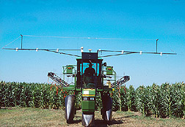
Why care about accrual adjustments to our cash expenses for the year?
See Prepaid Expenses for Example
$32,750 Beginning of Year – Let’s figure this is
all Fertilizer for Corn
+ bought $54,521 Fertilizer during 2018 (Includes $15,000 for pasture, rent for corn)
- Minus ending inventory of fertilizer value $35,000
= actual fertilizer used $52,271
$37,271 would be the amount charged to corn and $15,000 to pasture for 2018
Notes:
Begin with $32750 (all corn fertilizer) + add $54521 purchased. = $87271 total in ($15000 of this was for pasture so $72271 for corn less $35000 corn fertilizer left over = $37,271 corn fertilizer used.

Slide 9

Keep Record of Expenses for each Enterprise
Corn seed $46,021
Soybean seed $44,100
See prior slide
Crop insurance -corn $12,400
Crop insurance -soybeans $10,012

Slide 10
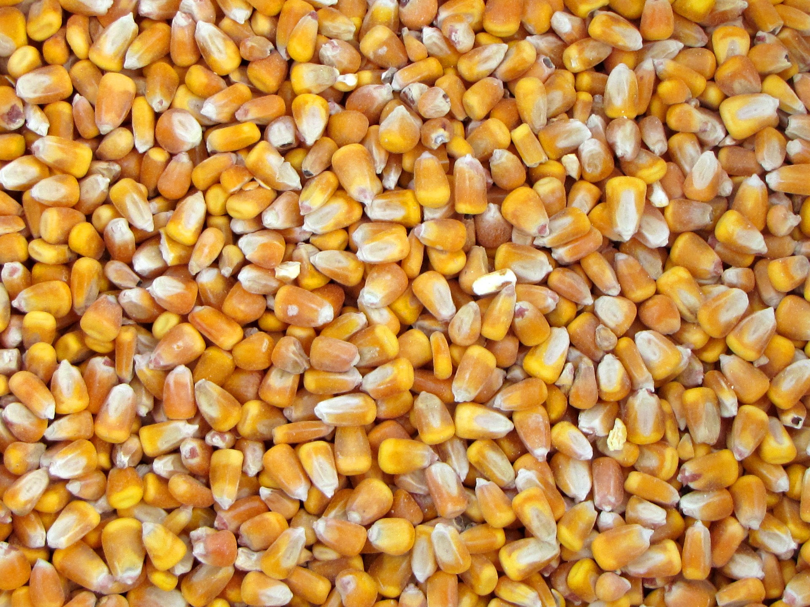
Historical Trivia from UNL Crop Budgets
1986 Center Pivot Irrigated Corn
#1 YIELD #2 Cost Per Bushel
a. 100 bu a. $2.80/bu
b. 135 bu b. $1.45/bu
c. 175 bu c. $2.00/bu
Notes:
1986 20 CROP BUDGETS
Corn 1986 135 bushels per acre center pivot irrigated $2.80 cost per bushel 2019 235 bu/acre and $3.60/bu total costs
Soybeans 1986 30 bushel dryland $5/bushel 2019 40 bu/acre and $8.06/bu total costs

Slide 11
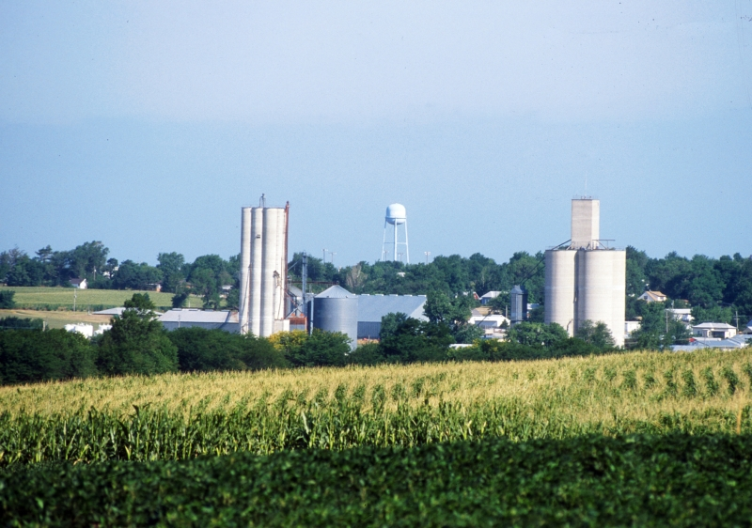
The Nebraska Crop Budgets are created based on cropping practice norms in Nebraska.
For 2019, 78 crop budgets representing 15 crops.
In Excel Spreadsheet format and pdf files.
TOTAL Production Cost and Cash Cost per unit of production is calculated.
Note - These budgets include Cost Estimates only and Do NOT provide net return or profitability estimates.

Slide 12
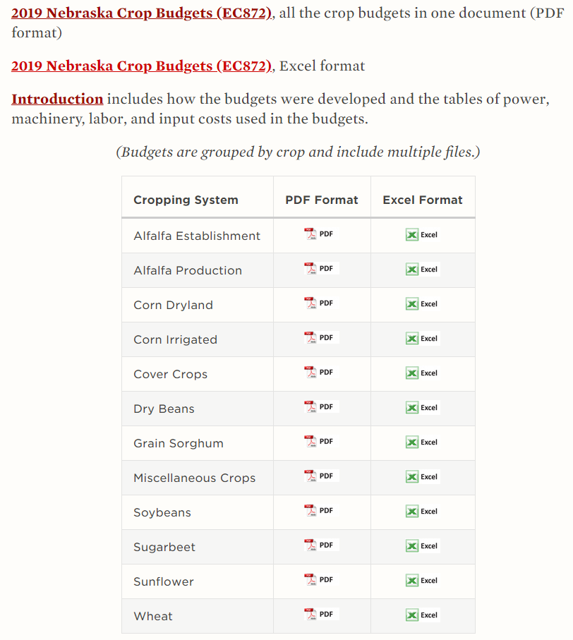
UNL Crop Budgets are found at:
https://cropwatch.unl.edu/budgets

Slide 13

Who does the research for these budgets?
Bob Klein and the team of University specialists.
Use as guideline on estimated costs and items that go into a crop budget.
Keep records and know your own costs of production.
Compare your cost estimates to the UNL budgets.
Notes:
Long history of preparing these budgets. They gather input prices and determine application amounts each year based on the various crop and the cropping practices outlined.
Bob is a crop specialist, plant pathologists, entomologist, systems engineers and other ag economists.

Slide 14
What’s different for 2019 vs 2018 crop budgets?
Budgets note a single yield goal
  The yield goal is used to determine application rates of inputs for the various cropping systems reported in the budgets.
A 1% adjustment to the real estate investment or opportunity cost was made in 2019, going from 4% to 3%.
The Real Estate tax rate was adjusted slightly upward
Land values used in the budgets were adjusted downward
Based on information gathered from the latest Nebraska
Real Estate Report.
Notes:
This year, a majority of the budgets note a single yield goal In past years, a yield goal and then an actual yield were noted in the budget headings. The yield goal is used to determine application rates of inputs for the various cropping systems reported in the budgets.
A 1% adjustment to the real estate investment or opportunity cost was made in 2019, going from 4% to 3%.
The Real Estate tax rate was adjusted slightly upward , however land values used in the budgets were adjusted downward based on information gathered from the latest Nebraska Real Estate Report.

Slide 15

INPUT COST ADJUSTMENTS
Nitrogen input costs reflect an approximate 20% increase,
Phosphorous increased by 11% for 2019.
Fuel costs were increased slightly from $2.45/gal for diesel to $2.49 /gallon for farm delivered diesel.

Slide 16

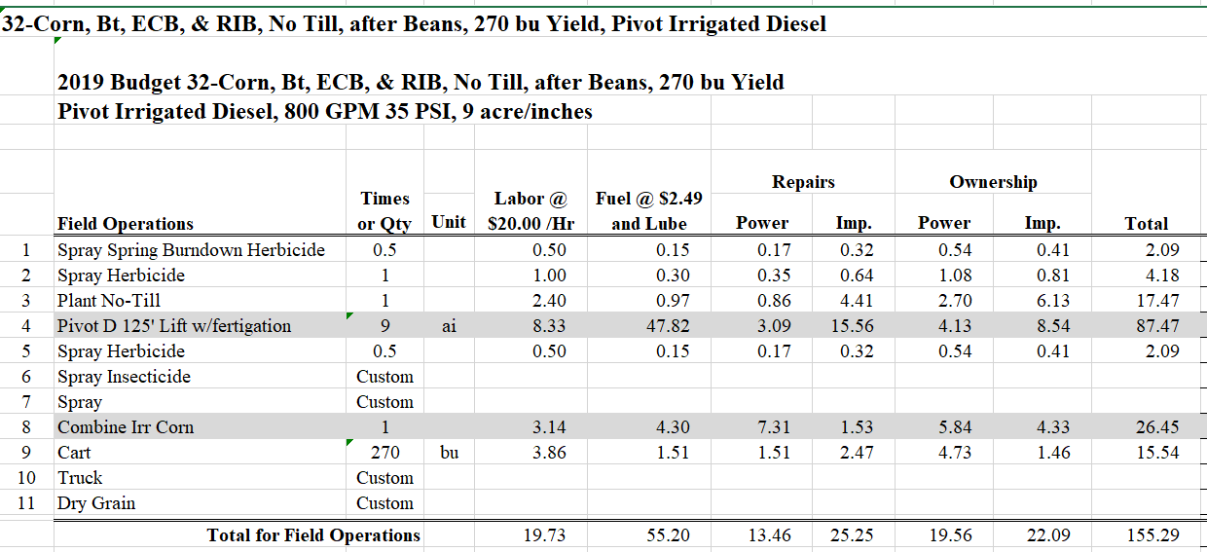

Slide 17
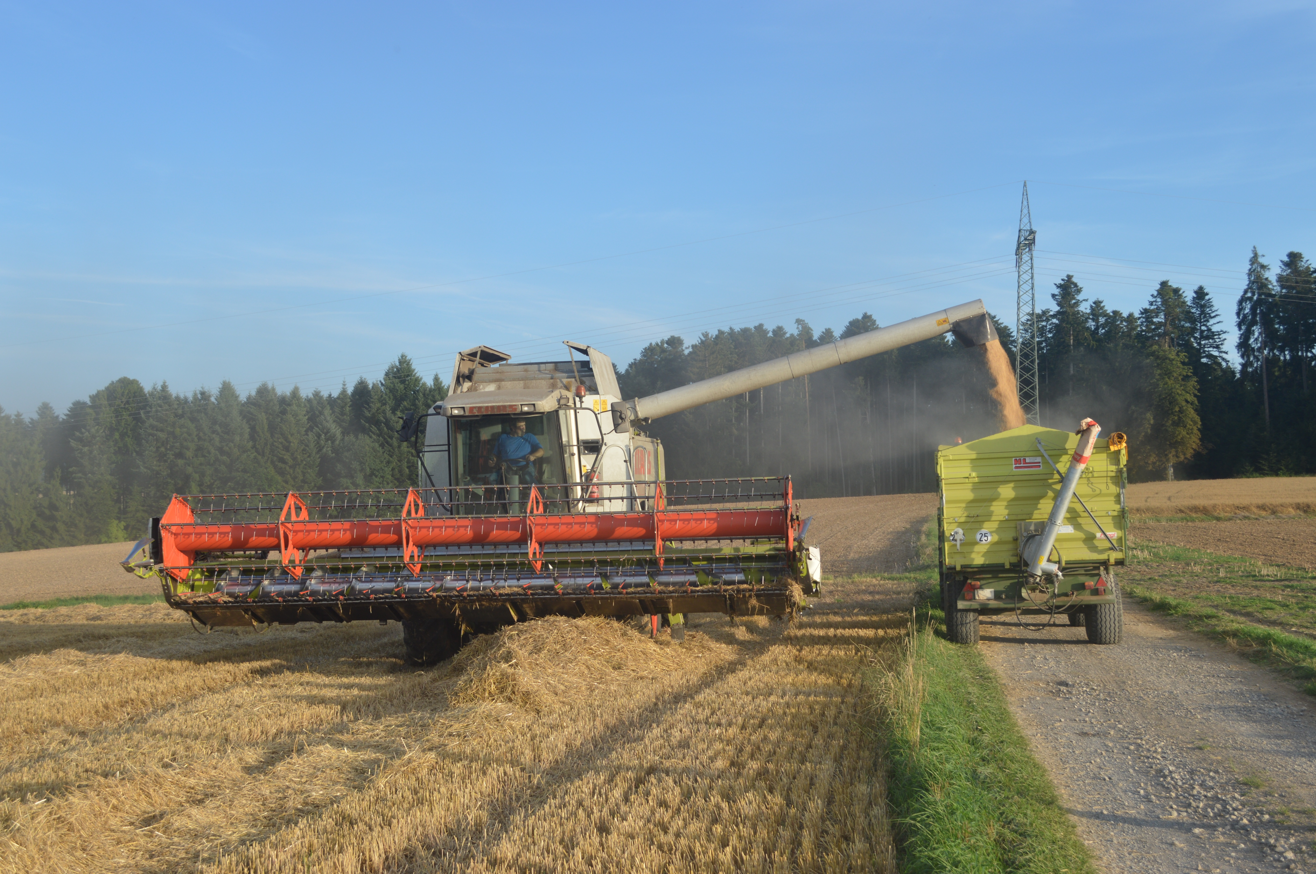
Money doesn’t buy happiness
But it buys a combine
Have you ever seen a sad person driving a combine?

Slide 18
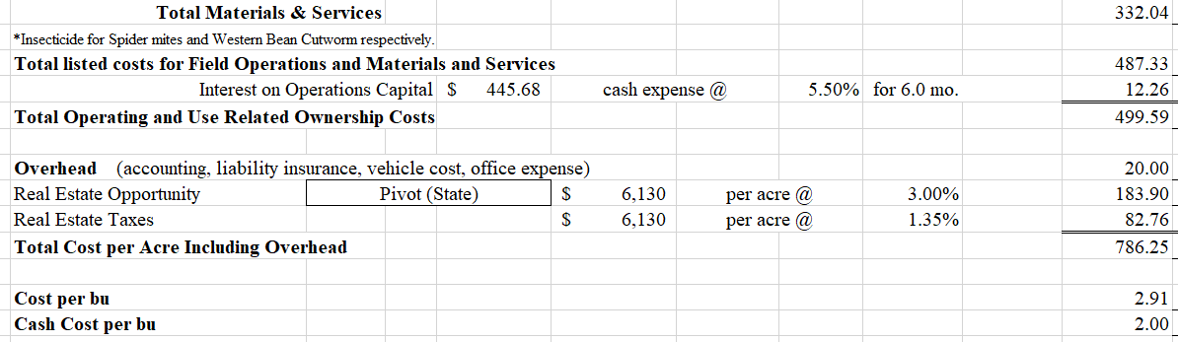
2019 Irrigated Corn
Budget #32
Breakeven cost per bushel using total economic cost = $2.91/bu
Notes:
Dec 2019 Corn futures - $4.00/bu minus 40 to 50 cents basis = $3.50/bushel Based on total economic costs of $3.60 – projected breakeven

Slide 19
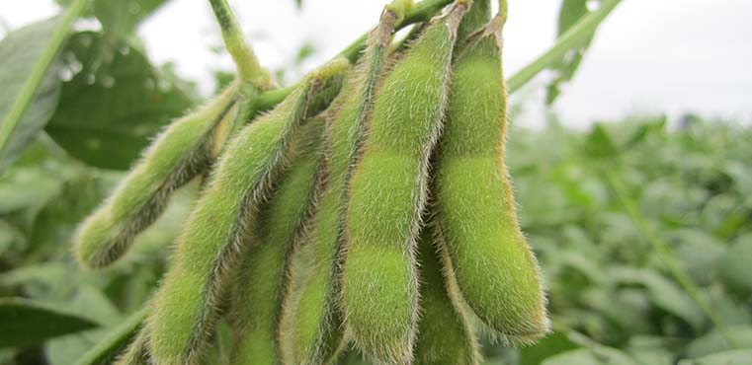
Historical Trivia from UNL Crop Budgets
1986 Dryland Soybeans
#1 YIELD #2 Cost Per Bushel
a. 25 bu a. $1.75/bu
b. 45 bu b. $6.50/bu
c. 30 bu c. $5.00/bu
Notes:
1986 20 CROP BUDGETS
Corn 1986 135 bushels per acre center pivot irrigated $2.80 cost per bushel 2019 235 bu/acre and $3.60/bu total costs
Soybeans 1986 30 bushel dryland $5/bushel 2019 40 bu/acre and $8.06/bu total costs

Slide 20
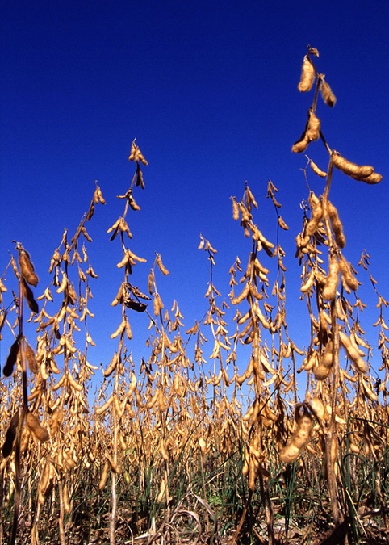
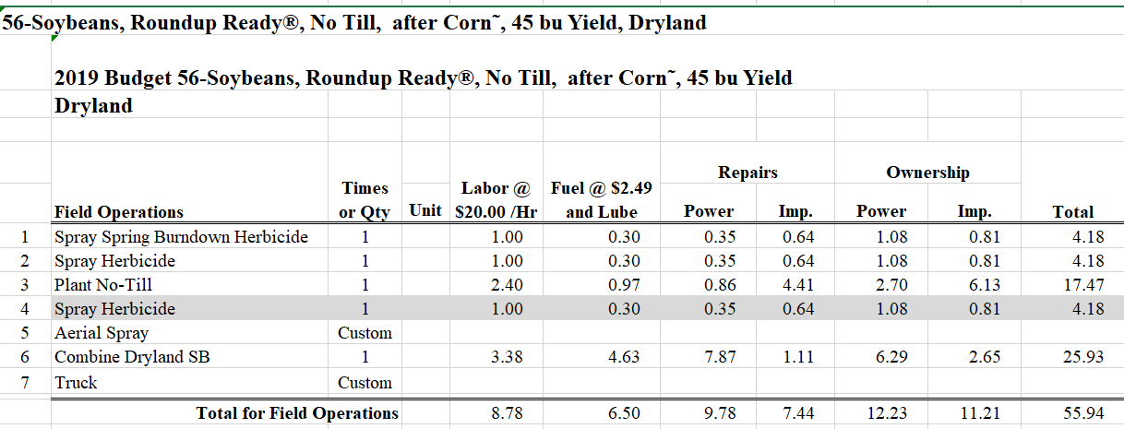

Slide 21
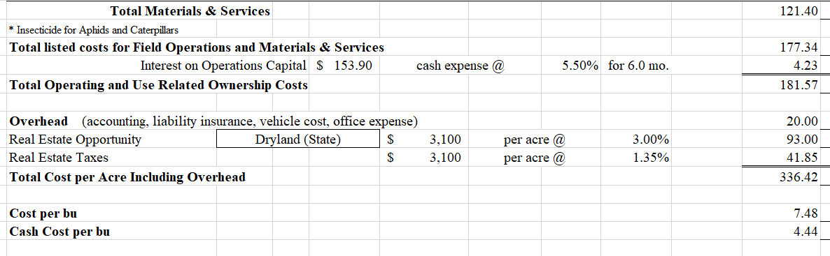
2019 Soybean
Budget #56
Breakeven cost per bushel using total economic cost = $7.48/bu
Notes:
Nov Soybean futures for 2019 is trading around $9.40 now minus 80 to 90 cent basis = $8.60 compared to total economic cost per bushel of $8.06

Slide 22

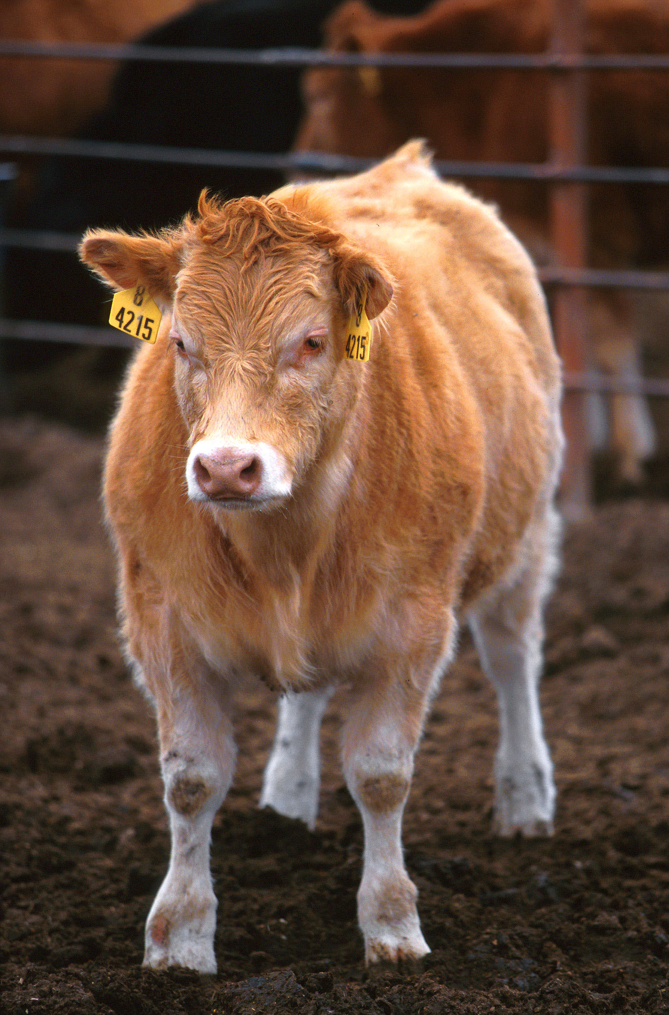
Revenue
Variable Costs
Animal Purchases
Feed (pasture and stalks rents included here)
Other variable costs – labor, fuel, vet, marketing
Operations Interest
Fixed Cash Costs
Repairs on buildings, machinery, vehicles
Overhead and Management
RE Tax, Insurance, Professional Feeds, Management fee
NON-CASH COSTS - Depreciation, Opportunity on Real Estate, Livestock investment
Cow-Calf Budgets
Notes:
With story and flowchart
Recently prepared representative budgets from 5 areas of the State

Slide 23
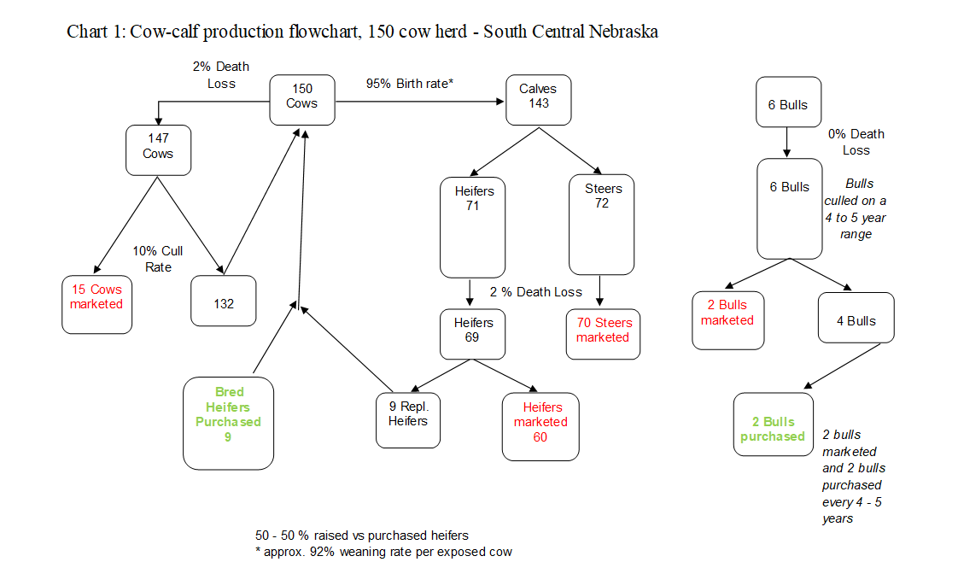

Slide 24
Cow-Calf Budgets
150 cows
South Central Nebraska

Slide 25


AGRICULTURE IS A STRESSFUL OCCUPATION
It is important that we Learn to Manage our Stress levels and recognize high stress levels in others
Nebraska Rural RESPONSE Hotline: 1-800-464-0258
National suicide prevention lifeline: 1-800-273-TALK (8255)
Notes:
Farm stress comes from many angles - finances, managing property, weather, animals and crop variables. Handout the Productive Mindset article from MSU

Slide 26


Presented by:
Glennis McClure, Extension Ag Economist / Farm & Ranch Management Analyst
gmcclure3@unl.edu
402.472.0661

