Slide 1
Trends in Nebraska Cash Rent and
Crop Share Leases
Jim Jansen
Extension Economist
Email: jjansen4@unl.edu
Phone: (402) 261-7572

Slide 2
NEBRASKA LAND VALUES

Slide 3
Nebraska Farm Real Estate Survey
Annual survey conducted since 1978 of Nebraska agricultural appraisers, professional farm managers, and bankers engaged in the land industry.
  Preliminary results for land values and rental rates published the second week of March.
  Full report published the following June.
Nebraska Farm Real Estate website full access to these resources: https://agecon.unl.edu/realestate

Slide 4
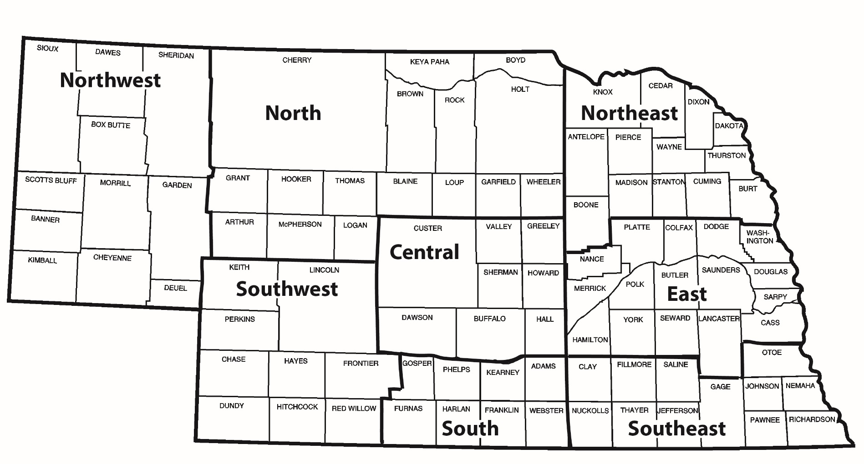
Nebraska Agricultural
Statistics Districts

Slide 5
Nebraska
Land Values
Land Averages and Annual Percent Changes

Slide 6
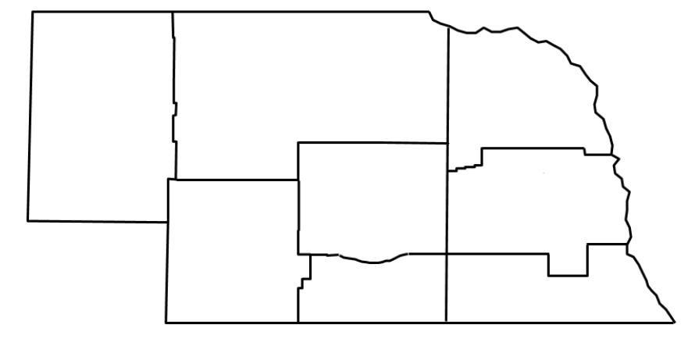
Nebraska Agricultural Average
All Land Values – Feb. 1, 2018
North
$1,090/ac
-7%
Northeast
$5,395/ac
-2%
Northwest
$715/ac
-5%
Central
$3,165/ac
-6%
East
$6,240/ac
-2%
Southwest
$1,650/ac
-5%
State
$2,720/ac
-4%
South
$3,750/ac
-3%
Southeast
$4,815/ac
-1%

Slide 7
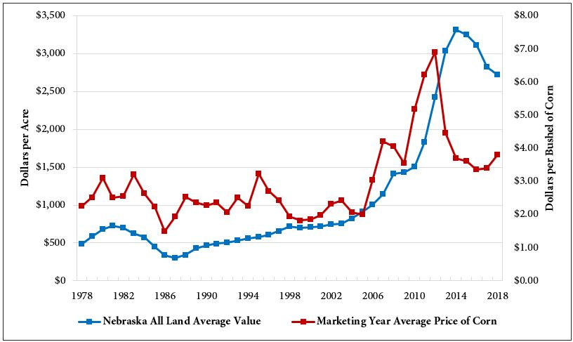
Nebraska Average Land Value & Corn Price 1978-2018

Slide 8
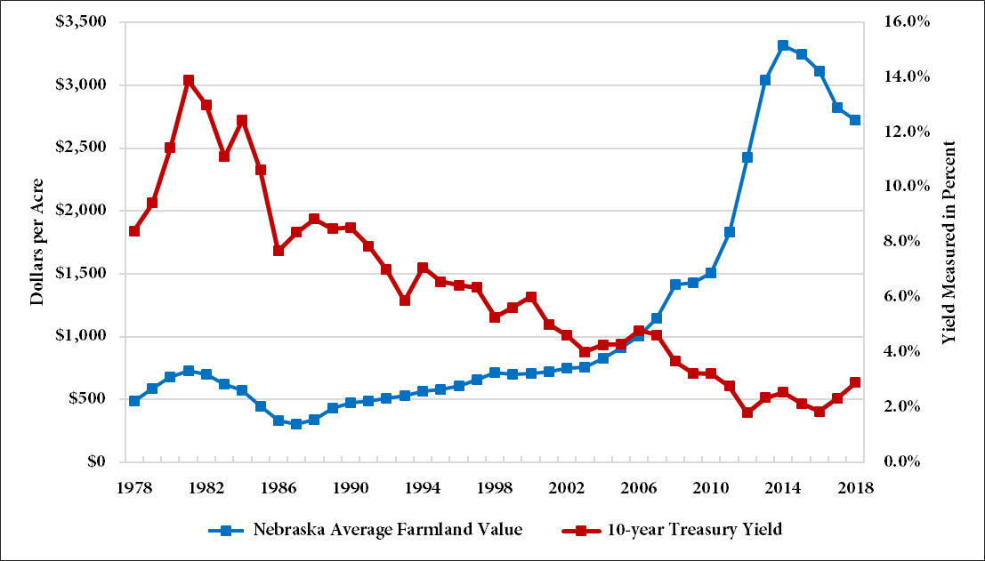
Nebraska Avg. Land Value & 10-year Treasury Bond Rate 1978-2018

Slide 9
Dryland Cropland (No Irrigation Potential) Average Value – Feb. 1, 2018
North
$1,515/ac
-3%
Northeast
$5,530/ac
2%
Northwest
$670/ac
-6%
Central
$2,720/ac
-2%
East
$5,675/ac
-2%
Southwest
$1,585/ac
-7%
State
$3,100/ac
-1%
South
$2,965/ac
-3%
Southeast
$4,205/ac
-2%

Slide 10
Dryland Cropland (Irrigation Potential) Average Value – Feb. 1, 2018
North
$1,985/ac
-6%
Northeast
$5,800/ac
-3%
Northwest
$730/ac
-5%
Central
$3,095/ac
-4%
East
$6,280/ac
-3%
Southwest
$1,635/ac
-5%
State
$4,115/ac
-3%
South
$3,620/ac
-3%
Southeast
$5,345/ac
-1%

Slide 11
Grazing Land (Tillable)
Average Value – Feb. 1, 2018
North
$1,075/ac
-8%
Northeast
$3,330/ac
-9%
Northwest
$510/ac
-4%
Central
$1,935/ac
-10%
East
$3,335/ac
-11%
Southwest
$950/ac
-3%
State
$1,250/ac
-6%
South
$1,950/ac
-4%
Southeast
$2,845/ac
2%

Slide 12
Grazing Land (Nontillable)
Average Value – Feb. 1, 2018
North
$640/ac
-9%
Northeast
$2,135/ac
-4%
Northwest
$435/ac
-6%
Central
$1,545/ac
-8%
East
$2,345/ac
-6%
Southwest
$785/ac
-4%
State
$835/ac
-7%
South
$1,460/ac
-3%
Southeast
$2,045/ac
2%

Slide 13
Hayland
Average Value – Feb. 1, 2018
North
$1,265/ac
-8%
Northeast
$3,155/ac
-4%
Northwest
$765/ac
-4%
Central
$1,980/ac
-9%
East
$2,990/ac
-3%
Southwest
$1,365/ac
-8%
State
$1,710/ac
-6%
South
$2,060/ac
-5%
Southeast
$2,615/ac
-2%

Slide 14
Gravity Irrigated Cropland
Average Value – Feb. 1, 2018
North
$3,645/ac
-5%
Northeast
$6,680/ac
-3%
Northwest
$2,340/ac
-9%
Central
$5,775/ac
-7%
East
$7,455/ac
-2%
Southwest
$3,910/ac
-6%
State
$5,795/ac
-5%
South
$5,795/ac
-4%
Southeast
$6,295/ac
-5%

Slide 15
Center Pivot Irrigated Cropland
Average Value – Feb. 1, 2018
North
$4,020/ac
-3%
Northeast
$7,310/ac
-2%
Northwest
$2,700/ac
-4%
Central
$6,510/ac
-5%
East
$8,645/ac
-1%
Southwest
$4,265/ac
-5%
State
$6,130/ac
-3%
South
$6,520/ac
-3%
Southeast
$7,720/ac
-1%

Slide 16
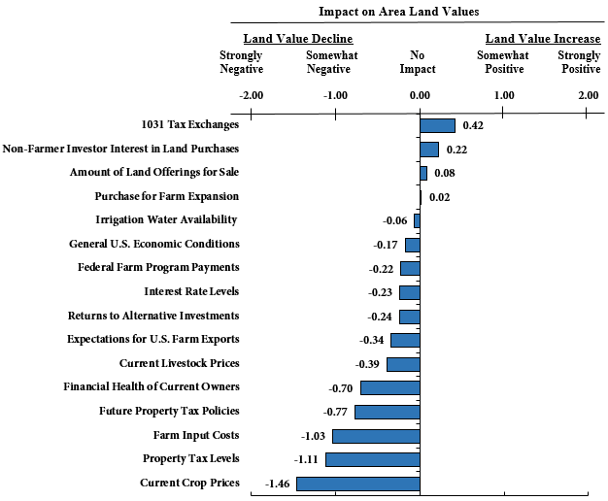
Rating of Factors Influencing Agricultural Land Values in 2018

Slide 17
NEBRASKA CASH RENTAL RATES
Dryland Cropland
Rental Rates

Slide 18
Dryland Cropland
Average Rental Rates – 2018 Season
(Nebraska Farm Real Estate Survey)
North
$53/ac
-4%
Northeast
$210/ac
-2%
Northwest
$28/ac
-3%
Central
$89/ac
1%
East
$190/ac
-3%
Southwest
$41/ac
5%
South
$76/ac
6%
Southeast
$160/ac
3%

Slide 19
Dryland Cropland
Rental Rate Ranges – 2018 Season
(Nebraska Farm Real Estate Survey)
North
H: $87/ac
A: $53/ac
L: $28/ac
Northeast
H: $255/ac
A: $210/ac
L: $175/ac
Northwest
H: $42/ac
A: $28/ac
L: $21/ac
Central
H: $115ac
A: $89/ac
L: $72/ac
East
H: $230/ac
A: $190/ac
L: $150/ac
Southwest
H: $56/ac
A: $41/ac
L: $35/ac
By Region
High Grade (H)
Average (A)
Low Grade (L)
South
H: $100/ac
A: $76/ac
L: $53/ac
Southeast
H: $205/ac
A: $160/ac
L: $125/ac

Slide 20
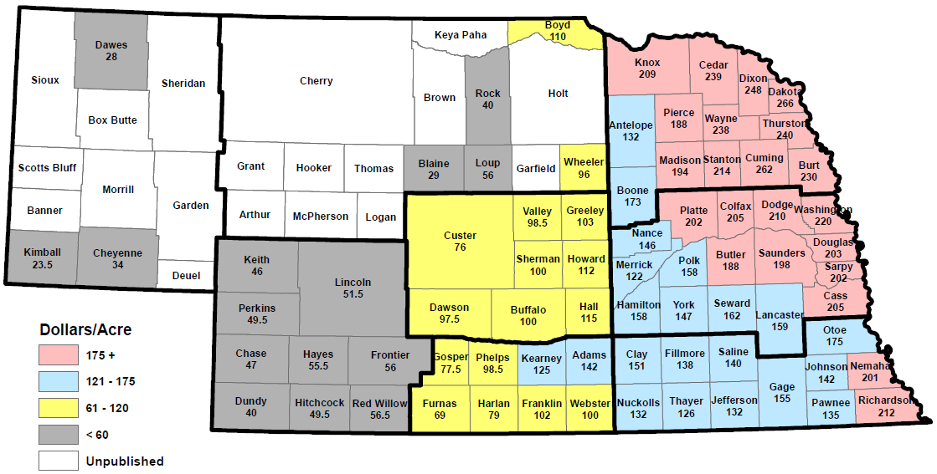
Dryland Cropland
Rental Rates – 2017 Season
(USDA-NASS Survey – Sept. 8, 2017)

Slide 21
NEBRASKA CASH RENTAL RATES
Irrigated Cropland
Rental Rates

Slide 22
Gravity Irrigated Cropland
Average Rental Rates – 2018 Season
(Nebraska Farm Real Estate Survey)
North
$170/ac
3%
Northeast
$250/ac
-2%
Northwest
$115/ac
-4%
Central
$205/ac
-7%
East
$255/ac
-2%
Southwest
$165/ac
-3%
South
$200/ac
-2%
Southeast
$225/ac
-4%

Slide 23
Gravity Irrigated Cropland
Rental Rate Ranges – 2018 Season
(Nebraska Farm Real Estate Survey)
North
H: $200/ac
A: $170/ac
L: $130/ac
Northeast
H: $285/ac
A: $250/ac
L: $220/ac
Northwest
H: $140/ac
A: $115/ac
L: $96/ac
Central
H: $235/ac
A: $205/ac
L: $175/ac
East
H: $300/ac
A: $255/ac
L: $220/ac
Southwest
H: $200/ac
A: $165/ac
L: $130/ac
By Region
High Grade (H)
Average (A)
Low Grade (L)
South
H: $245/ac
A: $200/ac
L: $175/ac
Southeast
H: $265/ac
A: $225/ac
L: $200/ac

Slide 24
Center Pivot Irrigated Cropland
Average Rental Rates – 2018 Season
(Nebraska Farm Real Estate Survey)
North
$200/ac
-2%
Northeast
$290/ac
-5%
Northwest
$150/ac
-3%
Central
$220/ac
-4%
East
$280/ac
-3%
Southwest
$190/ac
-5%
South
$215/ac
-4%
Southeast
$260/ac
-2%

Slide 25
Center Pivot Irrigated Cropland
Rental Rate Ranges – 2018 Season
(Nebraska Farm Real Estate Survey)
North
H: $240/ac
A: $200/ac
L: $145/ac
Northeast
H: $330/ac
A: $290/ac
L: $245/ac
Northwest
H: $190/ac
A: $150/ac
L: $115/ac
Central
H: $255/ac
A: $220/ac
L: $195/ac
East
H: $315/ac
A: $280/ac
L: $245/ac
Southwest
H: $215/ac
A: $190/ac
L: $165/ac
By Region
High (H)
Average (A)
Low (L)
South
H: $255/ac
A: $215/ac
L: $180/ac
Southeast
H: $310/ac
A: $260/ac
L: $215/ac

Slide 26
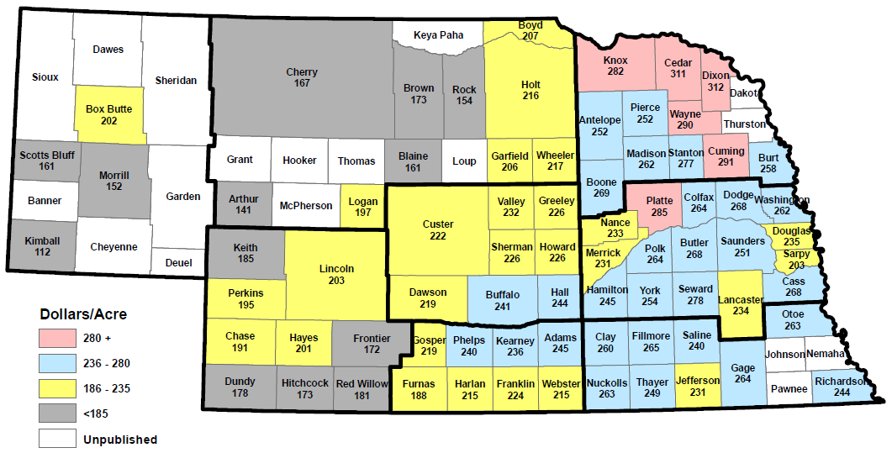
Irrigated Cropland
Rental Rates – 2017 Season
(USDA-NASS Survey – Sept. 8, 2017)

Slide 27
NEBRASKA CASH RENTAL RATES
Pasture and Cow-Calf Pairs
Rental Rates

Slide 28
Pasture per Acre
Average Rental Rates – 2018 Season
(Nebraska Farm Real Estate Survey)
North
$26/ac
2%
Northeast
$61/ac
-2%
Northwest
$10/ac
-5%
Central
$33/ac
-3%
East
$49/ac
-8%
Southwest
$21/ac
-5%
South
$36/ac
1%
Southeast
$47/ac
-4%

Slide 29
Pasture per Acre
Rental Rate Ranges – 2018 Season
(Nebraska Farm Real Estate Survey)
North
H: $37/ac
A: $26/ac
L: $15/ac
Northeast
H: $82/ac
A: $61/ac
L: $48/ac
Northwest
H: $19/ac
A: $10/ac
L: $7/ac
Central
H: $47/ac
A: $33/ac
L: $29/ac
East
H: $74/ac
A: $49/ac
L: $38/ac
Southwest
H: $28/ac
A: $21/ac
L: $17/ac
By Region
High Grade (H)
Average (A)
Low Grade (L)
South
H: $45/ac
A: $36/ac
L: $23/ac
Southeast
H: $66/ac
A: $47/ac
L: $38/ac

Slide 30
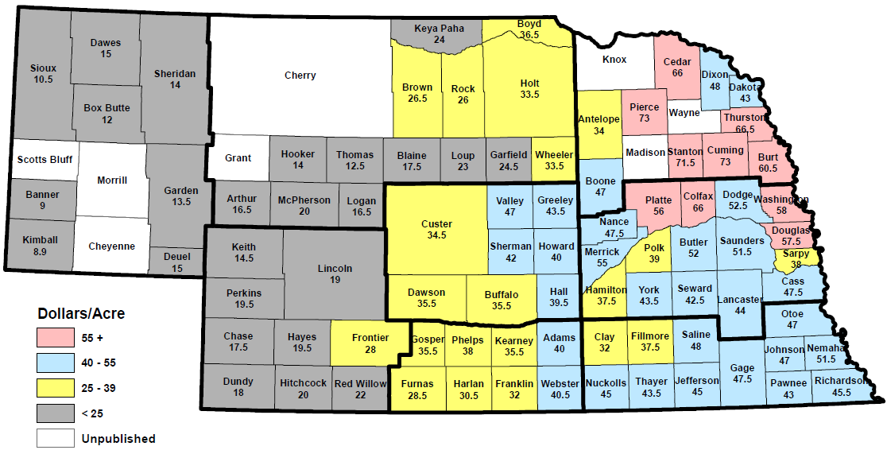
Pasture per Acre
Rental Rates – 2017 Season
(USDA-NASS Survey – Sept. 8, 2017)

Slide 31
Cow-Calf Pairs
Average Rental Rates – 2018 Monthly
(Nebraska Farm Real Estate Survey)
North
$58.95/pair
-3%
Northeast
$52.55/pair
-1%
Northwest
$35.65/pair
2%
Central
$52.30/pair
-2%
East
$48.25/pair
-6%
Southwest
$49.50/pair
-4%
South
$46.45/pair
-2%
Southeast
$47.05/pair
-3%

Slide 32
Cow-Calf Pairs
Rental Rate Ranges – 2018 Monthly
(Nebraska Farm Real Estate Survey)
North
H: $71.40/pair A: $58.95/pair L: $47.10/pair
Northeast
H: $64.30/pair
A: $52.55/pair
L: $43.55/pair
Northwest
H: $47.55/pair
A: $35.65/pair
L: $29.25/pair
Central
H: $65.00/pair
A: $52.30/pair
L: $42.30/pair
East
H: $65.70/pair
A: $48.25/pair
L: $40.55/pair
Southwest
H: $61.15/pair
A: $49.50/pair
L: $42.35/pair
By Region
High Grade (H)
Average (A)
Low Grade (L)
South
H: $59.70/pair
A: $46.45/pair
L: $39.25/pair
Southeast
H: $57.35/pair
A: $47.05/pair
L: $39.55/pair

Slide 33
TRENDS IN AGRICULTURAL
LAND LEASES
Setting Cash Rental Rates

Slide 34
Setting Cash Rental Rates
Setting a cash rental rate needs to be viable given the needs of the landlord and tenant.
Rates may be set according to:
  Fixed amount per acre for all acres on the farm.
  Fixed amount per cropland acre.
Different methods may be used to calculate a rental rate, but all methods must arrive at a viable rate.

Slide 35
Methods for Setting Cash Rental Rates
Basic methods for estimating a cash rental rate:
  Adjusting survey data.
  Cash equivalent from crop share.
  Return on investment.

Slide 36
Estimating Cash Rental Rates by Adjusting Survey Data
Land rental rate survey data:
  Evaluate available cash rental survey data to establish a baseline in the landlord and tenant negotiation process.
Average yields:

Slide 37
Cash Equivalent From Crop Share
Rent paid to landlord by tenant based off owner’s share of net returns per acre.
  Example 50/50 split:

Slide 38
Return on Investment
Multiply the estimated current market value by the expected rate of return to determine the rental rate per acre.
***Estimated net rates of return by land type are available in Table 5
of the Nebraska Farm Real Estate Market Highlights Report 2017-2018.

Slide 39
Return on Investment (continued)
Selecting an appropriate market value and rate of return are key to estimating reasonable rental rates.
Nebraska Farm Real Estate Survey provides estimated annual net rates of return (returns after landownership expenses – i.e. land taxes).
Summaries provided in the land report estimate net rates of return for irrigated cropland, dryland cropland, and grazing land.

Slide 40
TRENDS IN AGRICULTURAL
LAND LEASES
Lease Arrangement Trends

Slide 41
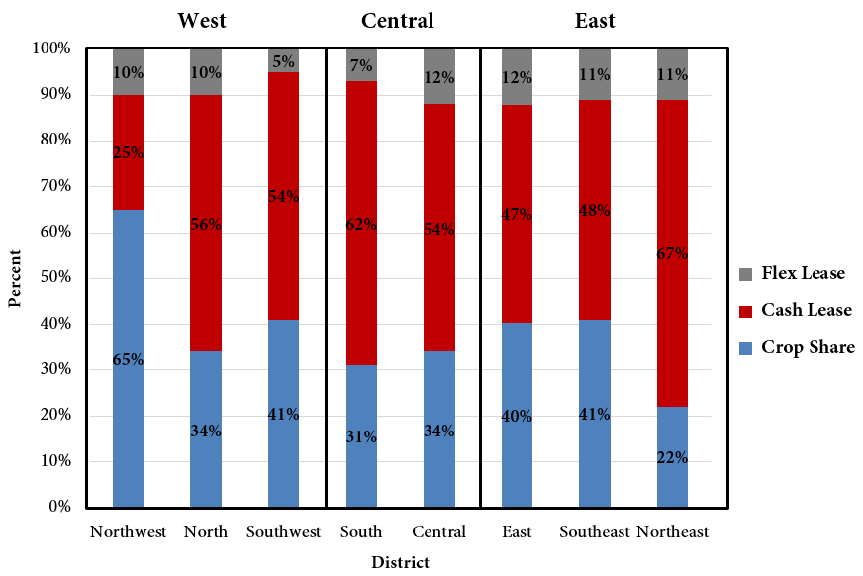
Cropland Lease Arrangements in Nebraska by District
Source: UNL Nebraska Farm Real Estate Survey, 2015

Slide 42
Expenses Paid by the Landlord to the Tenant in Common Crop Share Leases
Source: UNL Nebraska Farm Real Estate Survey, 2017

Slide 43
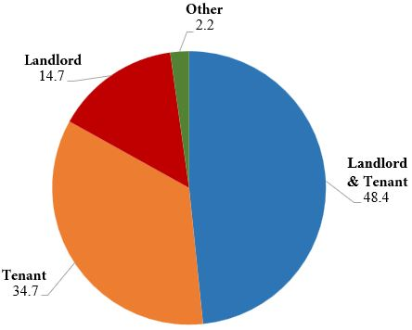
Entity Responsible for Maintaining Irrigation
System as Part of Cash Lease in Nebraska
Source: UNL Nebraska Farm Real Estate Survey, 2018

Slide 44
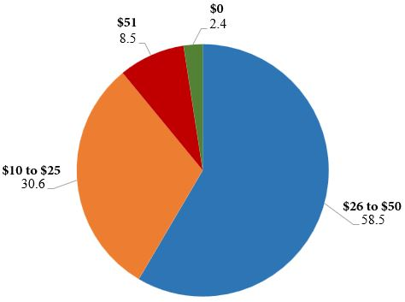
Discount on Cash Rent per Acre When Tenant Owns Pivot for Irrigation System in Nebraska
Source: UNL Nebraska Farm Real Estate Survey, 2018

Slide 45
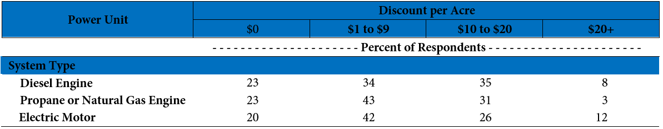
Discount on Cash Rent per Acre When Tenant Owns Power Unit for Irrigation System in Nebraska
Source: UNL Nebraska Farm Real Estate Survey, 2018

Slide 46
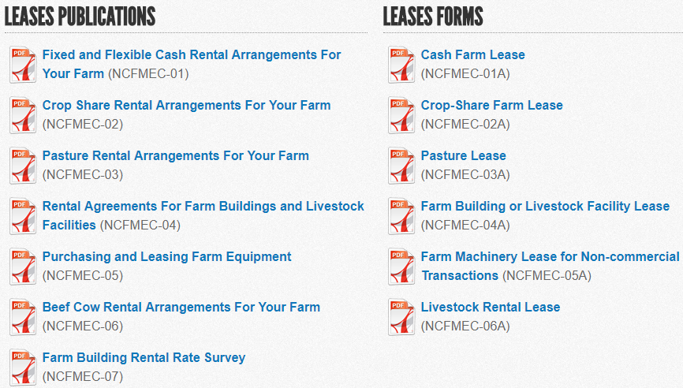
Fillable PDF Leases – AgLease101.org
Click Document Library
Fillable PDF Forms
Lease Publications

Slide 47
TRENDS IN AGRICULTURAL
LAND LEASES
Considerations for Absentee Landowners

Slide 48
BEGINNING FARMER
& RANCHER PROGRAMS

Slide 49
Resources for beginning farmers and ranchers
Nebraska Department of Agriculture
  Beginning farmer tax credit for landlords
Farm Credit Services of America
Nebraska Investment Finance Authority
Nebraska Department of Revenue
Farm Service Agency – variety of loans
  Livestock, buildings/bins, equipment, land
  Operating loans

Slide 50

Beginning farmer tax credit
Nebraska Department of Ag
  Beginning Farmer Tax Credit Program
    Offers a refundable tax credit to existing farmer/livestock producers who agree to rent to beginning farmers/ranchers
    Must be a three-year lease
    Credit is equal to 10% of the cash rent or 15% of share rent (to include livestock)
  Personal Property Tax Exemption
    Up to $100K of personal property used in production may be exempt from personal property tax
    Must apply by Nov. 1 of the year prior to credit sought

Slide 51
Beginning farmer tax credit - continued
Nebraska Department of Ag
  Beginning Farmer Tax Credit Program - tenant
    Must be a resident of Nebraska
    Must have farmed for less that 10 of the last 15 years
    Net worth less than $200K
    Must participate in an approved financial management program
  Beginning Farmer Tax Credit Program – owner
    Must have ownership
    If a close relative, must attend an approved succession workshop and the asset included in the resultant plan

Slide 52
Technical Assistance
NRCS – water, soil, and wildlife conservation programs with funded assistance on desired activities
Legal Aid of Nebraska – works to provide guidance for estate and transition plans, business organization, support programs, financial statements, and other legal issues
Nebraska Sustainable Ag Society – educational training and support to those wanting to evaluate and plan the farm enterprise from a sustainable view

Slide 53
UPCOMING LAND MANAGEMENT MEETINGS

Slide 54
Landlord & Tenant Cash Rent Meetings
Feb. 25, 2019 — David City, Butler County Events Center, Butler County Fairgrounds. Please register by calling 402-367-7410 by Feb. 21
  Contact: Melissa Bartels, mbartels6@unl.edu
Feb. 28, 2019 — St. Paul, St. Paul Public Library, 1301 Howard Ave. Please register by calling (308) 754-5422.
  Contact: Troy Ingram, tingram5@unl.edu
March 14, 2019 — Lincoln, Lancaster County Extension Office. Please register by calling (402) 441-7180 by March 11.
  Contact: Tyler Williams, tyler.williams@unl.edu

Slide 55
Upcoming Webinar: Ag Land Management Quarterly II Monday, May 20, 2019 at 6:30 PM
Website: https://agecon.unl.edu/landmanagement
Trends in Nebraska Cash Rental Rates and Land Values
  Trends in cash rent for 2019 across Nebraska
  Financial implications for changes in land values and cash rents
Proper Communication and Decision Making for Agricultural Land
  Improving communication between landlords, tenants, and family members
  Short and long-term decision making for agricultural land
Ask an Expert
  Review of submitted questions and from meeting participants
  Upcoming land management workshops and publications

