Slide 1
Flexible Grazing Land Leases and Considerations
Jim Jansen
Extension Economist
jjansen4@unl.edu
402-261-7572

Slide 2
Nebraska Farm Real Estate
Value of Nebraska Land

Slide 3
Nebraska Farm Real Estate Survey
Annual survey conducted since 1978 of Nebraska agricultural appraisers, professional farm managers, and bankers engaged in the land industry.
Preliminary results for land values and rental rates published the second week of March.
Full report published the following June.
Nebraska Farm Real Estate website full access to these resources: https://agecon.unl.edu/realestate

Slide 4
Nebraska Agricultural Statistics Districts

Slide 5
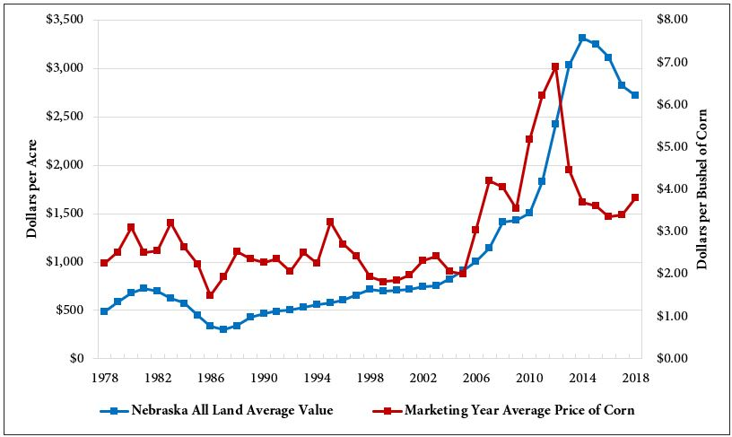
Nebraska Average Land Value & Corn Price 1978-2018

Slide 6
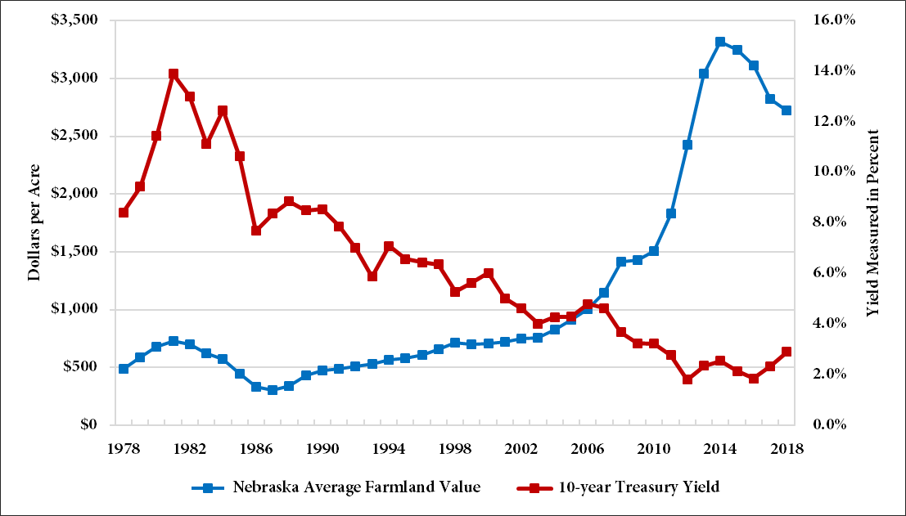
Nebraska Avg. Land Value & 10-year Treasury Bond Rate 1978-2018

Slide 7
Grazing Land (Tillable) Average Value – Feb. 1, 2018
North
$1,075/ac
-8%
Northeast
$3,330/ac
-9%
Northwest
$510/ac
-4%
Central
$1,935/ac
-10%
East
$3,335/ac
-11%
Southwest
$950/ac
-3%
State
$1,250/ac
-6%
South
$1,950/ac
-4%
Southeast
$2,845/ac
2%

Slide 8
Nebraska Agricultural Average All Land Values – Feb. 1, 2018
North
$1,090/ac
-7%
Northeast
$5,395/ac
-2%
Northwest
$715/ac
-5%
Central
$3,165/ac
-6%
East
$6,240/ac
-2%
Southwest
$1,650/ac
-5%
State
$2,720/ac
-4%
South
$3,750/ac
-3%
Southeast
$4,815/ac
-1%

Slide 9
Grazing Land (Nontillable) Average Value – Feb. 1, 2018
North
$640/ac
-9%
Northeast
$2,135/ac
-4%
Northwest
$435/ac
-6%
Central
$1,545/ac
-8%
East
$2,345/ac
-6%
Southwest
$785/ac
-4%
State
$835/ac
-7%
South
$1,460/ac
-3%
Southeast
$2,045/ac
2%

Slide 10
Hayland Average Value – Feb. 1, 2018
North
$1,265/ac
-8%
Northeast
$3,155/ac
-4%
Northwest
$765/ac
-4%
Central
$1,980/ac
-9%
East
$2,990/ac
-3%
Southwest
$1,365/ac
-8%
State
$1,710/ac
-6%
South
$2,060/ac
-5%
Southeast
$2,615/ac
-2%

Slide 11
Nebraska Farm Real Estate
Pasture and Cow-Calf Pair
Rental Rates

Slide 12
Pasture per Acre Average Rental Rates – 2018 Season (Nebraska Farm Real Estate Survey)
North
$26/ac
2%
Northeast
$61/ac
-2%
Northwest
$10/ac
-5%
Central
$33/ac
-3%
East
$49/ac
-8%
Southwest
$21/ac
-5%
South
$36/ac
1%
Southeast
$47/ac
-4%

Slide 13
Pasture per Acre Rental Rate Ranges – 2018 Season (Nebraska Farm Real Estate Survey)
North
H: $37/ac
A: $26/ac
L: $15/ac
Northeast
H: $82/ac
A: $61/ac
L: $48/ac
Northwest
H: $19/ac
A: $10/ac
L: $7/ac
Central
H: $47/ac
A: $33/ac
L: $29/ac
East
H: $74/ac
A: $49/ac
L: $38/ac
Southwest
H: $28/ac
A: $21/ac
L: $17/ac
By Region
High Grade (H)
Average (A)
Low Grade (L)
South
H: $45/ac
A: $36/ac
L: $23/ac
Southeast
H: $66/ac
A: $47/ac
L: $38/ac

Slide 14
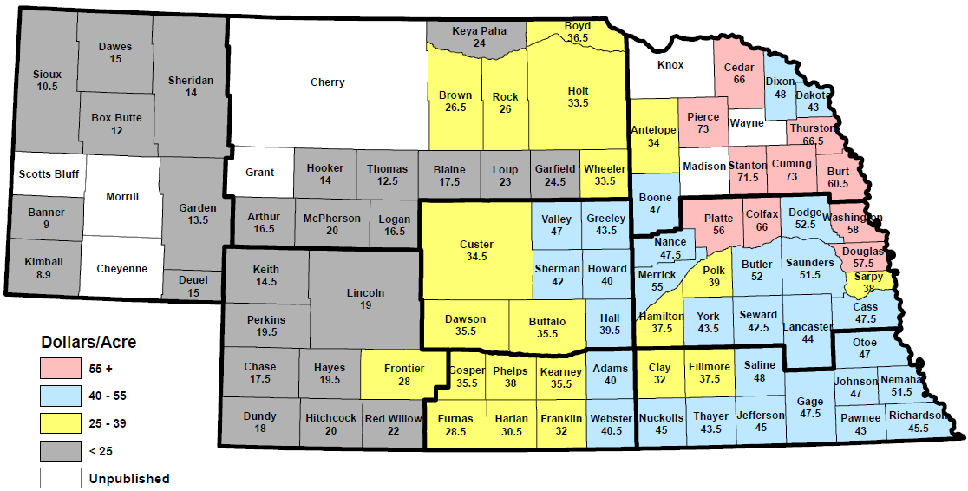
Pasture per Acre Rental Rates – 2017 Season (USDA-NASS Survey – Sept. 8, 2017)
Website: https://www.nass.usda.gov/Statistics_by_State/Nebraska/Publications/County_Estimates/index.php

Slide 15
Cow-Calf Pairs Average Rental Rates – 2018 Monthly (Nebraska Farm Real Estate Survey)
North
$58.95/pair
-3%
Northeast
$52.55/pair
-1%
Northwest
$35.65/pair
2%
Central
$52.30/pair
-2%
East
$48.25/pair
-6%
Southwest
$49.50/pair
-4%
South
$46.45/pair
-2%
Southeast
$47.05/pair
-3%

Slide 16
Cow-Calf Pairs Rental Rate Ranges – 2018 Monthly (Nebraska Farm Real Estate Survey)
North
H: $71.40/pair A: $58.95/pair L: $47.10/pair
Northeast
H: $64.30/pair
A: $52.55/pair
L: $43.55/pair
Northwest
H: $47.55/pair
A: $35.65/pair
L: $29.25/pair
Central
H: $65.00/pair
A: $52.30/pair
L: $42.30/pair
East
H: $65.70/pair
A: $48.25/pair
L: $40.55/pair
Southwest
H: $61.15/pair
A: $49.50/pair
L: $42.35/pair
By Region
High Grade (H)
Average (A)
Low Grade (L)
South
H: $59.70/pair
A: $46.45/pair
L: $39.25/pair
Southeast
H: $57.35/pair
A: $47.05/pair
L: $39.55/pair

Slide 17
Nebraska Farm Real Estate
Setting Hayland Rental Rates

Slide 18
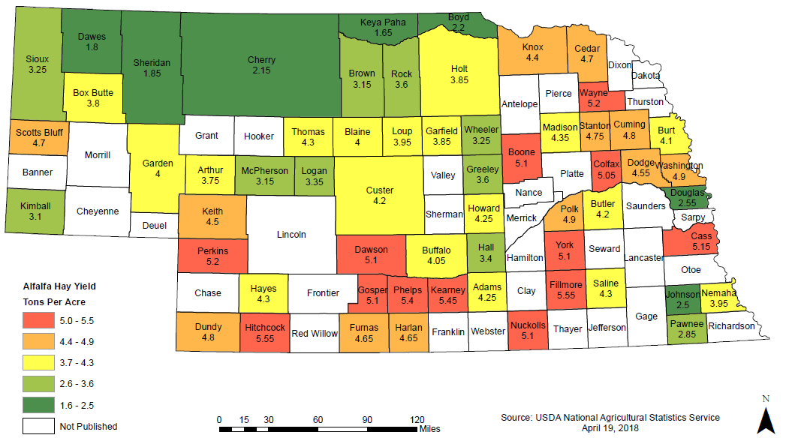
Nebraska Alfalfa Hay Yields – Tons/Acre - 2017
Website: https://www.nass.usda.gov/Statistics_by_State/Nebraska/Publications/County_Estimates/index.php

Slide 19
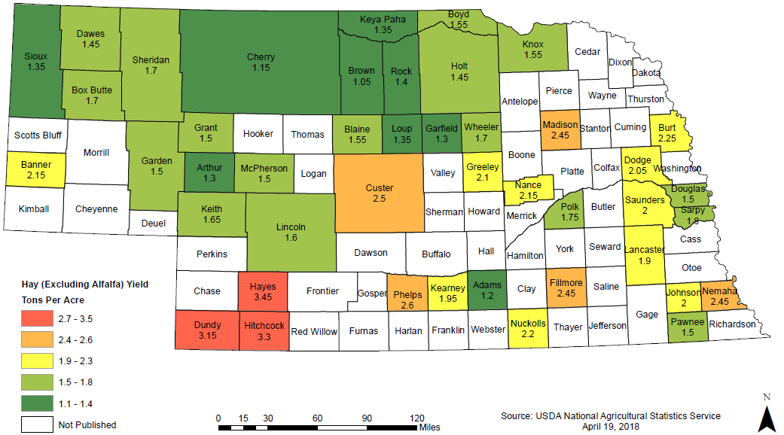
Nebraska Hay (Excluding Alfalfa) Yields – Tons/Acre - 2017
Website: https://www.nass.usda.gov/Statistics_by_State/Nebraska/Publications/County_Estimates/index.php

Slide 20
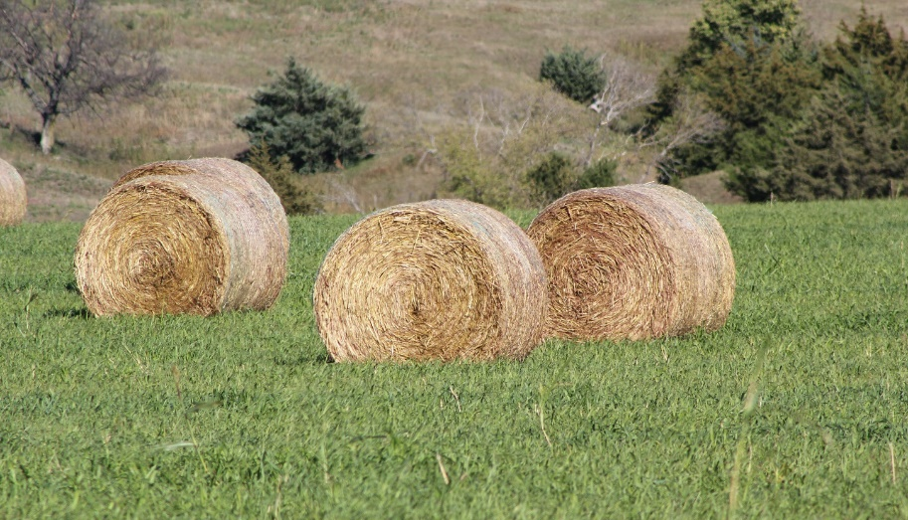
Hay Market Prices
USDA weekly hay reports
https://www.ams.usda.gov/market-news/hay-reports
Nebraska Hay & Forage Hotline
Connects buyers with sellers of hay and other forages
http://www.nda.nebraska.gov/promotion/hay/

Slide 21
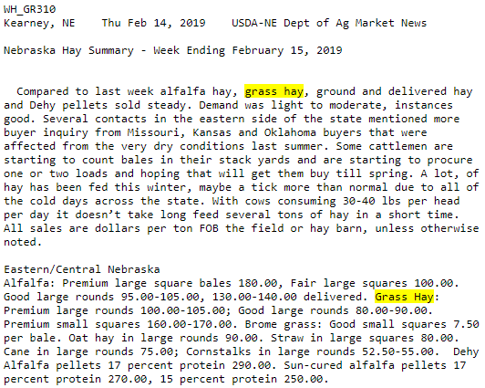
Hay Market Prices
USDA weekly hay reports
https://www.ams.usda.gov/market-news/hay-reports

Slide 22
Sampling & Testing Hay
Hay probe available at local Extension Office

Slide 23
Hay Lease Example
Lease type: crop share 50:50.
Hay produced in tons per acre: 2.5 tons.
Estimated value of high quality grass hay: $100 per ton.
Other major expenses: $30 per acre in fertilizer (20N).
Landlords share: 1.25 tons, $15 per acre in fertilizer expense
Tenants share 1.25 tons, $15 per acre in fertilizer expense

Slide 24
Hay Lease Example
Landlords cash equivalent from crop share:
50:50 Crop Share
1.25 tons of hay per acre
X $100 per ton
$125 per acre in hay revenue
$125 per acre in hay revenue
-$15 per acre in fertilizer exp.
$110 per acre in net in hay revenue per acre.
67:33 Crop Share
0.83 tons of hay per acre
X $100 per ton
$83 per acre in hay revenue

Slide 25
Grazing Land Leases
Cow-Calf Pair and Hayland Flexible Leases

Slide 26
Principle: Establishing the Base Rental Rate
Methods for estimating the base rental rate:
Adjusting survey data ~ UNL or NASS regional rates
Cash equivalent from crop share
Return on investment
What I am willing and able to accept and tenant is willing and able to pay?
Tenant: What is the maximum I can pay?
Landlord: What is the minimum I am willing to accept?

Slide 27
How will the Lease be Adjusted?
We will largely be comparing expected farm performance against actual performance
If performance is better than expected, more rent is paid
If performance is less than expected, less rent is paid

Slide 28
Flexible Leases
Flexible cash leases vary the rent paid for grazing land based upon the actual performance of the pasture, rangeland, or livestock.
The actual rent paid flexes with a predetermined range to more equitably divided the financial returns from the property.
Higher than expected performance results in a final rental rate higher than the agree upon base rate.
Lower than expected performance results in a final rental rate lower than the agree upon base rate.

Slide 29
Variable Provisions for Flexible Leases
Animal Performance
Average Daily Gain
Economic Forces
Cattle Marketing Price
Grazing land Performance
Rainfall
Forage Height (Tonnage)

Slide 30
Establishing Rental Rate Range
If Rent Rises Above $300/pair?
Default Max Payment is Made
$300/pair
Maximum Rent
$275/pair
Rent Range
Base Rent
$250/pair
Minimum Rent
If Rent Falls Below $250 Pair?
Default Min Payment is Made

Slide 31
Flexible Pasture Lease on Feeder Cattle Price Price Moves Down
Current Pasture Rent ($/Pair) | $275.00/pair
Expected Feeder Cattle Futures | $145.00/cwt.
Actual Feeder Cattle Futures | $135.85/cwt.
Percentage of Change
(135.85 – 145.00) / 145.00 | 7% Change in Price Down
Drop Pasture Rent by 7% | -$19.25/pair
Final Rent | $255.75/pair

Slide 32
Flexible Pasture Lease on Feeder Cattle Price Price Moves Up
Current Pasture Rent ($/Pair) | $275.00/pair
Expected Feeder Cattle Futures | $145.00/cwt.
Actual Feeder Cattle Futures | $155.15/cwt.
Percentage of Change
(155.15 – 145.00) / 145.00 | 7% Change in Price Up
Increase Pasture Rent by 7% | +$19.25/pair
Final Rent ($/Pair) | $294.25/pair

Slide 33
When are Payments Made?
As the tenant and landowner, you need to decide on when payments are made
Minimum Payment Due
One time or split it up over the season?
Spring – 1st installment
Summer – 2nd installment
Harvest – 3rd installment

Slide 34
Flexible Hayland Lease on Native Grasses Actual Yield Down
Current Hayland Rent ($/acre) | $110.00/acre
Expected Yield (tons/acre) | 2.5 tons/acre
Actual Yield (tons/acre) | 2.25 tons/acre
Percentage of Change
(2.25 – 2.5) / 2.5 | 10% Change in Yield Down
Drop Hayland Rent by 10% | -$11.00/acre
Final Rent | $99.00/acre

Slide 35
Flexible Hayland Lease on Native Grasses Actual Yield Up
Current Hayland Rent ($/acre) | $110.00/acre
Expected Yield (tons/acre) | 2.5 tons/acre
Actual Yield (tons/acre) | 2.75 tons/acre
Percentage of Change
(2.75 – 2.5) / 2.5 | 10% Change in Yield Up
Increase Hayland Rent by 10% | +$11.00/acre
Final Rent | $121.00/acre

Slide 36
Final Comments
There are an infinite number of ways to adjust a cash lease, these are only a few examples…
Start simple and small and build from there
Evaluate different options and methods in using alternative lease provisions
Remember the goal of the provisions
Manage the risk of the unknown in production
Receive income in the form of risk investment

Slide 37
Nebraska Farm Real Estate
Additional Resources

Slide 38
AgLease101.org – Free PDF Leases
AgLease101.org – Free PDF leases for landowners and operators
Click Document Library

Slide 39
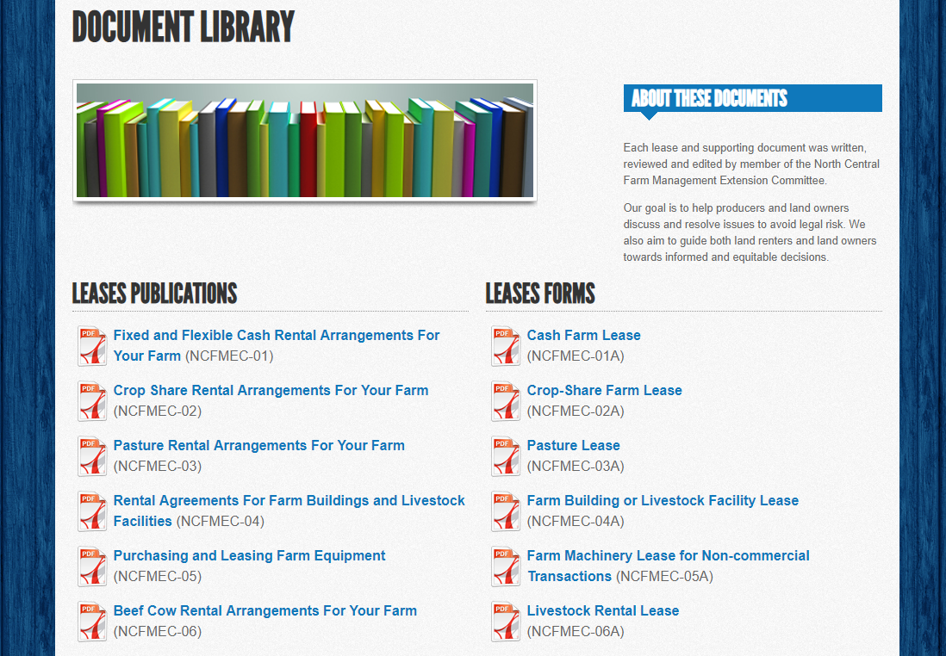
AgLease101.org – Free PDF Leases
Lease Publications
Fillable PDF Forms

Slide 40
Upcoming Landlord & Tenant Cash Rent Meetings
Feb. 25, 2019 — David City, Butler County Events Center, Butler County Fairgrounds. Please register by calling 402-367-7410 by Feb. 21
Contact: Melissa Bartels, mbartels6@unl.edu
Feb. 28, 2019 — St. Paul, St. Paul Public Library, 1301 Howard Ave. Please register by calling (308) 754-5422.
Contact: Troy Ingram, tingram5@unl.edu
March 14, 2019 — Lincoln, Lancaster County Extension Office. Please register by calling (402) 441-7180 by March 11.
Contact: Tyler Williams, tyler.williams@unl.edu

Slide 41
Upcoming Webinar: Ag Land Management Quarterly II Monday, May 20, 2019 at 6:30 PM
Website: https://agecon.unl.edu/landmanagement
Trends in Nebraska Cash Rental Rates and Land Values
Trends in cash rent for 2019 across Nebraska
Financial implications for changes in land values and cash rents
Proper Communication and Decision Making for Agricultural Land
Improving communication between landlords, tenants, and family members
Short and long-term decision making for agricultural land
Ask an Expert
Review of submitted questions and from meeting participants
Upcoming land management workshops and publications

Slide 42
Questions?
Jim Jansen
Extension Economist
jjansen4@unl.edu
402-261-7572

