Slide 1
Food Labeling Fact or Fiction?

Slide 2
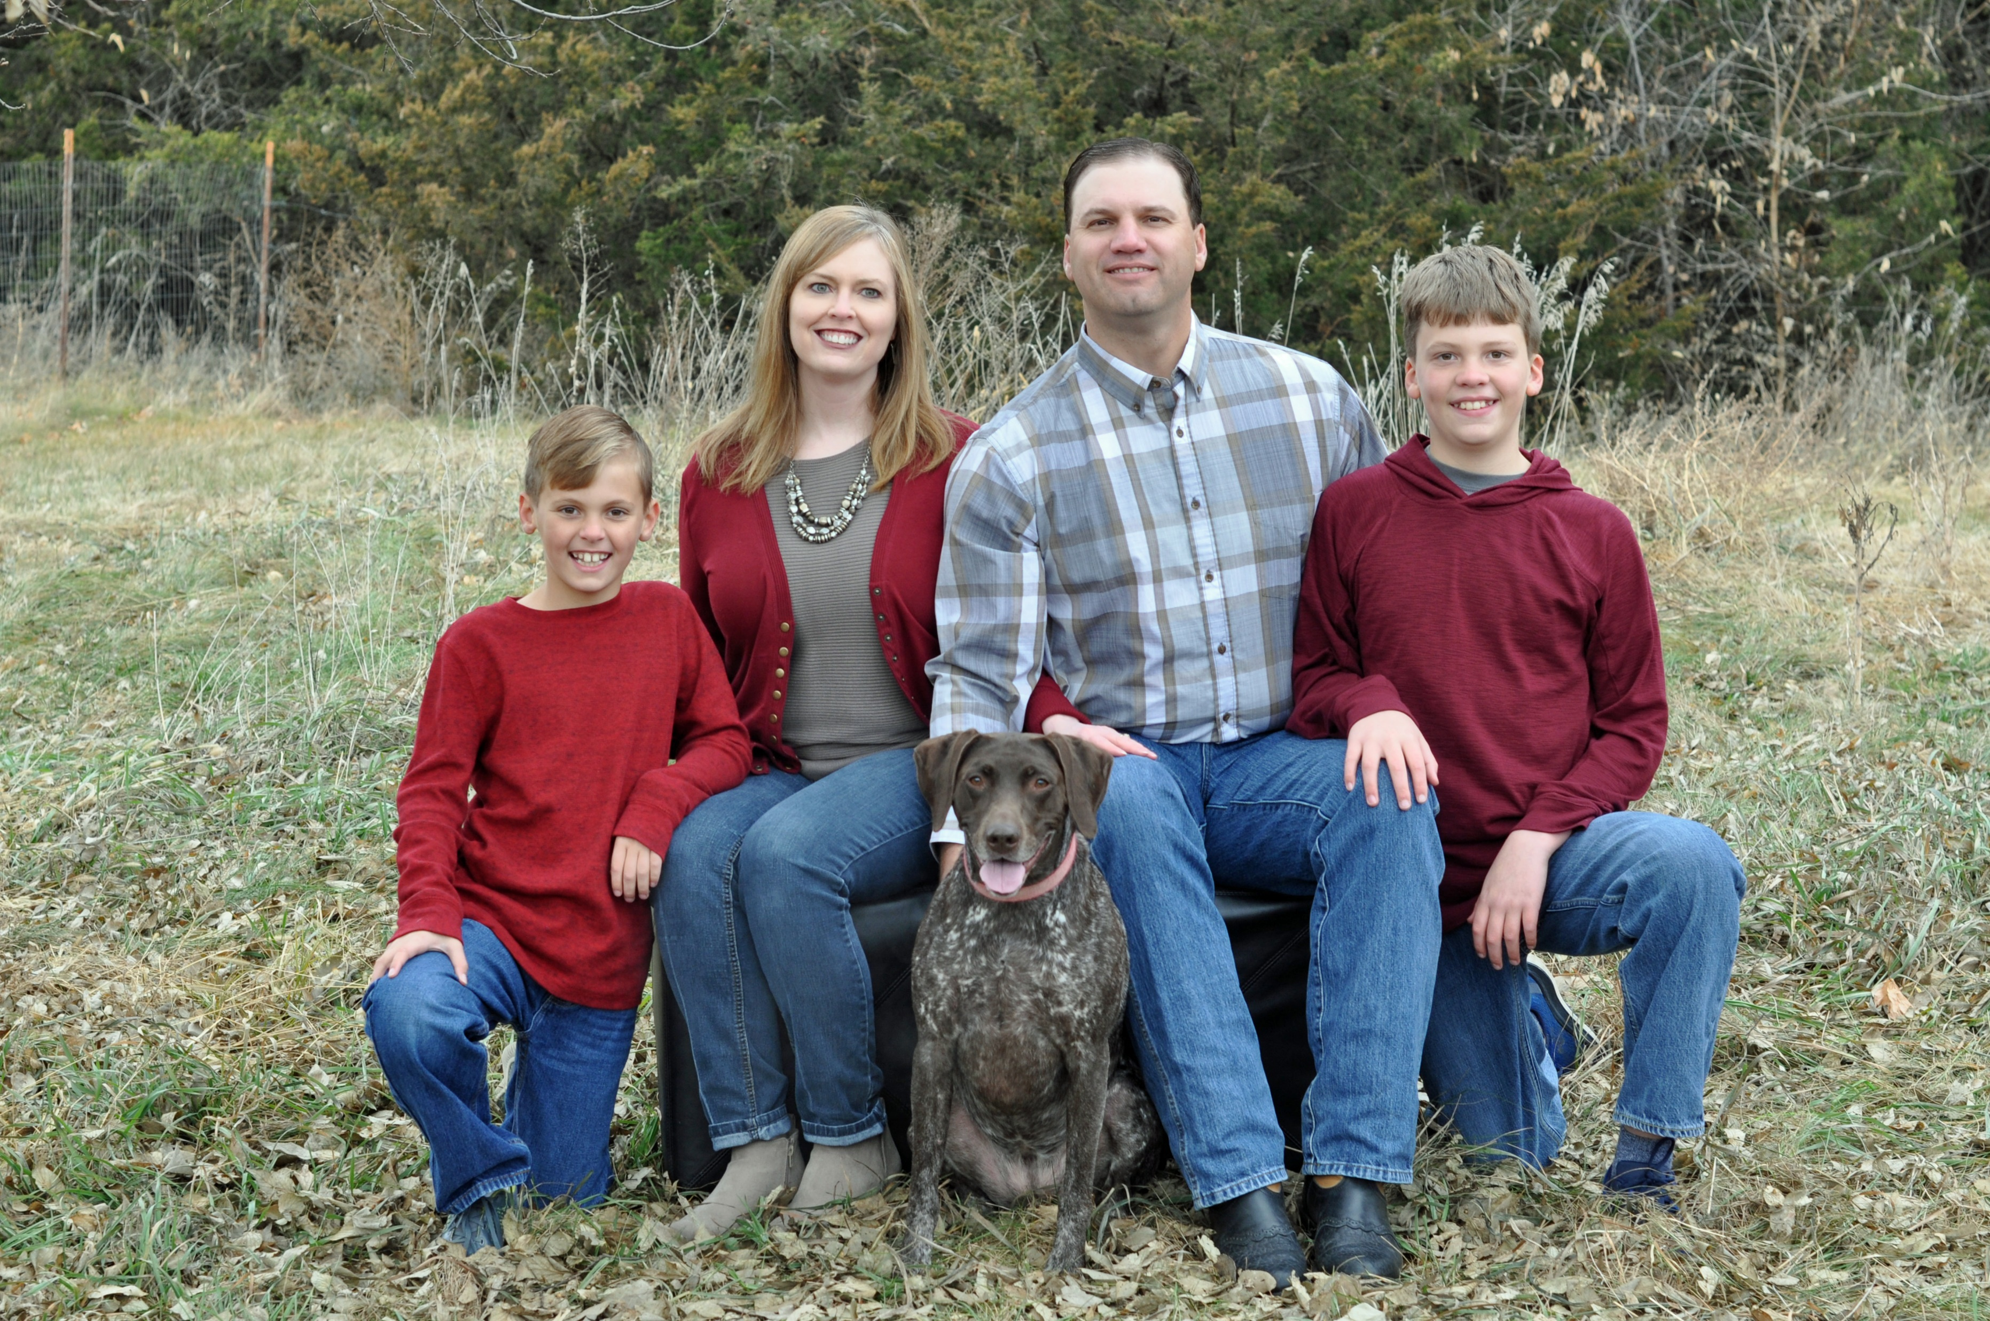
Welcome
Notes:
Introduction of Megahn
Work for Farm Bureau, Care about agriculture, Love Nebraska,
Mom, Wife, Sister, Aunt
Grew up in Litchfield, parents owned restaurant, dad raised red angus cattle
Purpose of P&E Committee – members are a dedicated group of individuals who believe in Nebraska agriculture
Why do we do what we do? Answer with why you chose to farm/ranch and why you wanted to be a part of the committee
Think of a connection to the audience and interests and concerns you might share: Family, health, environment
(Encourage any questions throughout presentation)

Slide 4
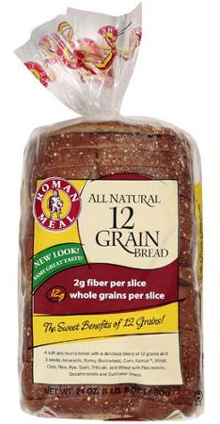
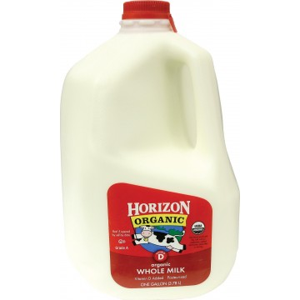
What Do You Look For?
Notes:
Ask audience to think about grocery shopping and consider food labels for products they purchase.
Tell them we aren’t focusing on nutrition information, more the front and sides of the label.
Pose these questions:
Raise your hand if you are the lead purchaser of food items in your family.
What words do you look for when you go grocery shopping?
How do you feel after reading/looking for labels at the grocery store?
Do you feel a responsibility to read the labels in the grocery store for your family?

Slide 5
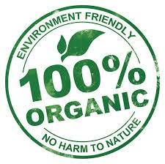
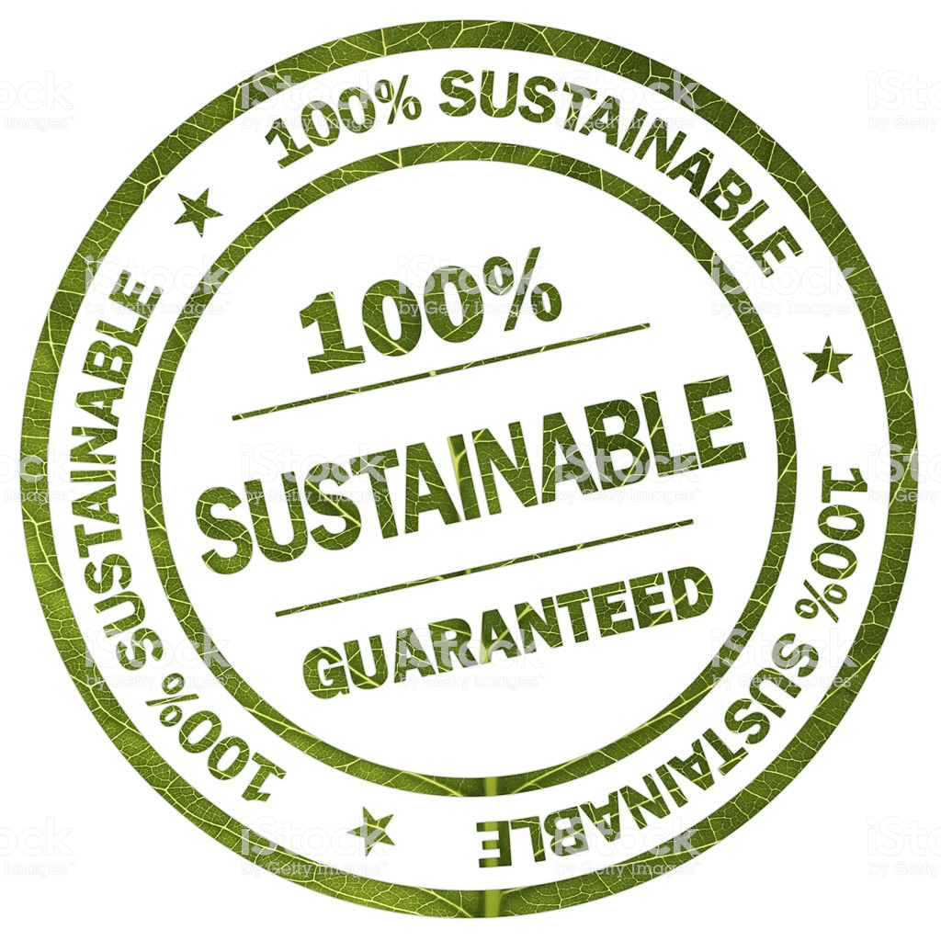
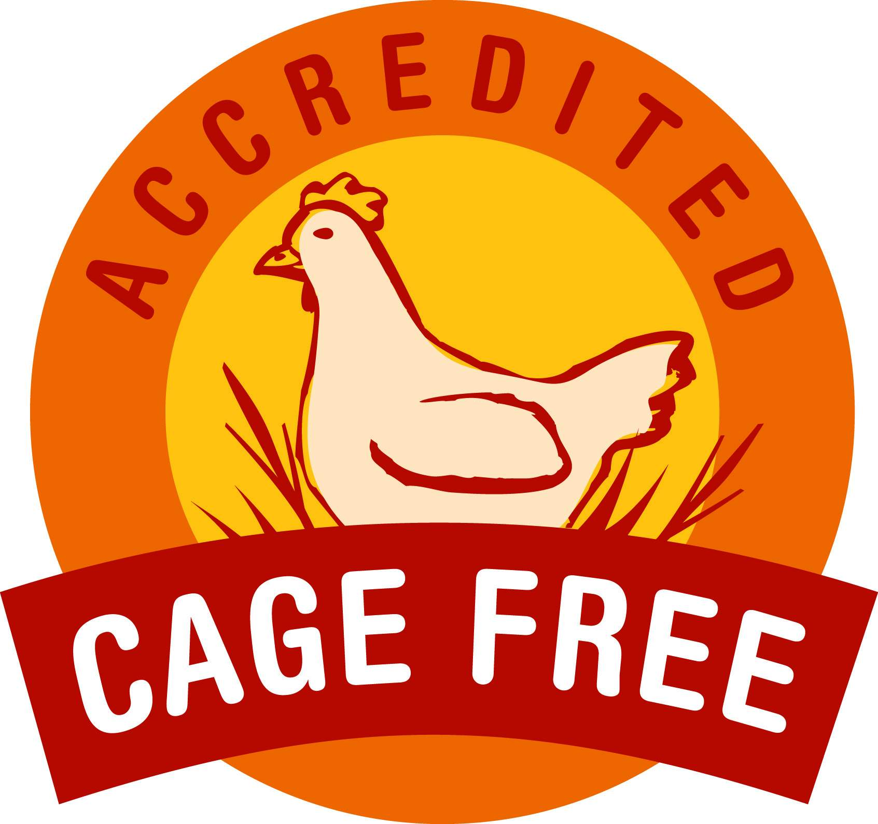
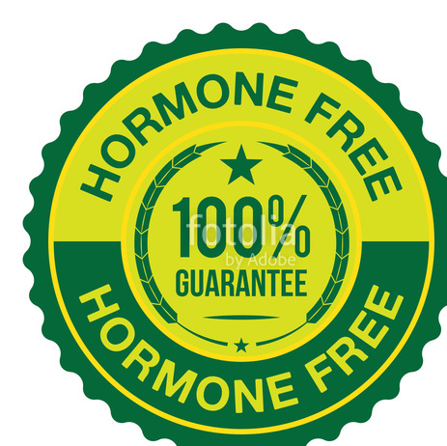
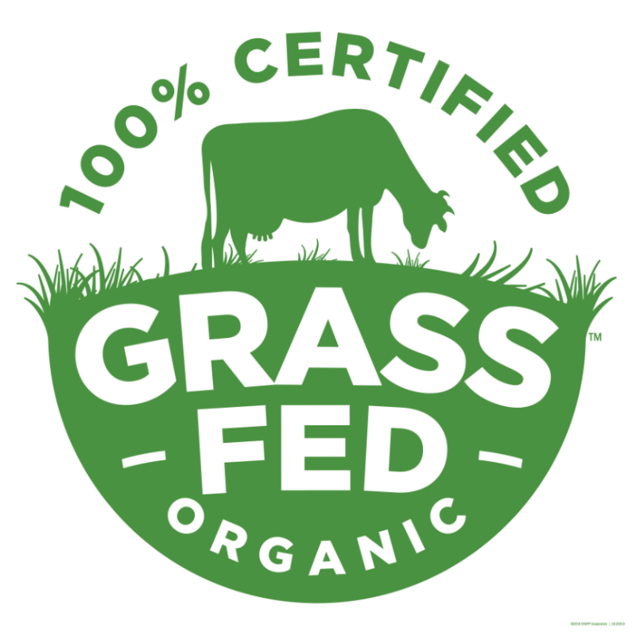
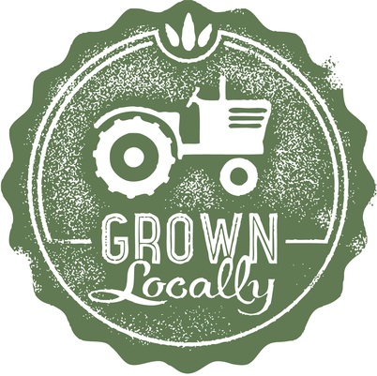
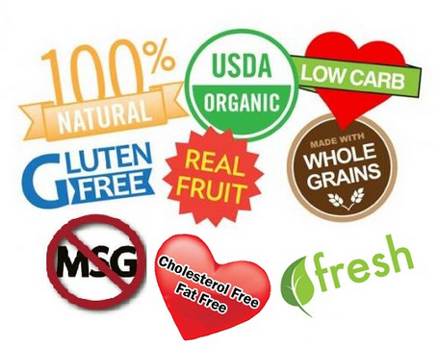
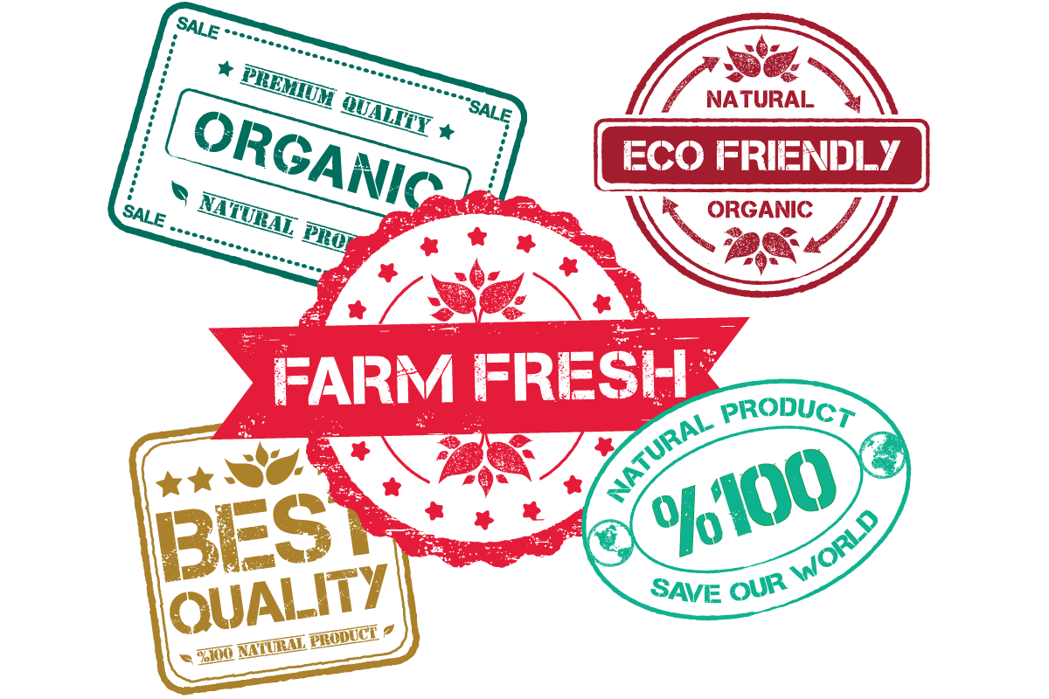
The world of food labeling can be confusing
Notes:
It’s a big job to purchase food that you feel is right for your family.
And the world of food labeling can be confusing.
What do these words mean?
Many labels today are created by companies that use marketing to play on consumer’s emotions to purchase products. So why are farmers and ranchers interested in food labels?

Slide 6
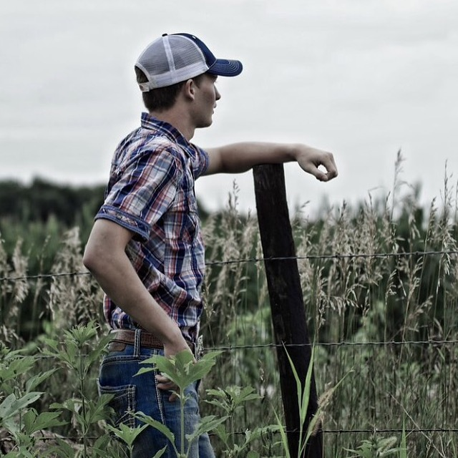
Why are farmers and ranchers interested in food labels?
Notes:
Farmers and ranchers grow 100% of the food that we eat. We have the responsibility to provide safe products for the food supply.
Many of the foods available on the market have labels related to the growing or raising of the food, including
Product origin
How the product was raised or produced

Slide 7
Our Goal Today
CHOICE
EQUIPPED
FACTS
Notes:
You have a choice. We live in a country with many products and you have a choice to choose a product that fits your families needs.
Choice is good, but all food in the United States is a safe option to choose.
We want you to leave equipped today knowing that whatever food choice you make, you’re making a safe one.
We will provide you with facts about food labeling in the United States that you can communicate with friends, family, and community members

Slide 8
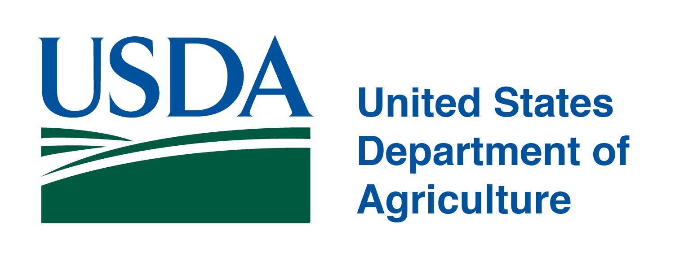
Food Labeling 101
Responsible for the oversight of the farming community.
Responsible for protecting public health by ensuring safety of our nation’s food.
Notes:
How does food labeling work?
Food labeling begins on farms and ranches. The USDA is responsible for the oversight of the farming community. They create definitions and guidelines for farmers and ranchers to follow.
The FDA is responsible for protecting public health by ensuring the safety of our nation’s food.
These two organizations – USDA and FDA – partner to create guidelines and definitions that protect farms and ranches and our nation’s food supply.

Slide 9
United States FDA
Led by the Commissioner of Food and Drugs
(Who is appointed by the President of the United States)
The Federal Food, Drug, and Cosmetic Act
Fair Packaging and Labeling Act
Laws
Regulations
Notes:
US FDA
Led by the Commission of Food and Drugs – that’s a position appointed by the president
Two primary pieces of legislation are:
The Federal Food, Drug, and Cosmetic Act and the Fair Packaging and Labeling Act provide laws and regulations for food labeling.
Consumers often have input on food labeling. These acts were created through consumer surveys and people interested in their food.
FDA creates policies and practices to carry out the legislation.

Slide 10
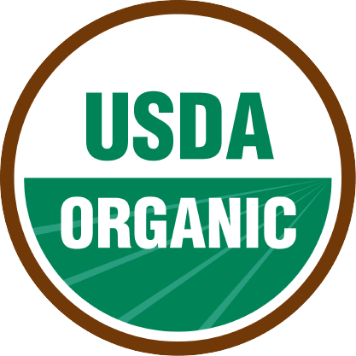
Organic
Healthiest option available on the market
Regulated by the USDA
Products are grown on small farms

Slide 11
Organic
Healthiest option available on the market
Regulated by the USDA
Products are grown on small farms
Notes:
2 Fictions
1 Fact – Regulated by the USDA

Slide 12
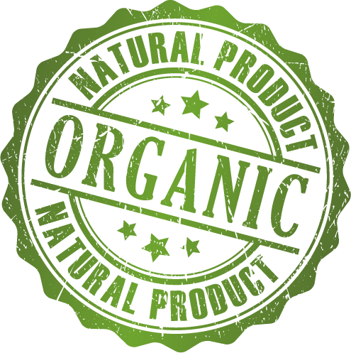
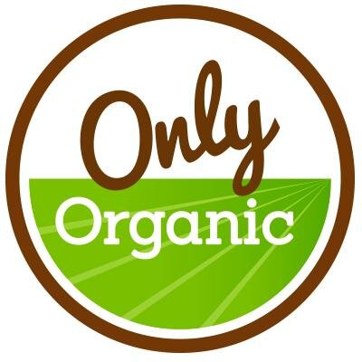
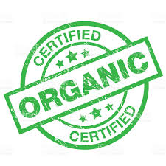
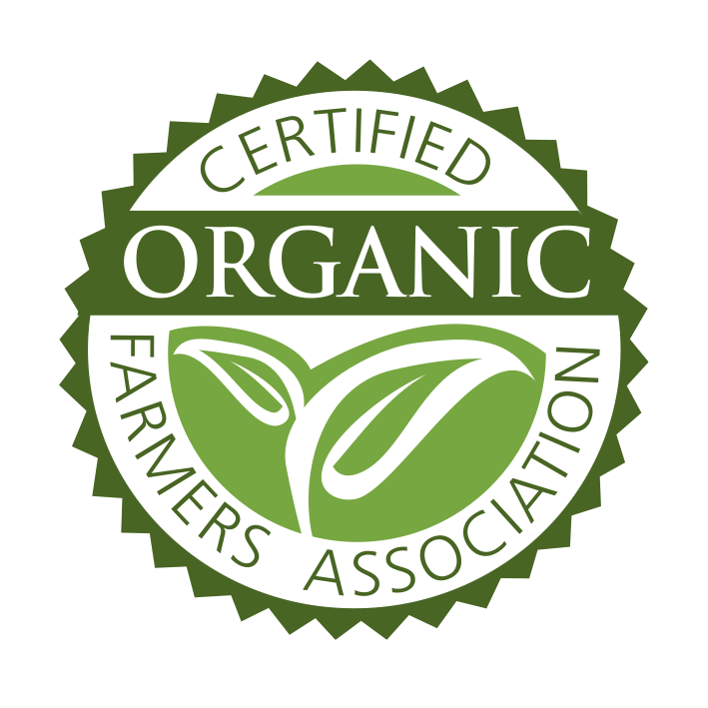
Notes:
These labels are not monitored by the USDA. They may or may not be 100% organic. They could have organic ingredients or be made with organic…

Slide 13
Notes:
The USDA Organic label is the only organic label monitored by the USDA.
There are different levels of organic.
You can find information about Organic labels from the USDA.

Slide 14
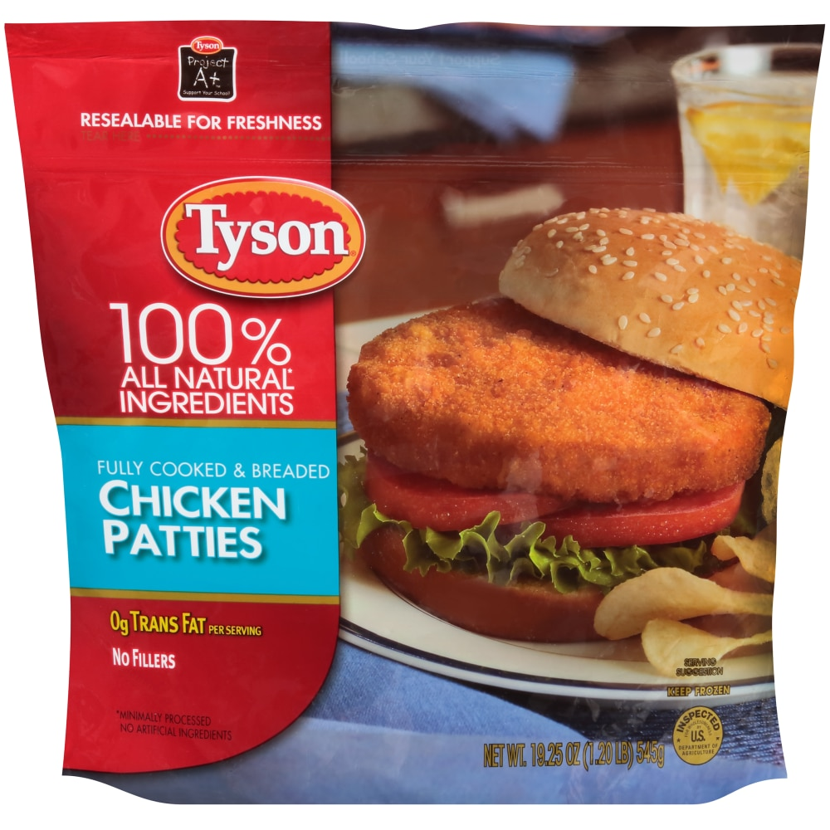
Natural
Nothing artificial or synthetic has been added
No antibiotics have been used
No herbicides or pesticides have been used to grow the product
Notes:
Fact: Nothing artificial or synthetic has been added
Fiction: No antibiotics have been used & No herbicides or pesticides have been used to grow the product

Slide 15
Natural
Nothing artificial or synthetic has been added
No antibiotics have been used
No herbicides or pesticides have been used to grow the product
Notes:
Fact: Nothing artificial or synthetic has been added
Fiction: No antibiotics have been used & No herbicides or pesticides have been used to grow the product

Slide 16
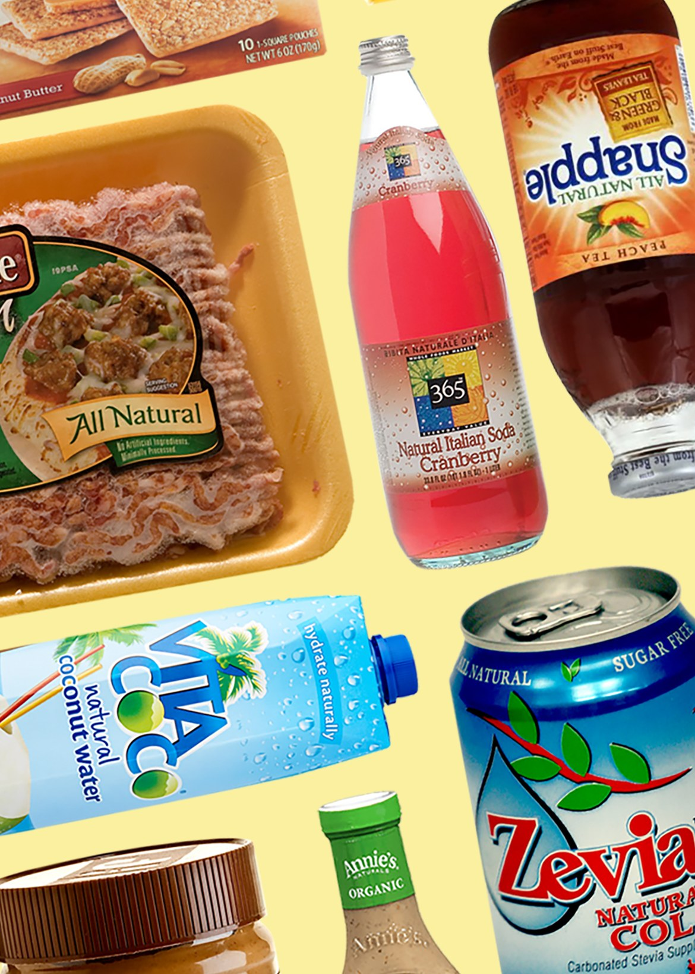
Natural Definitions
FDA: No formal rulemaking; policy requires explaining statement
USDA: A product containing no artificial ingredient or added color and is only minimally processed.
Notes:
While the FDA has not engaged in rulemaking to establish a formal definition for the term “natural”, they do have a longstanding policy concerning the use of “natural” in human food labeling.
The label must include a statement explaining the meaning of the term natural (such as Natural: “no artificial ingredients” or “minimal processing”)
In 2016, FDA asked for consumers to comment on the term Natural and has yet to issue a definition.
For meat and poultry, the USDA regulates the term, and the “natural” label has nothing to do with how the animal was raised and more to do with how the meat has been processed.
Minimal processing means that the product was processed in a manner that does not fundamentally alter the product.

Slide 17
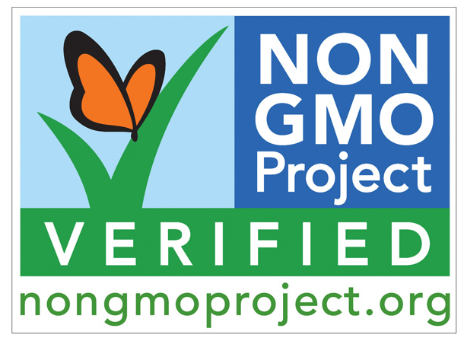
Non GMO Project
All ingredients are verified and are GMO free
Regulated by the USDA
Prohibits use of synthetic fertilizers and pesticides
Notes:
All fiction
This is a private label and monitored by a private organization.
What does GMO mean?

Slide 18
Non GMO Project
All ingredients are verified and are GMO free
Regulated by the USDA
Prohibits use of synthetic fertilizers and pesticides
Notes:
All fiction
This is a private label and monitored by a private organization. You can read more at the website, but it is important to note that it is self-monitored.
So, what is accurate about genetic engineering?

Slide 19
GMOs on the Market
Notes:
The 10 genetically modified crops available today: alfalfa
Apples
Canola
corn (field and sweet)
Cotton
Papaya
Potatoes
Soybeans
Squash
sugar beets.

Slide 20
The FDA on GMOs
Foods derived from genetically engineered plants must meet the same safety, labeling, and other regulatory requirements that apply to all foods regulated by the FDA.
Notes:
This definition applies to all foods, but if the genetic engineering alters the composition of a product, it must be labeled. For example, GE soybeans have higher levels of oleic acid – they must be labeled high oleic soybean oil.
So, as a farmer, how do you explain why you would want to use GMOs? (personal story – focus on the good things it does for the environment)

Slide 21
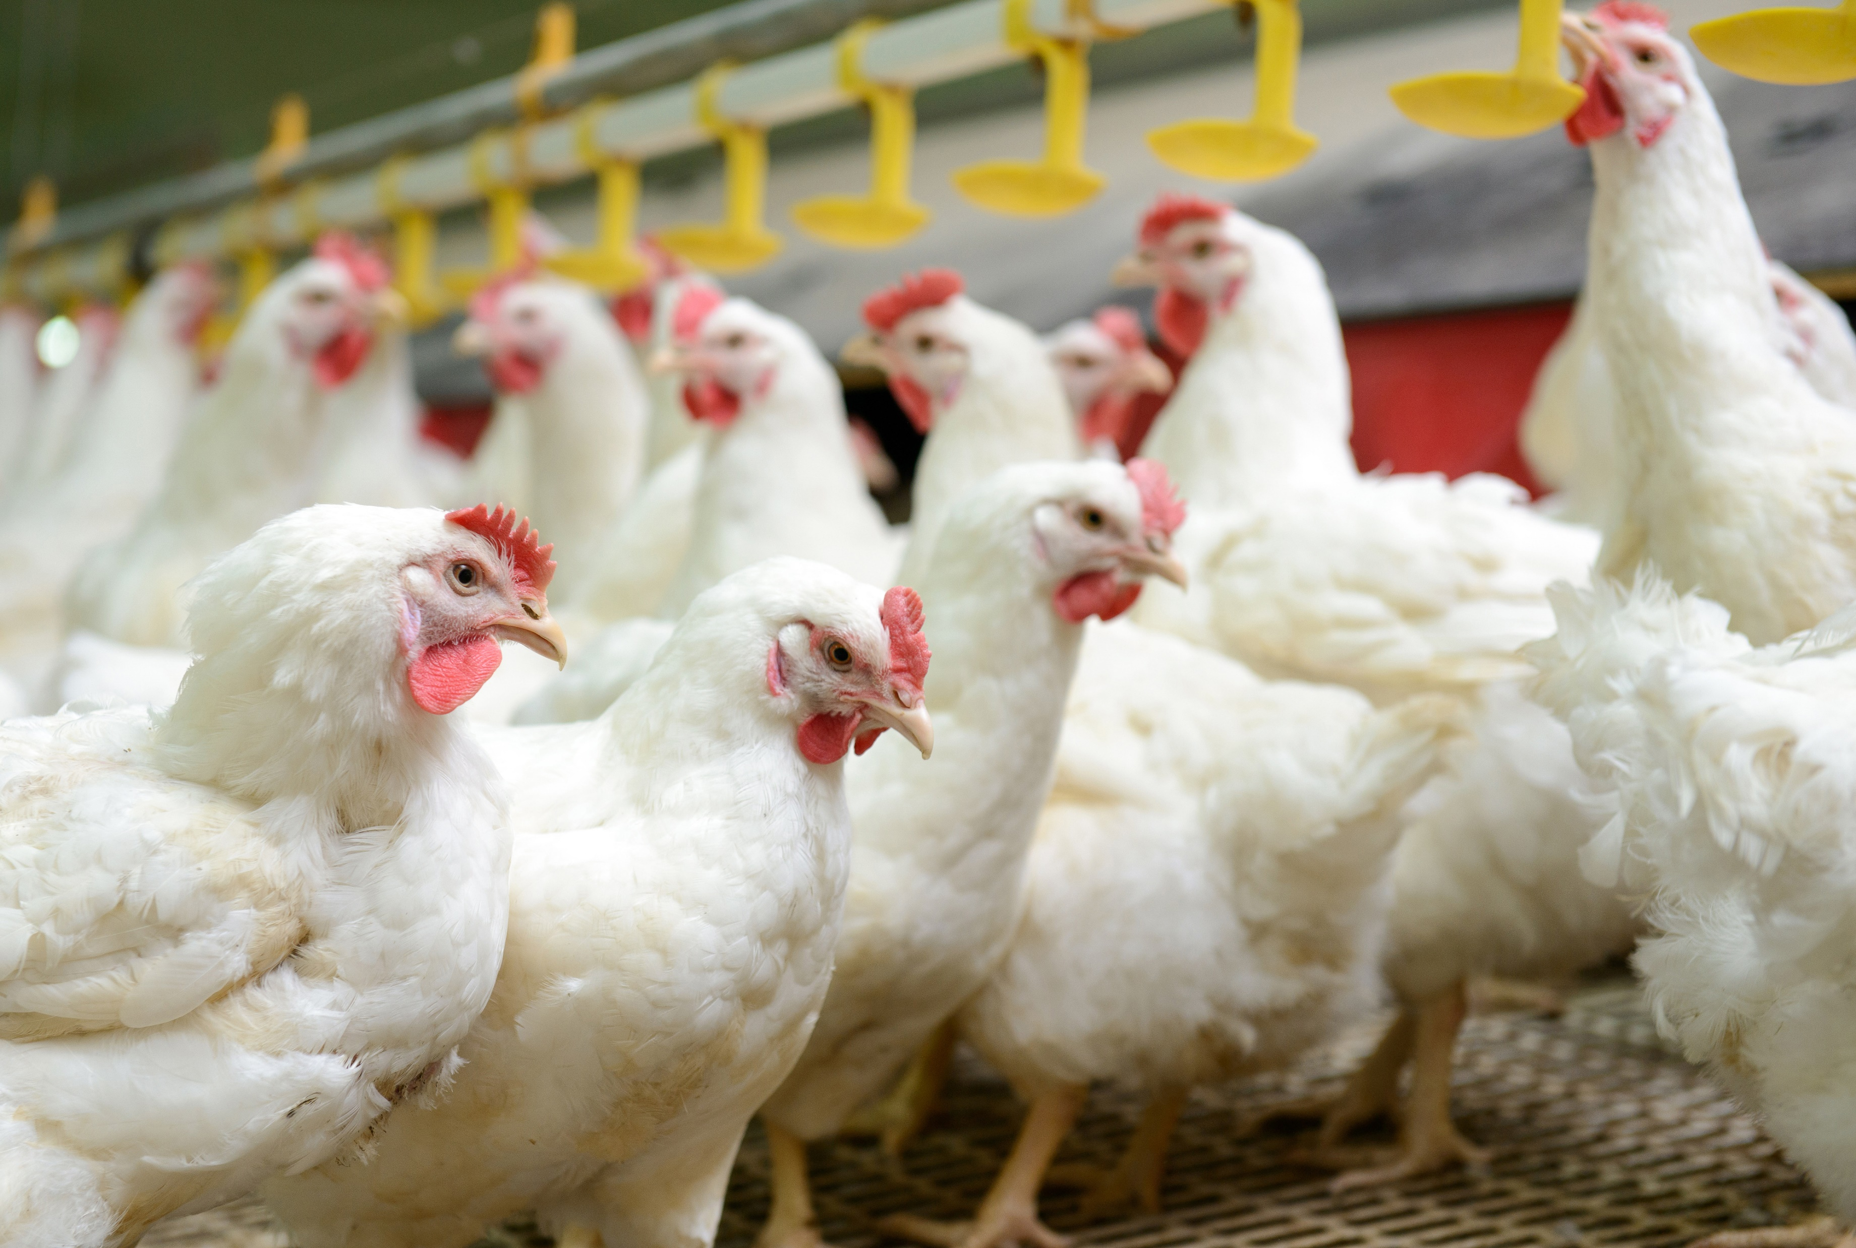
Free Range or Cage Free
Animals live outside 100% of their life
Farmers must pay a fee to participate in a verification process
Only for poultry
Notes:
Fact: Only for poultry….
There is no verification process for farmers and the USDA says the poultry must have “access” to the outside. It does not state how much time they should be allowed to live outside.

Slide 22
Free Range or Cage Free
Animals live outside 100% of their life
Farmers must pay a fee to participate in a verification process
Only for poultry
Notes:
Fact: Only for poultry….
Through its Livestock, Poultry, and Seed Program, AMS provides shell egg quality grading and certification services to businesses on a voluntary, fee-for-service basis. Egg cartons bearing the USDA Grade Shield – usually either “USDA Grade AA” or “USDA Grade A” – must meet strict U.S. quality standards. In addition to verifying that eggs meet the stated grade, USDA’s highly-trained graders inspect processing facilities for proper sanitation and refrigeration, and verify proper identification and traceability methods such as code dating and plant numbers. Further, packaging materials that bear a USDA Grade Shield must be pre-approved by USDA to ensure the labeling is truthful and not misleading. This includes claims regarding the method of production (cage-free, free range, etc.), making the USDA Grade Shield a symbol of quality and integrity.
Not all USDA graded eggs are cage-free, and not all cage-free eggs are graded by USDA. But, eggs packed under a USDA Grade Shield and marketed as cage-free – or with any other production claim – must be source-verified by USDA through onsite farm visits, at least twice annually, to check that the laying hens are housed in the appropriate production system. For AMS approval, cage-free eggs must be produced by hens housed in a way that allows for not only unlimited access to food and water, but, unlike eggs from caged hens, also provides them the freedom to roam during the laying cycle.
We also know some consumers prefer their eggs to come from “free range” hens. For those eggs, we verify they are produced by hens that are not only housed in a way that allows for unlimited access to food and water and provides the freedom to roam within the area like cage-free hens but also gives the hens continuous access to the outdoors during their laying cycle.
Whether you are an agricultural business wanting to differentiate your product in the marketplace or a consumer looking for quality eggs, AMS grading and certification services ensure that quality and marketing claims are verified from farm to table.

Slide 23
USDA Definition
Producers must demonstrate to the Agency that the poultry has been allowed access to the outside.
Notes:
Labels provide impression to consumers that the chickens live outside all of the time.
Farmers must provide proof that the poultry is allowed outside to the USDA; however, no labels are regulated by the FDA.
All labels have a private company provide their own verification process. Are those sources reliable? Research to find more about your labels!
So, as a chicken farmer, why would you want to keep your birds inside instead of outside?

Slide 24
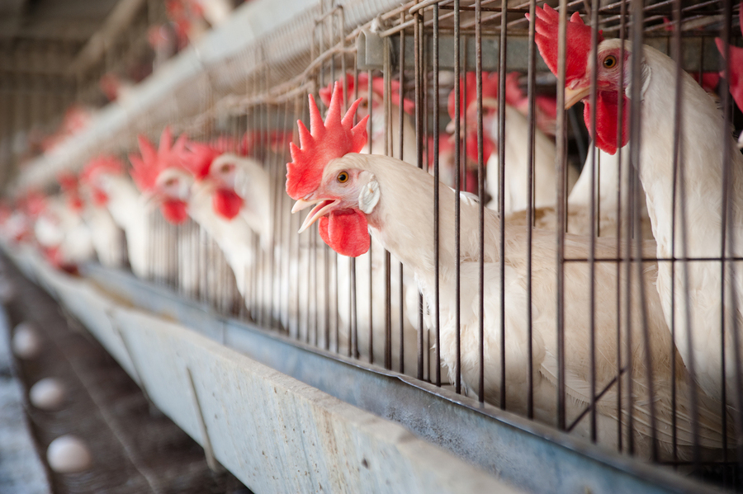
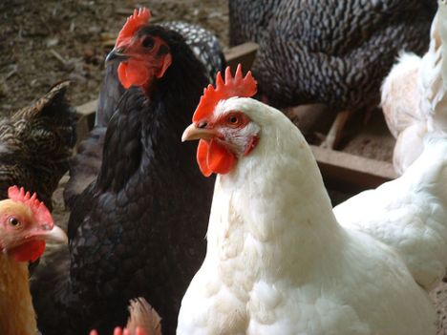
Why Barns?
PROTECTION
FROM
Weather
Disease
Predators
Notes:
We can control the temperature inside of the barns. It may be 100 degrees in the summer, but 70 degrees in the barn. Or the opposite. – 10 degrees outside and 70 degrees in the barn.
We practice biosecurity. Avian flu is one of the most widely known diseases, restricting outside access to the chickens prevents chickens from getting sick or spreading illness to other farms.
Chickens are easy prey. We’ve got a lot of prey in Nebraska! Coyotes, bobcats, raccoons, and foxes, and but also hawks and owls. Having an enclosed shelter gives them a sense of security.
Pecking virus, Keel bone injuries, crowding on the floor

Slide 25
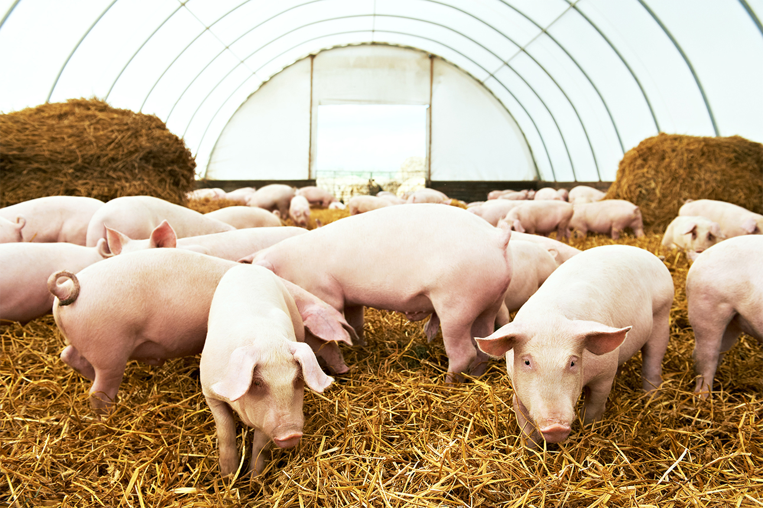
Local
Product traveled less than 60 miles.
Products are made in small batches.
Farmers are sustainable, small, and organic.
Notes:
Fact: None

Slide 26
Local
Product traveled less than 60 miles.
Products are made in small batches.
Farmers are sustainable, small, and organic.
Notes:
Fact: None
There is no FDA or usda regulation on the term local for labels.
What about “local” food? Is that regulated?
This is another vague label. There is no legal definition of what makes a food “local.” Some consider a 400-mile radius local. Whole Foods says 200 miles. Other locavores may want food only from within 100 miles; it all depends on who you ask. Amid the debate of what “local” means, there are arguments that food miles are just one component of calculating a dish’s carbon footprint — production and storage are bigger factors.

Slide 27
Local: Nebraska!
Notes:
Defined as “locality or region where final food product is marketed.” Not where it was grown!
Some places it means 400 miles and others mean 30 miles….
There is no regulation behind this label.
A farmer’s market isn’t the only place to purchase local food. Nebraska is one of the Top 5 Agricultural States. We have some of the biggest processing plants in our state; Tyson, Cargill, Farmland, and JBS to name a few. We also have many hogs and cattle in our state. When you’re buying from those companies, you’re buying local. Many farmers and ranchers in Nebraska work with those companies to provide them a product to sell on a national scale.

Slide 28
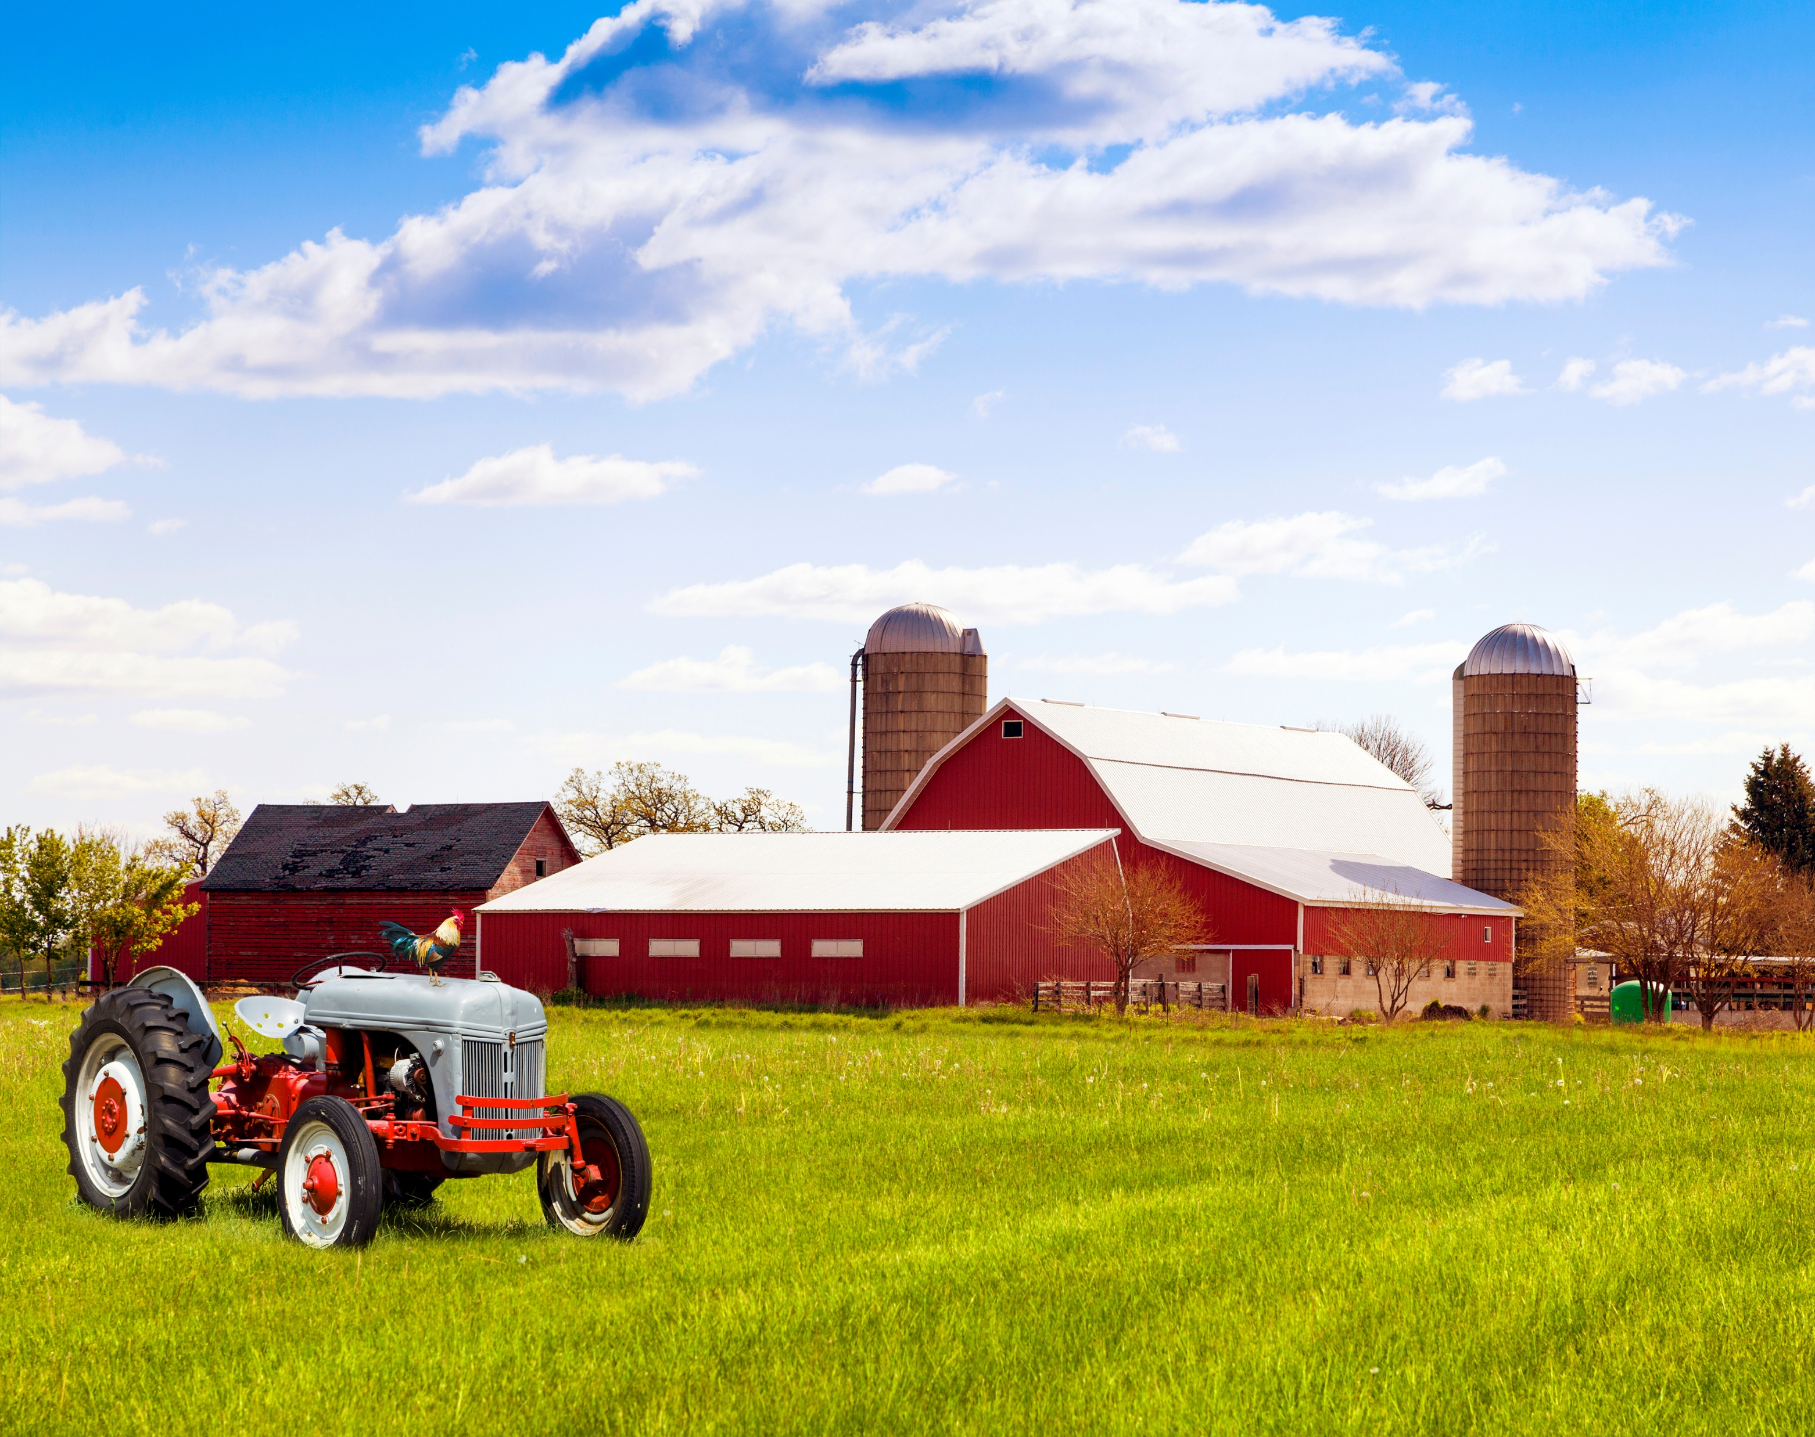
Sustainable
USDA regulated
Farmers/ranchers use less natural resources
Farmers/ranchers enhance the quality of life for animals
Notes:
The USDA has a 1 page definition for sustainable farming, but no verification process for a label through the FDA.

Slide 29
Sustainable
USDA regulated
Farmers/ranchers use less natural resources
Farmers/ranchers enhance the quality of life for animals
Notes:
The USDA has a 1 page definition for sustainable farming, but no verification process for a label through the FDA.

Slide 30
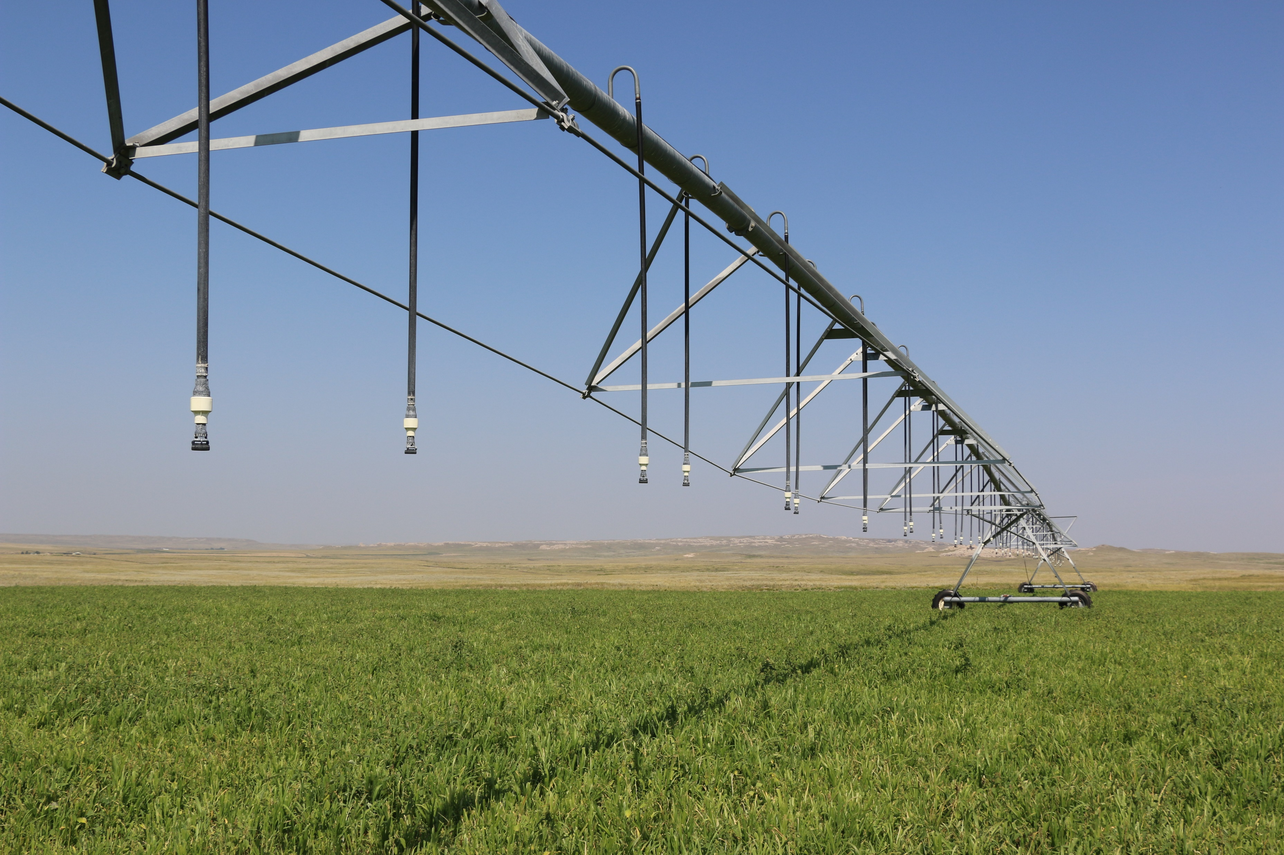
Sustainable
Food and fiber
Natural resources
Nonrenewable resources
Economic viability
Quality of life
Notes:
The USDA has a 1 page definition for sustainable farming, but no verification process for a label through the FDA.
Legal Definition of Sustainable Agriculture
The term ''sustainable agriculture'' (U.S. Code Title 7, Section 3103 (link is external)) means an integrated system of plant and animal production practices having a site-specific application that will over the long-term:
Satisfy human food and fiber needs.
Enhance environmental quality and the natural resource base upon which the agriculture economy depends.
Make the most efficient use of nonrenewable resources and on-farm resources and integrate, where appropriate, natural biological cycles and controls.
Sustain the economic viability of farm operations.
Enhance the quality of life for farmers and society as a whole.

Slide 31
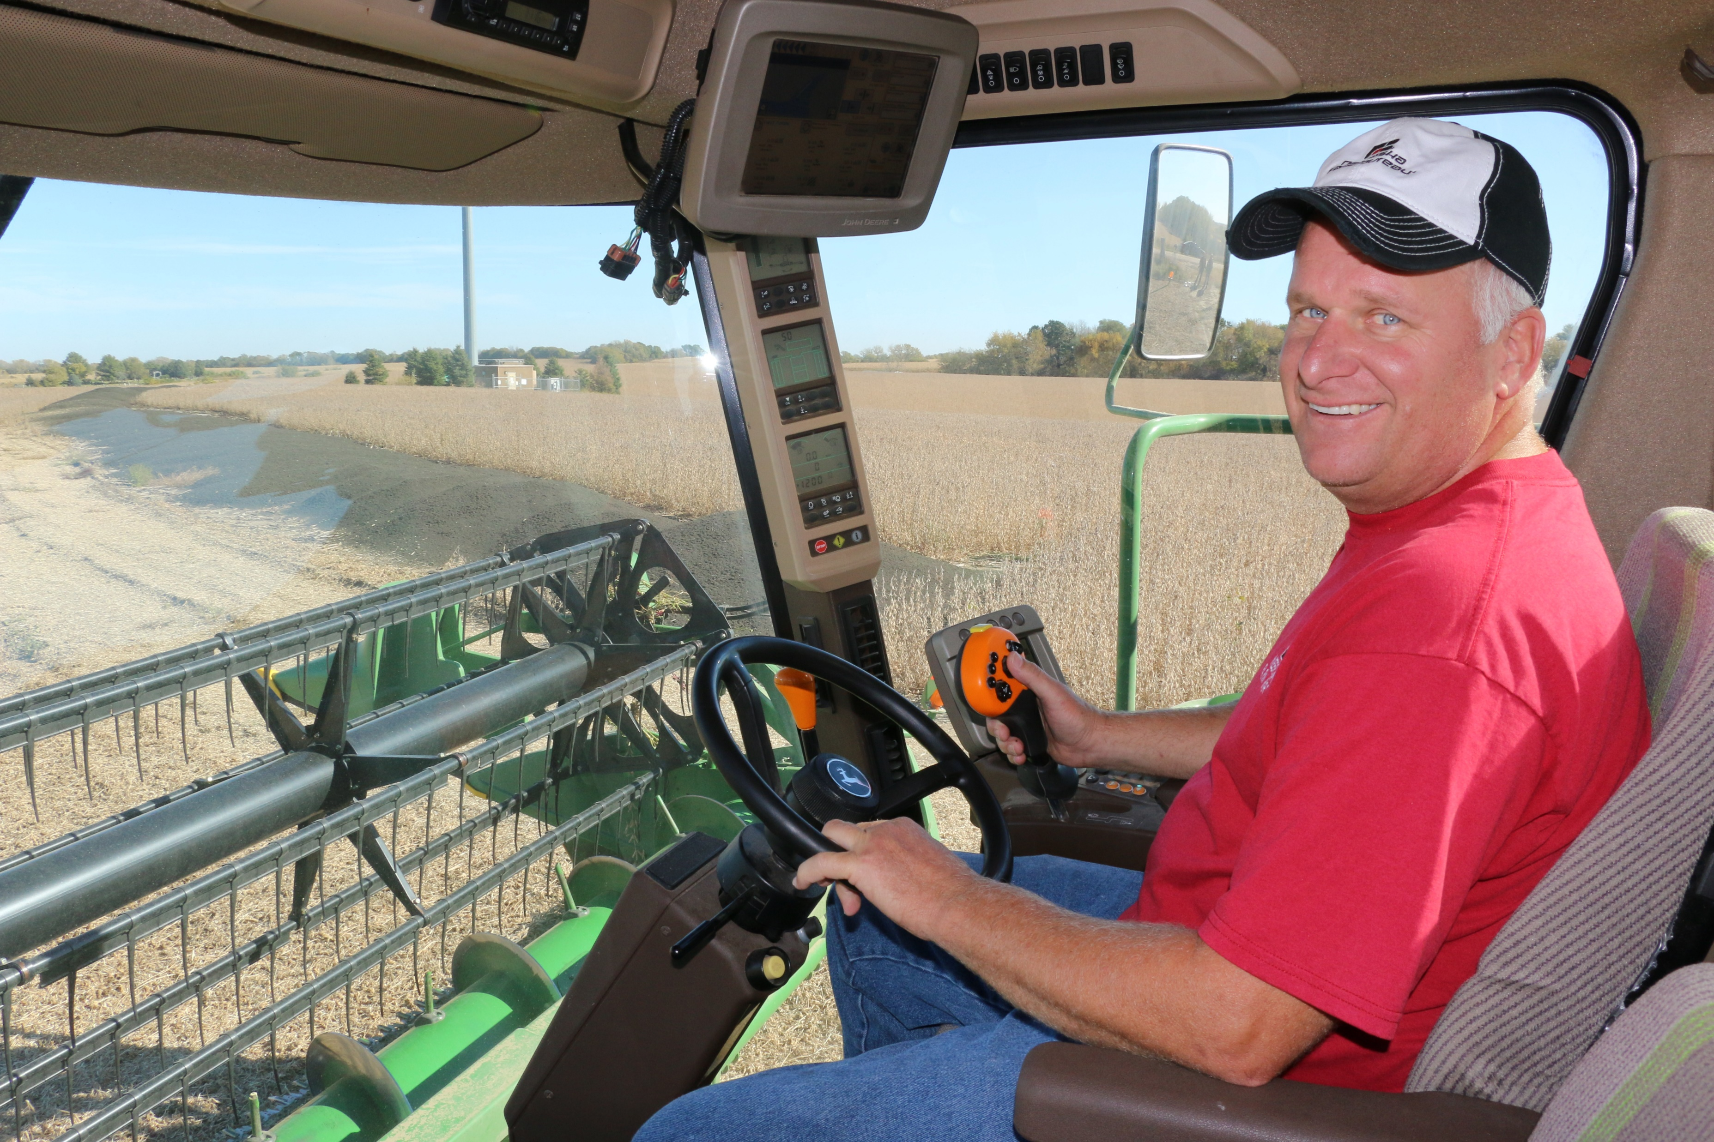
Sustainable Farm & Ranch Practices
Integrated Pest Management
Rotational Grazing
Soil Conservation
Water Quality/Wetlands
Cover Crops
Crop/Landscape Diversity
Nutrient Management
Agroforestry
Alternative Marketing
Notes:
Integrated Pest Management (IPM): IPM is an approach to managing pests by combining biological, cultural, physical, and chemical tools in ways that minimize economic, health and environmental risks.
Rotational Grazing: Management-intensive grazing systems take animals out of the barn and into the pasture to provide high-quality forage and reduced feed costs while avoiding manure buildup.
Soil Conservation: Many soil conservation methods, including strip cropping, reduced tillage, and no-till, help prevent loss of soil caused by wind and water erosion.
Water Quality/Wetlands: Water conservation and protection have become important parts of agricultural stewardship. Practices such as planting riparian buffer strips can improve the quality of drinking and surface water, as well as protect wetlands.
Cover Crops: Growing plants such as rye, clover, or vetch after harvesting a grain or vegetable crop or intercropping them can provide several benefits, including weed suppression, erosion control, and improved soil nutrients and soil quality.
Crop/Landscape Diversity: Growing a greater variety of crops and livestock on a farm can help reduce risks from extremes in weather, market conditions, or pests. Increased diversity of crops and other plants, such as trees and shrubs, also can contribute to soil conservation, wildlife habitat, and increased populations of beneficial insects.
Nutrient Management: Proper management of manure, nitrogen, and other plant nutrients can improve the soil and protect the environment. Increased use of on-farm nutrient sources, such as manure and leguminous cover crops, also reduces purchased fertilizer costs.
Agroforestry: Agroforestry covers a range of tree uses on farms, including inter-planting trees (such as walnuts) with crops or pasture, growing shade-loving specialty crops in forests, better managing woodlots and windbreaks, and using trees and shrubs along streams as buffer strips.
Alternative Marketing: Farmers and ranchers across the country are finding that innovative marketing strategies can improve profits. Direct marketing of agricultural goods may include selling at farmers markets, roadside stands, or through the World Wide Web; delivering to restaurants and small grocers; and running community-supported agriculture (CSA) enterprises.

Slide 32
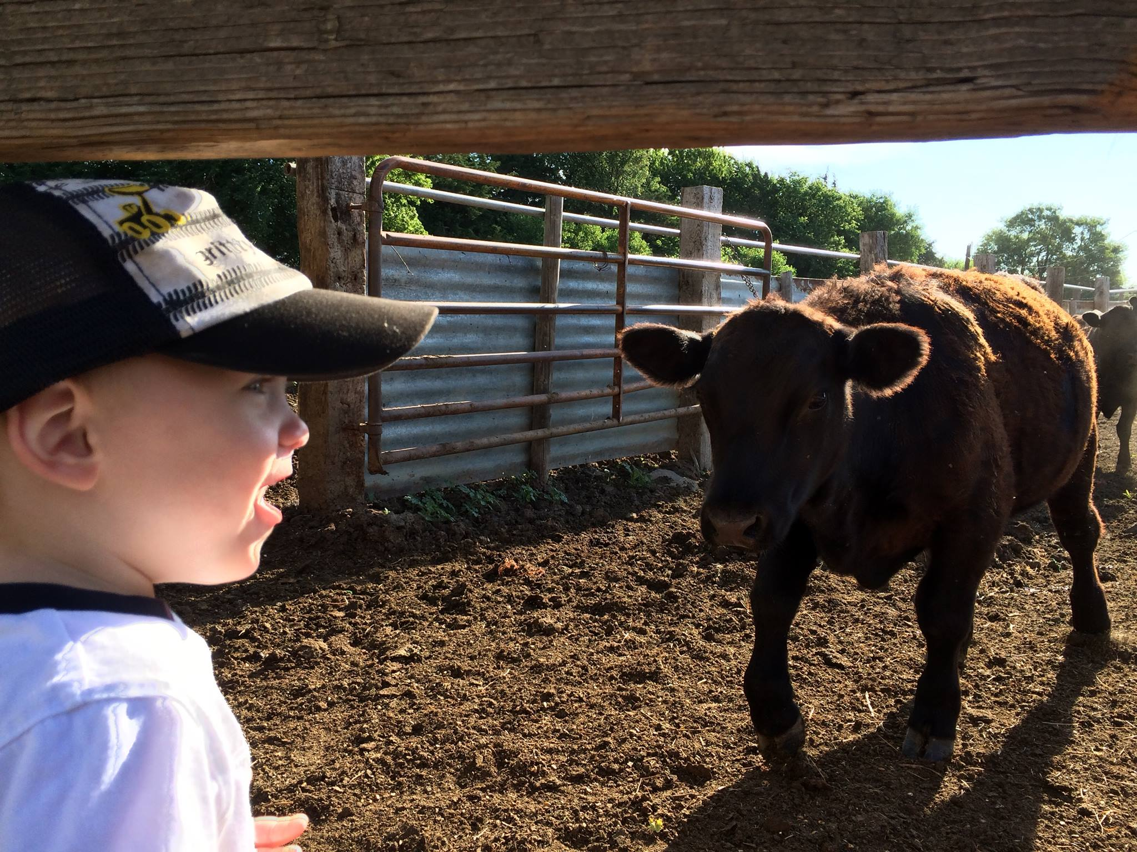
Raised Without Antibiotics
No label means the animal received antibiotics
No label means there could be antibiotics in the meat
Label indicates the animal never received any antibiotics in its lifetime
Notes:
When you see this label – it means that the animal never received any antibiotics in its lifetime.
However, did you know? No antibiotics enter into the food system. So how does that work?

Slide 33
Raised Without Antibiotics
No label means the animal received antibiotics
No label means there could be antibiotics in the meat
Label indicates the animal never received any antibiotics in its lifetime
Notes:
When you see this label – it means that the animal never received any antibiotics in its lifetime.
However, did you know? No antibiotics enter into the food system. So how does that work?

Slide 34
Notes:
Farmers work in partnership with veterinarians as a part of their quality assurance programs to give the right dose at the right time to animals.
Antibiotics are given only to animals that are sick. This prevents the spread of disease and keeps farm animals safe and healthy.
When an animal is given an antibiotic, they are given a dosage that has been approved by the FDA. So if we give the animals antibiotics on our farms and ranches, how do no antibiotics enter the food system?
Farmers and ranchers use Withdrawal periods.

Slide 35
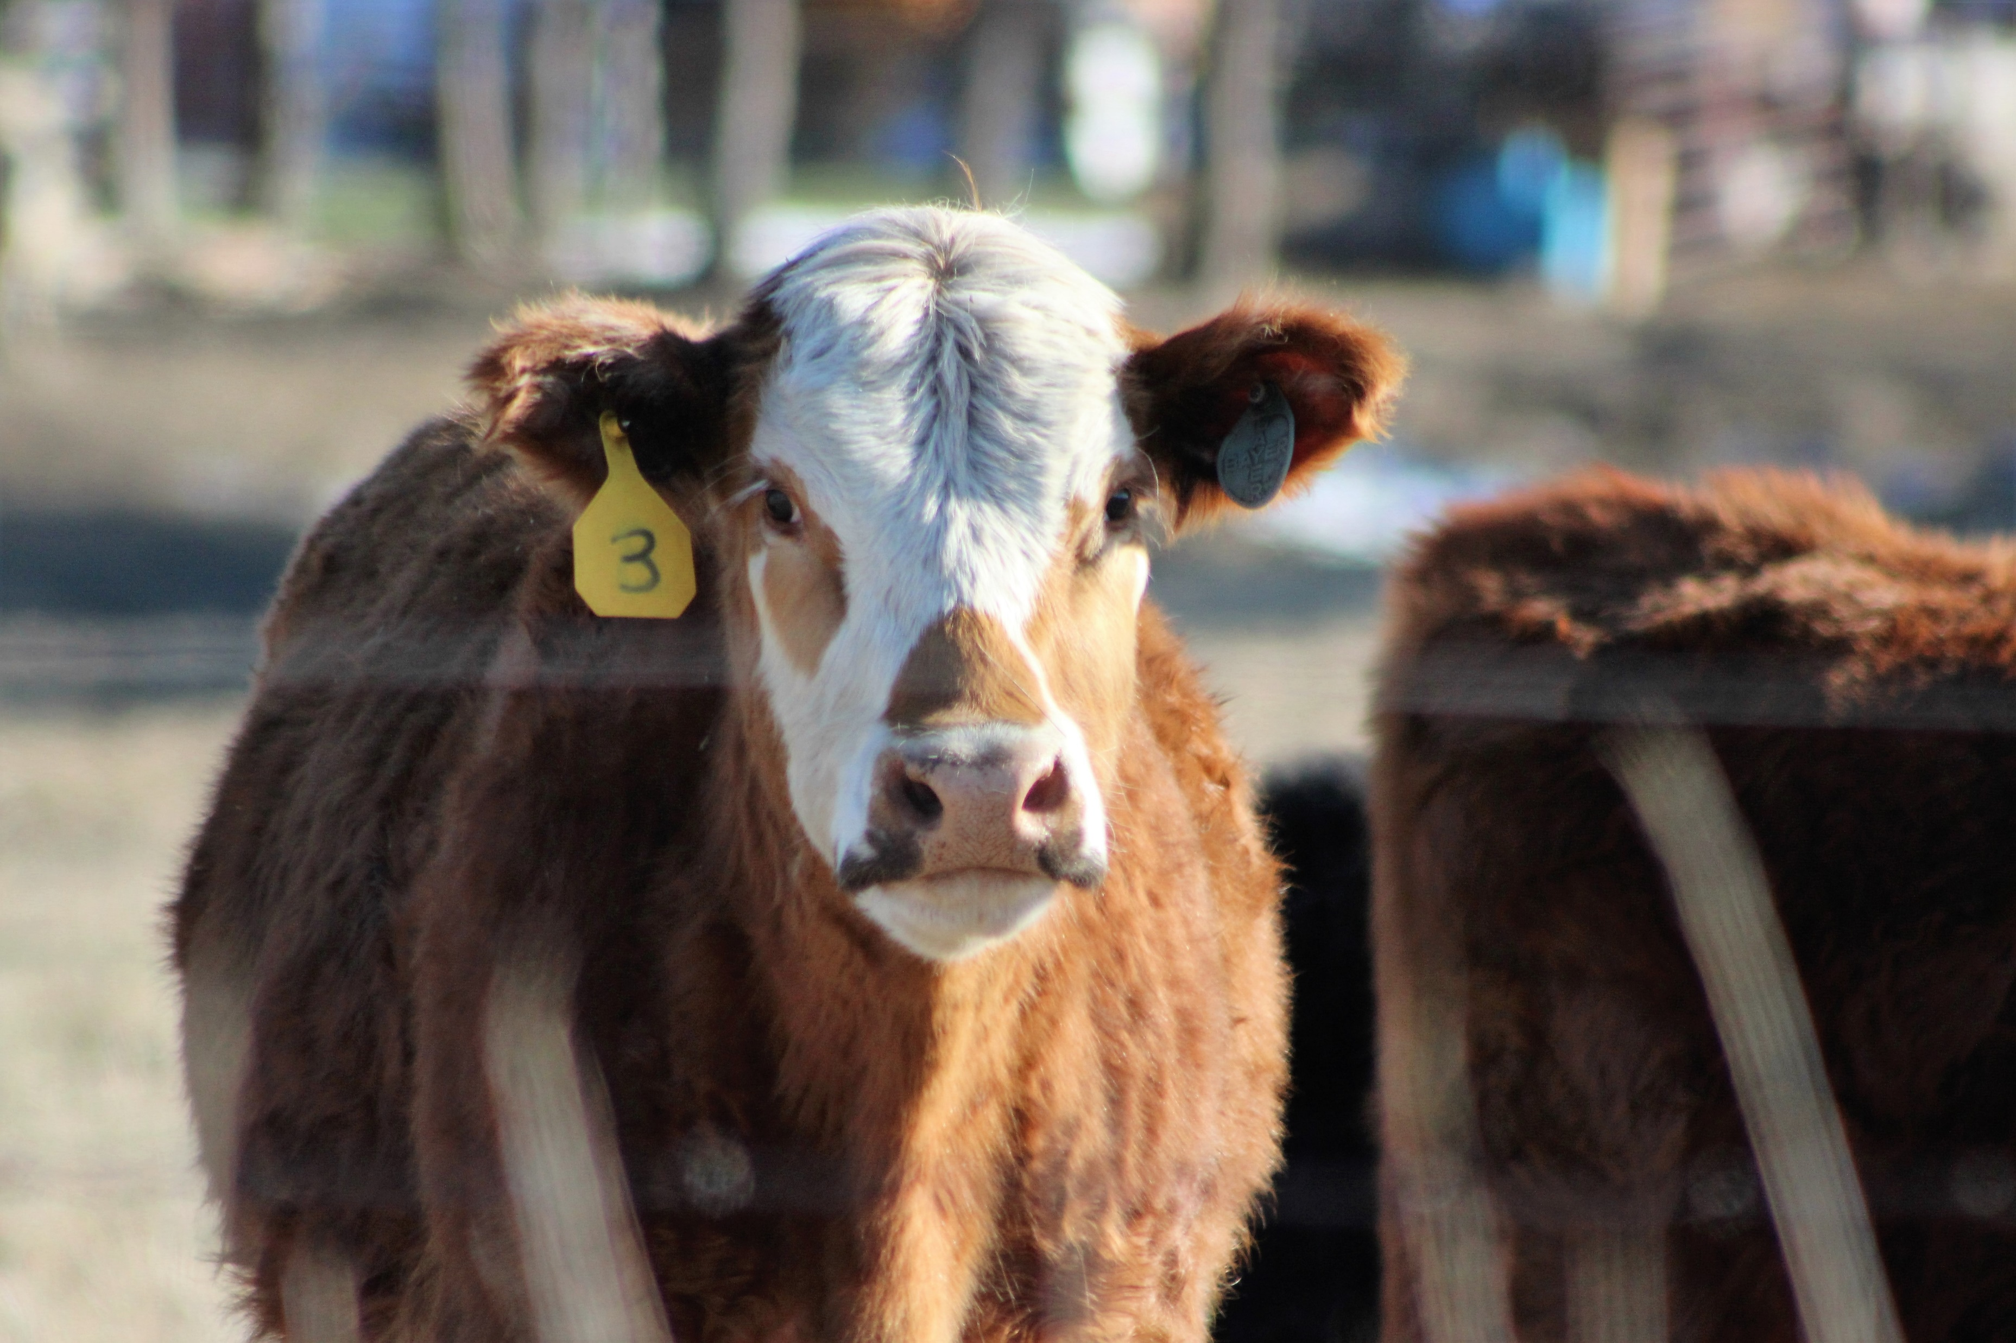
Hormone Free
No synthetic hormones are given to the animal
There are no hormones in the animal
This applies to all livestock
Notes:
Fact: No added hormones

Slide 36
Hormone Free
No synthetic hormones are given to the animal
There are no hormones in the animal
This applies to all livestock
Notes:
Fact: No added hormones

Slide 37
USDA Definition
Pork & Poultry
Added hormones are not allowed in raising hogs or poultry .
Beef
May be approved for use on a label of beef if sufficient documentation is provided to the Agency by the producer showing no hormones have been used in raising the animals.
Notes:
These definitions refer to added hormones in beef cattle.
Hormones are naturally occurring in all animals – even us!
We add hormones to beef cattle for the same reason people who workout take protein shakes. Synthetic hormones (estradiol & acetate) are given to beef cattle to help them efficiently build muscle. They’re like the athletes of the livestock industry. Because when you eat beef, you’re eating the muscle of the animal. Consumers want a lean product and this helps to give them that product.
The hormones are administered to the animal as an implant. They come in a slow-release pellet and it is placed under the skin on the back of the ear. (Have you heard of implants for women for birth control? This is the same concept)
This is a safe option for farmers and ranchers to use safely and with consultation from the veterinarian.
So how does beef with added hormones compare to other items containing natural hormones?

Slide 38
Hormone Comparison
Quantity | Source | Nanograms of estrogen
75g | Beef from steer given hormones | 2
355ml | Beer | 15
75g | Raw peas | 500
75g | Raw cabbage | 2,976
1 pill | Birth control | 35,000
Per day | Adult male | 100,000
Per day | Adult female | 5,000,000
Per day | Pregnant woman | 90,000,000
Source: BeefResearch.ca. Adapted from Ty Lawrence, Ph.D., 2012 (West Texas A&M University)
Notes:
Here is a table from the University of West Texas A&M.
Beef from a steer given hormones has 2 nanograms of estrogen compared to the same serving of raw cabbage that has 2976 nanograms of estrogen.
Non-implanted steer would be about 1.42 nanograms

Slide 39
Hormone Comparison
Food | Estrogenic Activity per 3 oz of Food (ng)
Soy flour (defatted) | 128,423,201
Tofu | 19,306,004
Pinto beans | 153,087
White bread | 51,029
Peanuts | 17,010
Eggs | 94
Milk | 5.4
Beef from implanted steer | 1.2
Beef from non-implanted steer | .85
Source: AgWeb Powered by Farm Journal. Hormones in Beef: Myth vs. Fact.

Slide 40
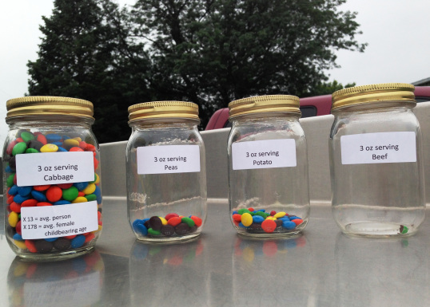
Notes:
L to R
Cabbage
Peas
Potato
Beef

Slide 41
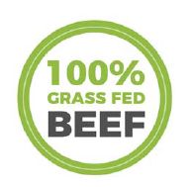
Grass Fed
Farmers can include silage (corn product) in their feeding regimen
Produces organic beef
Lower carbon footprint

Slide 42
Grass Fed
Farmers can include silage (corn product) in their feeding regimen
Produces organic beef
Lower carbon footprint
Notes:
Corn, in a small percentage, can be included in the diet of a grass-fed beef cow. All cattle spend the majority of their lives eating grass on pastures. Cattle can be “finished” on either grain or grass for around 6 months prior to processing.
Not all grass-finished beef is organic. In order to be organic, the beef product must meet the USDA’s National Organic Program regulations, including the requirement that the animal grazes exclusively on certified organic pastures.
Grain-finished beef actually has a lower carbon footprint than grass-finished beef. Cattle fed grain produce less methane and reach market weight more quickly, thus using fewer natural resources.

Slide 43
Grass Fed
NUTRIENTS | GRAIN-FINISHED | GRASS-FINISHED
Protein A powerful nutrient that helps strengthen and sustain the body | 22.2g | 21.8g
Zinc An important nutrient that helps maintain a healthy immune system | 3.8mg | 3.7mg
Iron An essential nutrient that helps your body transport and use oxygen to power through the day | 1.6mg | 1.8mg
Total Fat | 5.2g | 2.9g
Notes:
What does it mean?
Choose from today’s variety of nutritious and delicious beef options based on your own personal preferences.
Beef contributes 10% of less of saturated fat and total fat in the American diet.
Lean beef – whether it’s grass-finished or grain-finished – can be part of a heart-healthy diet.
All beef options are a natural source of more than 10 essential nutrients including protein, zin, and iron.
Source: https://www.slideshare.net/BeefFacts/grass-or-grain-08-lrind?from_action=save
REFERENCES
• Van Elswyk & McNeill. Impact of grass/forage feeding versus grain finishing on beef nutrients and sensory quality: the U.S. experience. Meat Sci 2014; 96:535-40.
• USDA and HHS. Dietary Guidelines for Americans, 2010.
• Hunter et al. Cardiovascular disease risk of dietary stearic acid compared to trans, other saturated, and unsaturated fatty acids: a systematic review. Am J Clin Nutr 2010;91:46-63.
• Zanovec et al. Lean beef contributes significant amounts of key nutrients to the diets of US adults: National Health and Nutrition Examination Survey 1999-2004. Nutr Res 2010;30:375-81.
• Capper. The environmental impact of beef production in the United States: 1977 compared with 2007. J Anim Sci 2011; 89:4249-61.

Slide 44
Food Environment
Policy Environment
Physical Environment
Social Environment
Individual Factors
Notes:
POLICY ENVIRONMENT: School meal programs, food and nutrition assistance, policies that affect food prices, regulations on food marketing
PHYSICAL ENVIRONMENT: food cost, food availability (in homes, stores, restaurants, schools), food access (vehicle access, sidewalks, public transit), food marketing (advertising, shelf placement, food labels, toys)
SOCIAL ENVIRONMENT: culture, religion, eating habits of friends, family, and coworkers
INDIVIDUAL FACTORS: hunger, taste, income, knowledge, emotions, health conditions, values and priorities (public health, environment, social justice, animal welfare, nutrition, convenience)

Slide 45
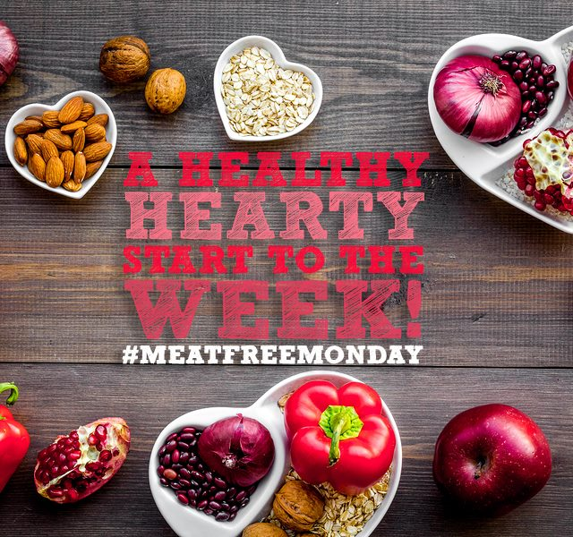
Current Environment
112,430

Slide 46
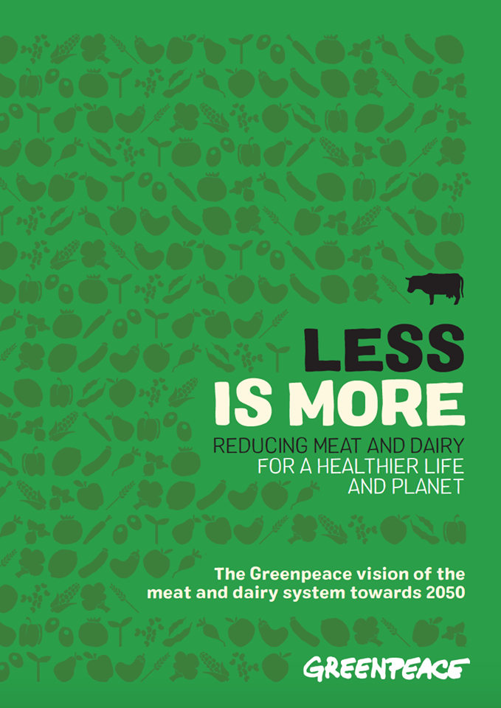
Current Environment
2.9 Million

Slide 47
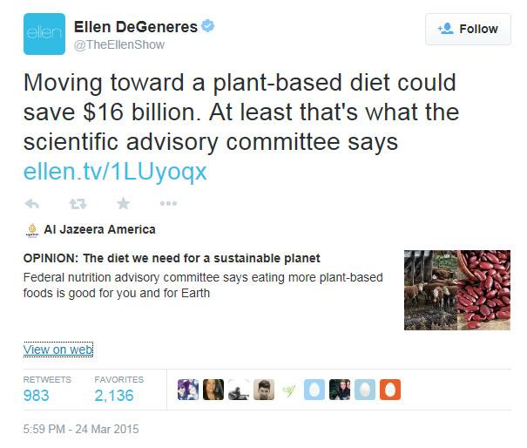
Current Environment
78.1 Million
Notes:
Other examples:
Dr. Oz, the Food Babe, Oprah – the new experts in agriculture – NOT!
The Food Babe –The Hidden Toxins In Your Food
Oprah – When people are concerned about where their food comes from do they ask farmers and ranchers – NOPE they ask Oprah

Slide 48
Current Environment
Notes:
HEALTH Medical research has proven that the typical American diet is linked to high rates of many diseases-- including heart disease, diabetes, certain cancers and other illnesses. A plant-based diet prevents or reduces the incidence and severity of many of these threats to human health and can be a life-saving choice. Current research proves the many connections between health and food choices and confirms the benefits of a plant-based diet. ENVIRONMENT Contemporary farms often dump all the by-products of raising animals and crops – excrement, fertilizers, pesticides, antibiotics, hormones – into the environment with few, if any, regulations or controls. These practices are polluting the water, the air and the soil, causing damage to human health and also the delicate ecosystems that animals and plants depend upon. Further, animal agriculture depletes the planet of valuable resources (water, fossil fuels, rainforests, etc.) and contributes to global warming.
ANIMALS
The quest to maximize profits has encouraged the growth of modern farms where animals are raised in crowded, stressful and miserable conditions. As a consequence of modern animal agriculture, farmed animals experience great pain and suffering, mutilations without anesthesia (such as castration and tail-docking), wrenching separation from their offspring, extreme crowding and barren environments in which animals are barely able to move about or perform any of their natural behaviors. Many students are unaware that animals continue to suffer under many of these same conditions when raised for food on smaller farms, as well. And while foods labeled as “humane”, “cage-free” and "free-range" may reduce some suffering, the labels mislead consumers about the absolute suffering that remains for every animal.

Slide 49
Current Environment
What would you like to see labeled on food labels?
Do you want GMOs labeled?
90% say yes
7% identify GMOs
Notes:
Washington Post
https://www.washingtonpost.com/lifestyle/food/the-surprising-truth-about-the-food-movement/2016/01/25/42bed508-bfcf-11e5-9443-7074c3645405_story.html?noredirect=on&utm_term=.13a7a8edc24b

Slide 50
Current Environment
VEGETARIANISM
How Many?
Growing Trend?

Slide 51
Current Environment
5%
Notes:
https://news.gallup.com/poll/238328/snapshot-few-americans-vegetarian-vegan.aspx
Well-Being
August 1, 2018
Snapshot: Few Americans Vegetarian or Vegan
2018 – 5%
2012 – 5%
2001 – 6%
1999 – 6%
Economist 2017 – 5% OF WORLD, TOO

Slide 52
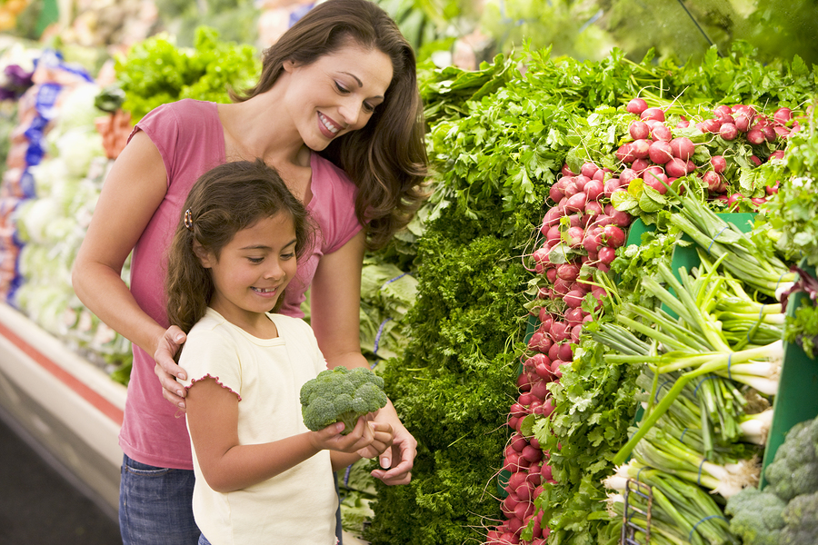
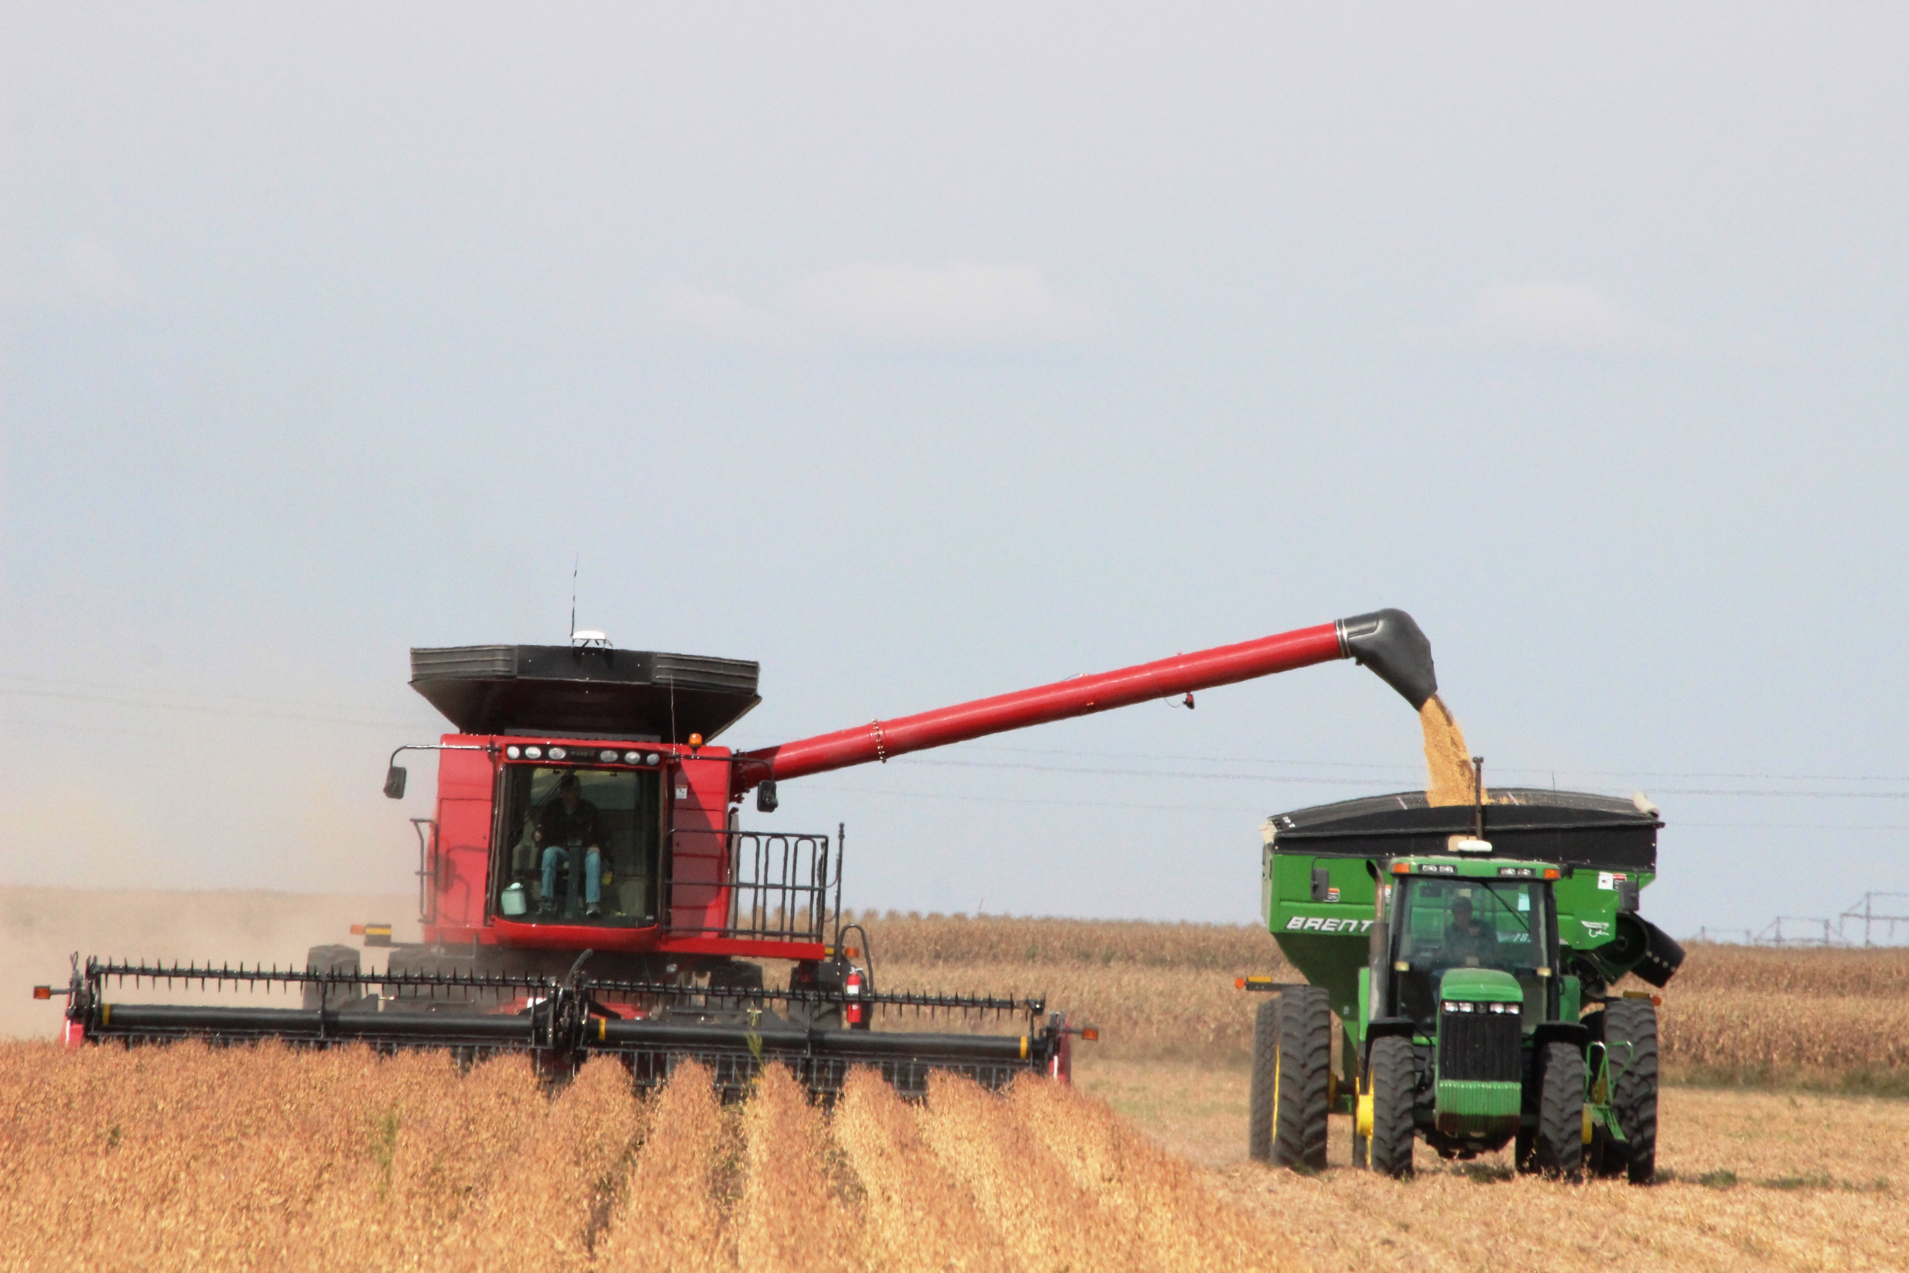
Agriculture’s Opportunities
Understanding today’s consumer
Understanding today’s media landscape
Understanding how to connect

Slide 53
Understanding Today’s Consumer
The public senses a change in the way food is produced, but doesn’t understand WHY it has changed.

Slide 54
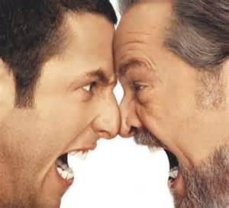
Conversation, Not Competition
Values Driven
Emotions in Check
Moveable Middle
Notes:
Be committed to a conversation, not a debate
That means understanding consumer concerns and embracing skepticism.
Focus on your principles, and you will likely help consumers understand that the food system may be better aligned with their values than they previously thought
DON’T enter a conversation with the intent to educate and change opinions
Avoid spending much energy attempting to persuade the activists. It’s okay to agree to disagree and best to do so with a smile. Leaving a conversation is always better than becoming defensive or hostile.

Slide 55
LISTEN (Don’t Judge)
Listen to Understand, Not to Respond
Ask Questions to Invite Dialogue
“Why do you believe GM foods are dangerous?”
“What does organic mean to you?”
“That’s interesting, where did you learn about that?”
Notes:
So you have an opportunity, and you want to the conversation.
Where do you start? Listen!
Listen with the intent to understand, not with the intent to respond. There is a big difference.
Help them see you’re interested
Show you care.
This bridges the gap and builds trust.
Ask questions to invite dialogue, for example,
“Why do you believe GM foods are dangerous?”
“What does organic mean to you?”
“That’s interesting, where did you learn about that?”

Slide 56
Science v. Ethics
Consumers are not asking
if WE CAN
they are asking
if WE SHOULD
Notes:
When you focus on the science, you may get impatient. You may say the answer is clear and simple.
Consumers are not asking if WE CAN, they are asking if WE SHOULD
They want to feel good about what we do and believe you do it for the right reason
Amber Pankonin is a Nebraska dietician turned ag-communications consultant. She says the worst thing you can do is lead with science when talking to consumers and dieticians. She recommends leading with malnutrition, food insecurity, and food waste. These issues resonate, and we can find common ground in agreeing these are challenges we SHOULD use every tool available to overcome.

Slide 57
Try This
Instead of This
Aim to Understand | Aim to Educate
Talk about FOOD | Talk about AGRICULTURE
Talk about your PASSIONS | Talk first about ISSUES
Ask how we can do better | Ask for thanks
Talk about improvement | Talk about productivity
Notes:
Continuous improvement – smart farms

Slide 58
When You Share
Be extremely candid
Make the audience feel like they understand the science
Be vulnerable
Be passionate
Have a sense of humor
Use and encourage story telling
Understand the “other side”
Notes:
Be extremely candid about who we are, what we do, and what we want. Consumers want authentic transparency
They want all details so they can decide for themselves
Authentic transparency reduces fear of the unknown and creates a platform for building trust
Make the audience feel like they understand the science; think Carl Sagan, Richard Feynman & Neil deGrasse Tyson.
Be vulnerable: tell why you chose to commit your life work to this industry, far more than working for a salary.
Be passionate that what we are doing is correct
Have a sense of humor about cynicism and dark stories
Encourage story tellers to create sharable ways of explaining complex information.
Understand the “other side” on a deep level, and speak to their point of view precisely.

Slide 59
Seek Shared Values
Compassion
Responsibility
Respect
Fairness
Truth
Notes:
While you are listening, seek shared values. These are some universal values, Others may be more specific.
Does the person you are talking with have a family like you?
Is she particularly concerned about natural resources?
Is he interested in technology and computers?

Slide 60
Connect Through Values
Impact of Technology
Animal Well Being
Role in Economy
Environment
Family Responsibility
Food Safety
Nutrition
Notes:
Stop communicating “what’s in it for me” and “feeding the world”
Put yourselves in their shoes
Be authentic – we’re not doing anything bad and we have nothing to hide – let’s just get on their level!

Slide 61
Connect Through Values
Values: We drink the same water and breathe the same air. I want to protect the environment for my family, my community, and for future generations so they can have it as good, or better, than I do.
Science: We use environmental practices on our farms that are based on research from land grant universities across the country. I also make sure I’m up to date by taking advantage of the latest training and certification.

Slide 62
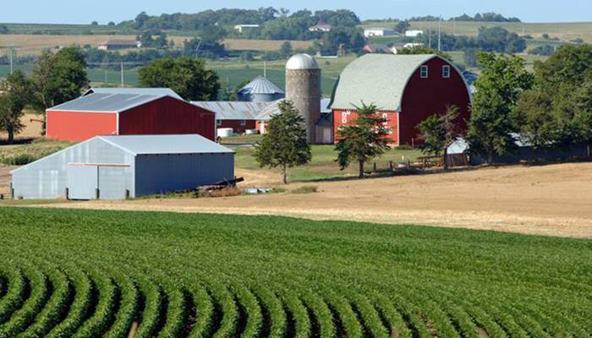
Connect Through Values
Old
Research proves it’s okay.
Financially, it makes sense.
New
“It sounds like food safety is important to you. I can assure you that it is my top priority.”

Slide 63
What does well?
Interesting
Surprising
Makes people feel like they are on the side of science
Notes:
When you are talking about science, science can’t be a wall. Must make people feel like they are part of the science.
When you listen to them, you leave feeling like, hey, I know something now. They make people feel like they know what’s going on and are a part of the discussion.
The best pseudo-science communicators do this, too. They make people feel like they understand and like they are a part of whatever decision or conclusion is reached.

Slide 64
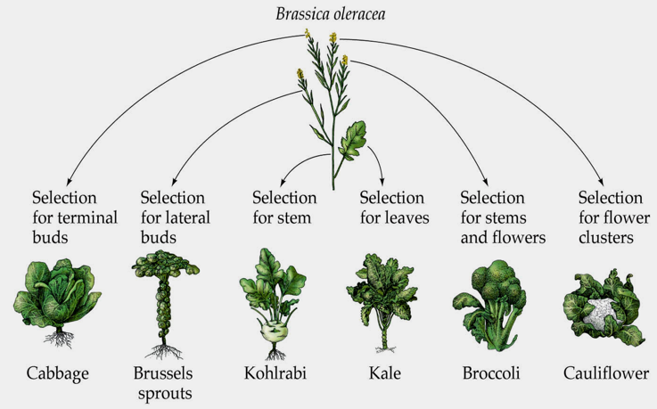
Interesting Facts
That surprised look when you show someone that broccoli didn't occur "naturally" humans bred it from wild mustard. @vancecrowe
Notes:
Sharing something surprising and interesting helps people open up and consider there may be a lot more things they would be interested to know.
This tweet by Vance Crowe…another website, Vox, picked it up. This is not conflict. This is information sharing.

Slide 65
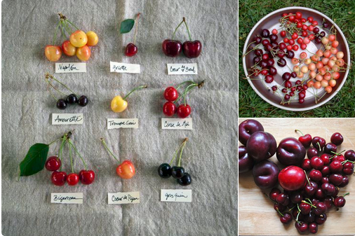
Interesting Facts
Genetic diversity in cherries
@seminisa
Notes:
Share interesting things. This will build up trust, and people will come to you to learn things.

Slide 66
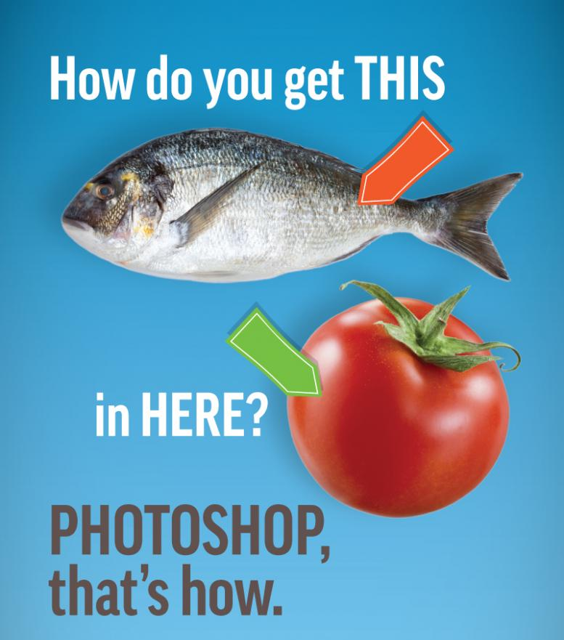
Myth Busting
GMOAnswers.com
Notes:
No GMO crops you eat contain animal DNA. Get facts, not fish tales at GMOAnswers.com

Slide 67
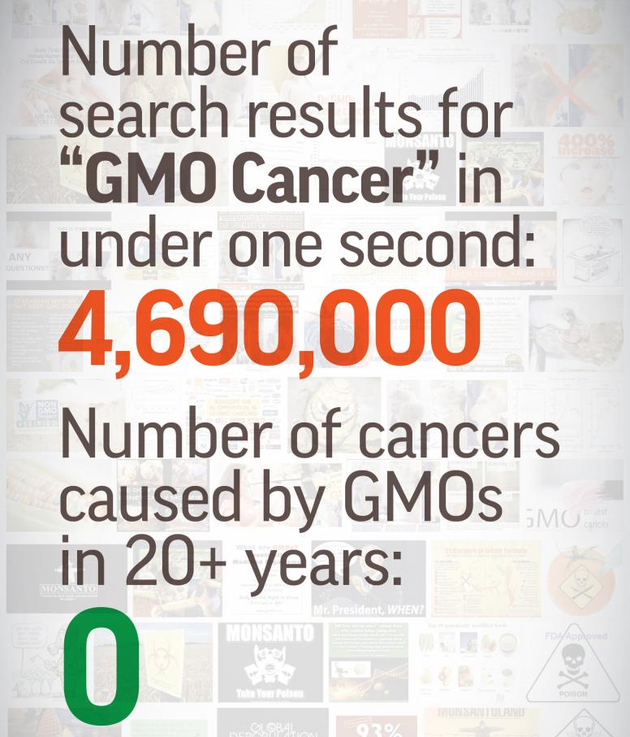
Myth Busting
GMOAnswers.com

Slide 68
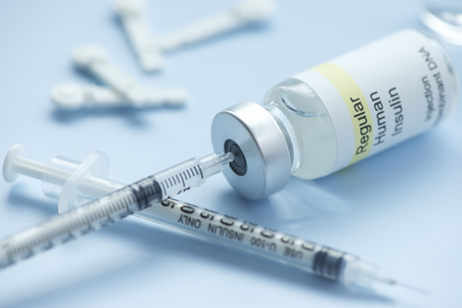
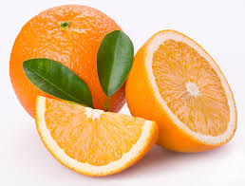
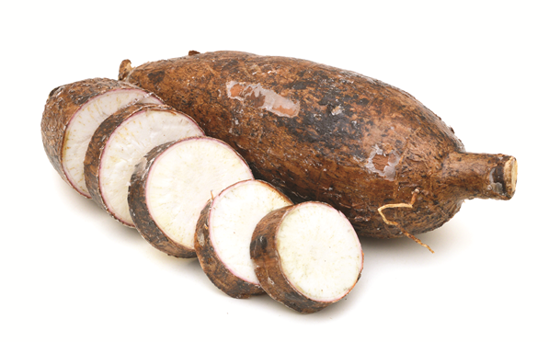
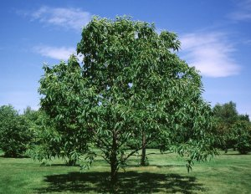
Shared Values: HEALTH & ENVIRONMENT
Notes:
Wat does the future of GMOs look like?
Genetic engineering has many applications other than food or the GMO crops currently on the market.
Healthcare: a CM tobacco plant has been used to develop a treatment for the Ebola virus, and most human insulin already is genetically engineered.
GM citrus could help fight citrus greening, a plant disease that is devastating the citrus industry in the US.
Biofortification: the Danforth Plant Science Center is development Bio Cassava Plus – more nutritious higher yielding and more marketable cultivars of cassava, the primary source of calories for 250 million Africans.
Restore near-extinct plant species: Scientists at the State University of New York (SUNY) have genetically modified the American Chestnut tree to withstand the blight that has nearly wiped out this iconic hardwood tree in the US.

Slide 69
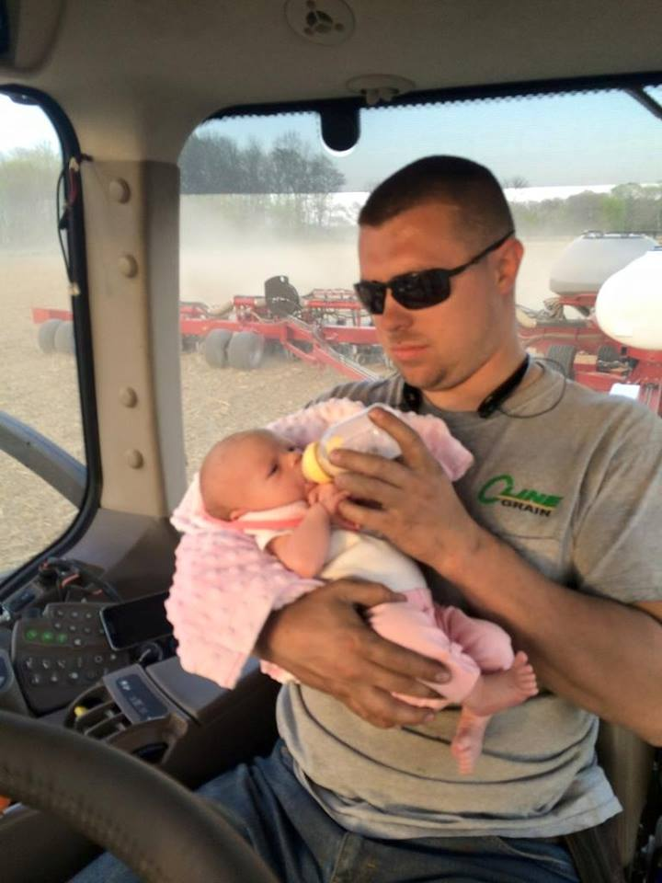
Shared Values: FAMILY
Benefits of Auto Steer
Michael Cline @precisionnerd
Notes:
Show humanity – breaks down barriers.
In ag, it’s hard to leave the pastoral image of Farmer Brown and his ducks and go to a new image and still feel like it’s safe and wholesome and still feel like real people with families are doing this.
Showing he’s a regular dad that wants to spend time with his child is important.
Similarly, you can let consumers know there is a family behind that farm, behind the big equipment, behind the big fields. Phrases like, yes our kids play in and around the fields. I wouldn’t grow anything on my farm that I wouldn’t have my family eat. I care about the food I put in my body, and I shop at the grocery store with my neighbors.

Slide 70
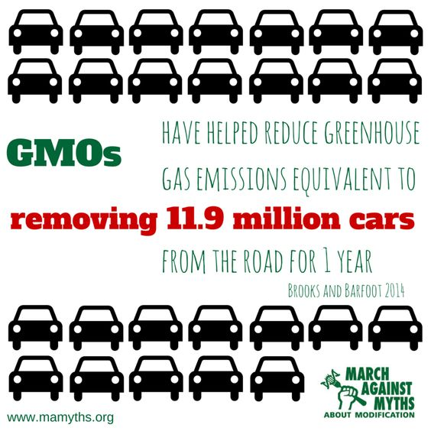
Shared Values: ENVIRONMENT
Notes:
With GMOs, we have healthier plants. Healthier plants resist bugs and need less pesticides.
Spraying and cultivating = greenhouse gasses.
Fewer trips across the field = less fossil fuel use.
GMO technology leads to : Less greenhouse gasses. Less soil loss.

Slide 71
You can make a difference
Clear
You can deliver the message to someone who doesn’t understand the issue.
Concise
10 seconds
or less.
Compelling Bring empathy and share those values!

Slide 72
The world of food labeling can be confusing

Slide 73
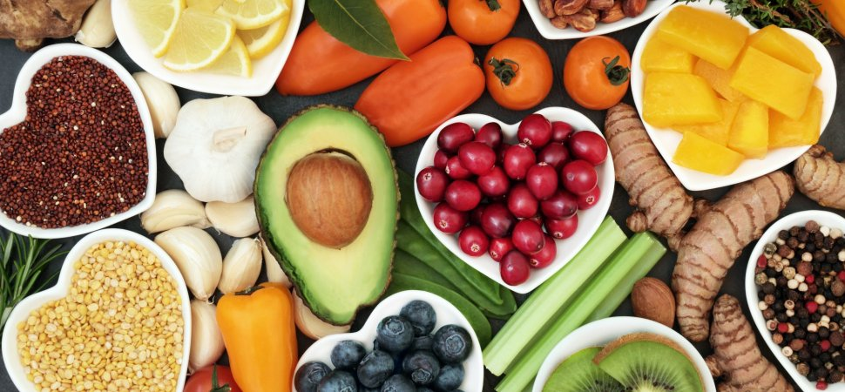
All food in the United States is safe!
Notes:
All food in the United States is safe – you don’t need a marketing label to feel like you’re making the right decision.
If a certain quality is important to you, look for labels with FDA and USDA approval.

Slide 74
From a Farmer and Rancher
CHOICE
EQUIPPED
FACTS
Notes:
You have a choice. We live in a country with many products and you have a choice to choose a product that fits your families needs.
Choice is good, but all food in the United States is a safe option to choose.
We hope you are leaving equipped today knowing that whatever food choice you make, you’re making a safe one and that you can see past marketing by having the facts of how farmers and ranchers care for their crops and livestock.
As farmers and ranchers, we continue to support the USDA and FDA to work together to protect agriculture and the nations food supply.
If you have any food labeling questions - these two departments can provide more information on their websites. We will stick around to answer any questions you may have.

Slide 75
Let’s Play!
Web Browser
www.kahoot.it
Game Pin: 740842

Slide 76
Thank You!

