Slide 1
Curiosity killed the “Cat”
2019 Women In Ag Conference
Kearney, NE
Carmen Egging-Draper
Carmen.draper@fcsamerica.com / 308-249-4795
Insurance Officer
Farm Credit Services of America
Notes:
IAS Introductions
Why are we doing this presentation?
Ask questions as needed
Slide numbers

Slide 2
Table of Contents

Slide 3
Packet Materials
In your packet, you will find:
APH
Schedule of Insurance
Crop Insurance Guide
Crop Hail Guide
Miscellaneous brochures on Crop Insurance

Slide 4
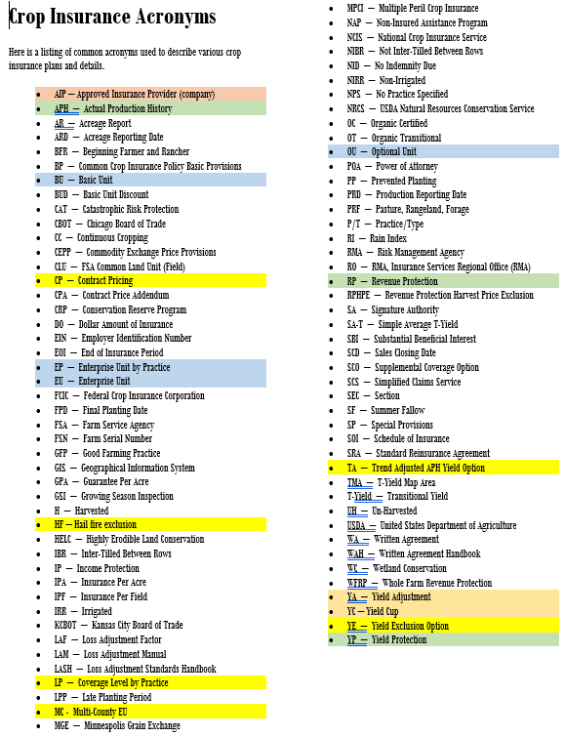

Slide 5
Responsibilities
What does the Company Do?
Insures crops
Provides for the processing of paper
Appoints agents
Hires loss adjusters
Ensures all claims are fairly and promptly paid
Accepts risk on the insurance policies
Interacts with RMA/agent/farmers
Trains agents and adjusters
What does the Agent Do?
Identifies a need for insurance
Explains product options
Sells insurance contract
Collects production and acreage report
Notifies company in case of loss
Informs farmer about changes to the program
Local, professional, trusted contact for farmer

Slide 6
Insured’s Responsibilities
Complete application – for crops and counties
Report entity changes
Keep and report production separate by unit
Report ALL acres by crop and practice
Mapped Based Acreage Report
Report planting dates and share
Report probable losses to the agent as soon as discovered
Provide adjuster with scale tickets and other production evidence – sell crop in insured name
Pay premium timely
Notes:
(Refer them to their MBAR)
Mention that losses need to be reported as quickly as possible (within 72 hrs of discovery)
Explain can’t sell grain in a trust name if insurance policy is listed under an LLC.
Remind them premiums for spring crops must be rec’d on or before Sept 30 by the HOME OFFICE, not FCSA, to avoid interest. Wheat is July 1st.

Slide 7
Insurance Cycle
Submit timely Notice of Loss (NOL) for each crop within 72 hours of discovery or by end of insurance period
Submit NOL no later than 45 days after harvest price is set for revenue policies
Leave required representative samples of the crop
Provide acceptable production records
Provide information as requested by company
Add crops/counties
Tax ID changes or corrections
Change plan of coverage, unit structure
All premium/repayments are paid
New Breaking Written Agreements -Intended acres for PP
Request for High Risk Land Exclusion
Add Trend Adjustment Option on Wheat, Corn & soybeans
Request Landlord applications
Sales Closing September 30 & March 15
Claims
Report losses timely
Production Reporting
November 14 & April 29
Report planted acres with plant dates
Report insured/uninsured/Second crop
List Prevented Planting acres
Added Land, New Crop/Practice/Type
Delete location no longer farming
Change share %, if applicable
Written Agreements
Choose optional/basic units
Report Production for current year
Add or remove Yield Adjustment
Add New Producer
Use share person’s records
RO Determined Yield requests
Dividing units
Correcting or revising past APH information
Acreage Reporting
November 15 & July 15
Notes:
Discuss SCD is where decisions for the year are made for each crop including levels, products, unit structure, Trend Adjustments, etc.
Production reporting we make changes & corrections to unit structure & history, set up new practices.

Slide 8
Application
New Insured must apply for a policy by Sales Closing Date
Policies are continuous thereafter until cancelled
Applicant must be of legal age
Minors may have a policy with a parent/guardian to co-sign
Duplicate policies covering same crop/county are not permitted
Applicant must choose plan of insurance, coverage levels and options for each insured crop
Notes:
Any person who has an interest of 10% or more in the crop must be listed as an SBI on any and all policies: if a SS #pops up with previous history it can impact current or new APH so if setting up kids on policy (for tax purposes), could impact them down the road.. They need to be aware, and will need to provide history, or would have to complete DYR
RCIS has 1 policy for each county. Most companies are policies by states.

Slide 9
Entities/Person Types
What type of tax ID do I need for the different entities/person types?
Individual-SSN
Spousal-SSN (must have POA in file for spouse to Sign forms)
Revocable Trust-SSN or EIN (if established)
Irrevocable Trust-EIN (if established)
Corporation-EIN
Estates-EIN
Individual Operating as a Business-EIN
Partnerships-EIN
EIN = Employer Identification Number
Notes:
The type of tax id required is also listed.

Slide 10
Plans of Insurance
Multi Peril Crop Insurance (MPCI) – protects from natural crop yield losses includes APH (yield protection), RP(revenue protection), and YP (yield protection)
Crop Hail (CH) –protects against crop damage caused by hail, fire, lightening and transit. Can add wind coverage to some policies.
Whole Farm Revenue Protection (WFRP) – Insurance plan that insures up to $8.5 million in insured revenue from all agriculture commodities produced on the farm.
Pasture Rangeland and Forage (PRF) – Insurance plan to provide insurance coverage on pasture, rangeland, or forage acres that are used to feed livestock.
Livestock Risk Protection (LRP) –declining market prices.
Dairy Revenue Production (DRP) – Insurance plan that protects milk and milk products against declining market prices.

Slide 11
Actual Production History (APH) Yield Protection (YP)
APH is for any crop where Revenue protection is not available, (millet, sugar beets, and dry beans)
Yield guarantee based on the growers previous Actual Production History (APH)
Available coverage levels are 50% to 85% in 5% increments of APH yield
Indemnifies the grower for harvested and/or appraised production less than the production guarantee
Growers may choose established or additional price election (Sometimes a price is increased by March 1 from the established price on APH crops, so grower should always choose additional price election. )
CAT coverage is available $655 per crop per county (2020?)
Prevented planting and replant protection (on some crops) are provided

Slide 12
APH and YP Example
Corn yield of 218 bushel 70% level
218 x 70% =152.6 bushel guarantee
Established price $3.96 per bushel (set March 1st)
Guarantee dollars of $604.30
You must go below 152.6 bu/acre to collect crop insurance payment regardless of what happens to price at harvest

Slide 13
Revenue Protection (RP)
Dollar guarantee based on the (Board of Trade) projected price
The projected price is used to calculate premium, replant payments and prevented planting payments
Available coverage levels are 50% to 85% in 5% increments
Additional dollar protection is available if the harvest price is higher than the projected price
Good product if you are marketing your crop
I recommend you do NOT take RP without the harvest price if marketing your crop
Notes:
CEPP – Common Exchange Price Provisions
80% - 85% coverage levels are available in limited areas. These levels are available in Gage, Jefferson, Lancaster, and Pawnee Counties.

Slide 14
Revenue Protection with Harvest Price Exclusion (RPHPE)
Dollar guarantee based on the projected price
Projected price is used to calculate the premium, replant payments and prevented planting
The available coverage levels are 50% to 85% in 5% increments
Additional dollar protection is not provided if the harvest price is higher than the projected price
The harvest price is used to calculate production to count at claims time
NOT a recommended option
Notes:
CEPP – Common Exchange Price Provisions
80% - 85% coverage levels are available in limited areas. These levels are available in Gage, Jefferson, Lancaster, and Pawnee Counties.

Slide 15
Revenue Protection Example Low price at harvest
Corn yield of 218 bushel / 70% level = 152.6 bushel guarantee
Established price $3.96 per bushel (set March 1st) Guarantee is 152.6 bu X $3.96 = $604.30. (dollar guarantee)
Harvest price $3.68 (set November 1) $3.96/$3.68= 1.08 factor times 152.6 bu = Trigger yield of 164.2 bu.
Harvest yield below 164.2 bu. will be a crop loss
If you take you harvested bushels X the harvest price and the dollar amount is lower than what is listed on your schedule of insurance, you have a loss.

Slide 16
Revenue Protection Example High price at harvest
Corn yield of 218 bushel / 70% level
152.6 bushel guarantee
Established price $3.96 per bushel (set March 1st) Guarantee dollars of $604.30
Harvest price $4.50 (set November 1) x 152.6 = NEW guarantee $686.70
Trigger yield of 152.6bu.
Harvest yield below 152.6 bu. will be a crop loss, paying you $4.50 for every bushel lost

Slide 17
Marketing with Crop Insurance
With a MPCI policy, how do I figure out what I can safely forward price?
Look for the total Liability on the schedule of insurance,
This example $60,540 (Lincoln) + $188,856 (Logan) =$249,396
Price in April gets up to $4.50 for a forward contract
$249,396.00 / $4.50 = 55,421 bushels you can forward contract safely
If the price is higher at harvest time your coverage will be set at the higher price, and you could afford to buy back bushels.
If the price is lower at harvest time and you completely lose your crop, you will be able to buy back the bushels from the elevator or neighbor to cover your contract.

Slide 18
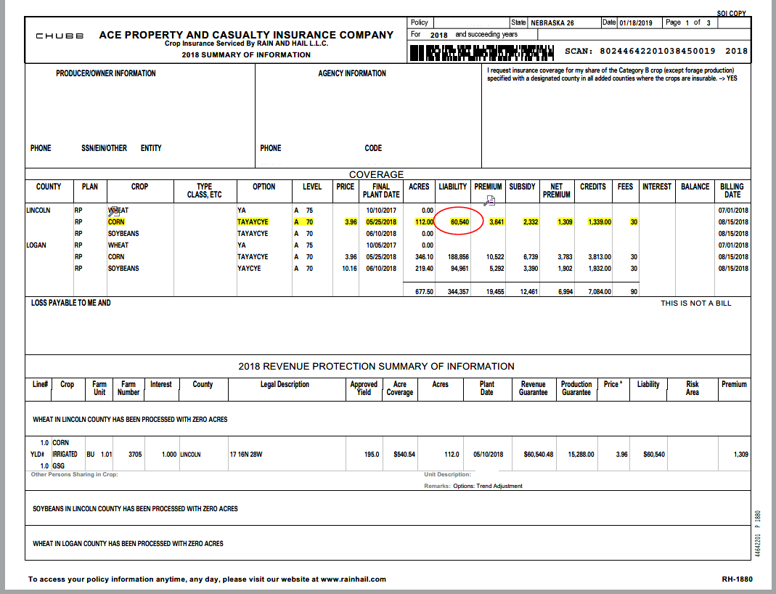
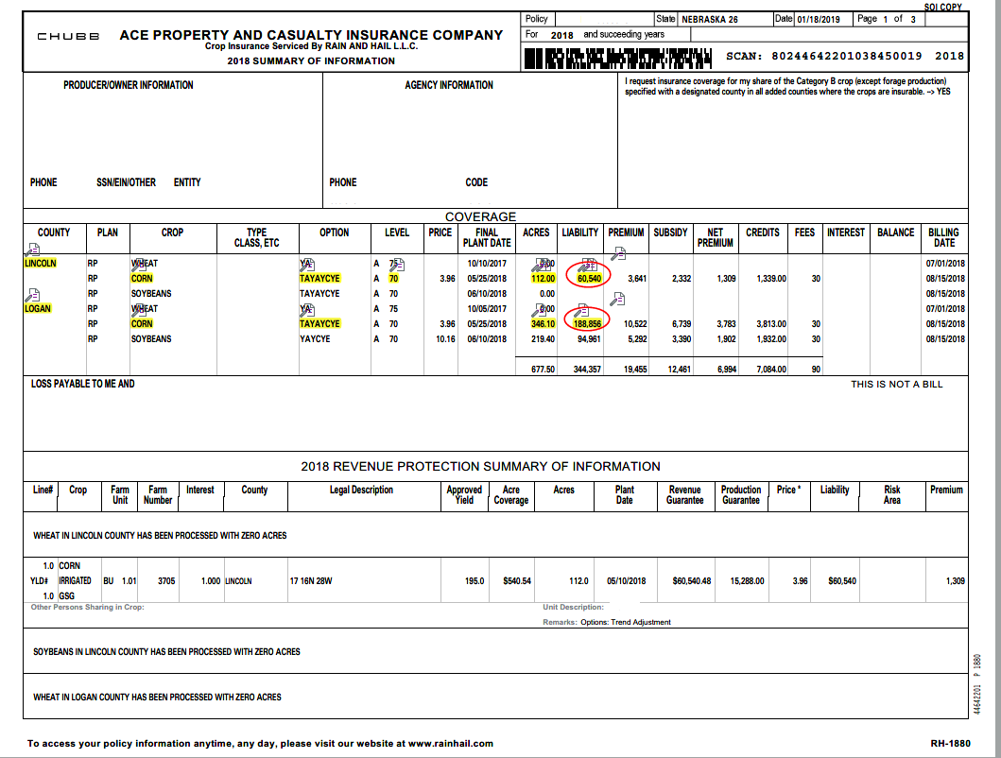

Slide 19
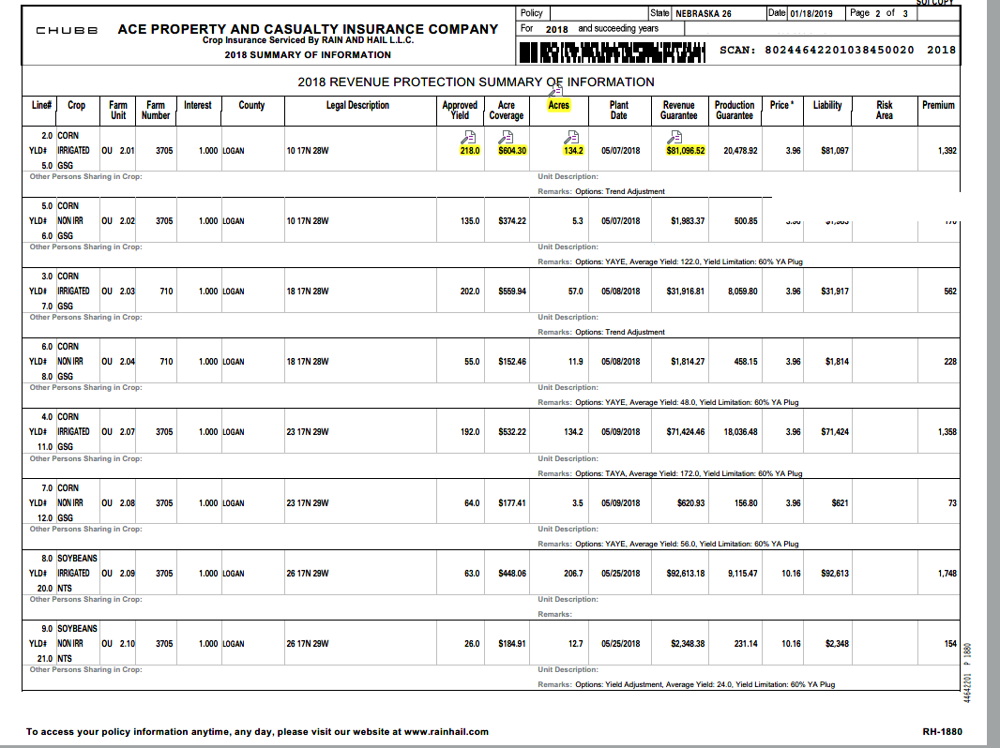

Slide 20
Subsidy Factors
*Where applicable
Subsidy Factors
Coverage Level | 50 | 55 | 60 | 65 | 70 | 75 | 80* | 85*
BU/OU Unit Factors | .67 | .64 | .64 | .59 | .59 | .55 | .48 | .38
Enterprise Unit Factors* | .80 | .80 | .80 | .80 | .80 | .77 | .68 | .53
Notes:
As of now, the subsidies have not changed, with a new farm bill, this may change but this is the current information.

Slide 21
Unit Structure
A unit is the acreage of the insured crop in the county that is taken into consideration when determining the guarantee, premium and the amount of any indemnity (loss payment) for that acreage. Each insured crop contract has its own unit structure.
BU - Basic Units
OU - Optional Units
EU - Enterprise Units
Notes:
The major difference between OU and EU. EU is 1/3 of the cost of OU. EU is putting all of your risk in “one basket”. So if section 7 is below your guarantee and has a loss but the rest of your sections make above their guarantee, you will probably not be paid for the loss in section 7.

Slide 22
Basic Units
Each share arrangement must be a separate basic unit
Varying percentages of interest within a basic unit does not qualify for separate basic unit
Example: Bob and Joe share 50/50 on one piece of ground and 30/70 on another piece of ground. Both pieces would be part of the same basic unit because both are shared by Bob and Joe.
Basic unit numbers are whole numbers to the left of the decimal point (1.00, 2.00, 3.00, etc.)
If basic units are elected rather than optional units, the insured may received a 10% discount in premium
Notes:
Share arrangement = Share Person, Basic units do not break down by Share Percent.

Slide 23
Basic Units
Joe cash rents
(100%)
How many basic units?
How many policies?
Joe 50%
Bob 50%
Joe owns (100%)
Joe 30%
Bob70%
Bob owns (100%)

Slide 24
Basic Units
Section 21-111-22
Joe cash rents
(100%)
How many basic units?
Joe’s Policy
0001.00 Joe’s 100%
Cash rent
Own
0002.00 share with Bob
Joe 50%
Joe 30%
Bob’s Policy
0001.00 Bob’s 100%
0002.00 Bob’s share with Joe
Bob 50%
Bob 70%
Joe 50%
Bob 50%
Joe owns
(100%)
Joe 30%
Bob 70%
Bob owns (100%)
Three basic units Two Policies
Joe 100% 1. Joe
Bob 100% 2. Bob
Bob and Joe share

Slide 25
Optional Units
If the following are met, the insured may elect to further divide a basic unit into optional units:
Separate verifiable records of planted acreage and harvested production provided by production reporting deadline
Optional units require separate production reports by unit for most recent
crop year
Optional unit numbers are indicated by the numbers to the right of the decimal (0001.0001, 0001.0002, 0001.0003, 0002.0001, 0002.0002, etc.)
Acreage is planted in different sections and does not cross the section line, or
Optional unit may be by section, practice (Irr & Non Irr), types, and farming practice (Organic)
Notes:
Keep separate records by section/share, not field
In some areas, soybeans have different types, i.e. Commodity, All Other Food Grades, Large Seeded Food Grade, Small Seeded Food Grade, etc. Soybeans is classified as NTS (No Type Specified) in this area.

Slide 26
Optional Units
How many basic units does Joe have?
How many optional units does Joe have?
Section 6
Section 5
Section 4
Section 6SS
Joe 100%
Joe 100%
Section 7
Section 8
Section 9
Joe 100%
Joe 50%
Bob 50%
Joe 50%
Bob 50%

Slide 27
Optional Units
How many basic units does Joe have?
Two basic units
0001.0000 Joe 100%
0002.0000 Joe and Bob
How many optional units does Joe have?
Five optional units
0001.0001-Sec 4
0001.0002-Sec 5 & 6
0001.0003-Sec 8
0002.0001-Sec 7
0002.0002-Sec 9
Section 6
Section 5
Section 4
Section 6SS
Joe 100%
Joe 100%
Section 7
Section 8
Section 9
%
Joe 100%
Joe 50%
Bob 50%
Joe 50%
Bob 50%

Slide 28
Enterprise Units
An Enterprise Unit is defined as all insurable acreage of the insured crop in the county in which you have a share on the date coverage begins for the crop year.
Available under Revenue Protection or Yield Protection
Must be selected by the applicable sales closing date
Must qualify:
Two or more sections, if sections are the basis for optional units
At least two of the sections must each have planted acres equal to 20 acres or 20% of the insured crop acres in the enterprise unit
If there are planted acres in more than two sections, they can be aggregated to form at least two parcels
Notes:
Example of last bullet point: Insured plants 100 acres of corn in section 1. He must plant at least 20 acres of corn in section 2 and/or remaining sections. The remaining sections can add up to the 20 acres or 20%.

Slide 29
Enterprise Units
Section 6
Section 5
Section 4
Joe 100%
corn
Section 6SS
Joe 100%
corn
How many Enterprise units will Joe have?
Section 7
Section 8
Section 9
Joe 100%
sbeans
Joe 50%
Bob 50%
corn
Joe 50%
Bob 50%
soybeans

Slide 30
Enterprise Units
Assuming Joe has EU on both corn and soybeans, how many enterprise units will Joe have?
Two EU
One for corn
Section 5 & 6
Section 4
Section 9
One for soybeans
Section 7
Section 8
Section 6
Section 5
Section 4
Joe 100%
corn
Section 6SS
Joe 100%
corn
Section 7
Section 8
Section 9
Joe 100%
sbeans
Joe 50%
Bob 50%
corn
Joe 50%
Bob 50%
soybeans

Slide 31
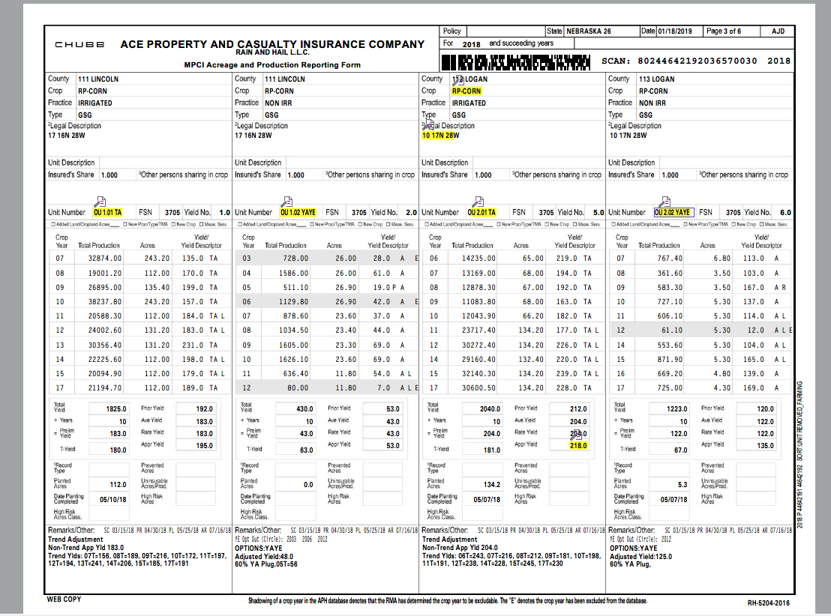

Slide 32
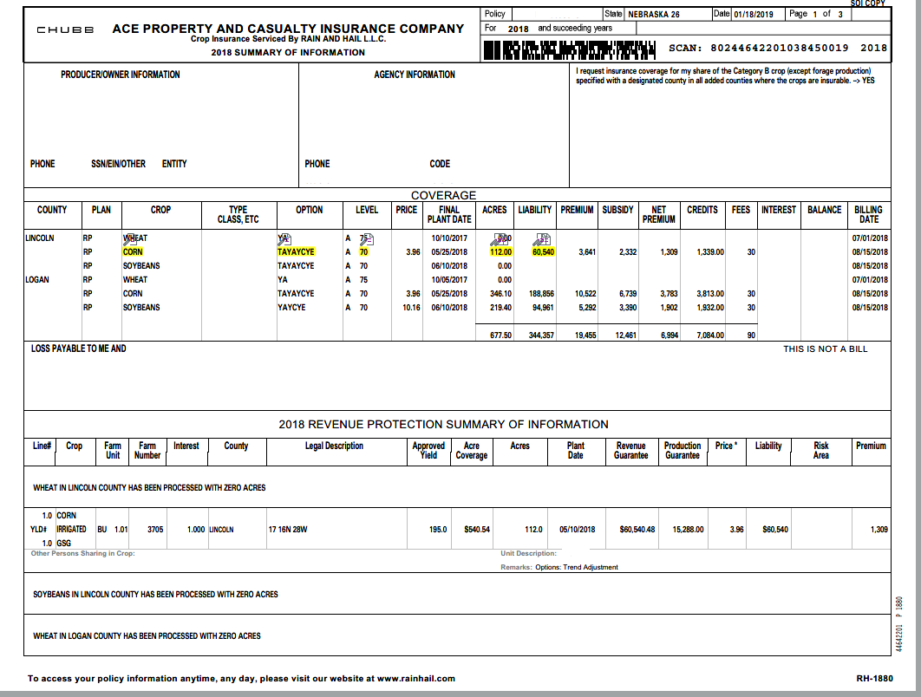

Slide 33
Options
YA – in loss plugs in 60% of County T-yield instead of actual yield to protect APH
YC – Yield Cup – average yield cannot drop more than 10% per year.
TA – Based upon county factors can increase APH (must have planted a crop in 1 of last 4 year to be eligible.) check for availability on crops in area
YE – Allows for the exclusion of an actual yield for any crop year where RMA determines the county average is less than 50% below Simple Average
LP – Level by practice (Irrigated / Non-irrigated)
MC – Multi county Enterprise unit (EU)
UUF – Unavoidable Uninsured Fire and third party damage
Using a combination of these options can increase your coverage. Make sure your agent is giving you the best combination of options

Slide 34
Different Coverage Levels by Practice
Have the option of choosing a different converge level for each practice for all crops
Cannot have a CAT as one of the levels
One administrative fee per crop/county
Must elect by sales closing date

Slide 35
Yield exclusions (YE)
Eligibility for the Yield Exclusions is based on county yield being at least 50% below the average county yield of the previous 10 consecutive crop years
Case by Case basis
Election must be made by Sales closing date
May affect your trend adjustment yield cups or floors

Slide 36
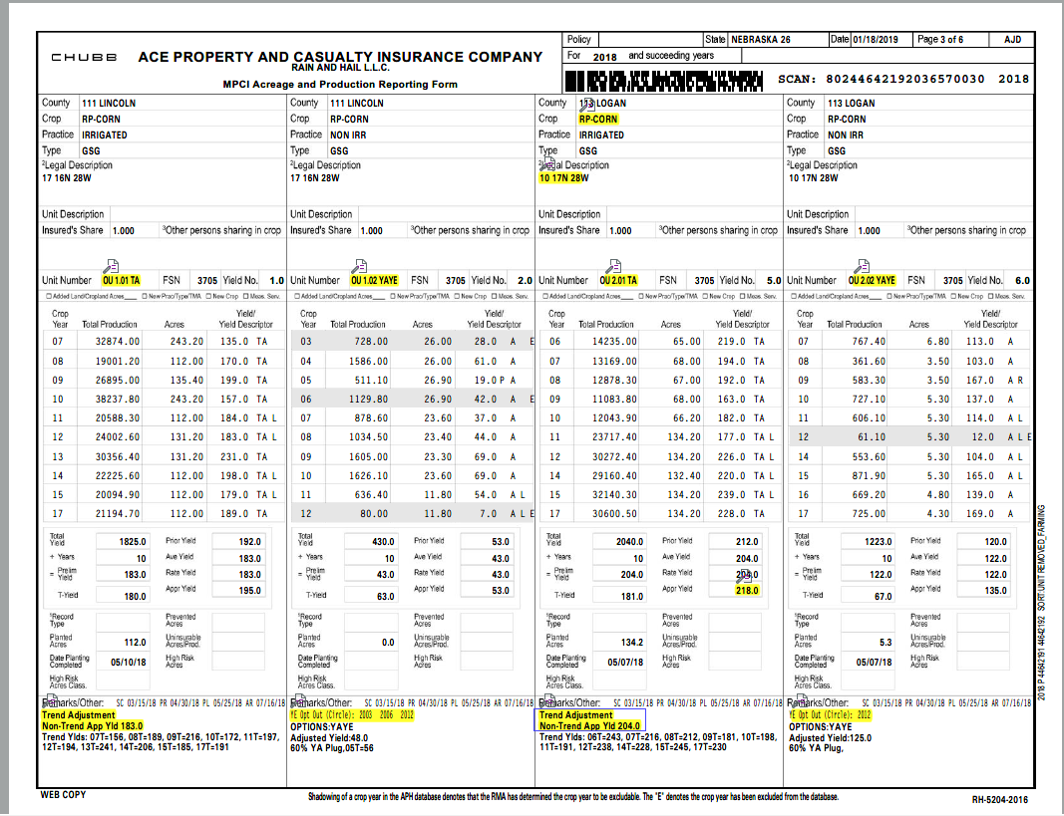
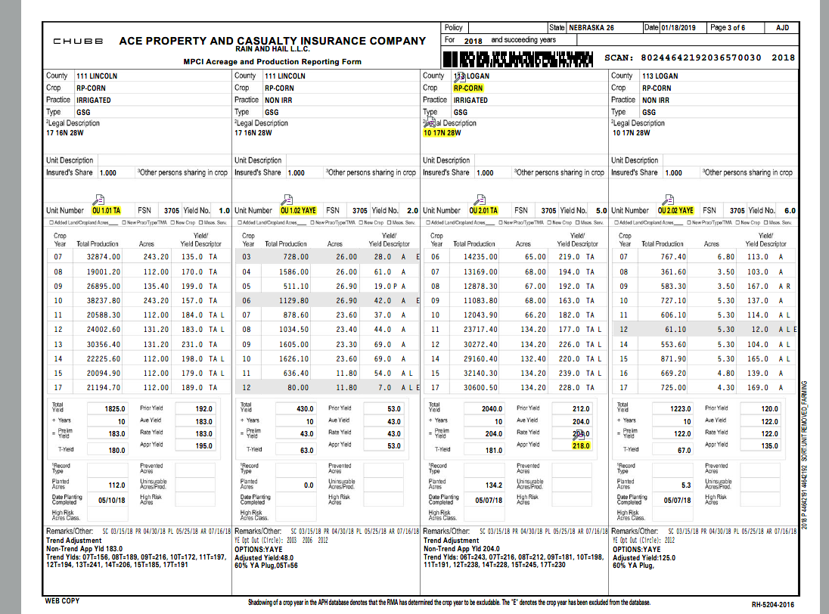

Slide 37
Yield Descriptors

Slide 38
Trend Adjustment (TA)
Improve accuracy of prior yields due to advances in seed and technology
Can affect history on added land when removed.
Must be elected by Sales Closing deadline.
Note: Yield limitations (cups and floors) do not apply if the TA Option is selected.
Factors differ per county
Crops available differs per county

Slide 39
TA Example for Corn
Year | Production | Acres | Yield Descriptor | Yield
2015 | 22,500 | 150 | A | 150
2016 | 19,300 | 100 | A | 193
2017 | 26,400 | 150 | A | 176
2018 | 19,700 | 100 | A | 197
Original Database
Approved APH: 179
Average Yield: 179
Year | Production | Acres | Yield Descriptor | Yield | TA Yield (TA Factor=2)
2015 | 22,500 | 150 | A | 150 | 158
2016 | 19,300 | 100 | A | 193 | 199
2017 | 26,400 | 150 | A | 176 | 180
2018 | 19,700 | 100 | A | 197 | 199
TA Database
Approved APH: 184
Average Yield: 179

Slide 40
Beginning Farmers and Ranchers (BFR)
Eligible for certain benefits designed to help start operations
BFR benefits may be available for up to 5 years
Available for most crops, except annual forage and nursery
Administrative fees are waived
Premium subsidy increased by 10 percentage points
Yields qualifying for Yield Adjustment (YA) will be replaced with 80% of applicable yield
May be eligible to use production history from other farming operations where insured was previously involved in decision-making or physical activities
Application deadline is Sales Closing Date

Slide 41
BFR – Rules
Uninsurable crop count for the year they would have been harvested, even if they did not grow
Uninsurable livestock-crop year is July – June using the ending calendar year
Don’t count anything the year that they turn age 18
College exclusion means they must have been enrolled for at least on semester (not to exceed 5 years)
It is a continuous endorsement
If a business all individuals must qualify for BFR and use the individual with fewest remaining years.
18

Slide 42
Schedule of Insurance
Once acres are processed, a Schedule of insurance (SOI)* will generate and be mailed. Please review the following to make sure they are correct:
Planted Acres/Plant Date
Prevented Planting Acres
Uninsured Acreage
Legal Description
Added Land Units
Risk Area
Share Percent
* A Schedule of Insurance may also be known as Summary of Coverage (SOC)
Notes:
Every SOI has the same basic information; just where they appear may be different depending on the company. When the producer receives this, it is very important that it is reviewed. If Errors are found, they need to notify us ASAP in order to make corrections so that if a loss occurs, they will be paid. If errors are not corrected, it could possibly jeopardize losses.

Slide 43
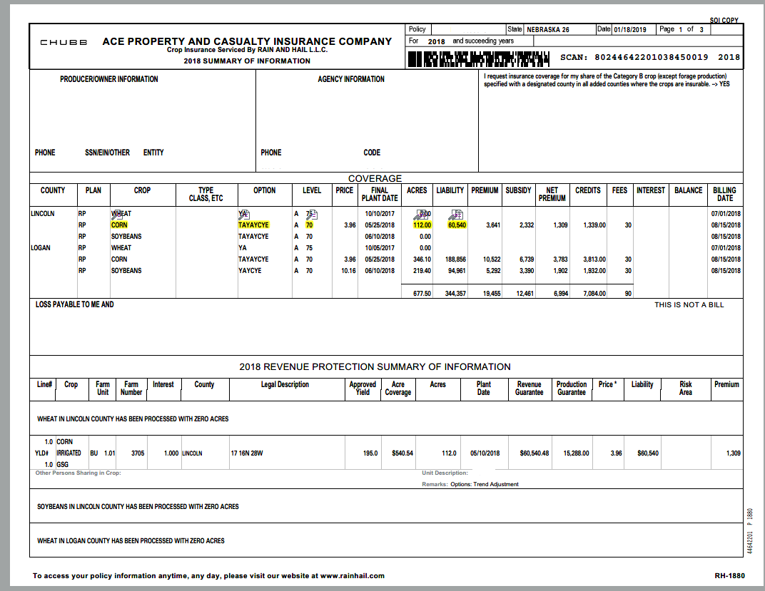

Slide 44
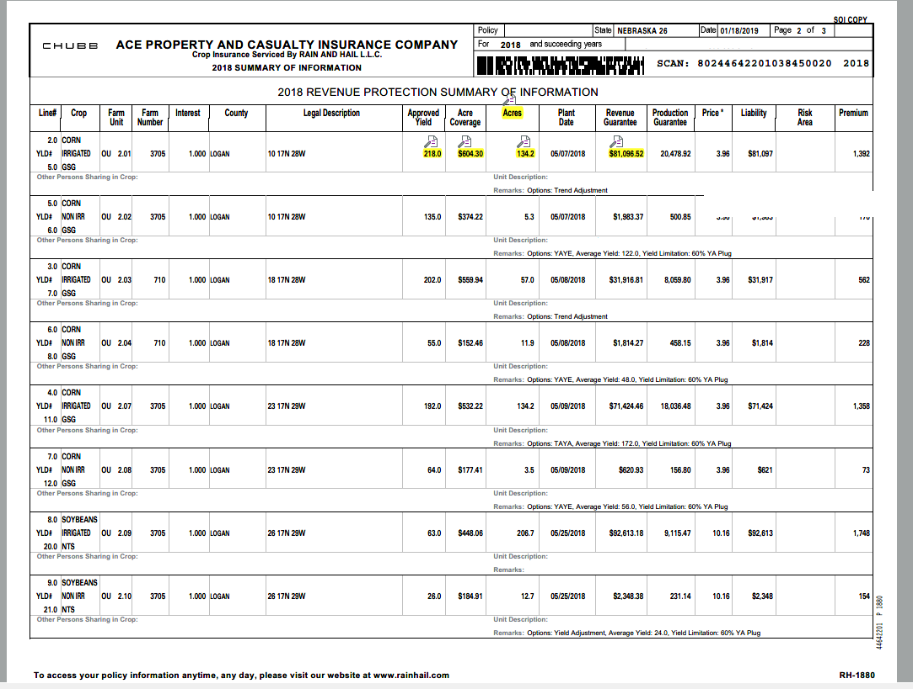

Slide 45
Important Dates
Sales closing
Fall- September 30
Spring- March 15
Production reporting
Fall- November 14
Spring- April 29
Acreage reporting
Fall- November 15
Spring- July 15
Premium billing date
Premium is earned and due when coverage attaches
Billing Date will not be earlier than August 15 for most crops
Billing Date for wheat is July 1
Check with your agent to be sure of the dates in your county
Deadlines that fall on weekends or Federal holidays are extended to the next business day.
Premiums must be paid in full, by September 30th for fall crops and March 15th for spring crops. If premiums are not paid by these dates your policy will be cancelled, for the next crop year. Not many exceptions!

Slide 46
Written Agreements
If a crop/practice is considered uninsurable we can submit a Written Agreement to the RMA to request coverage. Deadlines may vary. Examples of this are:
Uninsurable crop such as popcorn, amylose corn
Need to provide any past production
University Data
Where you will market the crop or contracts
Any other information
Newly Broke ground-pasture, grass
Re-Rate high risk ground
Notes:
If the insured breaks out 5% or more of the acres in a unit, a written agreement or NBAIR must be submitted to request insurance on the newly broken ground. The insured will receive 65% - 80% of the County T-yield on the newly broken ground.

Slide 47
Causes of Loss
Adverse Weather
Fire (due to natural causes)
Insects, but not damage due to insufficient or improper application of pest control
Plant disease, but not damage due to insufficient or improper application of disease control measures
Wildlife
Earthquake
Volcanic eruption
Failure of the irrigation water supply
Failure of irrigation equipment or facilities, due to an insured cause of loss
For Revenue Protection, a change in the harvest price from the projected price unless FCIC can prove the price change was the direct result of an uninsured cause of loss
Good Farming Practice must be carried out at all times.
Notes:
Remind them this doesn’t include combine fire. Failure of irrigation water supply would be if you receive a letter that you are to cease pumping or if your well runs dry. Does not include IRR engine failure.
A harvest loss would cover production loss, revenue loss for lower harvest price and quality factors such as aflatoxin, IF samples are taken prior to binning
Theft and vandalism are causes of loss covered under hail polices.

Slide 48
Crop Hail
Crop Hail coverage protects against damage due to hail, fire and lightning. It also protects against damage occurring during transit.
Crop Hail is not subsidized or regulated by RMA – state insurance departments and state insurance laws
Crop Hail policies and rates differ by company and state.
Many different types of coverages and deductibles are available.
Wind is an endorsement with crop hail, know when the cut off date is, they vary per company.
For Nebraska the 2019 rates have changed. Check with your agent on crop hail rates as well as production hail rates. Some crop hail rates have gone down and almost all production hail rates have gone up.

Slide 49
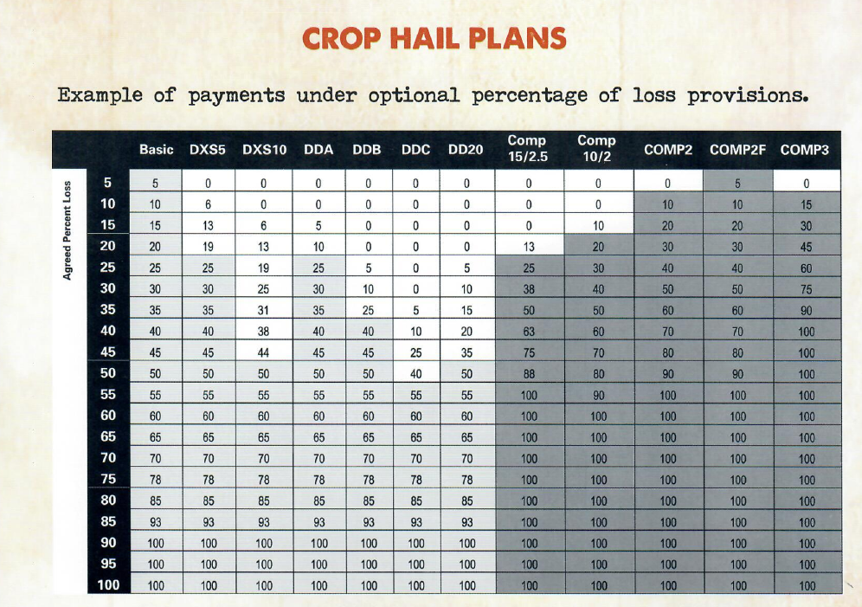

Slide 50
Production Hail

Slide 51
Production Plan Example

Slide 52
Takeaways Today
Get POA from your spouse on your policy
Always review the schedule of insurance
Acres and crop correct?
Review your premium
If a problem is found call your agent right away
Use Revenue Protection whenever available
Know what your revenue coverage is when marketing your crop
Do a yearly review of your policy and ask your agent if there were any changes
Understand what you are buying and ask questions.

Slide 53
Thank You! Any Questions?

