Slide 1
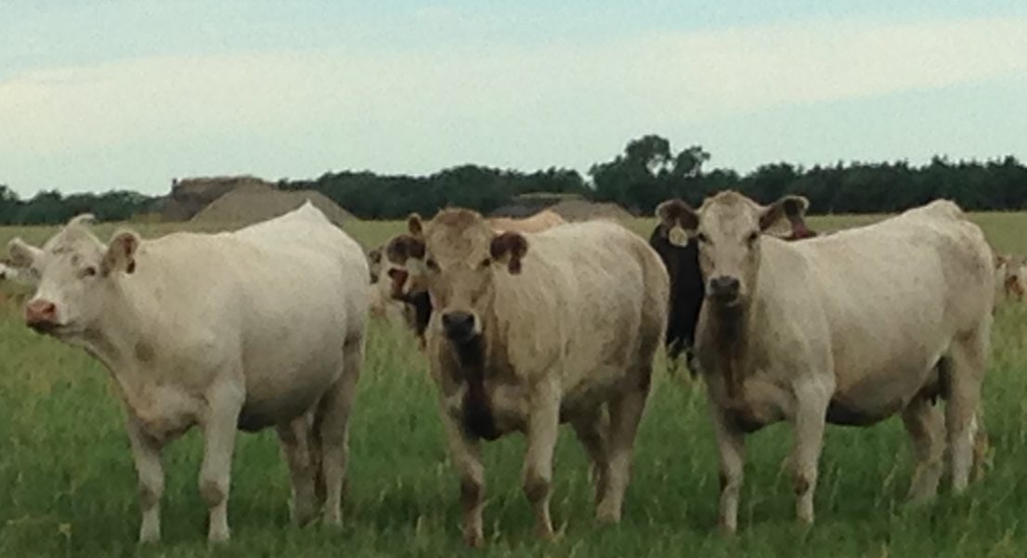
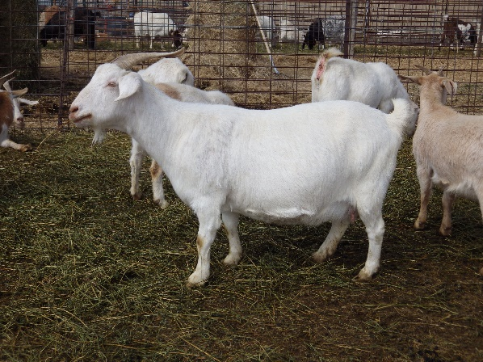
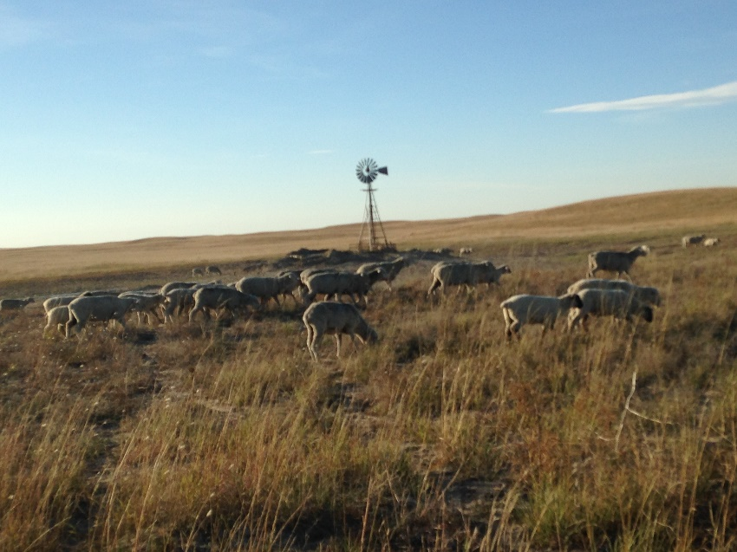
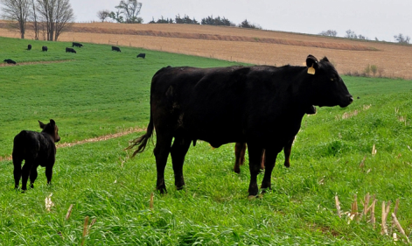
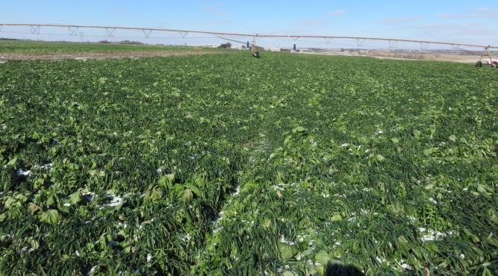


Increasing Your Profits
With Sheep and Goats
Randy Saner
Nebraska Extension Beef Educator
rsaner2@unl.edu

Slide 2
Considerations When Diversifying an Operation
Do your home work
  Consider the potential return on investment and down side risk if the project doesn’t go as planned
Talk to other producers
    Identify other producers who have taken this type of risk
      Learn from their experiences (get a leg up before starting)
Have an exit strategy
  Not every opportunity will work out know how to get out quickly)

Slide 3
Bring added value back to the farm
What time and resources do you have available with the present operation
Maximize every $ you spend since most producers are margin operators
  Examples of adding enterprises
    Row crop production add feedlot or backgrounding operation
    Cow/calf operation adding a hunting enterprise
    Cow/calf operation adding small ruminants
    Row crop adding a swine operation
    Row crop adding a poultry operation
    Corn, wheat and soybeans adding field peas, dry edible beans or alfalfa
Manure from livestock added back to crop production

Slide 4
Why Diversify Livestock Enterprises with Small Ruminants
Harvest Multiple Layers Off the Same Land
  Decrease Marketing Risk (not all the eggs in one basket)
  Increase Diversity
  Spread Out Labor and Other Overheads
Decrease Risk
  Disease
    Break Each Others Parasite Cycles
    Very Few Diseases Cross Species
  Drought
  Marketing
    More Opportunities to Sell
Information from Brock Terrell, Terrell Ranch, Hays Spring NE

Slide 5
Diversify to Increase Diversity
Different Grazing
  Different Plants
  Different Way
  Different Pattern
Different Animal Impact
  Smaller Hooves
  Stay Close Together
  Don’t Stay Close to Water
Information from Brock Terrell, Terrell Ranch, Hays Spring NE

Slide 6
Decrease Overheads
Labor
  Fence
  Fall and Winter Cattle Work
  Land
  One Cow/Ewe or Goat
Information from Brock Terrell, Terrell Ranch, Hays Spring NE

Slide 7
Sheep Advantages
Two Crops
  Wool – pays all direct costs and labor
  Lambs – Only Costs is Land
Wool 2017
  Merino: 20.4 Microns 15.76 lbs x $2.41 = $38/head
  White face sheep 22.4 Micron 13 lbs x $2 = $26/head
  Black face sheep 9.2 lbs. x $.51 = $4.66
Information from Brock Terrell, Terrell Ranch, Hays Spring NE

Slide 8
The advantages of buying replacements
Quickly De-stock / Re-stock
Buy the Undervalued
Follow the Droughts
Information from Brock Terrell, Terrell Ranch, Hays Spring NE

Slide 9
Lamb and Calve in Sync with Nature
Low Input : High Output
  Low Labor
  Low Supplemented Feed
  Low Value (Costs) Animals
  Low Depreciation
  High Value Products and Diverse Marketing
Information from Brock Terrell, Terrell Ranch, Hays Spring NE

Slide 10
Adds Flexibility
Different Species / Classes
Corn Grazing
Mob Grazing
Winter Range / Corn Stalks
1500 cows 1500 ewes and cropland
Information from Brock Terrell, Terrell Ranch, Hays Spring NE

Slide 11
Adding Sheep to Cattle is
Profitable
Labor Efficiency
Family Friendly
Wool
Impacts Range Production
Able to Stack Enterprises
Meet New People
H2A program helps with costs
Guard Dogs necessary
Cold May Rains can be a problem
Lambing with wool on is helpful
Prejudice Against Sheep can be a problem
Steep Leaning Curve with Sheep
Information from Brock Terrell, Terrell Ranch, Hays Spring NE

Slide 12
Advantages of a Mixed Livestock System of Cattle Sheep and Goats
Cattle help
  Diversify income sources
  Deter predation
  Beneficial on the range/pasture sustainability
  Help control parasite contamination of pastures
  Easily moved/dispersed in response to drought
Sheep
  Hair sheep no shearing required
  Lambed in May separate from cows
  Merged with other stock after lambing
  Lambs sold off of pasture in October 55 – 70 lbs
  Replacements weaned and bred in dry lots
  Mature Ewes bred on pasture with other livestock
Cattle + Sheep + Goats = Environment + $
Information from Mike Wallace, Double M, Nelson NE

Slide 13
Advantages of a Mixed Livestock System of Cattle Sheep and Goats
Goats
  Spanish-Boer Crossbred does kid in April in dry lots
  Kids are vaccinated for diseases and castrated before moving to pasture in May
  Kid crop sold off of there mom/pasture at the end of September
  Replacements are weaned, bred and kept in drylot until they go to pasture with their kids in May
  Nannies are bred and wintered with the other stock on pasture until early February when they are brought to dry lots before kidding
  40 mother cows, 230 ewes and 40 does on 400 acres of fenced paddocks
  Animals are rotationally grazed using holistic management principles
Cedar control and reclamation management of abandoned feedlots as well as income are advantages of a mixed livestock species operation
Information from Mike Wallace, Double M, Nelson NE

Slide 14
Species Variation in Grazing Patterns Patterns
100
90
80
90
70
60
70
% in Diet
50
60
60
40
30
20
10
30
10
20
20
4
6
10
20
0
Goats
Horses
Cattle
Sheep
grasses
forbs
browse

Slide 15
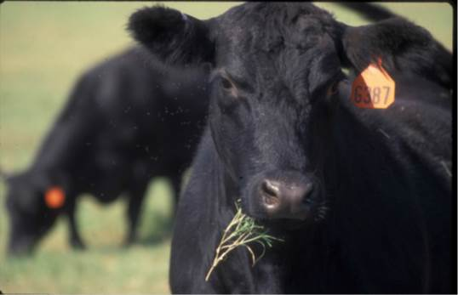
Sheep & Goats Prefer Different
Plants Than Cattle
Forbs (weeds) broadleaf
Grass
Browse shrubs, trees, vines

Slide 16
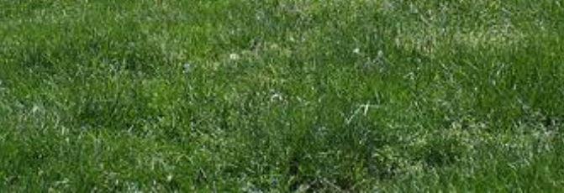
Multispecies Grazing Preferences
Browse
Forbs
GOATS
SHEEP
CATTLE
Grass

Slide 17
ASI study of cost of sheep production
 | 2015
 | WY | ND | KY | TX | National | NE
gross receipts
lambs | 120.76 | $170.83 | 150.05 | 109.08 | 133.80
cull ewes | 17.90 | $11.14 | 12.84 | 13.71 | 14.97
cull rams | 0.62 | $0.62 | 4.64 | 0.31 | 1.04
wool | 13.47 | $13.46 | 13.56 | 13.46 | 13.48
Total Receipts | $152.76 | $196.05 | 181.09 | 136.56 | 163.29 | 0
Variable costs
Pasture | 13.5 | 19.6 | 20.00 | 10.00 | 15.06
Federal range | 2.54 | 0.00 | 0.00 | 0.00 | 1.19
Hay | 7.22 | 30 | 19.60 | 3.50 | 13.33
PRF Rainfall Insurance | 0 | 0.0 | 0.00 | 0.85 | 0.15
Feed Grain | 1.51 | 18 | 36.50 | 43.06 | 16.98
Salt & Mineral | 0.6 | 6.8 | 3.60 | 8.40 | 3.80
Vet & Medicine | 0.63 | 7 | 6.00 | 7.59 | 4.00
Breeding (ram cost per ewe) | 5.5 | 6 | 7.00 | 7.80 | 6.21
Marketing & Hauling | 4.2 | 5.5 | 6.18 | 4.16 | 4.73
Fuel, lube, repairs, utilities | 10.32 | 9 | 12.00 | 8.00 | 9.79
Shearing ewes | 3.8 | 5 | 5.00 | 5.00 | 4.44
Shearing Rams | 0.23 | 0.4 | 0.45 | 0.45 | 0.34
Predator Control | 1 | 2 | 2.00 | 10.50 | 3.06
Dog Food | 2 | 1 | 1.00 | 1.00 | 1.47
ALB Checkoff | 0.55 | 0.55 | 0.55 | 0.55 | 0.55
Operator/Family Labor | 13.5 | 18 | 22.50 | 9.00 | 14.80
Hired Labor | 20 | 0.75 | 0.00 | 0.00 | 9.54
Camp Supplies | 5 | 0.00 | 0.00 | 0.00 | 2.34
Housing Improvement & Repair | 0.72 | 0.00 | 0.00 | 0.00 | 0.34
Interest on Operating Capital | 1.05 | 5.42 | 5.94 | 6.00 | 3.54
Total Variable cost | 93.87 | 135.02 | 148.32 | 125.86 | 115.66 | 0
Fixed Cost
Capital Recovery
Housing & Improvement | 1.00 | 0.00 | 0.00 | 0.00 | 0.47
Machinery, Equipment, Vehicles | 5.80 | 5.00 | 2.40 | 6.30 | 5.30
Interest on Retained Livestock | 6.25 | 3.00 | 2.60 | 3.00 | 4.48
Taxes & Insurance | 0.80 | 2.28 | 2.00 | 1.20 | 1.36
Overhead | 8.20 | 4.00 | 3.00 | 3.00 | 5.67
Total Fixed Costs | 22.05 | 14.28 | 10.00 | 13.50 | 17.28 | 0
Total Costs | 115.92 | 149.30 | 158.32 | 139.36 | 132.94 | 0
Returns | $36.84 | 46.75 | 22.77 | -2.80 | 30.35 | 0
costs per pound live weight | $1.43 | $1.31 | $1.58 | $1.94 | $1.49
lbs. of lamb marketed per ewe | 81 | 114 | 100 | 72 | 89.2

Slide 18
Adding Small Ruminants to Your Operation
$133,875 from lambs( 950 x $148.75)
$80,000 cost of Aged Ewes
$26,670 depreciation per year 3 year life
Shepherd salary range $12,000 to $35,000 1000 ewes per shepherd
$95,205 ($12,000 shepherd) / 1000 ewes
$95.20 per ewe

Slide 19
Adding Small Ruminants
Other costs
  Vet Costs
    $2.60/ewe
  Ram replacements
    $5.28/ewe
  Salt and Mineral Costs
    $5.99/ewe
$95.20 - $13.87 = $81.33 or 81,330/1000ewes

Slide 21
Obstacles to Small Ruminants
Care and management are different
Fences that hold cows will not hold small ruminants
  Hire shepherd or add electric fence to conventional fence
Predators can be a problem
  Use guard animals

Slide 22
Leafy Spurge Control
Notice Any Difference?
This fenceline contrast provides
an excellent example of
the control that can potentially
be achieved with multi-species
grazing. Spurge densities on
the left are inhibiting the
Production of desirable grasses
and drastically reducing the
pasture’s value to a cattle
producer. On the right side of the
fence, sheep are being used to
reduce, then maintain, a significant
reduction in leafy spurge
densities, resulting in a pasture
that can once again be utilized
for cattle grazing.
No sheep
Sheep

Slide 23
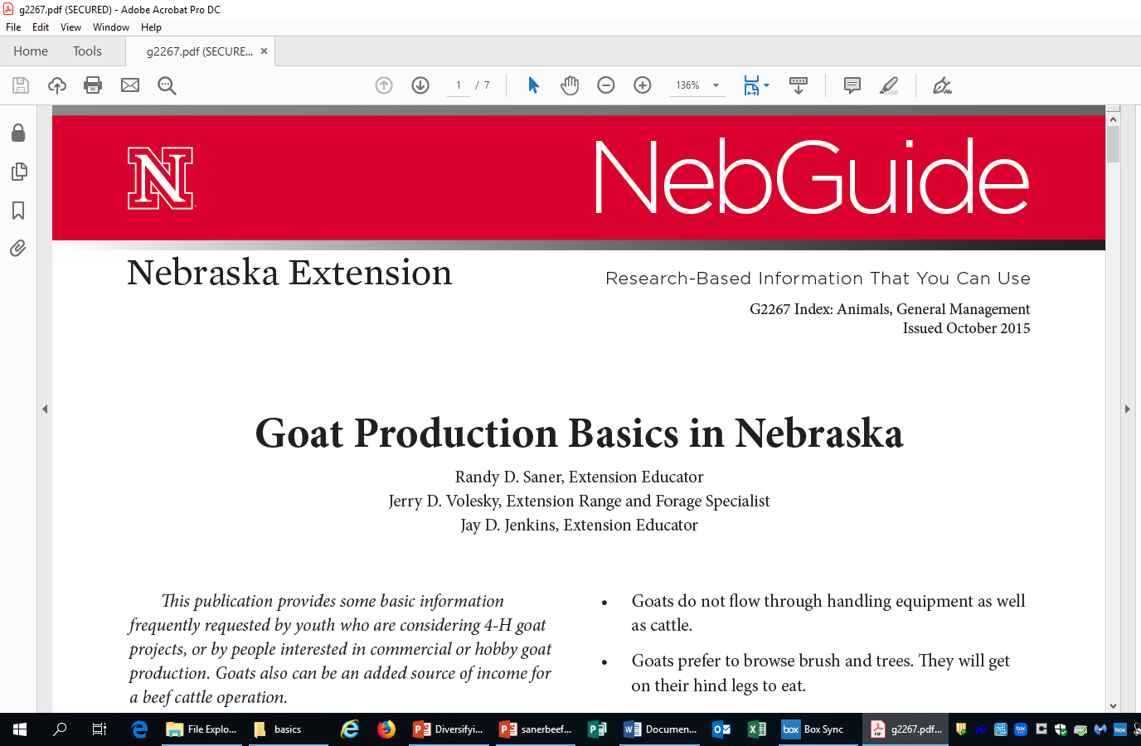
For more information

