Slide 1
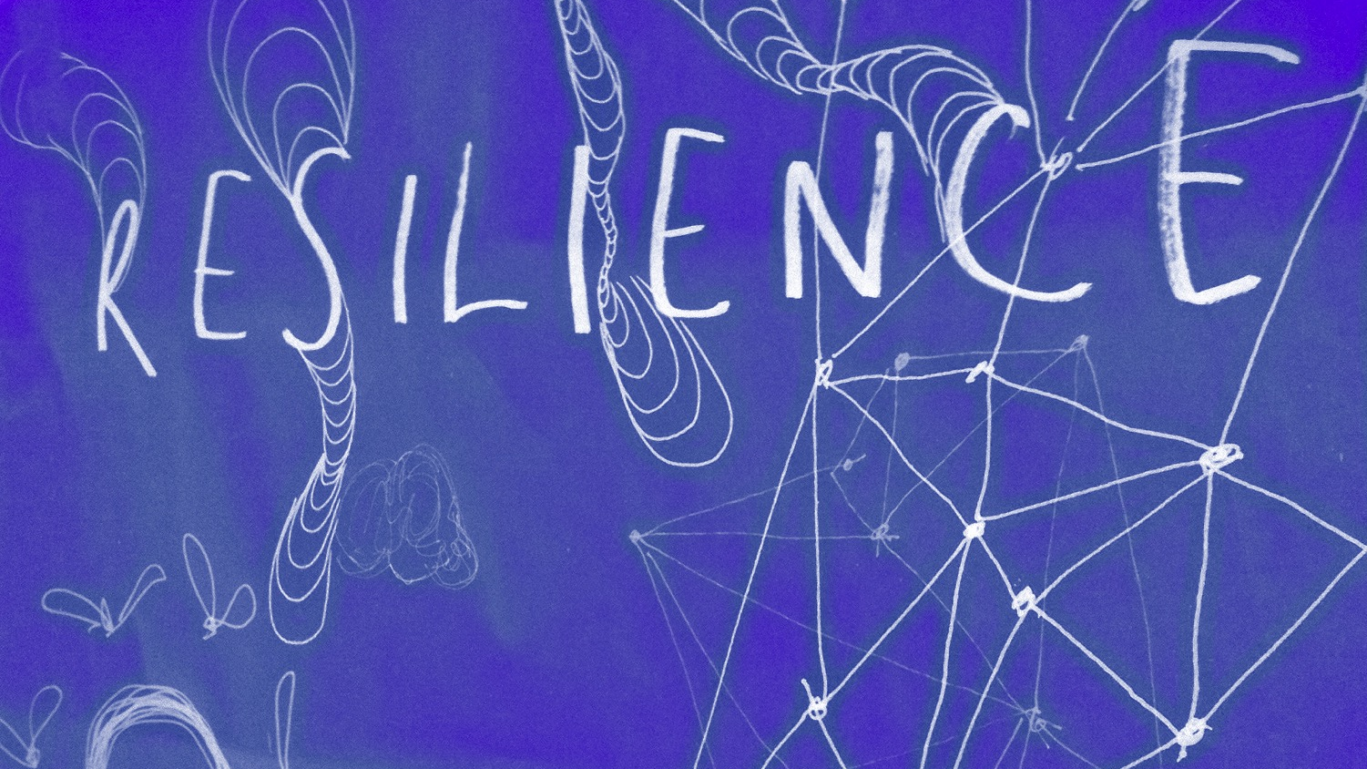
Circles of Support
Resilience Through Relationships
Bob Bertsch - @ndbob NDSU/MFLN
Notes:
"Resilience Glow", a derivative of "Resilience" by Neil Cummings, used under CC BY SA by Bob Bertsch.

Slide 2
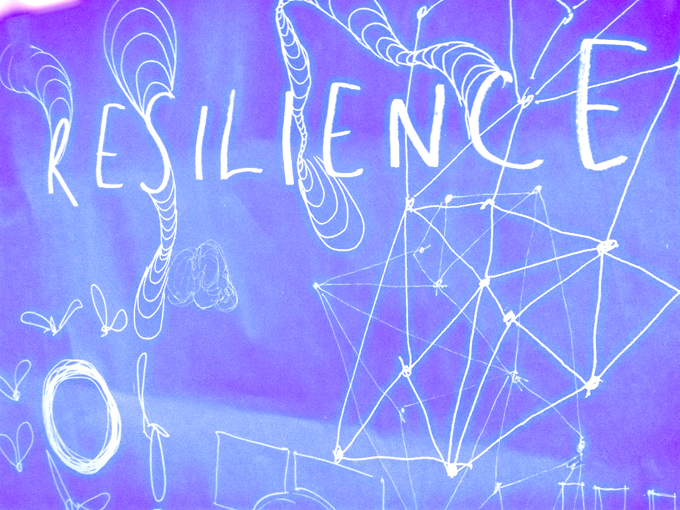
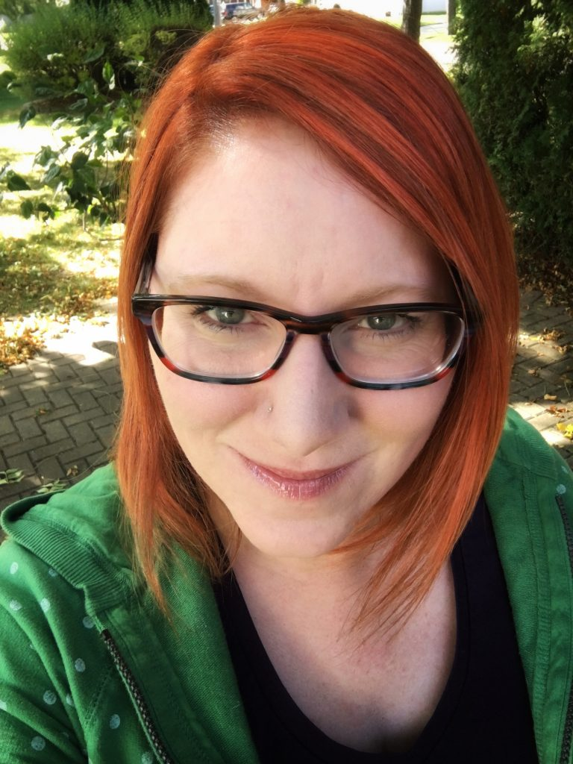
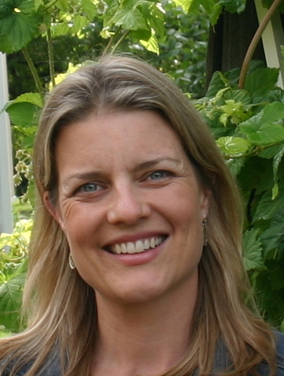
Adaptation & Resilience in an Uncertain World
Jessica Beckendorf
@uwexjess
Karen Jeannette
@kjeannette

Slide 3
What are the factors that make one person more resilient than another?
Notes:
We want to start with getting you talking - please share your answers to this question in the chat.

Slide 4
2 types of factors
personal qualities
happiness
sense of purpose
self-efficacy
social context
relationships
social support
environment
Notes:
2 types of factors in resilience: - https://greatergood.berkeley.edu/article/item/four_ways_social_support_makes_you_more_resilient
We know, positive social connections,can provide important social resources that change the way we experience and respond to stressful events. Research shows:
People that have a more diverse relationship portfolio report higher well-being (Cheung, Gardner, Anderson, 2014 - Northwestern University and UC Santa Barbara)
Highly resilient ICU nurses draw emotional support, communication and connectivity from positive social networks (Mealer, Jones, Moss)
A key component to resilience for U.S. Airmen and their families is social fitness, or the combined resources a person gets from his or her social world (McGene - Rand Corp.)

Slide 5
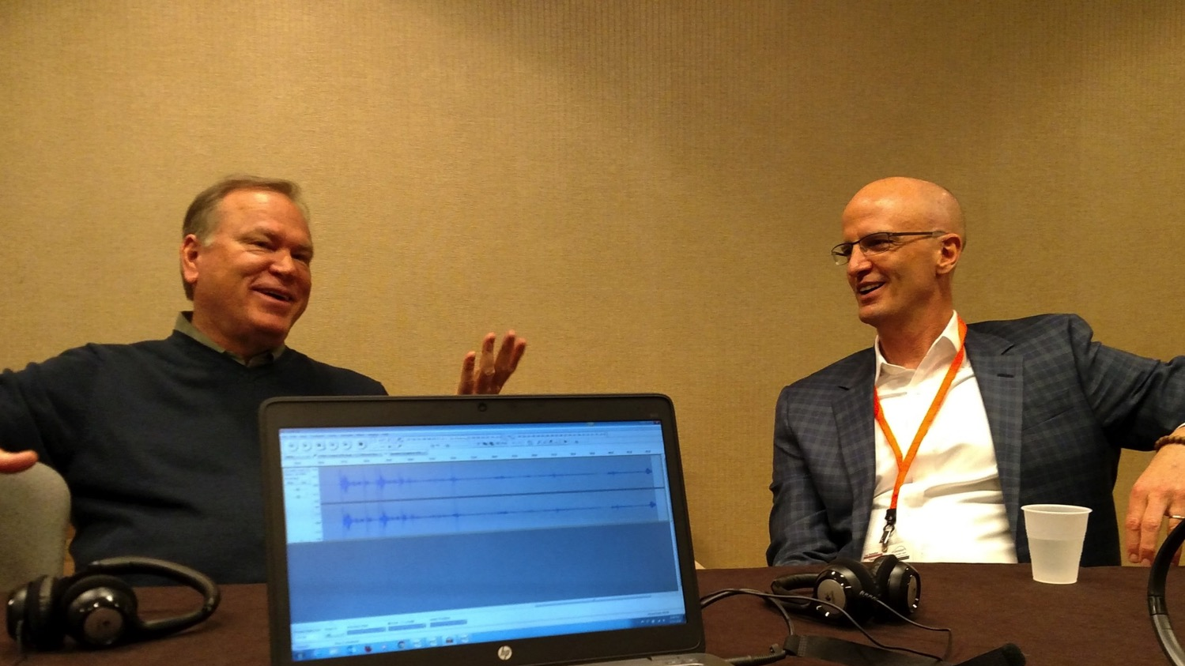
What is Working Out Loud?
John Stepper
Photo: Bob Bertsch CC0
Notes:
We often don’t think about level of support we get from our family, our co-workers, our neighbors or even our community, until we are faced with a crisis.
What if, instead of leaving our social connections to chance, we could be intentional in build the kind of networks that would support us when we are facing a challenge?
John Stepper created the Working Out Loud process to make corporate cultures more collaborative and innovative by showing people a more engaged way of working that gives them access to more opportunities. We think adapting John’s effective network building practices to build the social support we need to make us more resilient as helping professionals, and maybe even help military families and the people we all serve be more resilient in times of transition.
We are drawing from the fields of network theory, positive psychology, asset based community development and integrating those ideas into John’s simple approach to practice network building.

Slide 6
5 elements of Working Out Loud
Purposeful Discovery
Relationships
Generosity
Visible Work
Growth Mindset

Slide 7
Elements of Building Resilience Through Relationships
Purposeful Self Discovery
Relationships
Generosity
Vulnerability
Making Yourself Visible Work
Growth Mindset

Slide 8
What makes it work?
being mindful
taking small steps
practicing self-reflection
having peer support
Notes:
What makes it work, briefly?

Slide 9
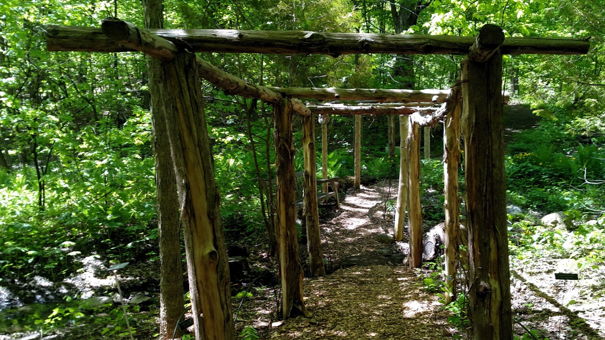
Purposeful Discovery
Photo: Bob Bertsch CC0
Notes:
What does purposeful discovery mean to you - please share in chat
Here’s why it is important to building networks for resilience
Being mindful about what’s important to you
Seeking out resource and relationships that will help you grow and support you when you need them

Slide 10
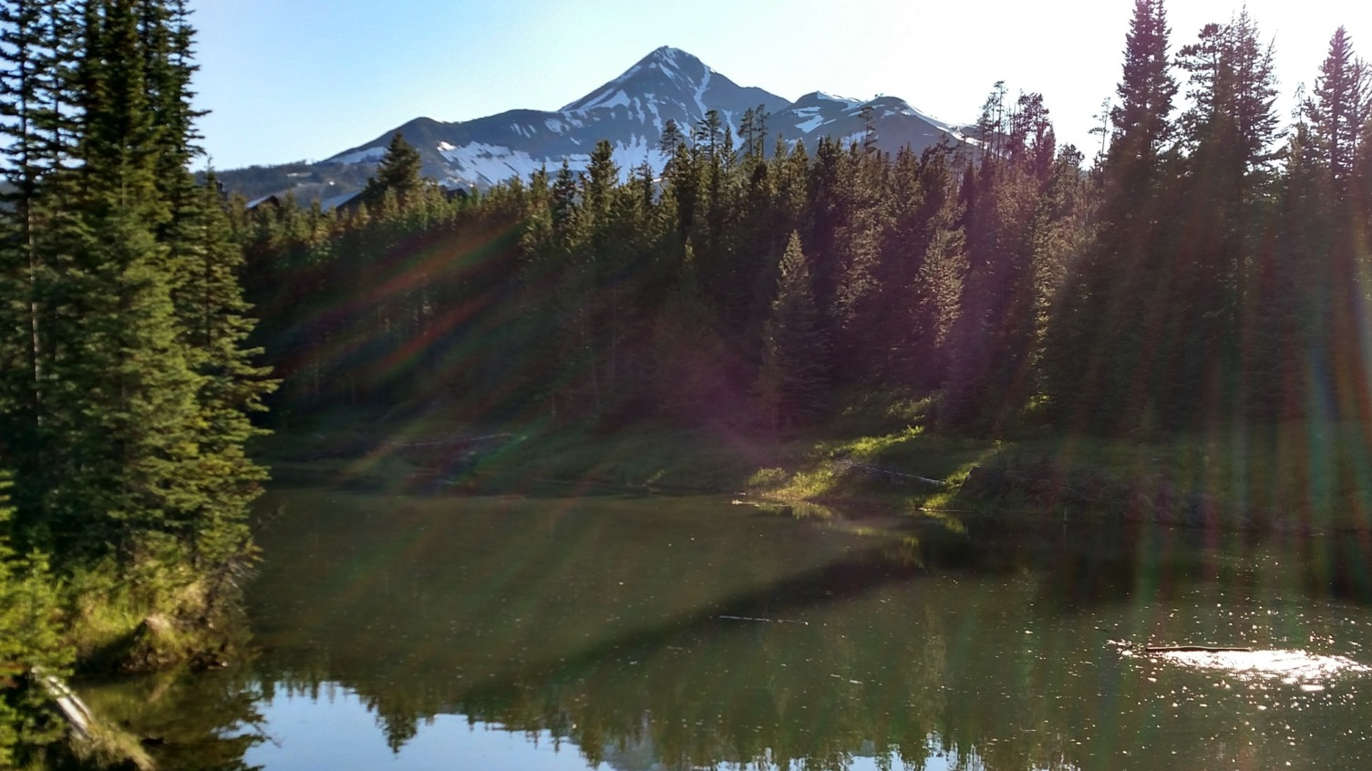
What lights you up?
What do you care most about?
What are you an advocate for?
Photo: Bob Bertsch CC0
Notes:
Finding what’s important to you - different ways of thinking about it
What lights you up?
What do you care most about?
What are you an advocate for?
Try to think outside of your societal and organizational roles: spouse, parent, employee, grandparent, etc
Take 3 minutes to think about these questions and write down your answers for yourself. Now let’s introduce ourselves to the others at our table (it’s OK to do this again if you did introductions before). Your introduction should go something like this, “Hi, I’m Sonja. I light up when I…” or “Hello, my name is Ellen. I really care about…” After each introduction, feel free to ask a question, share a related idea or experience, or just offer validation by saying something like, “Thanks for sharing that with us.” Capture your reflections in the space below.

Slide 11
Reflection
Photo: Bob Bertsch CC0
Notes:
How did it feel to introduce myself using my answers to these questions?

Slide 12
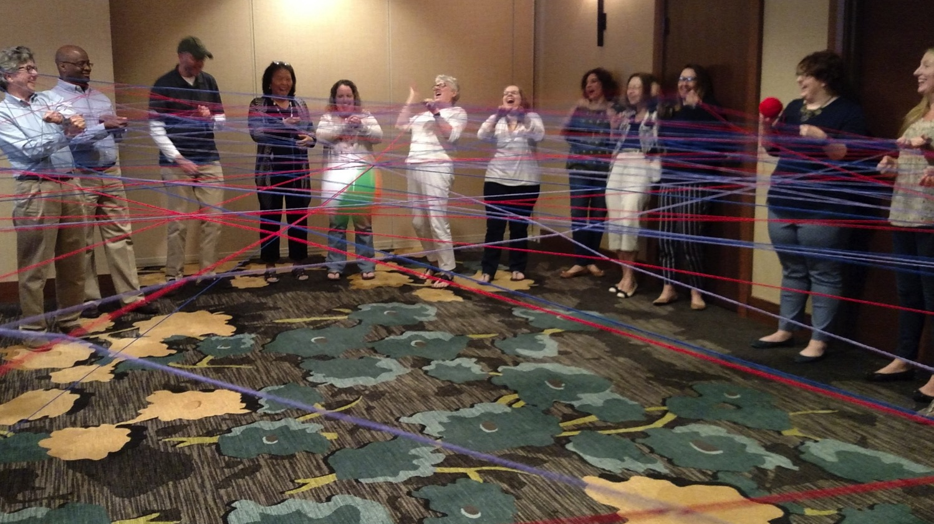
Relationships
Photo: Bob Bertsch CC0
Notes:
This is where personal attributes of resilience, like happiness and sense of purpose meet the social context of resilience if relationships.
Need to think about/build relationships
More relationships
More diverse relationships - diversity of background, strengths, emotional support
Different levels of relationships - strengthen where needed

Slide 13
Write down 40 things about you
Self-discovery is important in building resilience Each of these things is a bid for connection
Notes:
Self-discovery is an important part of building resilience. Spending time thinking about yourself can help you reflect on how you remained resilient through difficult experiences, and it can help you identify the personal strengths that contribute to your resilience. In this activity, we are going to use self-discovery to find the things about ourselves that can help us connect to others.
Let’s take 5 minutes to write down as many facts about ourselves as we can. You might start with more obvious facts like your age, relationship status, or hometown, but you’ll find you’ll have to dig deeper for facts as you go. Write down your facts below.

Slide 14
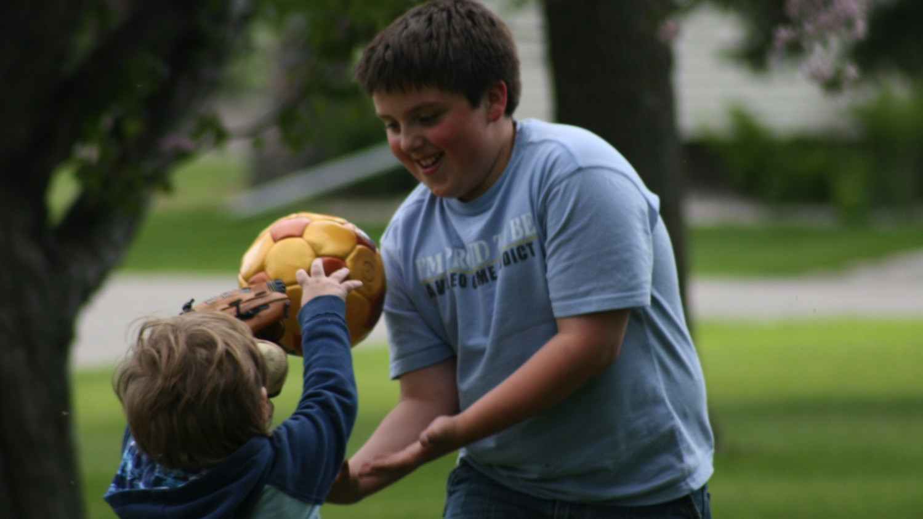
Generosity & Vulnerability
Photo: Bob Bertsch CC0
Notes:
We build relationships by offering small gifts out of generosity
Healthy relationships are not transactional or quid pro quo

Slide 15
Yes, and
We’re practicing generosity & vulnerability
Try to expand the conversation
Notes:
ow we are going to practice making connections using our things about ourselves. We’ll use “Yes, and,” a technique from improvisational theater to reveal all the threads that connect us. Once we are done with the “Yes, and” exercise, jot down a few of your reflections below.

Slide 16
Reflection
Photo: Bob Bertsch CC0
Notes:
What did you learn about hose around tour table? How did this exercise feel?

Slide 17
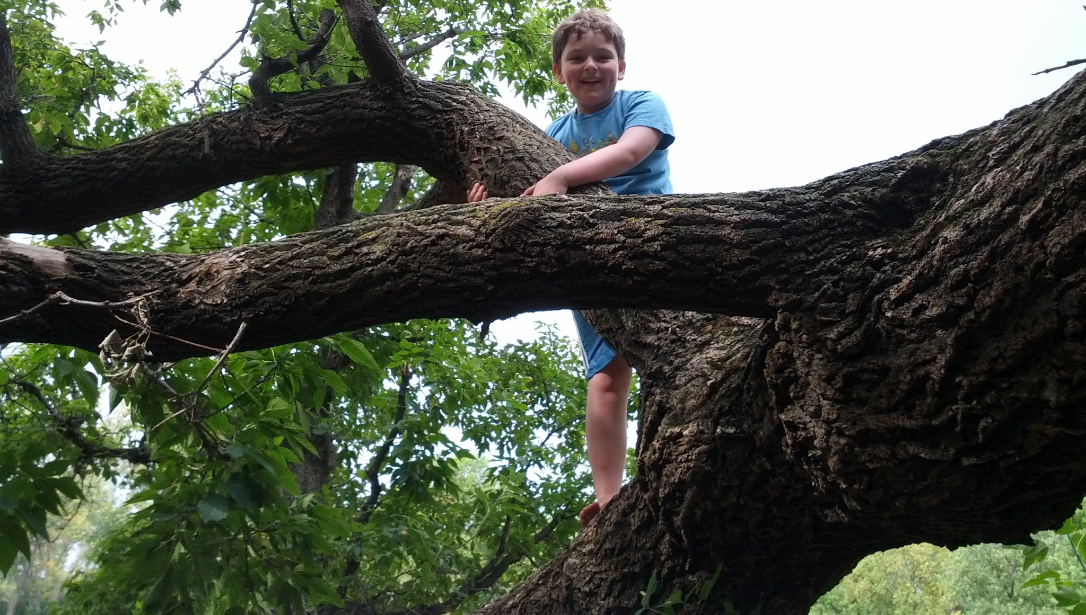
4 Distinctions of Trust
Sincerity
Reliability
Competence
Care
Photo: Bob Bertsch CC0
Notes:
Care - considered the most important. Sincerely offering small gifts out of generosity exhibits care
Trust is critical to building relationships. You’ll see these 4 distinctions of trust represented in the types of small gifts you can use to strengthen a relationship.

Slide 18
10 examples of small gifts
1. Attention
2. Gratitude
3. Share interesting or useful resources
4. Ask a question
5. Answer a question
6. Introduce people
7. Offer feedback
8. Share your work in progress
9. Share your experience
10. Offer original ideas
Notes:
10 examples of small gifts
Pick one small gift for one or both people on your list. We won’t ask you to offer it right now, but try to commit to a deadline by which you want to offer it by.

Slide 19
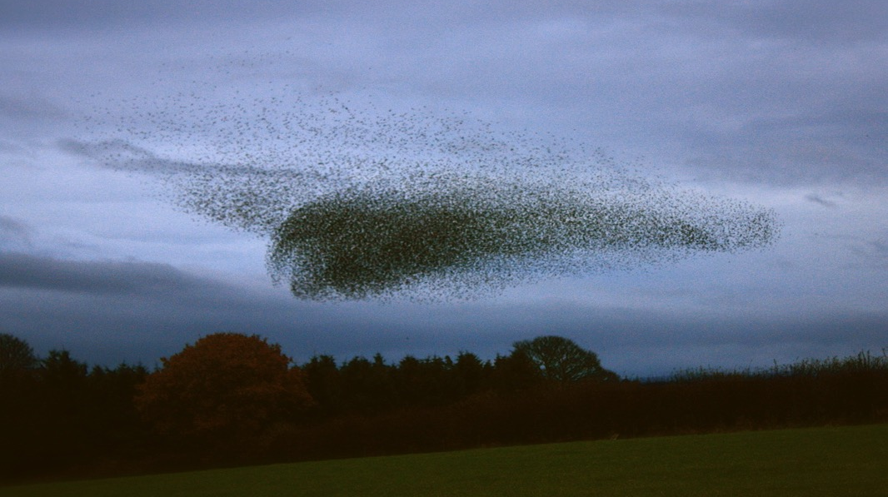
Making Yourself Visible
Photo: Adam (Flickr) CC BY
Notes:
Visible work. Making parts of yourself visible as bids of connection to others.
Making yourself visible. Sharing of yourself and your experience. Being vulnerable.
We can’t predict everyone that is going to be important in our networks.
Share your work in progress, share your experience. Opening yourself up to the serendipitous relationship....By making yourself visible, you open up the possibility of being on someone else’s list. Someone else offering you gifts.
This is a murmuration. Flocks of birds create these beautiful shifting patterns as they fly together, each individual bird adjusting to those nearest them as they try to stay close enough to sense the movement of other birds without getting too close and colliding. In face-to-face workshops, I’ve used an exercise that’s similar to murmuration. Participants stand up and silently move around, adjusting to the position of 2 other people they have picked out in the group until everyone has formed a perfect triangle with the other 2 people they have picked out. What I’ve noticed is the participants have a really hard time adjusting to the position of others when they are moving. It’s much easier to adjust to a person when they are standing still. Making your work visible is like standing still. It’s a way of stopping briefly and saying, “This is what I’m working on. This is what I care about. This has me curious,” and that allows other to adjust to your position and connect with you.

Slide 20
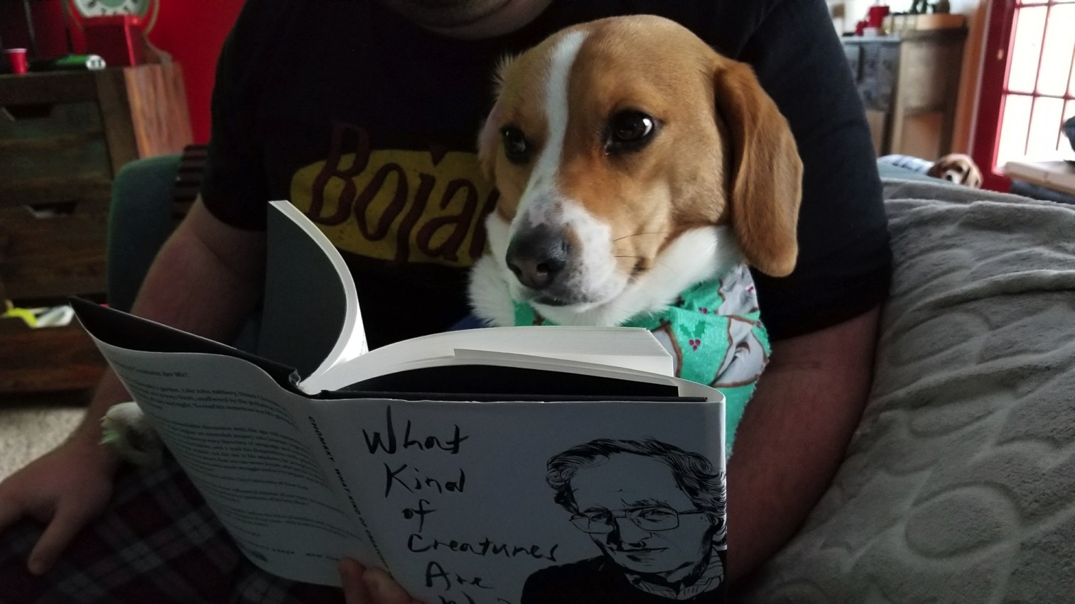
Growth Mindset
Photo: Bob Bertsch CC0
Notes:
Growth vs fixed. Carol Dweck. You’re really good/smart vs You must have worked really hard. Grit, Duckworth
Our personal development and our lives are a work in progress. A growth mindset is about getting better vs getting good.
Yoga practice not yoga perfect.
Practice creates new neural pathways :) Neuroplasticity

Slide 21
We can grow & change
We grow by finding, developing & celebrating our strengths
And by practicing in supportive spaces

Slide 22
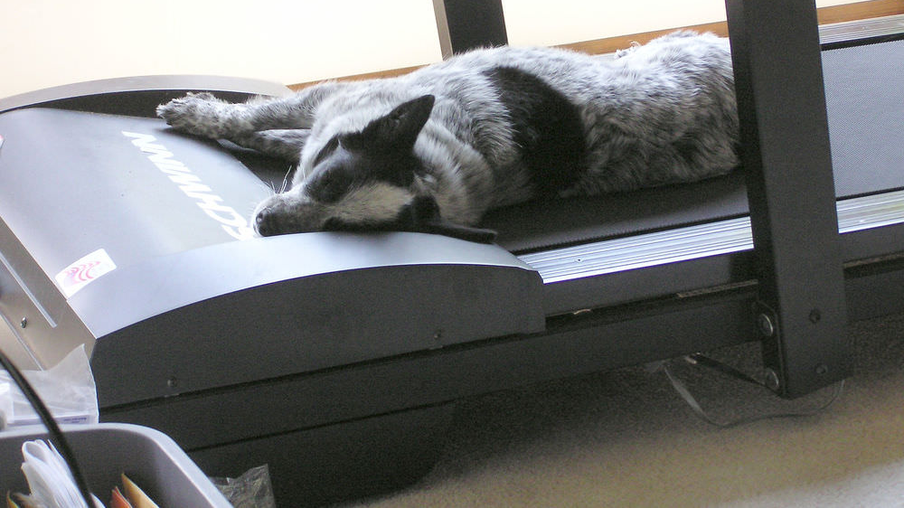
Touching the Treadmill
Photo: normanack (Flickr) CC BY
Notes:
Start by touching the treadmill. Build toward behavior change.
Accept that you are going to fail. That’s ok. Just start touching the treadmill again.

Slide 23
How are you going to get started building your resilience?
Start or join a circle
Sign up for support

Slide 24
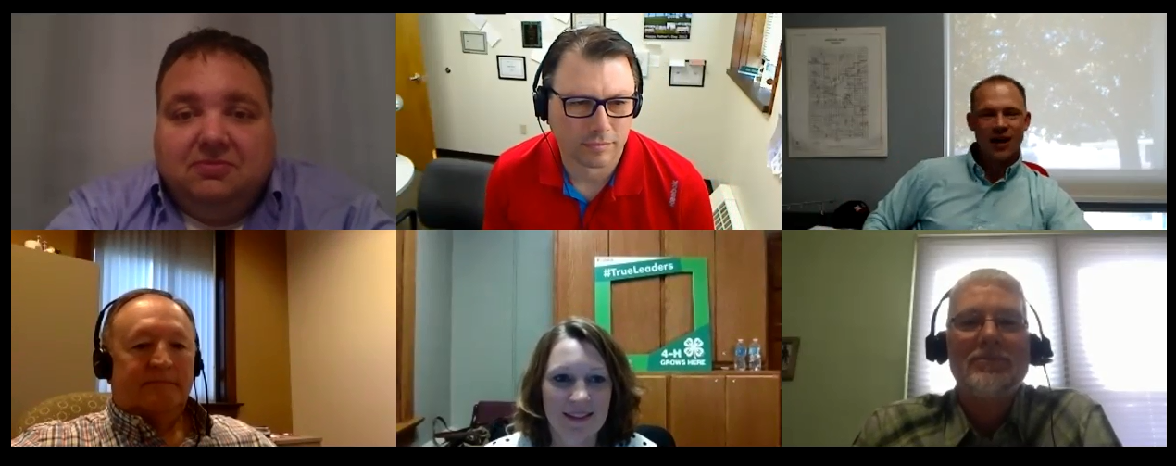
Learning Circles
Small group makes for a safe space
Space and time to take small steps
Peer support bolsters resilience
Guides provide the momentum

Slide 25
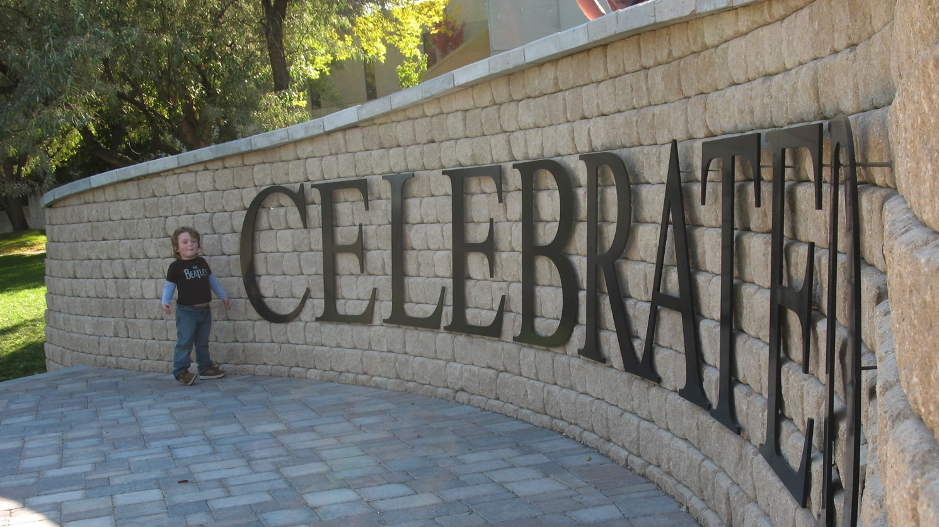
Celebrate!
Photo: Bob Bertsch CC0
Notes:
Whether you shared in the chat or not, let’s take a moment to celebrate our networks and how our resilience is already being supported.
We also want to celebrate all of you for thinking about it, putting time into being intentional. This process is about seeking out new networks of support and strengthening those we already have.

